Slide 1
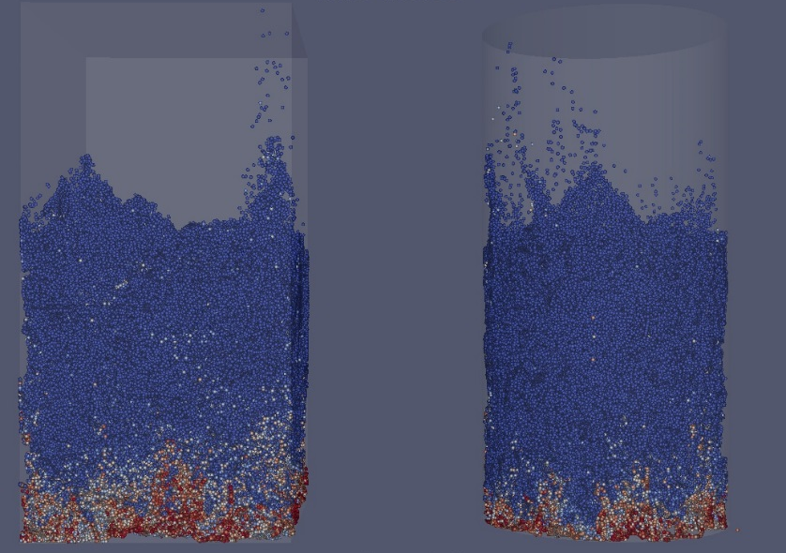
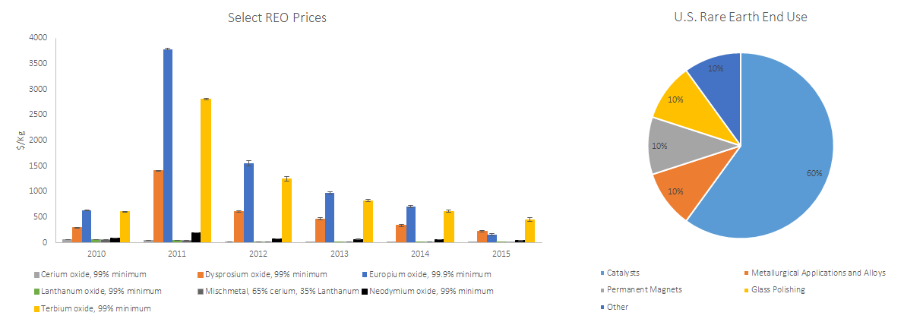
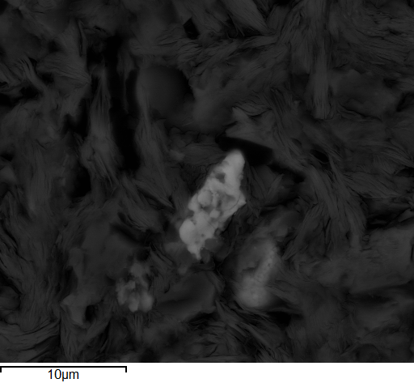
Characterization and Recovery of Rare Earths from Coal and By-Products
Evan Granite, Elliot Roth, Mary Anne Alvin
Rare Earth Element Challenges
Field Sampling Effort
Separations
Roughly 87% of REEs came from China in 2014
Potential national security and supply risk for critical rare earths for defense and clean energy
Y, Nd, Eu, Dy, Tb
Not typically found in concentrated ores
Difficult to extract and separate
REs are not distributed evenly
Causes excess supply for some REs and shortages for other REs
Price significantly different for individual REs
Identification of Promising By-Products for Rare Earths
Rare Earth Archive houses approximately 1,000 samples
470 samples collected since June 30, 2015 (nearly all solids, a few aqueous)
164 sample analyses uploaded onto EDX website March 2016
Promising Materials identified with over 500 ppm RE+Y on dry whole basis
Geochemistry
Marker Elements and Element Associations
Mineral Processing and Physical Beneficiation
Density Float-Sink
Magnetic
Size
Froth Flotation – Shakedown and commercial interest
Bench/Pilot Scale Process Design
Ammonium Sulfate
Deep Eutectic Solvents/Ionic Liquids
Acid dissolution
High Temperature Phase Separations
REE Selective Sorbents – Aqueous Feeds
Photophoresis
In-situ CO₂ Brine injection and extraction
Reactive Grinding
Characterization Effort
Over 1,000 assays – bulk elemental analyses
Approximately 40 SEM-EDX, 40 XRD
ICP-MS – best in class - digestion, uncertainty, publications
ICP-OES – bulk multi-elemental analysis (supplementary)
C, H, N, S, Ash, and Moisture
SEM-EDX – identified phosphates in by-products, possible Ca-association in ash
XRD – determine minerology of the sample
LA-ICP-MS – Spot and Depth Analyses; State-of-the-Art Mass Spectrometer to Resolve Overlapping Peaks
Ion Exchange Capacities and pH – novel technique developed
Stanford Synchrotron – several awards of beam time – identified sulfates, oxides, phosphates in ash – now focusing on mine by-products
Sequential Extractions – current – form of RE in coal and by-products
LIBS: Laser Induced Breakdown Spectroscopy
Sensitized Fluorescence
Portable XRF
Gamma Detection
Modeling
Extraction of REEs from clays and other coal and coal by-products
CFD Modeling
Mass/Heat Transfer
Kinetic/Reaction Modeling
Modeling Physio-Chemical properties and REE Extraction Simulations
Tech Transfer
2016 USGS Mineral Commodities Summary
21 presentations to date
At least 10 presentation at upcoming meetings
7 publications
Several ROI
MOUs for Sample Acquisitions
Possible CRADA for Lab Froth Flotation
Sessions Organized on Rare Earths at International Conferences
REE Extraction Opportunities
for Coal and Coal By-Products
Everything in the earth’s crust, good and bad, is found to some extent in coal and coal by-products
The US burns almost 1 Billion tons of coal a year
Producing 100-150 million tons of coal ash with an average concentration of ~470ppm REE+Y
Coal ash produced yearly based on average concentrations contains ~47,000-70,500 tons of REE+Y or 2 - 4 times the US consumption
Coal mining and coal prep by-products could provide additional opportunities for REE extraction and recovery.
Other critical or valuable elements could also be extracted from coal and coal by-products during the extraction of REEs
Extraction of REEs from coal and coal by-products could provide a stable source of REEs and other critical metals
Extraction of REEs could also be environmentally friendly by utilizing already mined materials and potentially treating and utilizing by-product materials
Sensitized Fluorescence Sensor Diagram
Conclusions and Future Work
Preliminary SEM Data
Zircon
ZrSiO₄
Xenotime
YPO₄
_{(2-3% Dy, Er, Yb)}
Monazite
(Ce, La, Nd)PO₄
High power LED
fiber Coupler
Sample
Much of the recent research on coal utilization in the United States has focused upon the capture of pollutants such as acid gases, particulates, and mercury, and the greenhouse gas carbon dioxide. The possible recovery of rare earth elements from abundant coal and byproducts is an exciting new research area, representing a dramatic paradigm shift for coal. Additional data is needed on the rare earth contents of coals and byproducts in order to determine the most promising potential feed materials for extraction processes. Future work will likely focus on the characterization of coals and byproducts, as well as separation methods for rare earth recovery.
Power source
luminescence detector
XANES and Synchrotron
Hematite
(Ti,Fe)₂O₃
Barite
BaSO₄
Pyrite
FeS₂
_{(Hf, La)}

