Slide 1



Improved Performance Thermal Barrier Coatings Using The Solution Precursor Plasma Spray Process
Maurice Gell, Eric Jordan,
Jeffrey Roth, Rishi Kumar
University of Connecticut
Jiwen Wang, Chen Jiang Balky Nair
HiFunda LLC
+
-
+
UTSR SBIR Phase IIA Presentation
November 4, 2015

Slide 4



Solution Precursor Plasma Spray (SPPS) Process
Liquid reservoir
Solution Precursors
A, B or A+B
Multiple composition
A
B
Temperature
control unit
Liquid
injector
Plasma gun
Droplets
Coating
Substrate

Slide 5
3 SPPS TBCs Developed
SPPS TBC
Benefits
YSZ
High Durability
YSZ with IPBs
Lower K
High Durability
YAG
Higher Temp.
Lower K
High Durability
Lower Density

Slide 6
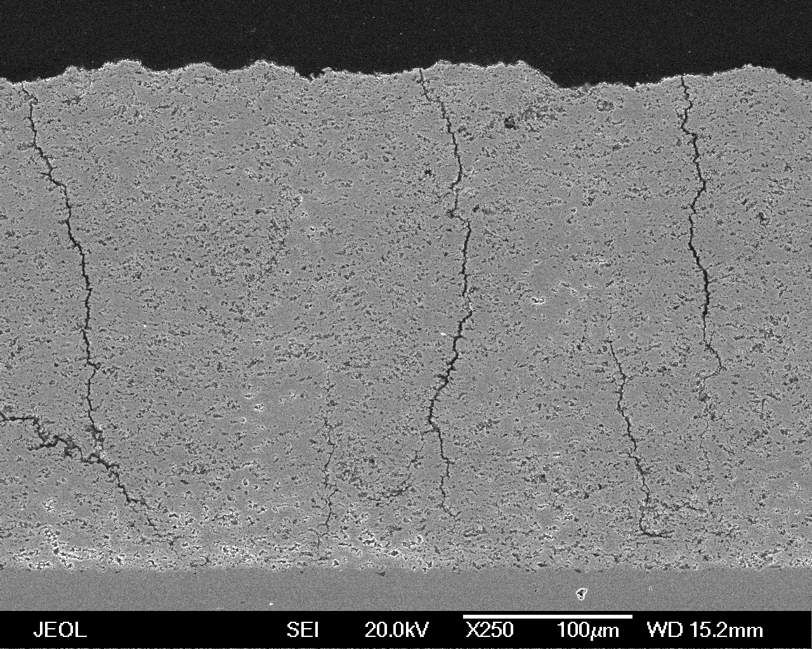
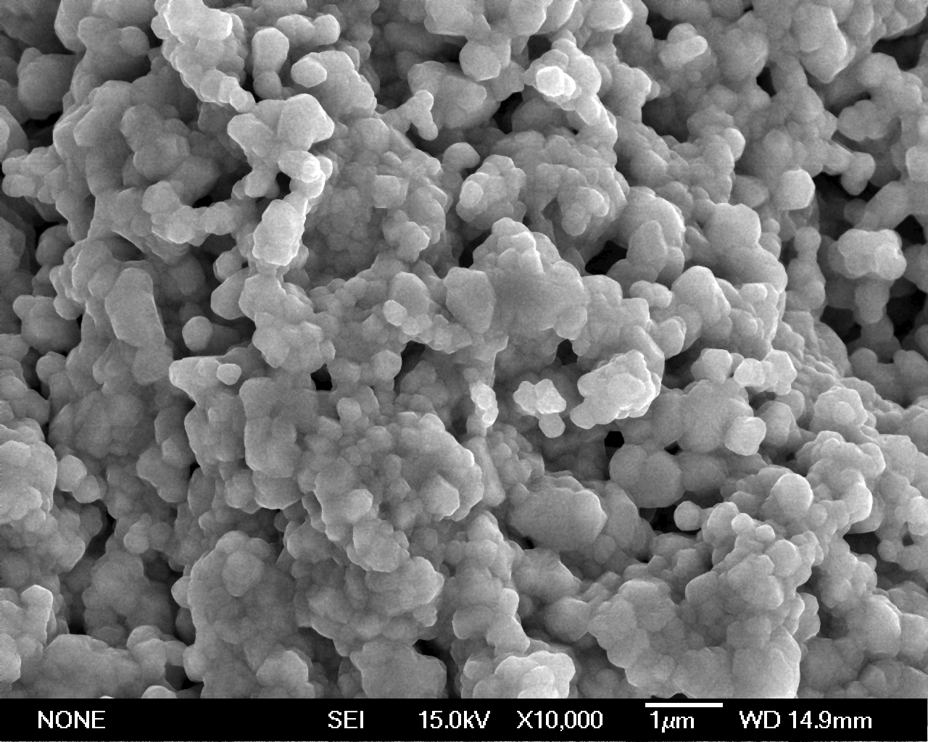
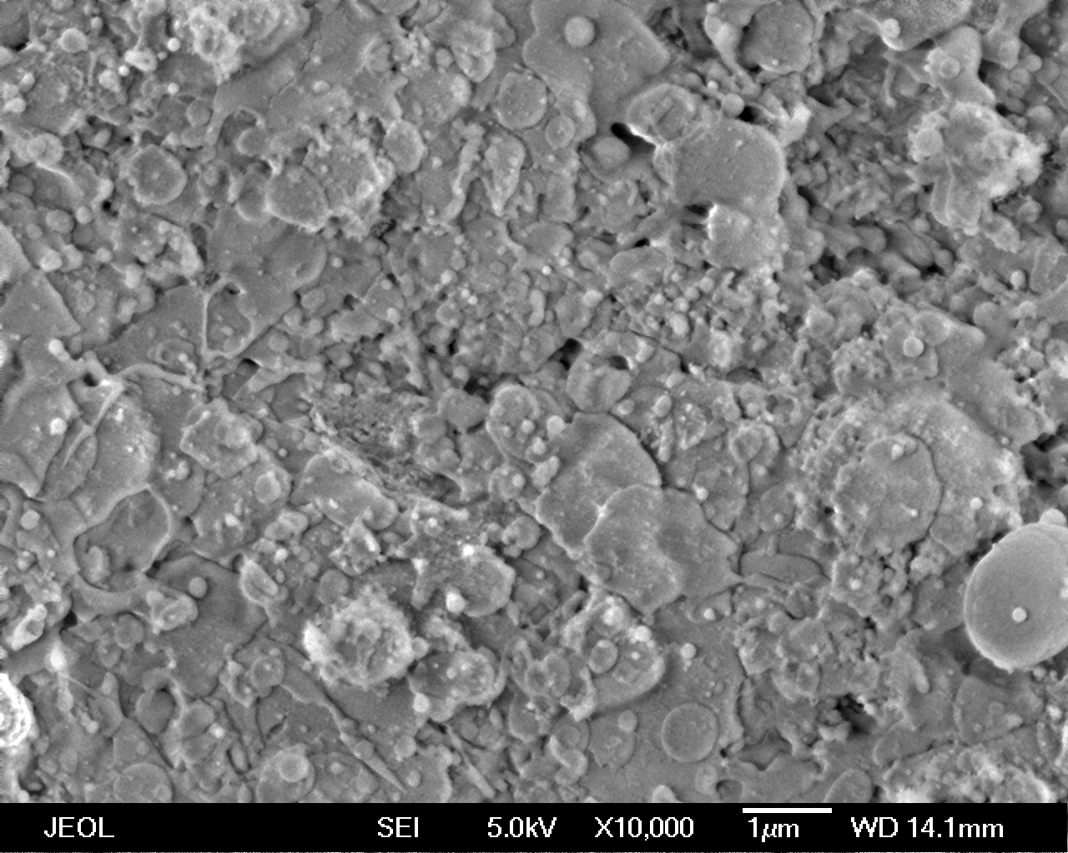
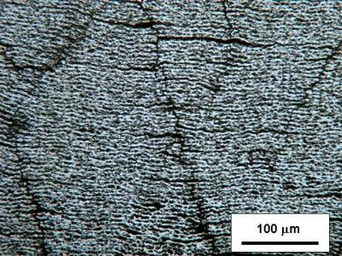
Solution Precursor Plasma Spray:
Unique Microstructural Features
Varied nano/micro-scale porosity:
0~40%
Through-thickness vertical cracks
100 μm
Layered porosity: inter-pass boundaries.
Splat diameter < 2 μm
Splat thickness < 1 μm
Splat area is 1/2500 of that in APS TBCs
1 μm

Slide 7
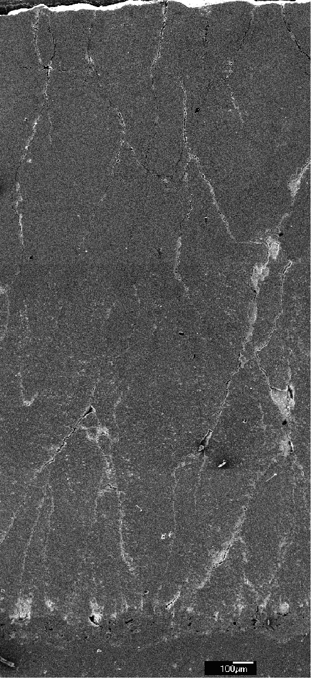
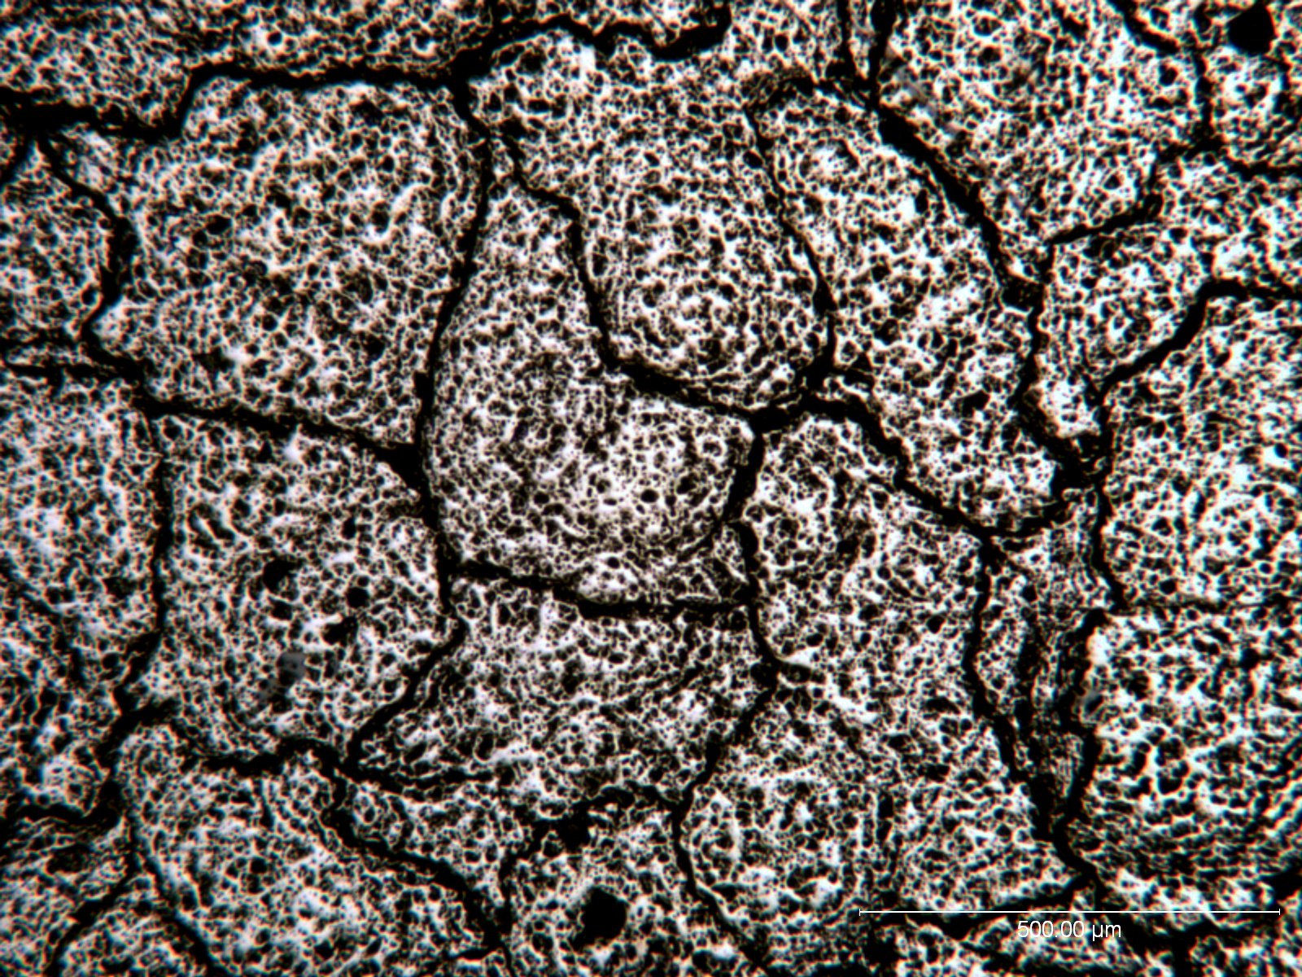
Thick SPPS Thermal Barrier Coatings
SPPS
4mm
500 μm
Surface
Substrate

Slide 8
Effect of SPPS TBC Thickness On Durability
Substrate A
Substrate B
500
Spallation Life, Cycles
Thermal Cycle:
1121°C/1 hour
400
300
200
100
0
0
1
2
3
Coating Thickness (mm)
Normalized Crack Spacing
0.8
0.6
0.4
0.2
0
0
0.5
1.0
1.5
2.0
2.5
3.0
Coating Thickness (mm)

Slide 9
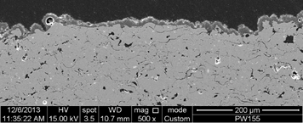
SPPS can Make Thin Dense Layers 10 Micron

Slide 10
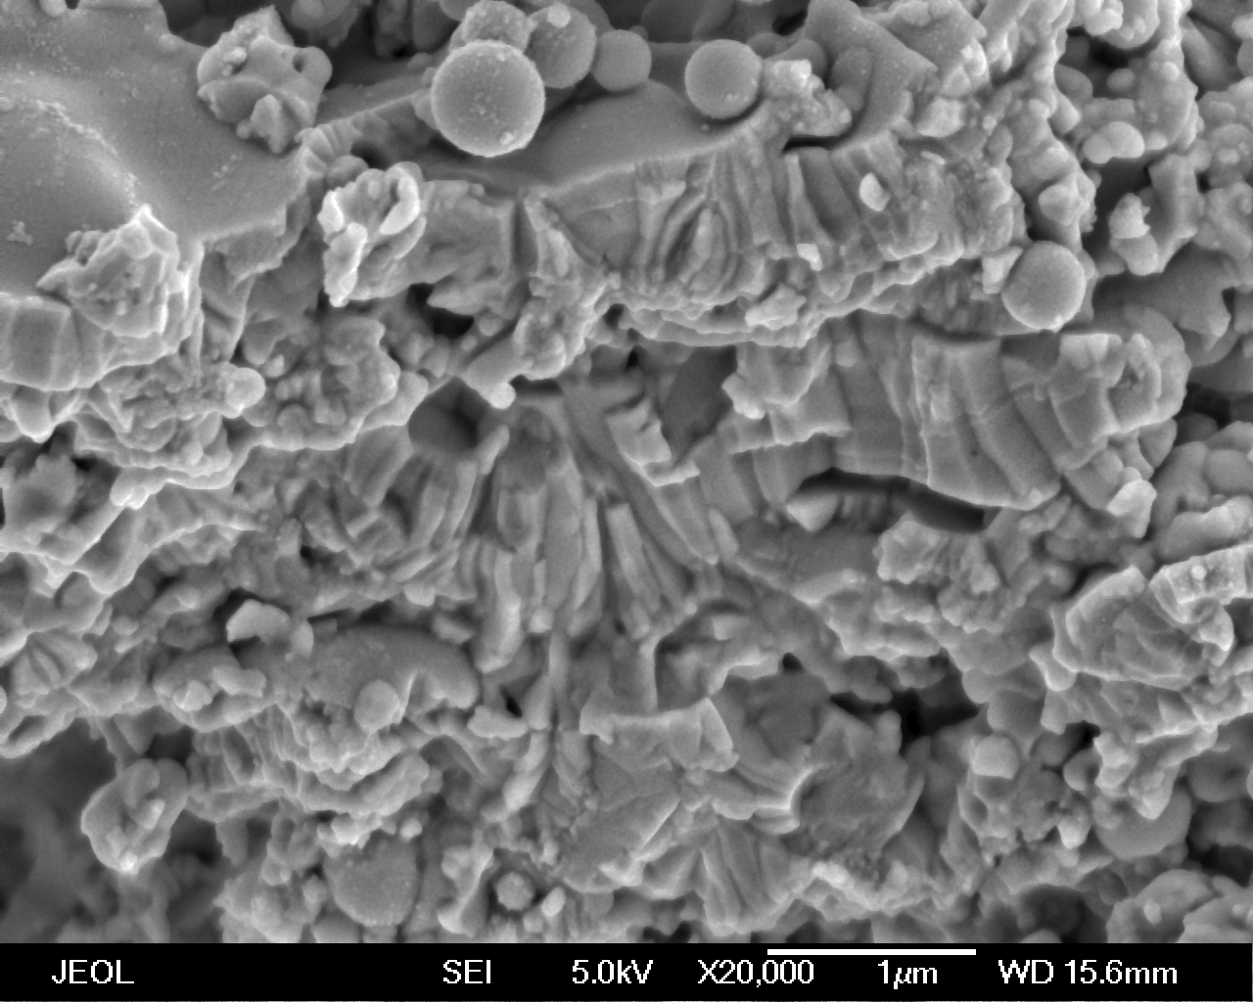
Ultra-Fine Splats Formed In The SPPS Process
1 μm
1 μm
Splat diameter: < 2 μm
Splat thickness: < 1 μm
Splat area is 1/2500 of splats in APS TBCs

Slide 11
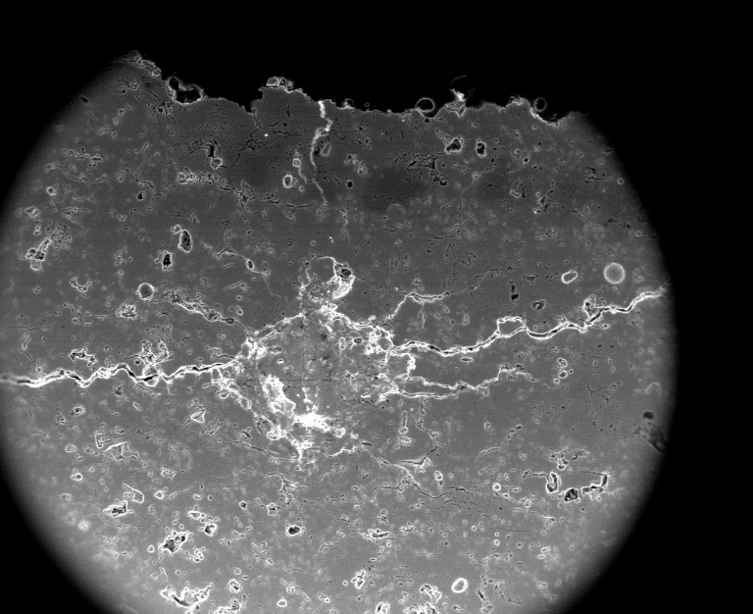
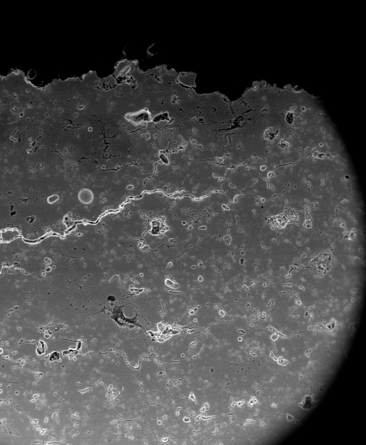
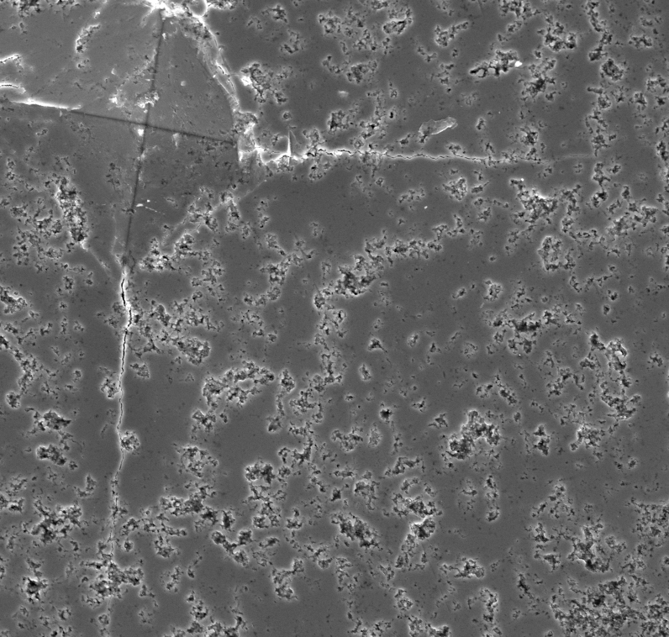
In-Plane Fracture Toughness
100 μm
400 μm
SPPS
TBC
APS
TBC
400 μm
100 μm
In Plane Fracture Toughness (MPa•m^{1/2})

Slide 12
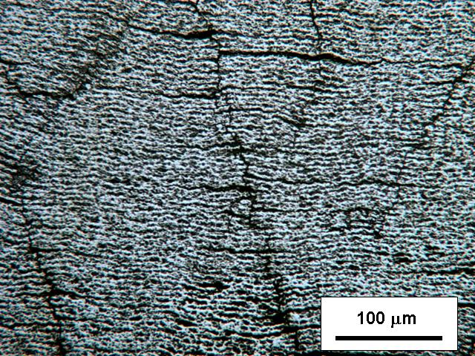
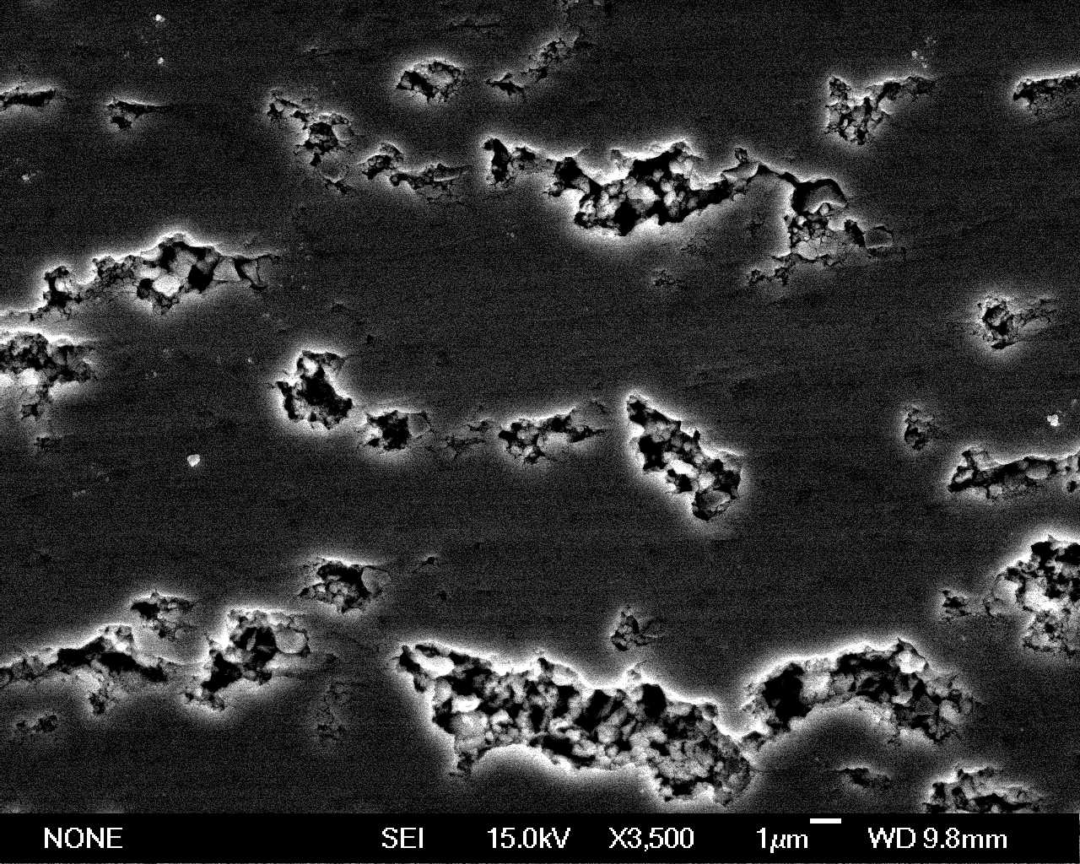
Engineered SPPS YSZ TBC Architecture
10 μm
Vertical cracks for strain tolerance/thermal cycle durability
Planar pores (IPBs) for low thermal conductivity

Slide 13
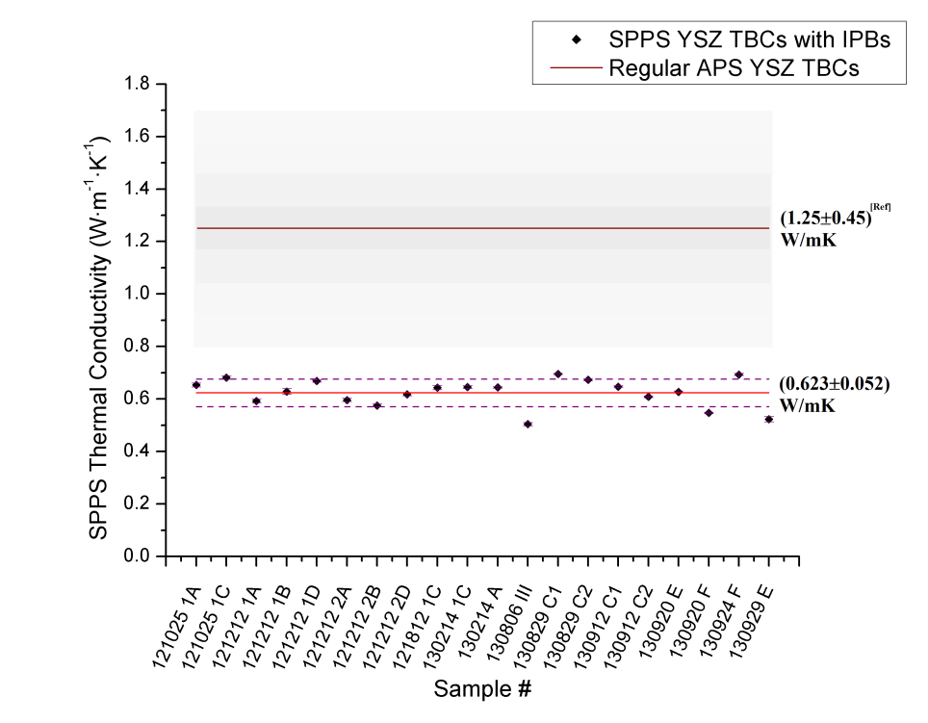
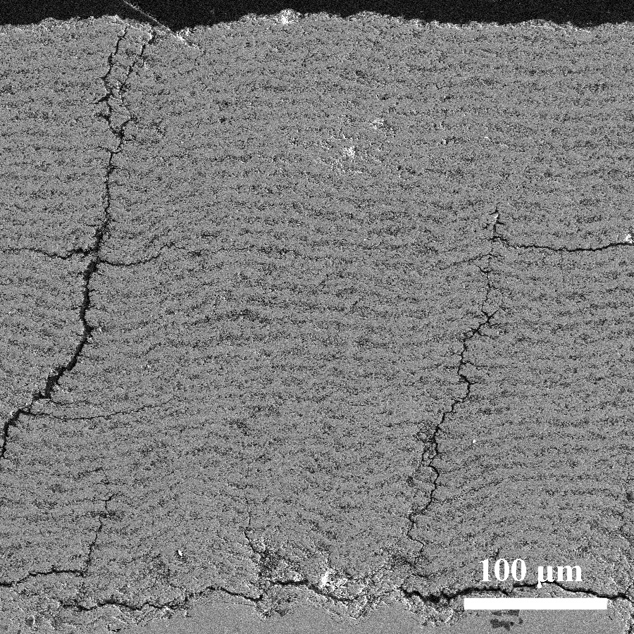
SPPS YSZ With IPBS: Thermal Conductivity
50% Reduction Demonstrated
Notes:
Enter speaker notes here.

Slide 14
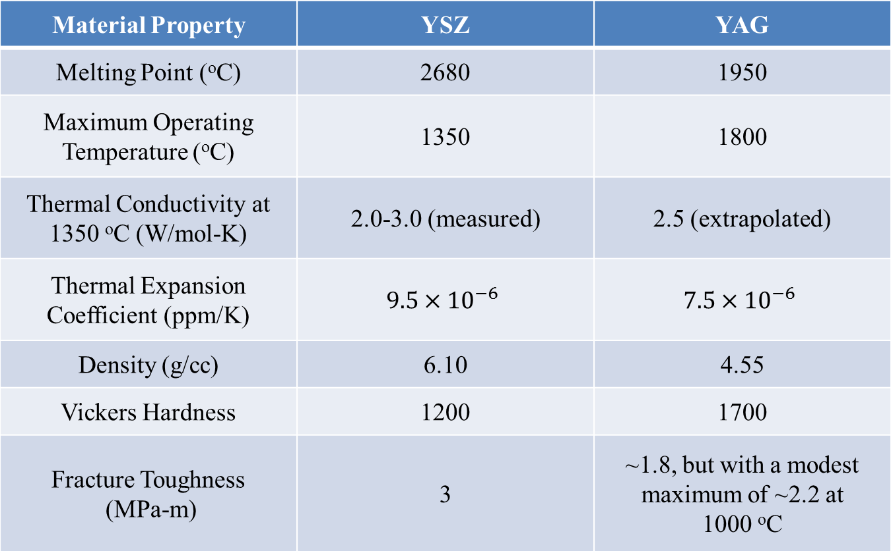
Properties Of YSZ and YAG
Material Property | YSZ | YAG
Melting Point (ºC) | 2680 | 1950
Maximum Operating Temperature (ºC) | 1200-1300 | 1800
Thermal Conductivity at 1350 ºC (W/mol-K) | 2.0-3.0 (measured) | 2.5 (extrapolated)
Thermal Expansion Coefficient (ppm/K)
Density (g/cc) | 6.10 | 4.55
Vickers Hardness | 1200 | 1700

Slide 15
SPPS YAG TBCs: Project Objectives
Develop a Higher Temperature (+200ºC), Lower Thermal Conductivity Thermal Barrier Coating Using Yttrium Alumina Garnet (YAG) and the Solution Precursor Plasma Spray Process (SPPS)
Phase IIa Objective Improve Performance/Cost ratio.

Slide 16
Anticipated Benefits
A New TBC That Can Tolerate Surface Temperatures of 1500ºC Can Be Game-Changing For the Gas Turbine Industry Due to Higher Turbine Efficiencies and Lower Fuel Consumption

Slide 17
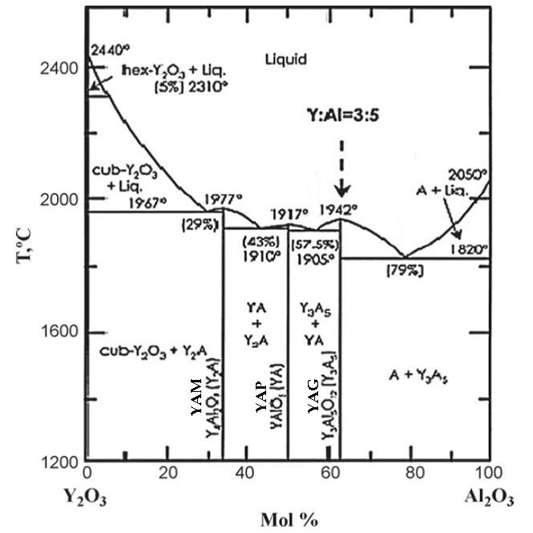
Yttria-Alumina Phase Diagram
M. Shojaie-Bahaabad et al,
Ceramics Intl.,Vol 35, 2009

Slide 18
Performance

Slide 19
Thermal Spray Optimization Many Variables
Stand off Distance
Precursor Composition
Atomizing Gas Pressure
Scan Speed and Step Height
Injection Method, Stream vs. Atomizing
Feed Rate
Gun Power
Gas Mix
Gun Type

Slide 20
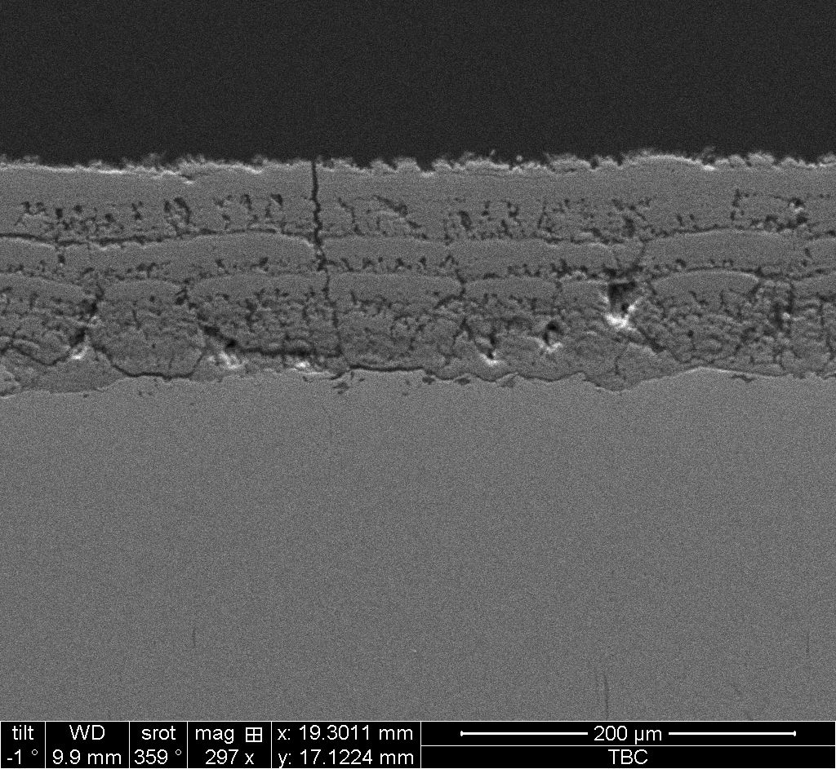
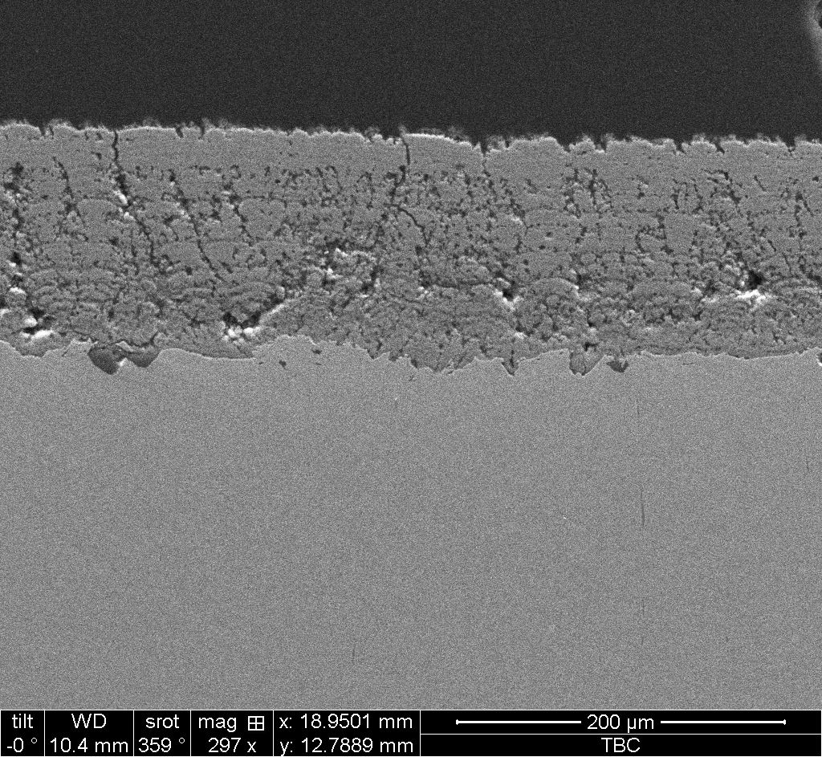
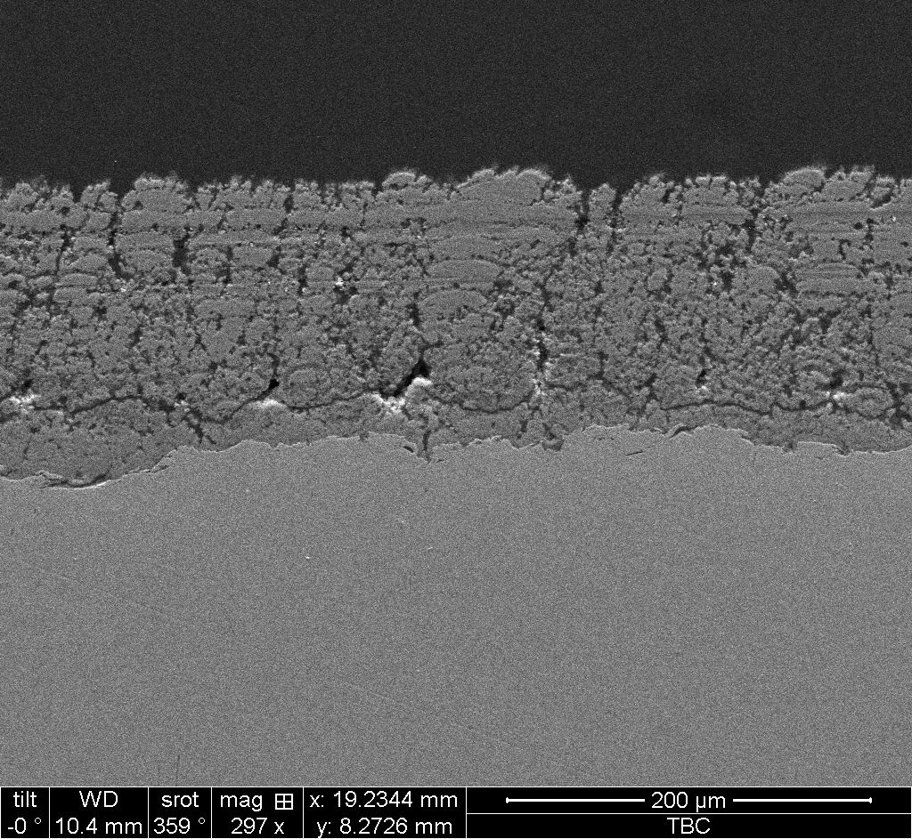
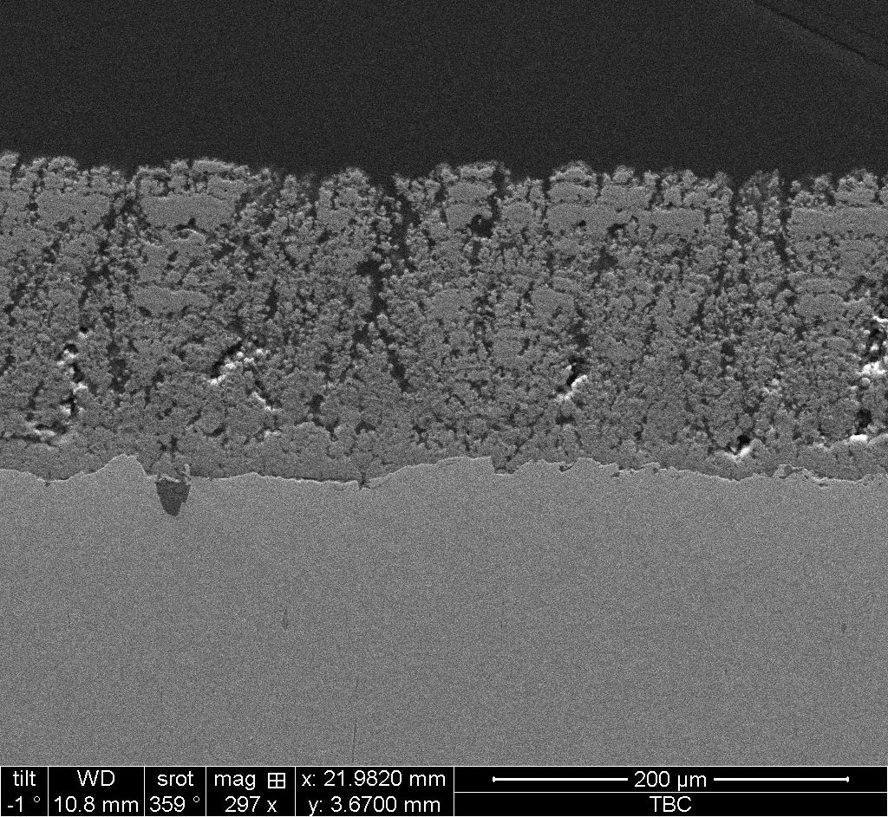
Increased Spray Distance at Lower Atomizing Pressure
SD = 1.375” 1.425” 1.5” 1.625”

Slide 21
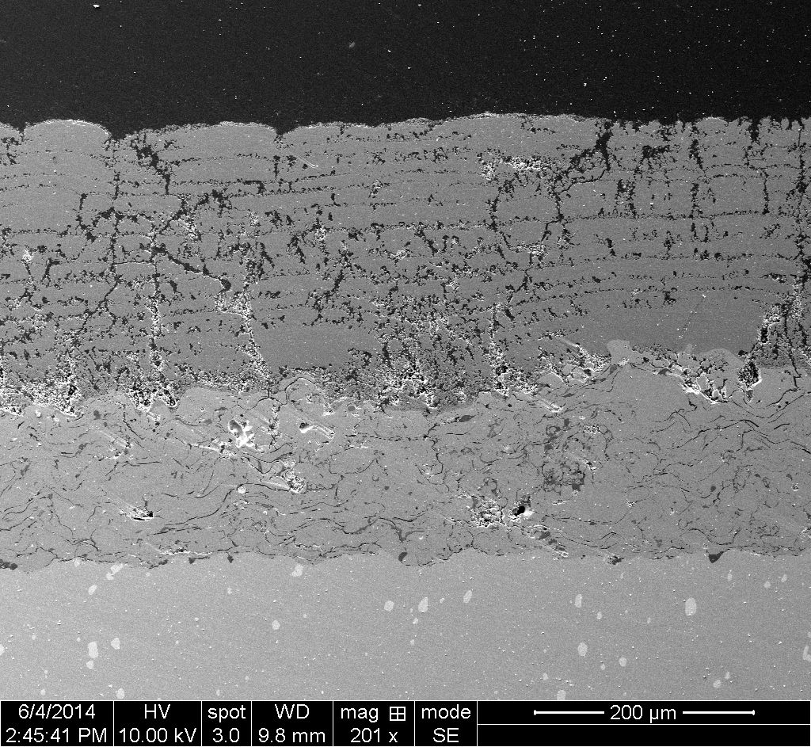
SPPS YAG TBCs: Standard Microstructure
--Used for Engine-Critical Properties Tests--
SPPS YAG
APS YSZ
Bond Coat
Superalloy
Vickers Hardness: 200-400
Porosity: 15-20%

Slide 22
SPPS YAG TBCs: Critical Engine Properties
200ºC Temperature Advantage
Phase Stability
Sinter Resistance
CMAS Resistance
Improved Durability
Thermal Cycle Resistance
Erosion Resistance
Other Significant Properties
Lower Thermal Conductivity
Reduced Density
Surface Smoothness

Slide 23
Stoichiometric YAG Deposited By SPPS Process
As-Sprayed SPPS YAG
Intensity
M: YAM
P: YAP
P
M
Predominantly YAG Phase with Minor Amounts of YAM and YAP
As-Sprayed SPPS YAG with Excess Al³⁺ in precursor
Pure YAG phase

Slide 24

SPPS YAG TBCs: Phase Stability
As-sprayed SPPS YAG
M: YAM
P: YAP
M
P
1500ºC 100 hr
M: YAM
P: YAP
M
P
1600ºC 100 hr
M: YAM
P: YAP
M
P
SPPS YAG TBCs Are Phase Stable To At Least 1600ºC

Slide 25
Thermal Conductivity of SPPS YAG TBCs
APS YSZ
SPPS YAG
Measured by Netzsch Instruments Using Laser Flash
1 mm thick sample with Vickers Hardness of 246

Slide 26
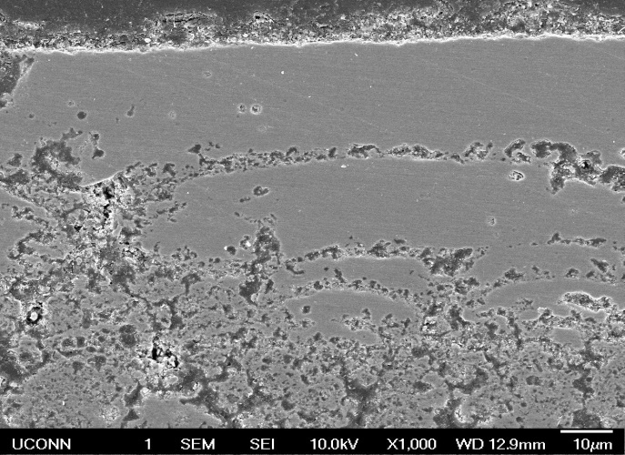
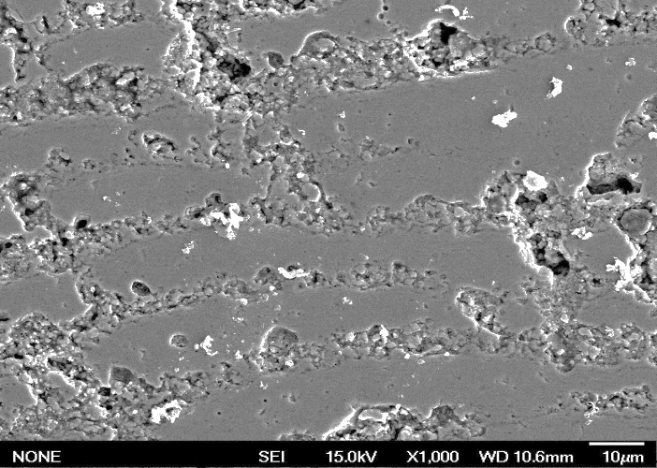
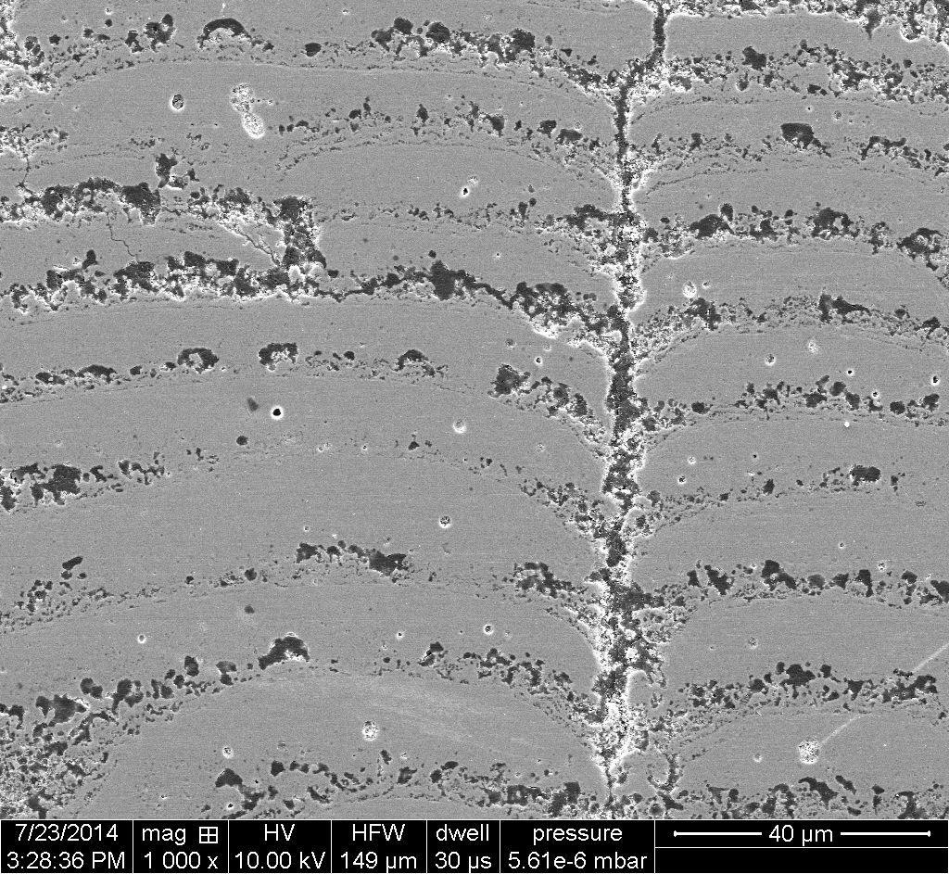
Thermal Conductivity of different YAG samples
Porosity ~15%
HV= 249±175
Porosity ~33%
HV= 260 ±33
Porosity ~23%
HV= 324±60

Slide 27
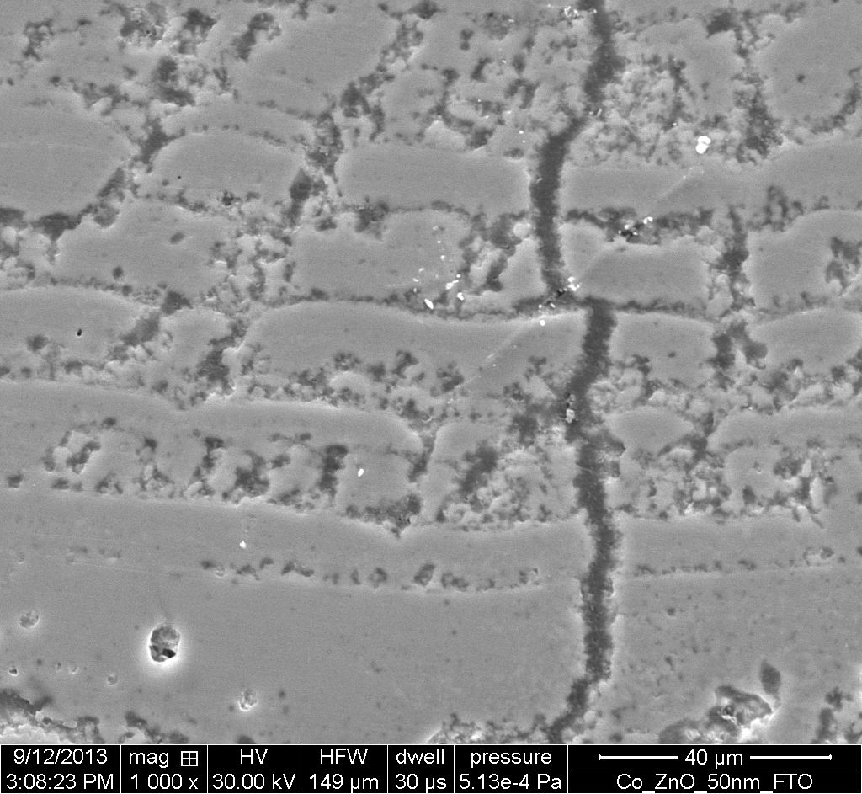
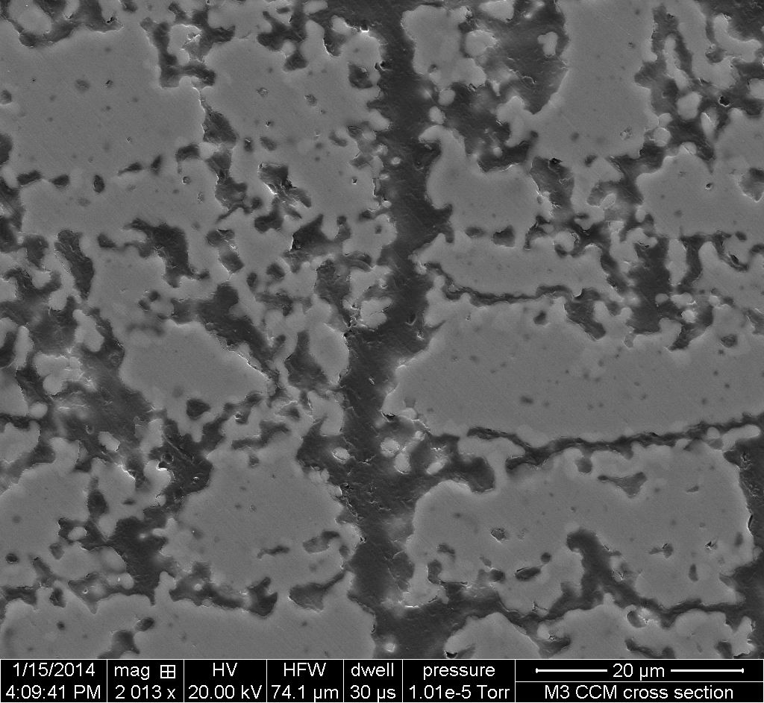
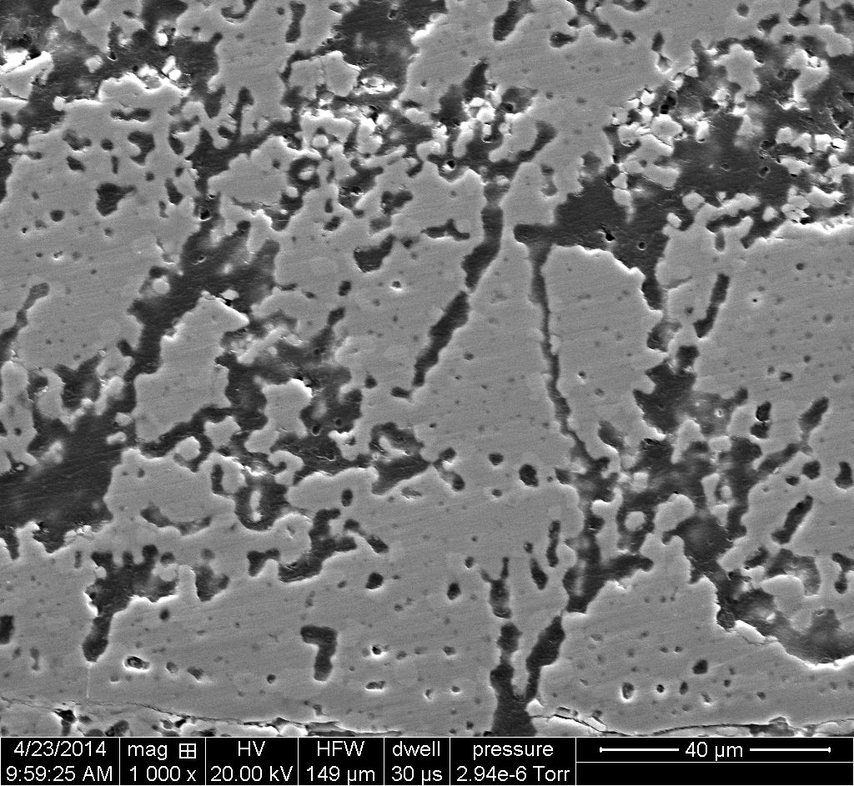
SPPS YAG TBCs: Sintering Resistance
As-sprayed
1500ºC 100h
1600ºC 100h
HV = 380±185
HV = 324±122
HV = 378±139
Sintering Effects Are Small Up to 1600ºC

Slide 28

SPPS TBCs: Sintering & Thermal Conductivity
SPPS YSZ 50 hrs
20 hrs
SPPS YAG
50 hrs
SPPS YAG TBCs More Sinter Resistant Than SPPS and APS YSZ

Slide 29
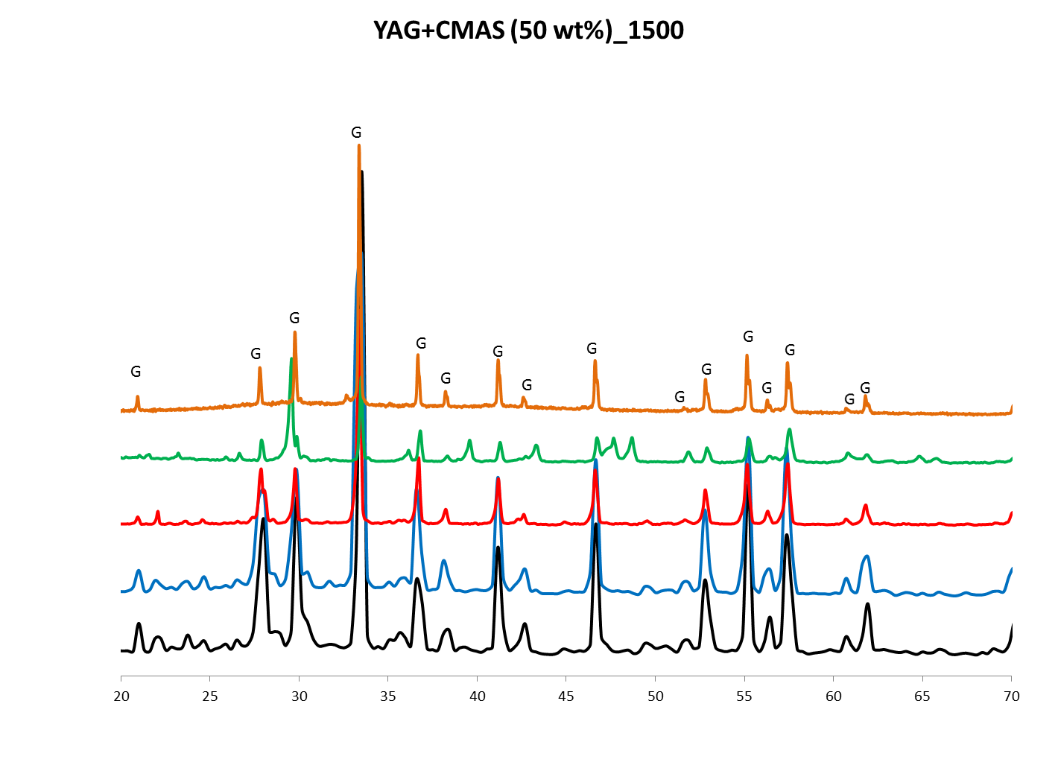
Phase Stability: 50:50 w/o YAG/CMAS Powder
1500 °C
G: YAG
1500 ֯C
1400 ֯C
1300 ֯C
1200 ֯C
1100 ֯C
YAG Phase Stable To 1500ºC In Presence of CMAS

Slide 30
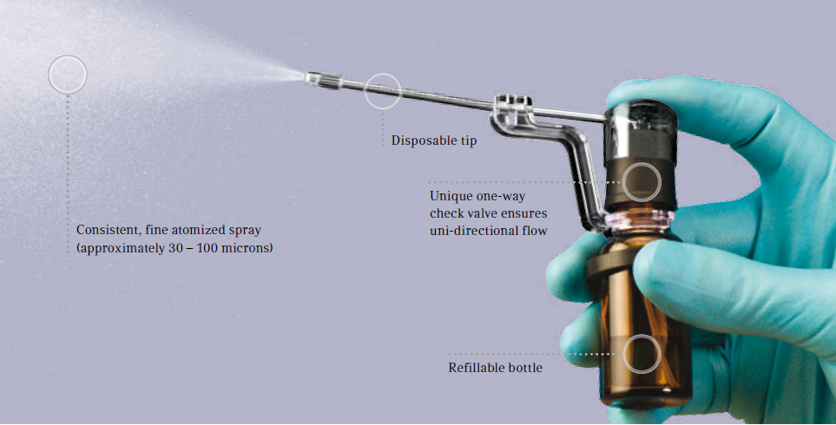
Spritz/Atomizer Test Conditions
1 wt% CMAS Aqueous Solution
0.1 mL/spray
4-CMAS (M.P. ~1200 ºC )
9-CMAS (M.P. ~1180 ºC)
Oxide | SiO₂ | CaO | Al₂O₃ | MgO
Wt.% | 52.3 | 37.1 | 7.1 | 3.5
Mol.% | 51.5 | 39.2 | 4.1 | 5.2
1180 ºC
Temperature
0
10
20
30
40
50
60
Time (min)
Oxide | CaSO₄ | SiO₂ | CaO | Al₂O₃ | MgO | Fe₂O₃ | K₂O | TiO₂ | Na₂O
Wt.% | 42.00 | 31.57 | 1.54 | 16.50 | 2.66 | 1.54 | 1.54 | 1.33 | 1.32
Mol.% | 26.75 | 45.56 | 2.38 | 14.03 | 5.72 | 0.84 | 1.42 | 1.44 | 1.85

Slide 31
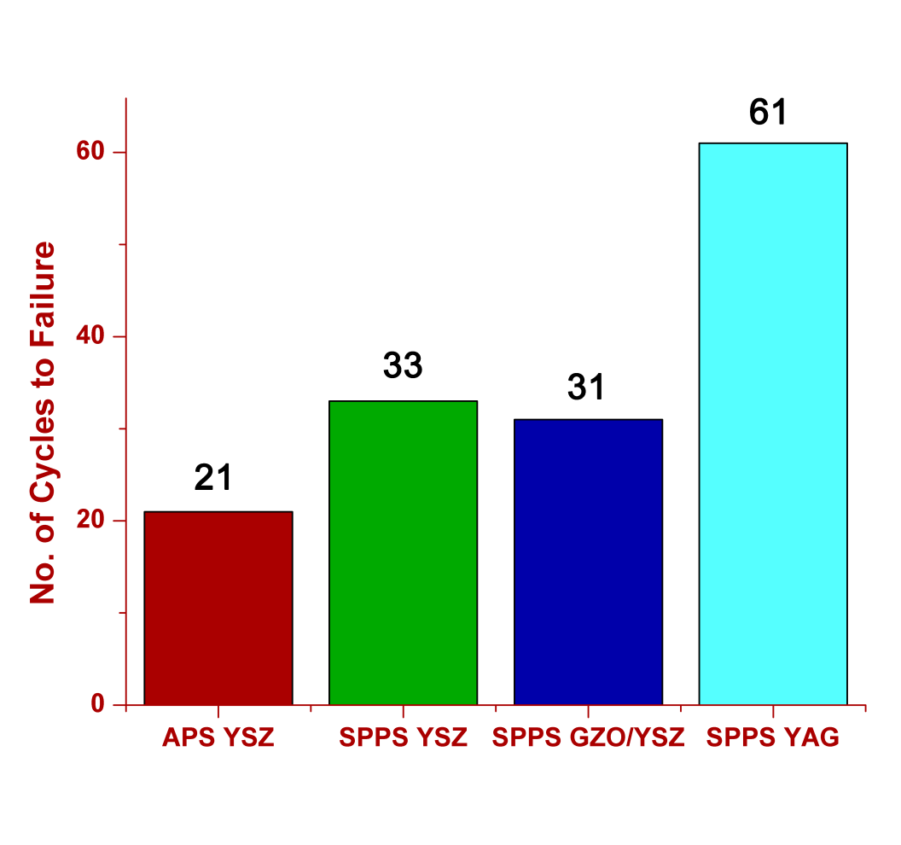
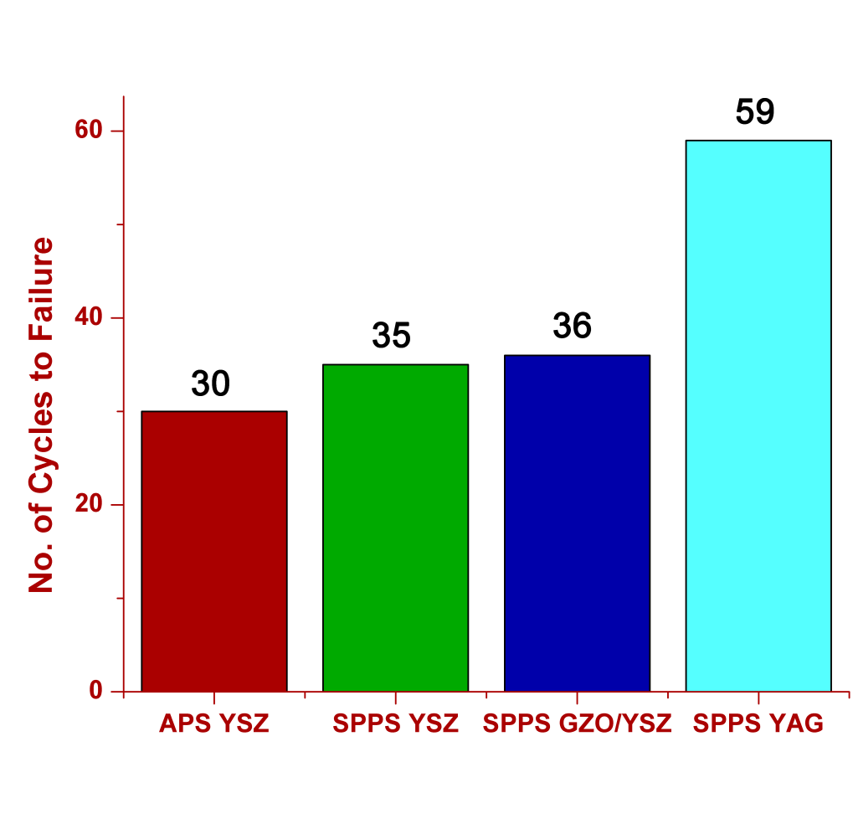
Spritz Test: Cyclic Lives
4 Component CMAS
9 Component CMAS

Slide 32
SPPS YAG TBCs: Thermal Cycle Life vs Hardness
MAX
AVERAGE
MIN
SPPS Strain-Tolerant Microstructure Overcomes
Higher Thermal Expansion Mismatch Stresses

Slide 33
SPPS YAG TBCs: Erosion Rate vs Hardness
(Tests Performed at Penn State Univ. By Dr. D Wolfe)

Slide 34
SPPS YAG TBCs: Erosion Rate vs Hardness
(Tests Performed at Penn State Univ. By Dr. D Wolfe)
YSZ
YAG
hardness

Slide 35
SPPS YAG TBCs: Erosion Rate vs Hardness
-30º Impingement-
(Tests Performed at Penn State Univ. By Dr. D Wolfe)
SPPS YAG Has Superior Erosion Resistance To APS YSZ In Both 30º
90º Impingement Erosion Tests.

Slide 36
Cost Reduction- Utility Improvements

Slide 37
Phase IIA Industry Partners
Solar Turbines
Siemens Energy
Pratt & Whitney
Praxair
Progressive Surface
Chromalloy
General Electric Power
Rolls-Royce
Oerlikon-Metco

Slide 38
Industrial Partners Activities
Olikon Metco spray trials done
Praxair spray trials in progress this week
Solar Engine Parts sprayed and delivered
Progressive Spray trials scheduled
Outside of Phase IIa we are involved in Tech Transfer

Slide 39
Goals Related to Industrialization Benefits Cost Ratio
Lower Thermal Conductivity(less thickness)
Higher Deposition Efficiency
Higher Deposition Rate
Larger Stand off Distance

Slide 40
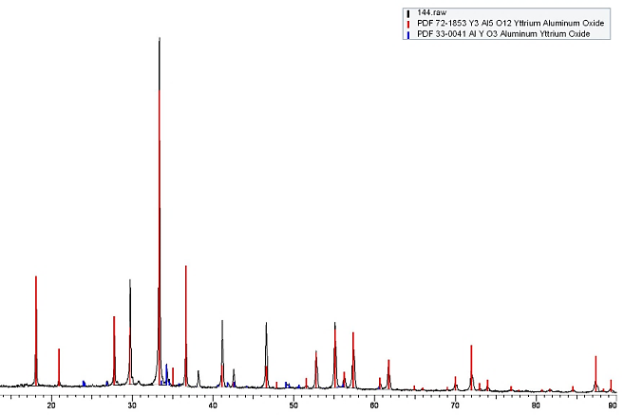
Conductivity reduction via rare earth Doping
SPPS YAG coatings were produced with 1 atm.% doping of a Rare Earth
~24% reduction in thermal conductivity was achieved at RT
SEM images of SPPS YAG coatings with 1 atm.% doping
XRD showing phase stability
Comparison of Thermal conductivity

Slide 41
Improved Deposition Efficiency from 24% to 42%

Slide 42
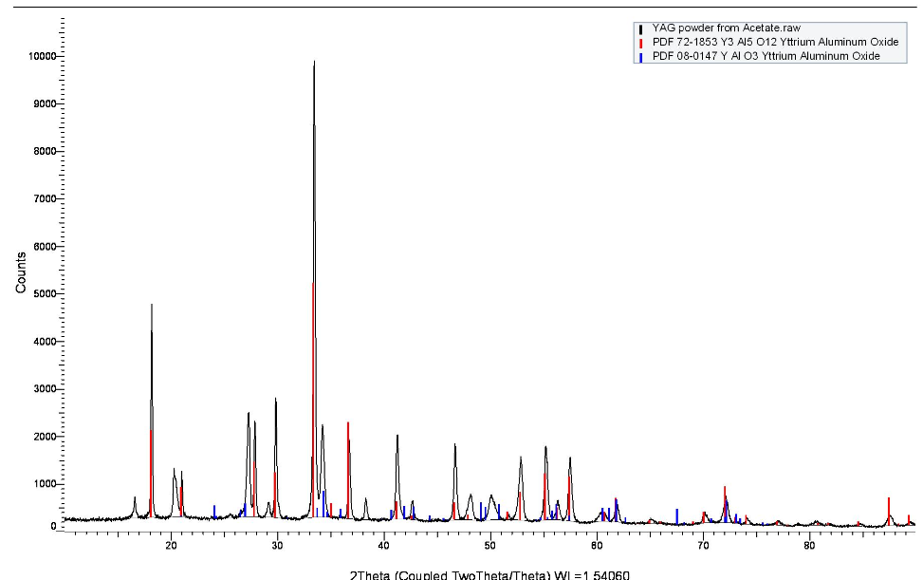
Improved Using Acetate Vs. Nitrate Precursor
DSC
Substantial increase in DE and DR leads to a 40% reduction in production cost of SPPS YAG coatings with Acetate precursor
Lower Viscosity helps in more uniform flow, less clogging and buildup at the nozzle
Stronger exothermic peaks during decomposition aids in melting of YAG particles in plasma
Crystallization of YAG
YAG peaks are visible (in red) with some YAP phase (in blue)
XRD of heat treated precursor for 5 hours at 1200˚C

Slide 43
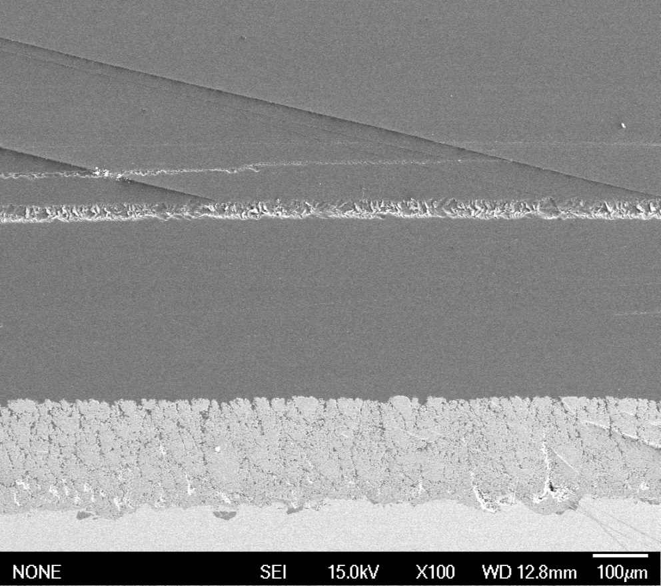
Diluted Nitrate Precursor Increased DE and Reduced Cost
15% Dilution, SD: 1.375’’
HV: 374 ± 54
25% Dilution, SD: 1.375’’
HV: 243 ± 48
30% Dilution, SD: 1.5’’
HV: 229 ± 25
Repeatable microstructures and hardness were produced with all the precursors
50% Dilution, SD: 1.5’’
HV: 250 ± 25

Slide 44
Standoff Distances
Industrial Partner Visits | STTR Phase | Plasma Gun Used | Standoff Distance (inch) | Results/ Comments | Future work
Praxair 11/2014 | 2 | F-4 | 1.5-3.0 | Poor- Fair initial results | F-4, 100HE, Plazjet, HE1100
Progressive 02/2015 | 2 | 100HE | 2.0-2.75 | Fair initial results | 100HE itself
Progressive 05/2015 | 2a | 100HE | 2.0-2.75 | Good, Columnar structure, Vickers Hardness-400 | Spray B/C, APS YSZ and SPPS YAG for Thermal Cycling
Metco 09/2015 | 2a | Sinplex Pro | 2.25-2.75 | Initial testing with YSZ, Good results | Spray YAG
Praxair 11/2015 | 2a | F-4 | 2.0-3.25 | Will explore parameters of F-4 gun to deliver acceptable microstructure and hardness | HE1100

Slide 45
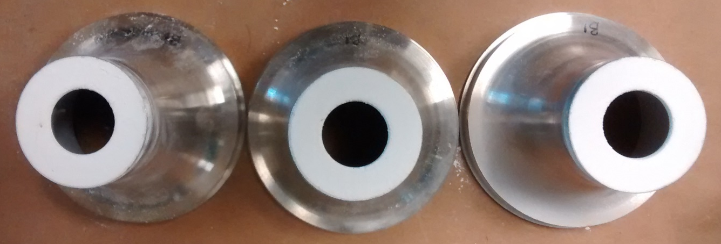
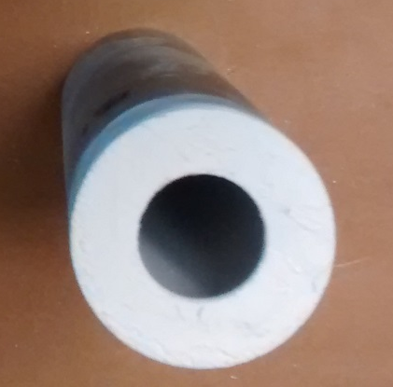
Injectors Tips Coated and Delivered for Solar Turbines for a Rig Test
Sim

Slide 46
Summary & Conclusions-I
SPPS YAG TBCs Show Potential For >1500ºC Operation Based On Phase Stability, Sinter and CMAS Resistance
This Represents >200ºC Advantage Over APS YSZ
Durability of SPPS YAG TBCs ≥ APS YSZ In Thermal Cycle and Erosion Tests
Thermal Conductivity of of SPPS YAG TBCs with IPBs is 0.99 Watt/mºK at at room temperature extrapolates to 0.62 at 1300 C based on our earlier results of 1.65 at RT and 0.9 at 1300 C. To Date Doping expected to reduce K by 25% more

Slide 47
Summary & Conclusions-II
Deposition Efficiency increased from 24% up to 43% using a different Precursor. More improvement sought.
Standoff distance improved from 1.6 inches to 3 inches Further Improvement sought.
Now being applied to Engine parts and separate arrangements for Tech Transfer to a fortune 500 company.

Slide 48
Summary & Conclusions-II
Engine Manufacturers Show Strong Interest In SPPS YAG TBCs; Are Conducting In-House Testing
Technology Transfer Being Conducted With TBC Coating Suppliers; They Will Conduct Demonstration Trials and Provide Process Economics
SPPS YAG Continues to Show Strong Promise As Higher Temperature (200ºC), Sinter-Resistant, CMAS-Resistant, Low K, Low ρ, Durable TBC

Slide 49
Acknowledgements
Dr. Briggs White, DOE Program Manager, UTSR Program on SPPS YSZ with IPBs
Dr. Patcharin Burke, DOE Program Manager, STTR Phase I, II & IIA Programs on SPPS YAG TBCs
Our Industrial Partners for Phase II SPPS YAG TBCs: Solar Turbines, Siemens Energy, Pratt & Whitney, Praxair and Progressive Surface

Slide 50
Thermal Conductivity of different YAG samples
Porosity ~15%
HV= 249±175
Porosity ~33%
HV= 260 ±33
Porosity ~23%
HV= 324±60

Slide 51
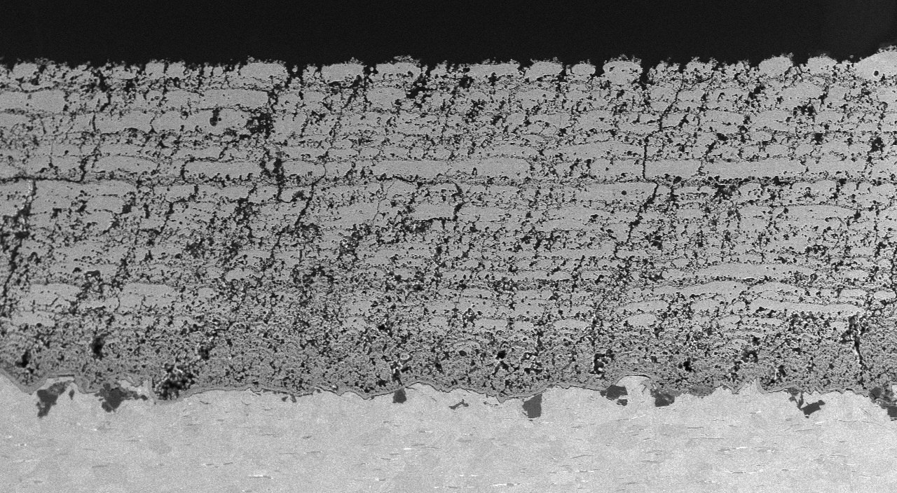
SPPS YAG TBCs: Praxair Trials
Proprietary and Confidential

Slide 52
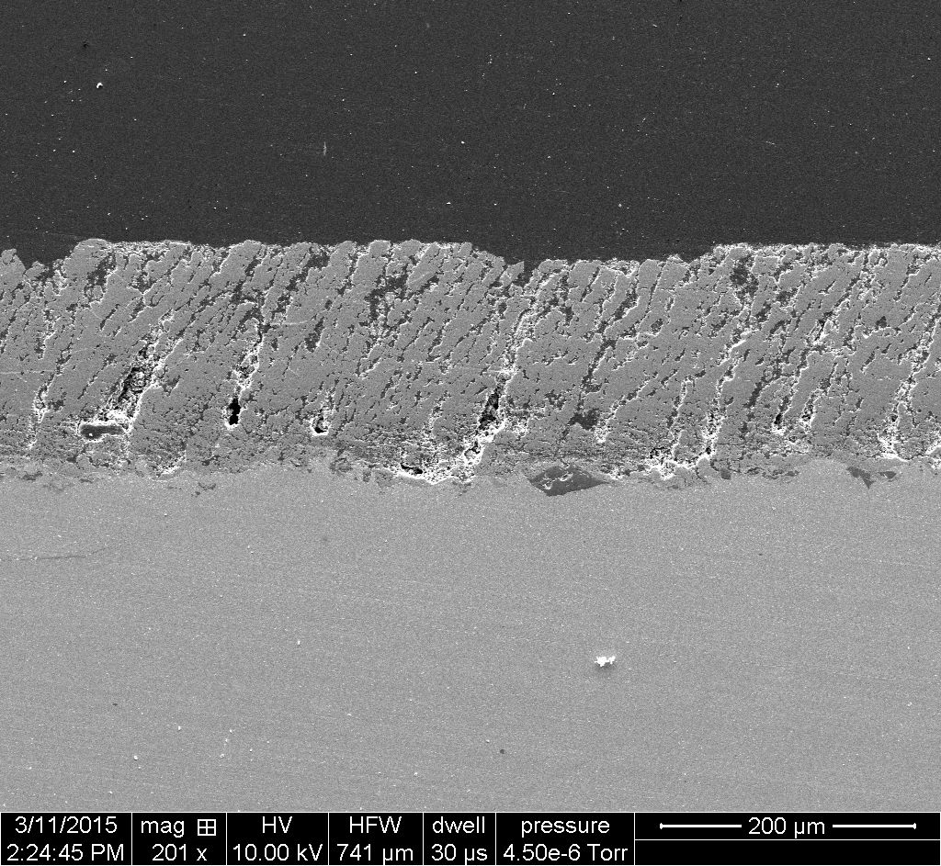
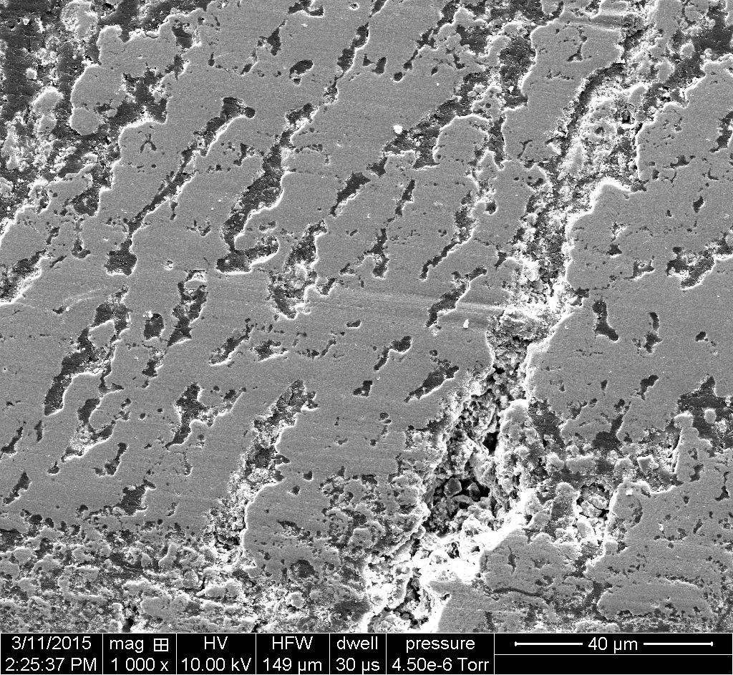
SPPS YAG TBCs: Progressive Surface Trials
YAG
Steel
YAG
HE-100 Gun Vickers Hardness (Hv): 187±36
Proprietary and Confidential

Slide 53
Summary & Conclusions-II
Engine Manufacturers Continue To Show Strong Interest In SPPS YAG TBCs; Will Conduct In-House Testing
Technology Transfer Being Conducted With TBC Coating Suppliers; They Will Conduct Demonstration Trials and Provide Process Economics
SPPS YAG Continues to Show Strong Promise As Higher Temperature (200ºC), Sinter-Resistant, CMAS-Resistant, Low K, Low ρ, Durable TBC
Phase IIA, Starts 4-22-15, Emphasizes Further Conductivity Reduction, Precursor & Processing Improvements, Scale-Up to Complex Geometries
Proprietary and Confidential

Slide 54
Questions ?

Slide 55
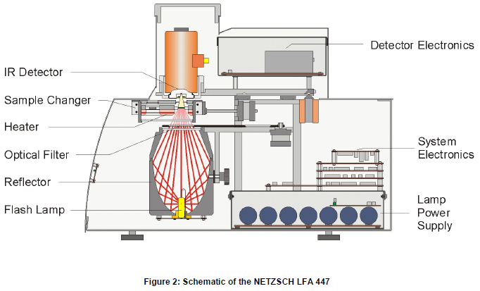
Laser Flash Apparatus

Slide 56
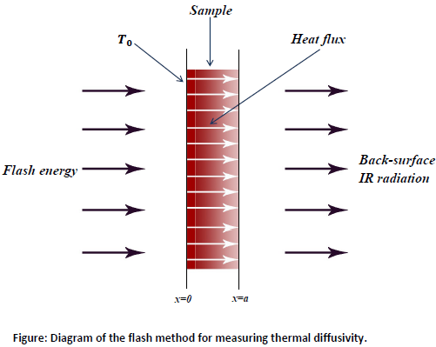
Flash Method Schematic

Slide 57
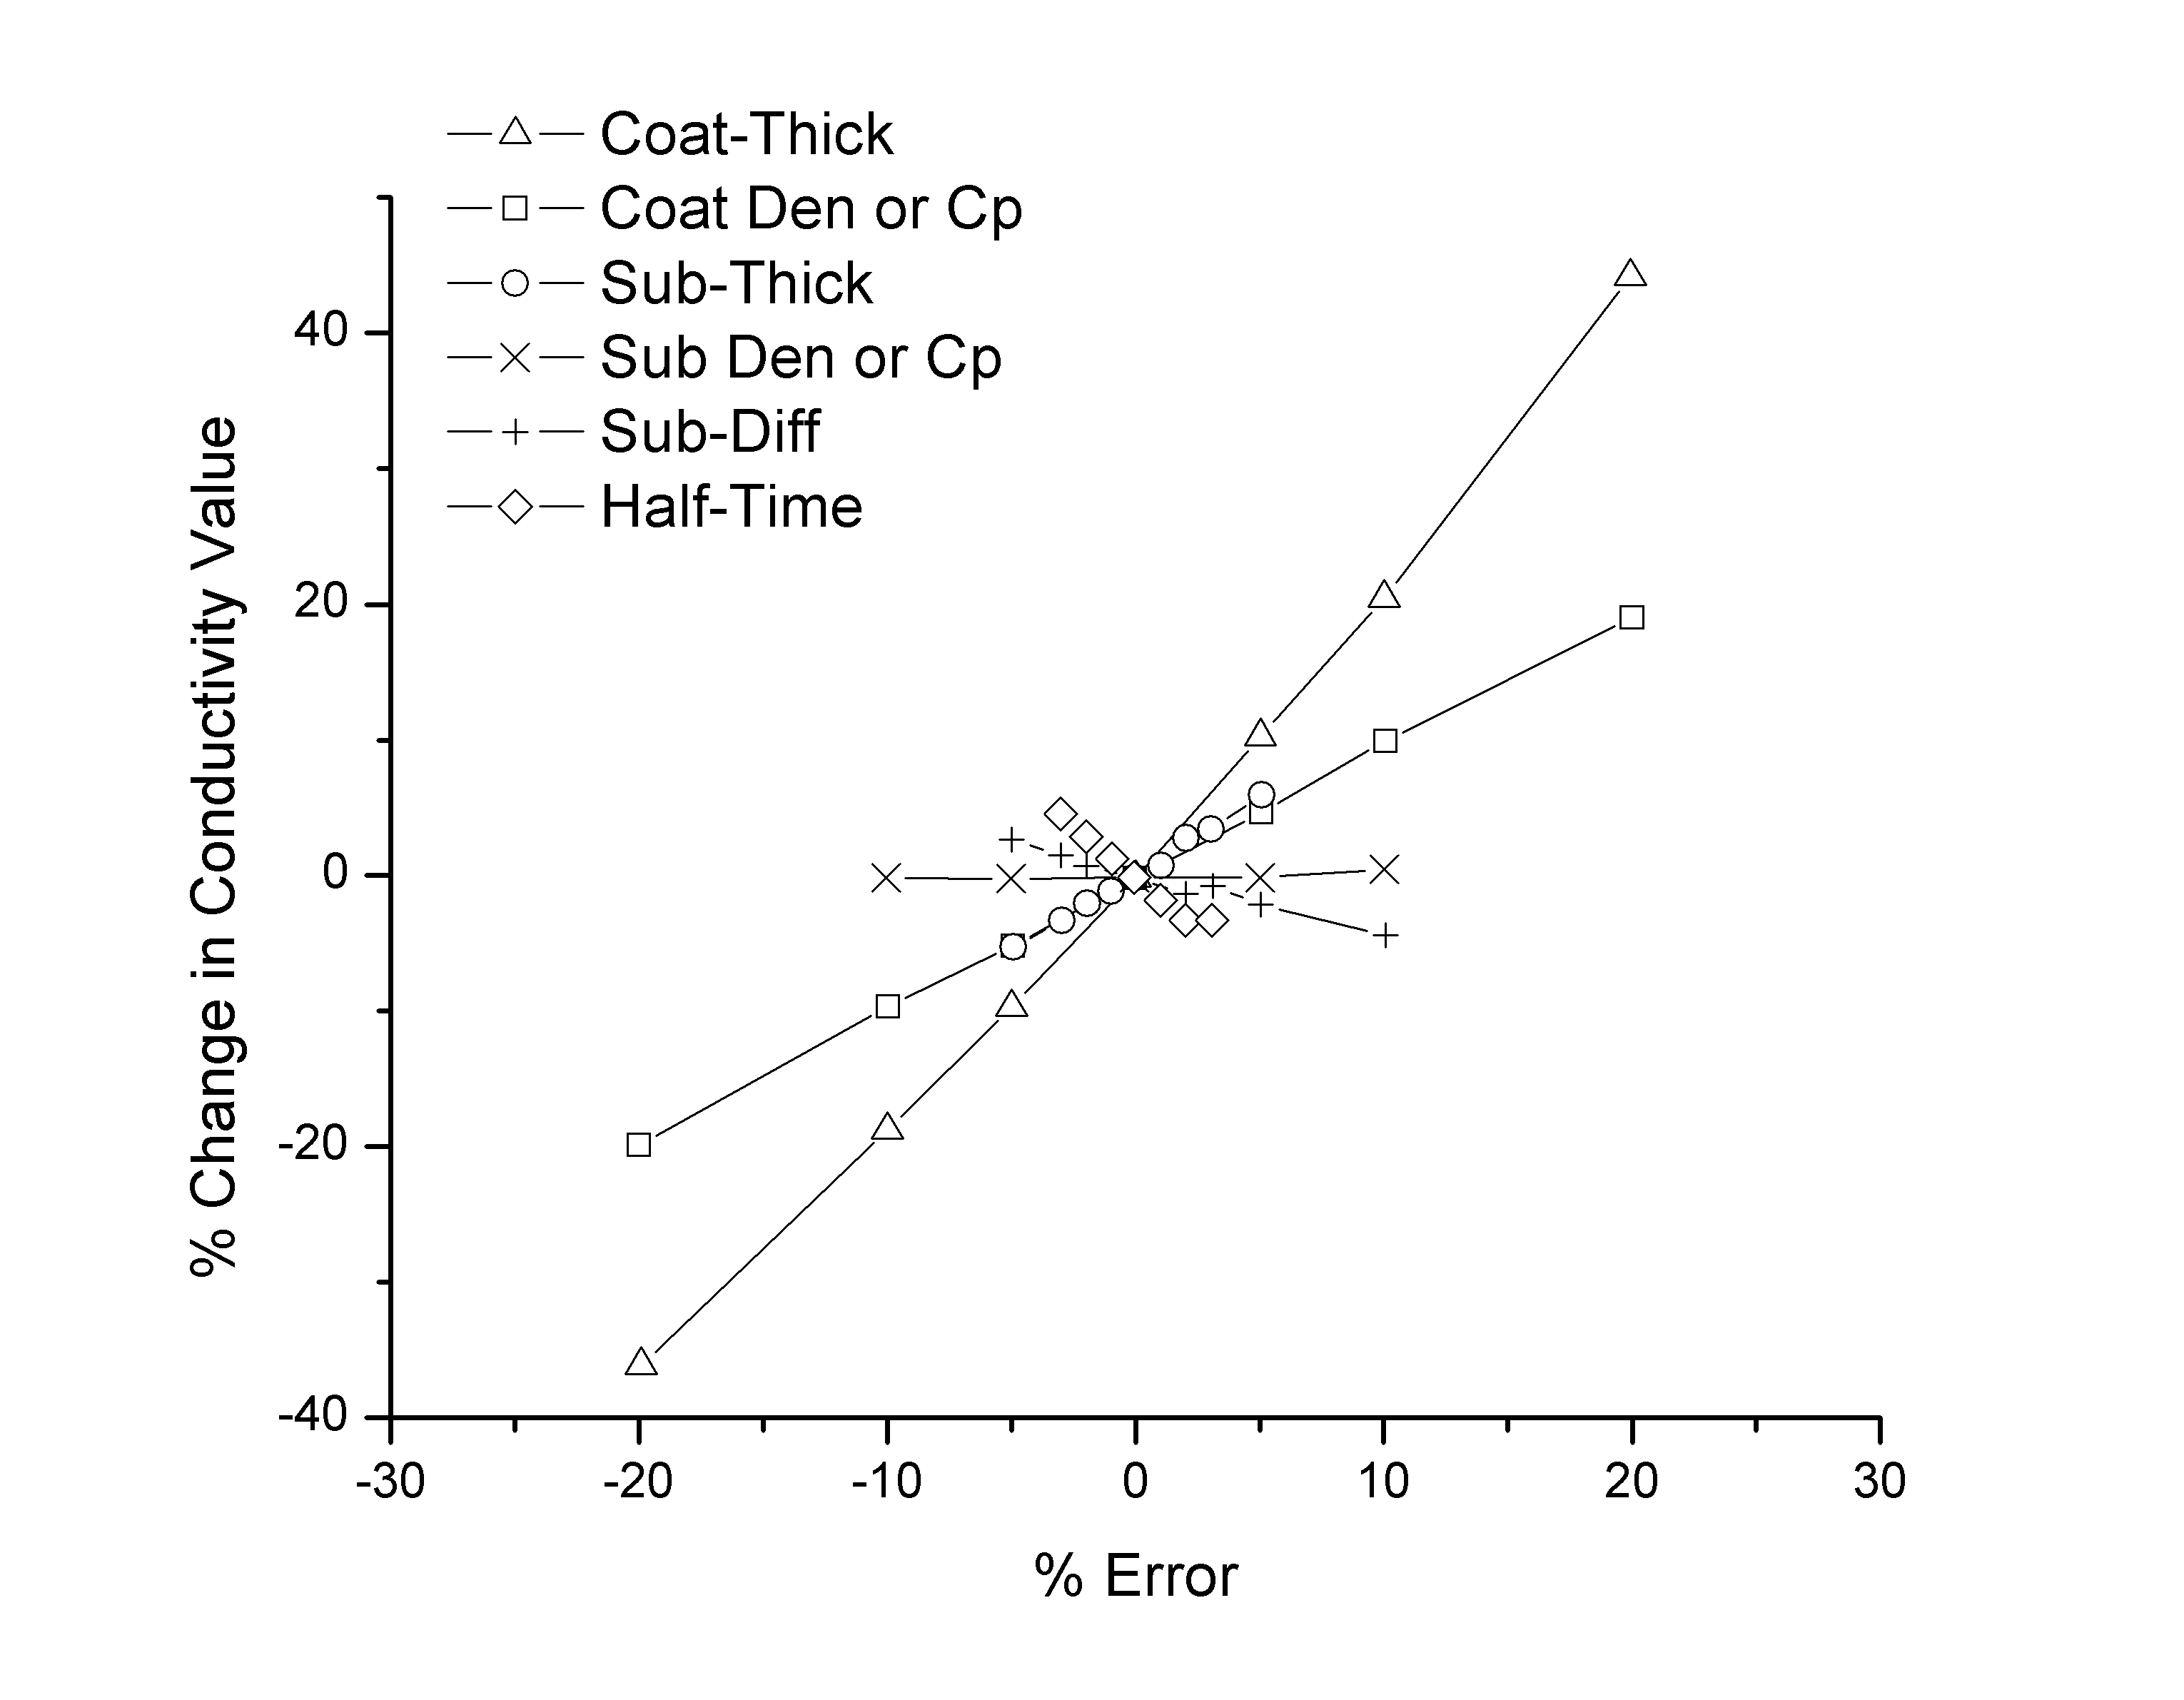
Flash Method Error
[4] Taylor RE. Thermal conductivity determinations of thermal barrier coatings. Materials Science and Engineering A245.1998: 160–167

Slide 58
Spray trials with diluted precursor
15% Dilution, SD: 1.375’’
HV: 374 ± 54
25% dilution, SD: 1.375’’
HV: 243 ± 48
30% Dilution, SD: 1.5’’
HV: 229 ± 25
DE values show an improvement with higher dilution levels with overall reduction in cost
Repeatable microstructures and hardness were produced with all the precursors
50% Dilution, SD: 1.5’’
HV: 250 ± 25

Slide 59
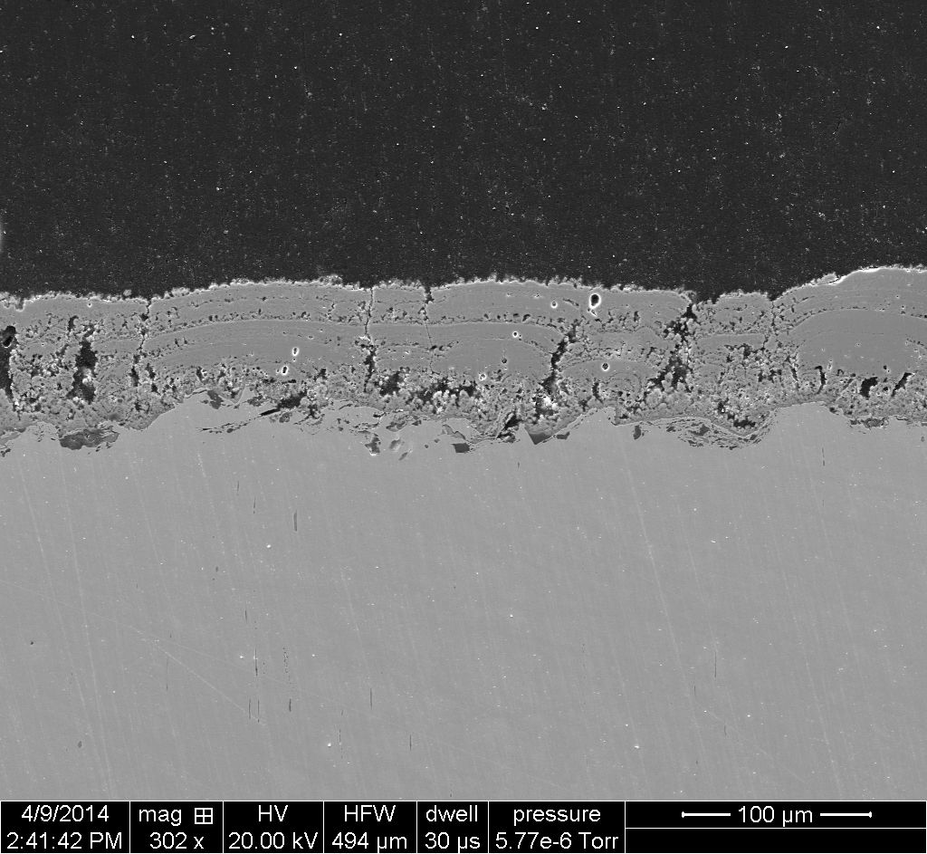
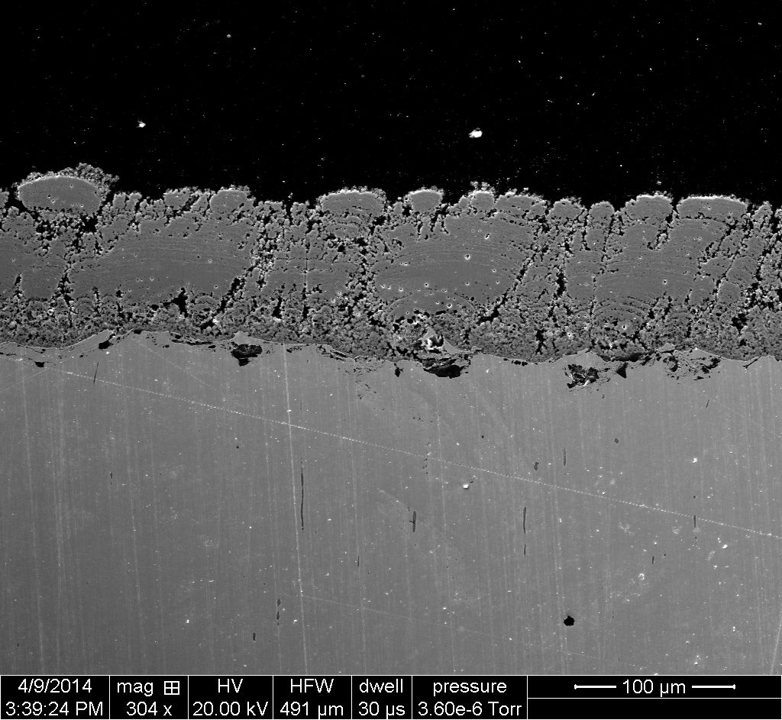
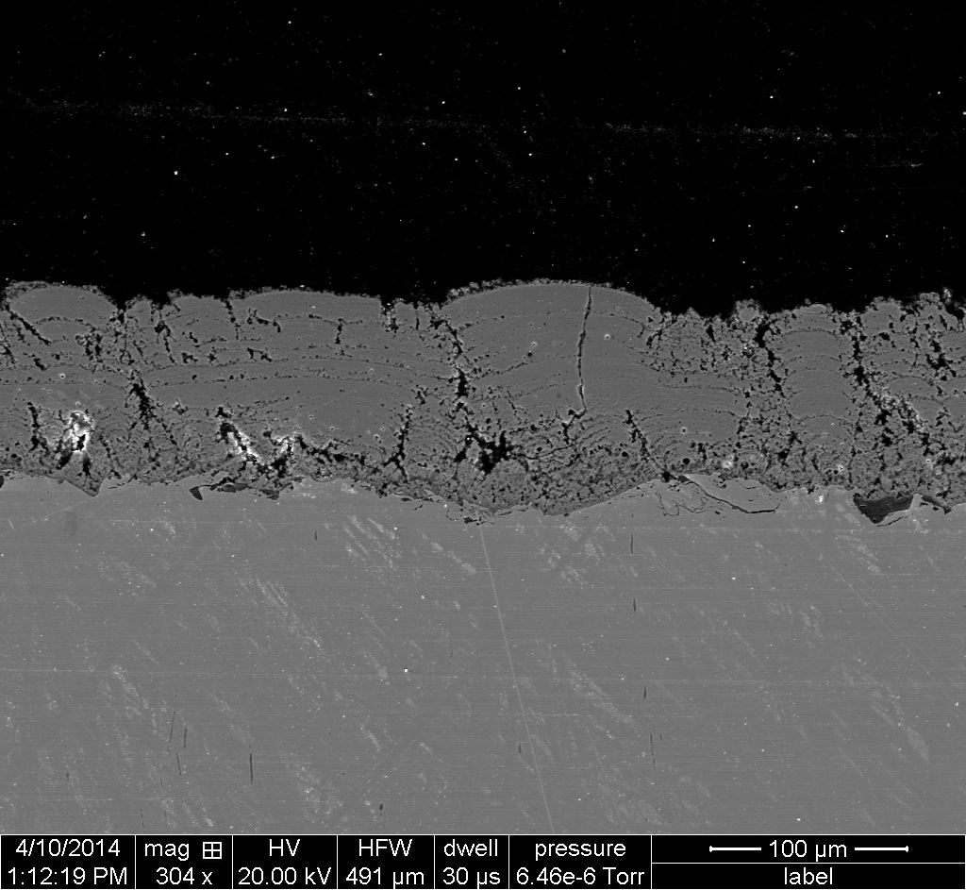
SPPS YAG TBCs: Effect of Precursor Concentration
SPPS YAG 5 wt% urea, 1.375”, on SS.
SPPS YAG 5 wt% urea, 10% H2O dilution, 1.375”, on SS.
SPPS YAG 5 wt% urea, 20% H2O dilution, 1.375”, on SS.
Increased Precursor Dilution Produces Denser Harder TBCs

Slide 60
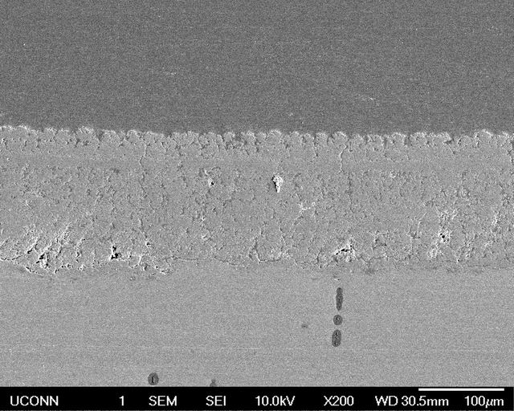
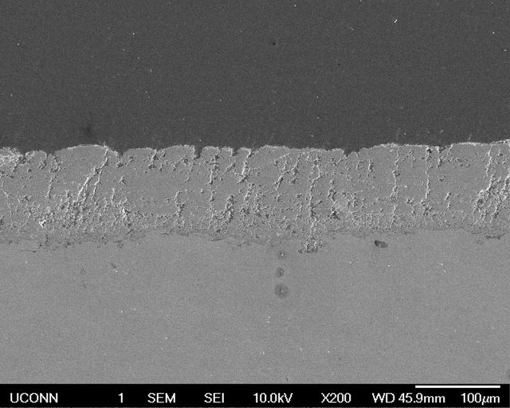
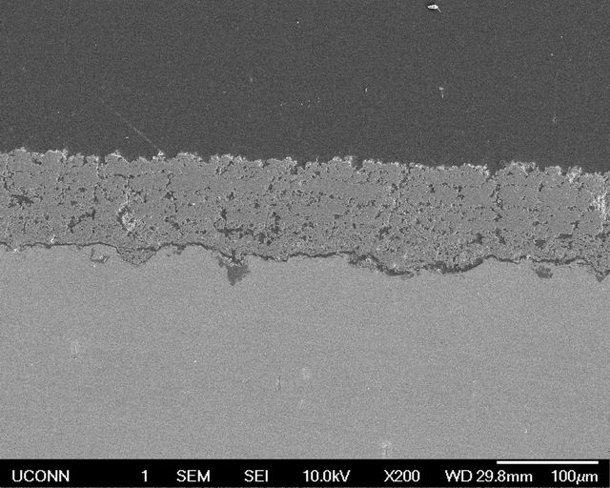
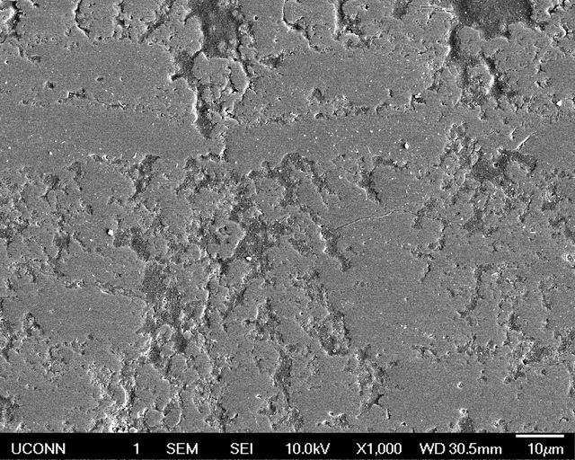


Addition of Polyvinyl Alcohol (PVA)
YAG, η= 5.9
YAG+1 wt% PVA low MW, η= 7.5
YAG+1 wt% PVA high MW, η= 10.3
Increased precursor viscosity with PVA addition

Slide 61
Addition of Polyvinyl Alcohol (PVA)
No PVA
Spray distance
Spray distance
Spray distance
Adding PVA increases the microhardness, low MW PVA is more effective (spray distance 1.25”, 1.375”, 1.425”, 1.5”)

Slide 62



Changing Atomizing Pressure

Slide 63
Increased Spray Distance at Lower Atomizing Pressure
SD = 1.375” 1.425” 1.5” 1.625”

Slide 64

APS YSZ Baseline Samples
APS YSZ 13v/o Porosity
HVOF MCrAlY Bond Coat
Haynes 230
Ni-Base Alloy

