Slide 1
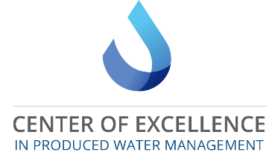
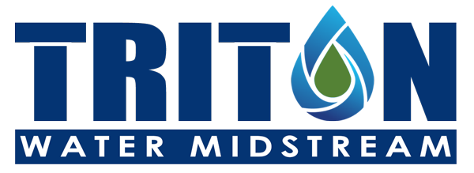
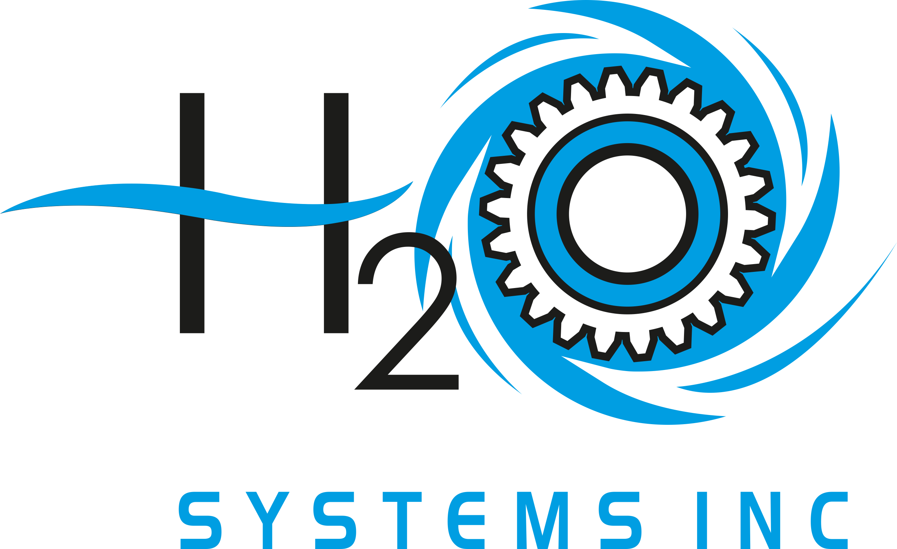

Resource Recovery and Environmental Protection in Wyoming’s Greater Green River Basin Using Selective Nanostructured Membranes
DE-FE0031855
Dr. Jonathan Brant, Dr. Stefan Heinz (UW)
Mr. Thomas England (Triton)
Mr. Vaughn Jones (H2O Systems)
February 13, 2020. DOE Kick-Off Presentation

Slide 2
Task 1
Project Management and Planning
Jonathan Brant (UW)

Slide 3
Project Team
2 Faculty at UW
Jonathan Brant: Tasks 1-3
Stefan Heinz: Task 2
H2O Systems Team
Vaughn Jones: Tasks 2-3
Aaron Worlie: Task 3
Triton Water Midstream Team
Thomas England: Task 3
MS/PhD Students at UW
Seyed Mahdi: Tasks 2-3
Pius Jjagwe: Task 2
To be hired: Task 2
Other UW Research Team Members
Thomas Johnson: Task 3

Slide 4
Project Goals and Objectives
This project will develop a working prototype of a two-part affinity based membrane separation process for recovering hydrocarbons, and separating particulates and organics, from produced water originating from the Greater Green River Basin in Wyoming. To this end we will:
Synthesize superhydrophobic/oleophilic and superhydrophilic/oleophobic membranes to achieve high flux/selectivity for BTEX/oil and water filtration while being resistant to fouling from particulates and organics representative of GGRB produced waters, respectively.
Design and manufacture membrane spacers and channel geometries optimized for phase separation/recovery in spiral wound membrane element configurations.
Execute a techno economic assessment (TEA) of the implementation of the proposed membrane process in the GGRB to include economic benefits from resource (BTEX/oil) recovery, water savings, and reduced treatment costs.
Deliver two membrane prototype modules for BTEX/oil recovery and water filtration.

Slide 5
Project Schedule
Key Dates:
Project Start – Jan 1, 2020
Project End – Dec 31, 2021

Slide 6
Project Budget
 | Budget Period 1 |  | Budget Period 2 |  | Total
 | DOE Funds | Cost Share | DOE Funds | Cost Share | DOE Funds | Cost Share
Applicant | $746,743 | $0 | $459,520 | $0 | $1,206,263 | $0
H2O Systems | $6,700 | $155,000 | $6,400 | $85,500 | $13,100 | $240,500
Triton Water | $0 | $40,000 | $0 | $19,500 | $0 | $59,500
Total ($) | $753,443 | $195,000 | $465,920 | $105,000 | $1,219,363 | $300,000

Slide 7
Anticipated Products & Deliverables
Products
Deliverables
Project Management Plan
Data Management Plan
Final Project Report
Superhydrophobic/oleophilic membrane prototype
Superhydrophilic/oleophobic membrane prototype
Produced water characterization results for GGRB
TEA for BTEX/oil/water recovery process in GGRB
View from the Outside – Knowledge generated on relating membrane properties to selective phase permeation will advance the development of “smart” membranes for targeted resource recovery.

Slide 8
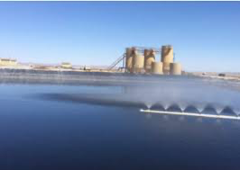
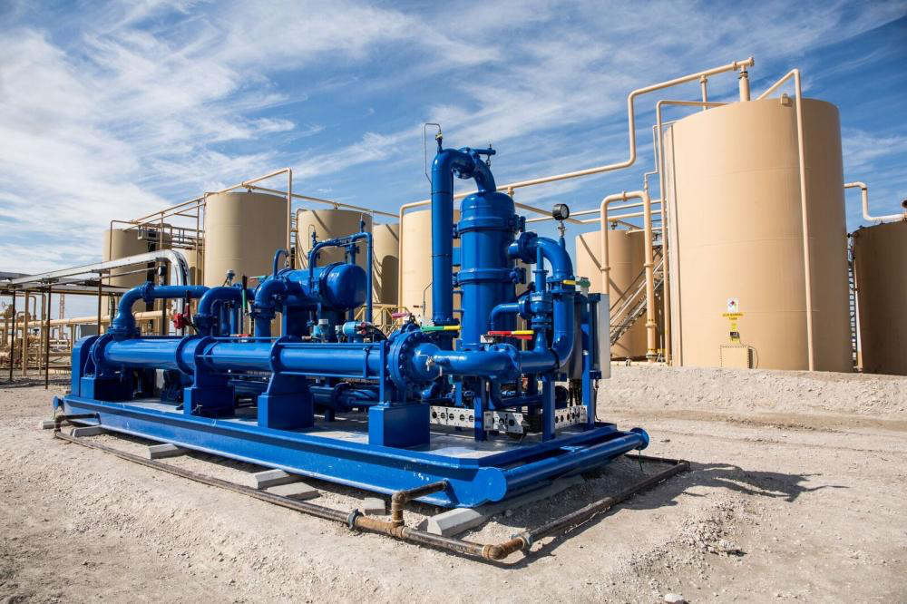
Research Challenges & Knowledge Gaps
Water
VOCs
Hydrocarbon recovery via separators is incomplete leaving VOCs/free oils to persist in PWs moved to pits
  VOC concentrations in GGRB ~ 0.06 to 5.1 lbs/bbl
VOC emissions are problematic from an environmental perspective & BTEX/oil represents lost revenue
PW
Oil

Slide 9

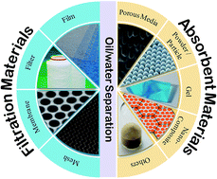
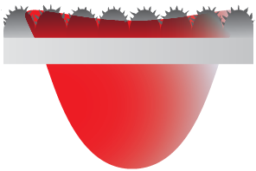
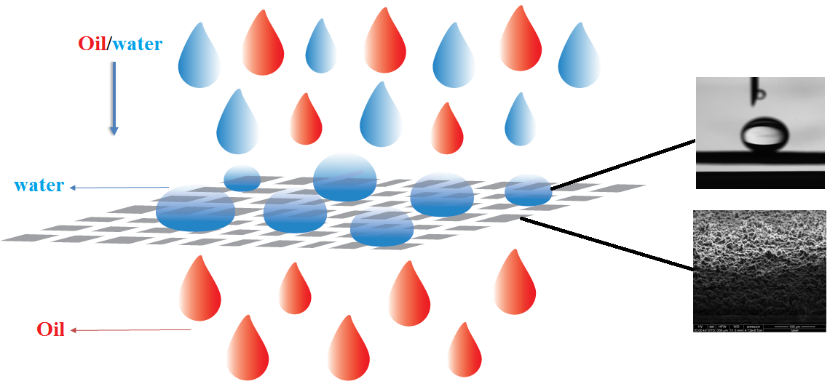
Research Challenges & Knowledge Gaps
*Image Credit: Gupta et al. 2017
Conventional separations plagued by inefficiencies related to non-selectivity and inability to target dispersed fractions.
Development of “smart” membrane materials reduces fouling and achieves high selectivity for target phase.

Slide 10
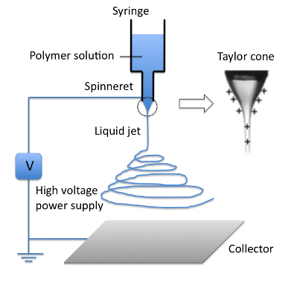
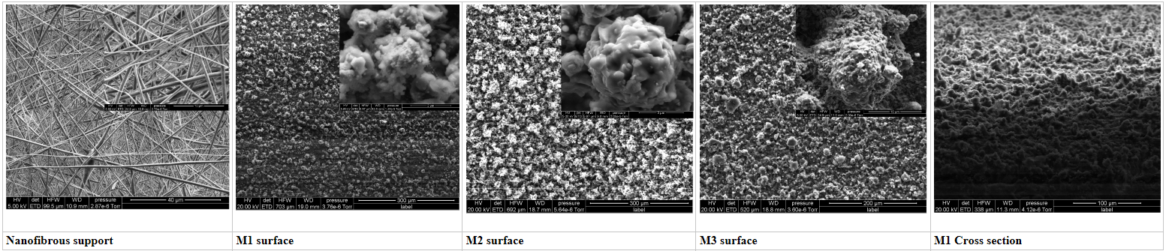
Research Challenges & Knowledge Gaps
Challenge – creating membrane modules / elements using electrospun membranes while optimizing process hydraulics and maintaining separation efficiency
Solvent, Nanoparticle, Polymer Solution
Using interfacial chemistry, the selectivity of the membrane is tailored through selection of appropriate nano-surface coating(s).

Slide 11
Task 2
Membrane Synthesis and Performance Assessment
Jonathan Brant (UW)

Slide 12
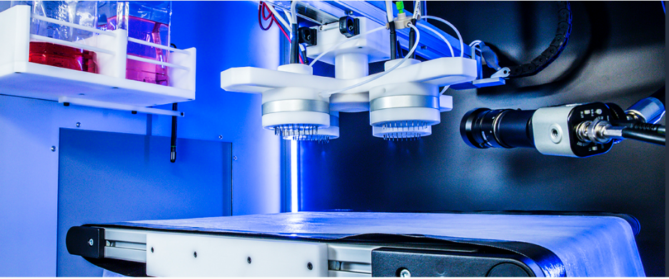
Membrane Fabrication
Superhydrophobic membranes made coating PVDF nanofibers w/ nano-carbon black
  Spinning/spraying conditions manipulated to optimize fiber size → liquid entry pressure
  Surface coatings explored for enhancing non-aqueous phase adhesion to fibers (enhanced permeation)
Superhydrophilic membranes made using polyacrylonitrile
Synthesis conditions optimized for roll-to-roll production required for prototype construction

Slide 13
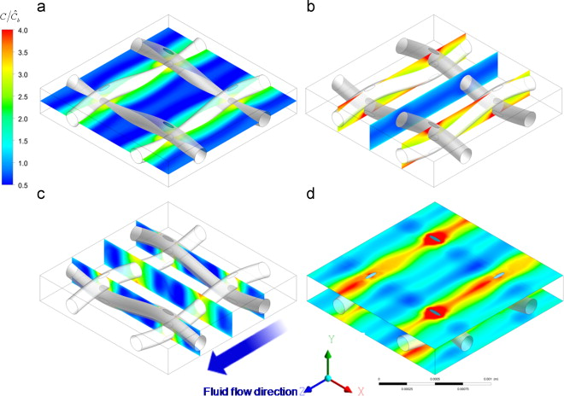
Membrane Performance Testing
Performance evaluated using model and field collected PW samples from the GGRB
  Performance = flux, selectivity (rejection), and fouling (performance degradation w/ time)
Water samples analyzed for TDS, particulates, BTEX, organics, and O&G
Feed/permeate spacer design optimized for mass transfer in respective channels
  Spacer design optimized through CFD modelling
  Spacer construction done using 3D printing
Image Credit: Gurreri et al. 2014.

Slide 14
Task 3
Design and Construction of Hydrocarbon Recovery Membrane Prototype
Thomas England (Triton)

Slide 15
TEA of Water and BTEX/Oil Recovery in GGRB
Input data (PW WQ, existing PW management costs) collected from existing management facilities in the GGRB (operated by H2O & Triton)
Contemplate both economic profitability and market analysis
Membrane Prototype Design and Construction
Spiral wound configuration w/ approximate dimensions of 2.5×21 in
Housings are commercially available FRP
Channel dimensions and spacers optimized based on findings from Task 2

Slide 16
Project Milestones & Success Criteria
Task/ Subtask | Milestone Title & Description | Planned Completion Date | Verification Method
1.1 | M1 - Project Management Plan | 01/30/2020 | PMP is received by the DOE Project Manager
1.2 | M2 – Technology Maturation Plan (TMP) | 09/01/2020 | TMP is received by the DOE Project Manager
1.3 | M3 – Data Management Plan (DMP) | 01/30/2020 | DMP is received by the DOE Project Manager
2.2, 2.3, 3.1 | M4 – Water samples collected & characterized from 4 distinct stations in GGRB (70% of total sites) | 09/01/2020 | UW summarizes and reports PW WQ data to H2O/Triton for TEA & use in initial phase membrane performance analyses
 | M5 – Continuation Application | 09/01/2020 | Continuation Application is received by the DOE Project Manager
2.1 | M6 – Design of superhydrophobic & superhydrophilic membranes is complete | 12/31/2020 | UW reports bench-scale performance and characterization analysis data on membranes (final design and iterations) to match with prototype requirements
2.4 | M7 – Completion of CFD modelling for membrane spacers & channel height | 04/01/21 | Dimensions (AUTOCAD files) and geometry of spacers/flow channel reported to PI and Triton
3.1 | M8 – TEA of BTEX/oil recovery process complete | 12/31/2021 | H2O/Triton reports TEA to UW/DOE
3.2 | M9 – Membrane prototype design and construction complete | 12/31/2021 | UW presents prototype design and performance specs to DOE Project Manager

Slide 17
Current Activities
Submitted PMP and DMP
RFP submitted for bidding for the pilot-scale electrospinning/spraying system
Working with H2O/Triton to finalize PW sampling locations in GGRB
Continuing work on optimizing electrospinning/spraying conditions for hydrophobic/hydrophilic membranes
Initiated CFD modelling construct for feed channel spacers

