Slide 1

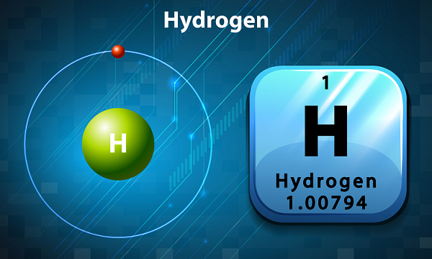


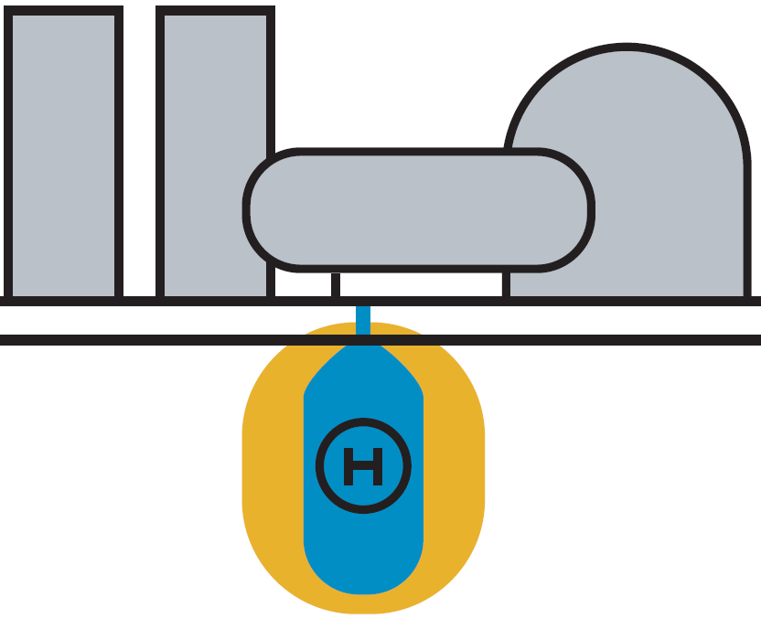

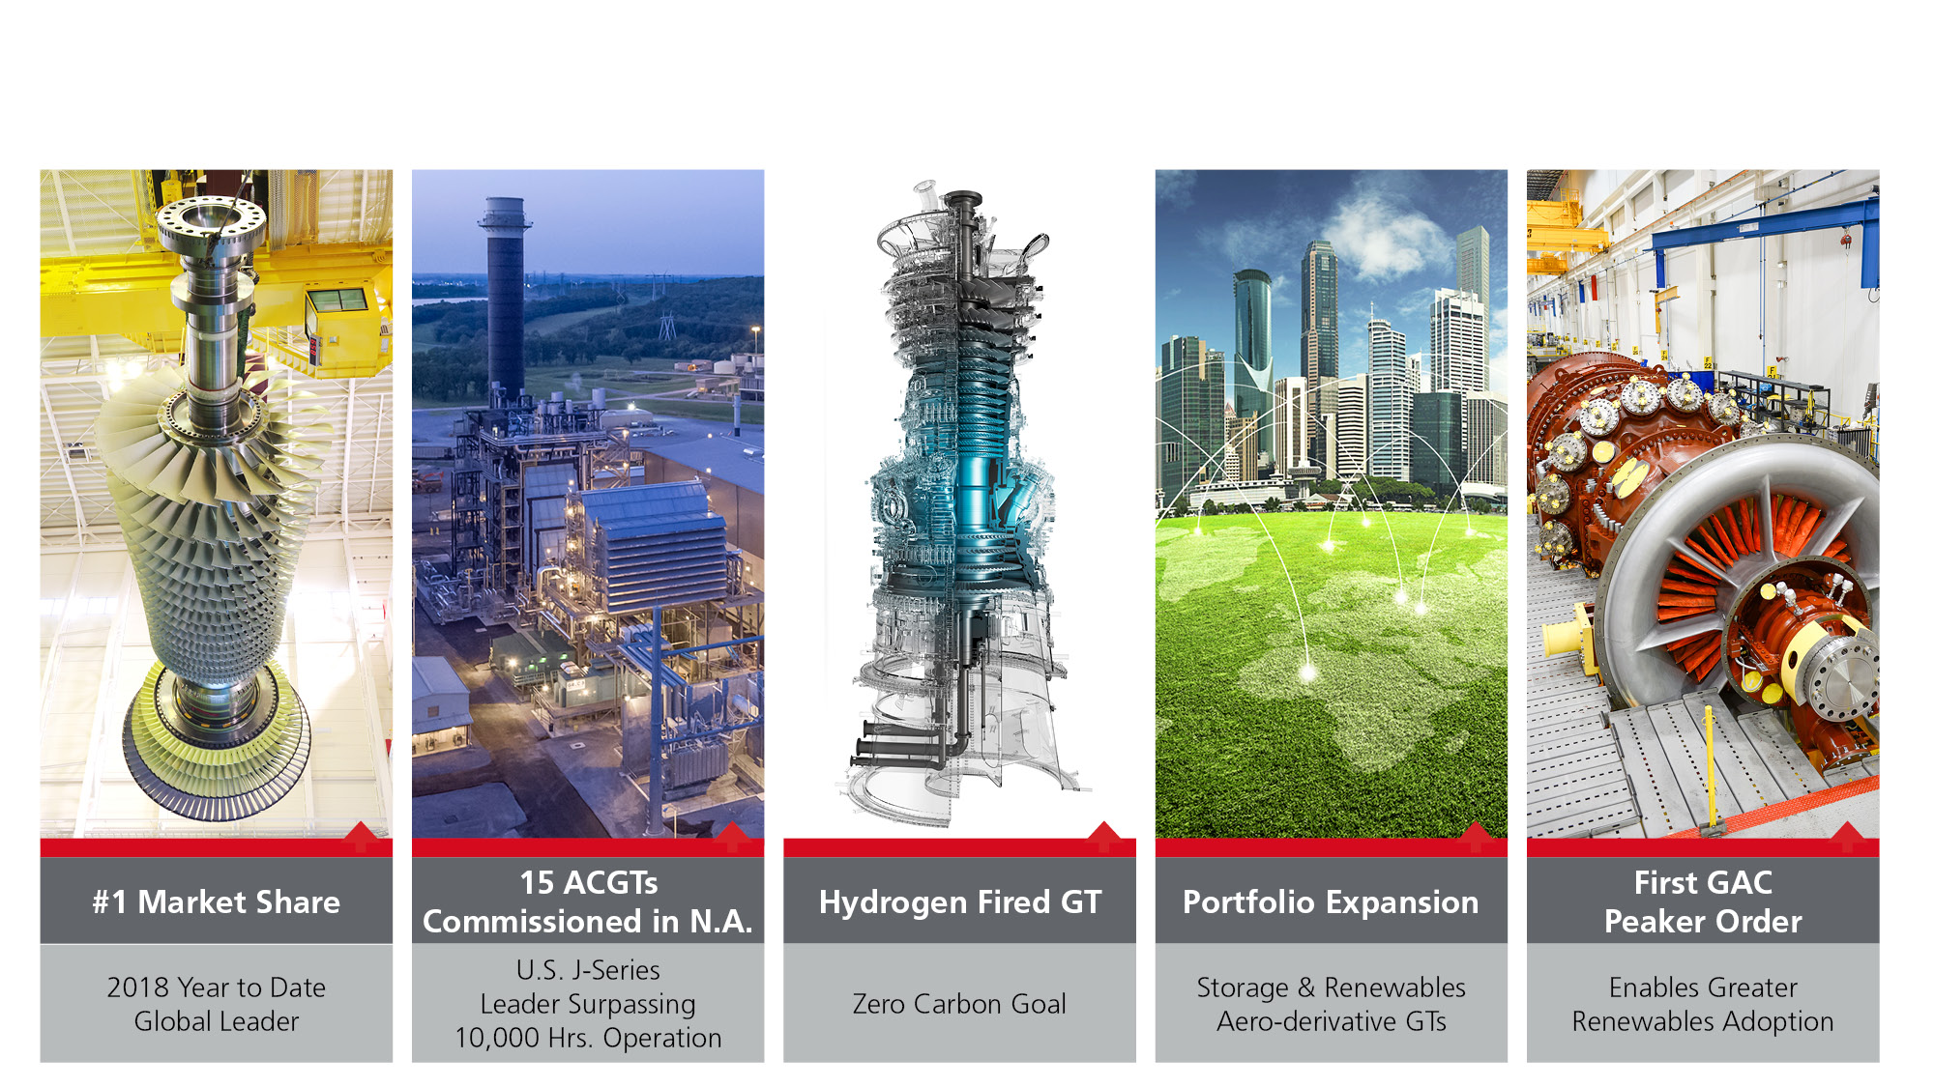
UTSR Panel Discussion
Large Scale Energy Storage
Michael J. Ducker
Senior Director, New Business Ventures
November 5th, 2019

Slide 2
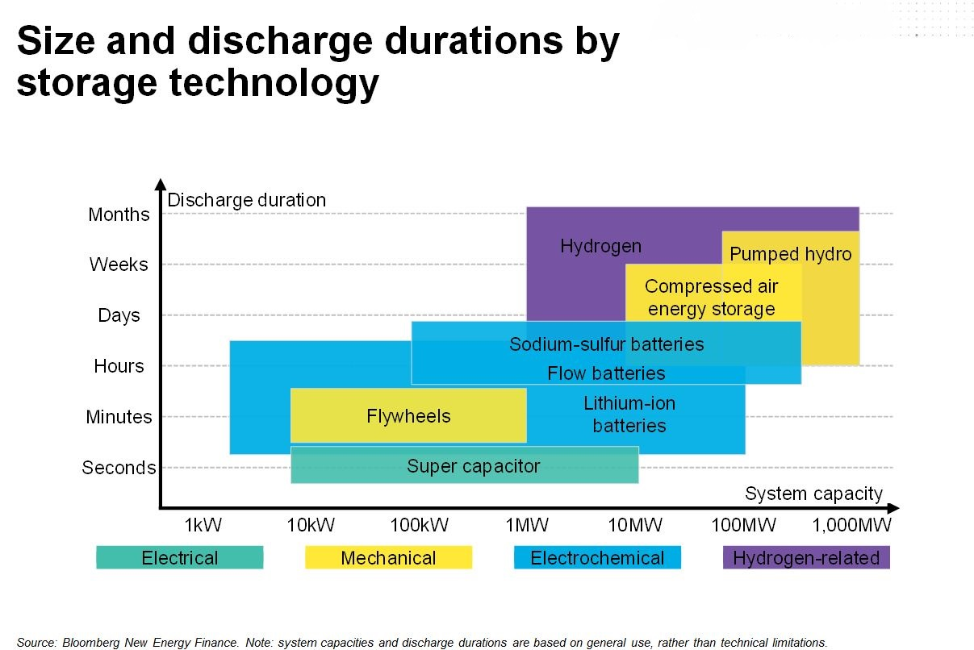
H2 super bulk storage

Slide 3
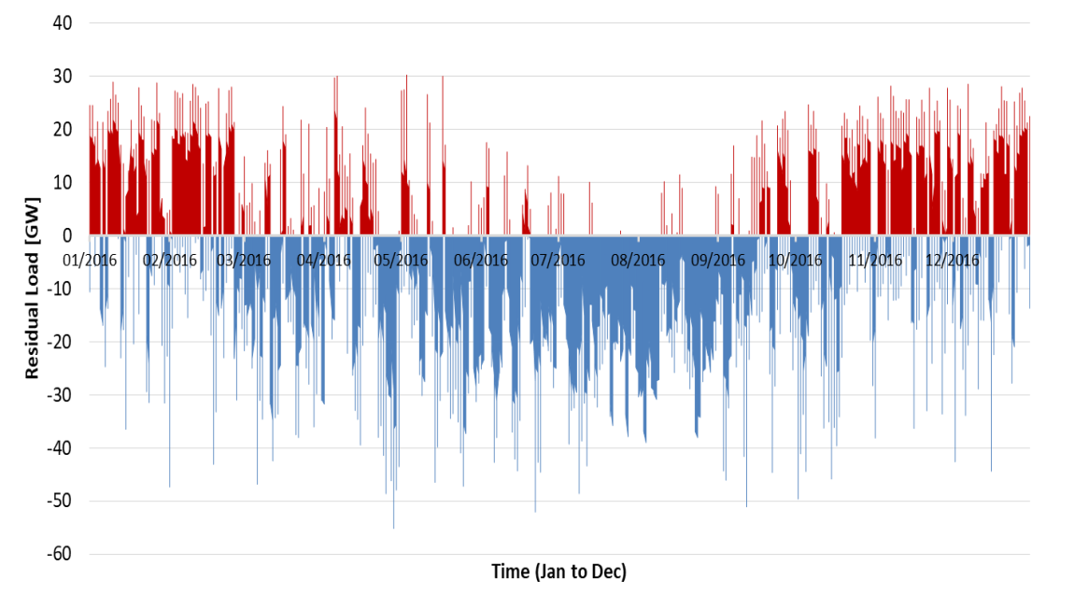
High Renewable Penetration Requires Long Duration / Seasonal Storage
Recent 1-Year Simulation of 100% Renewable Grid in CA
Wind dominant case (37 GW solar capacity, 80 GW wind capacity)
Over 10 days of Deficit
Deficit
Surplus
National Fuel Cell Institute, CPUC Workshop 24 May, 2019
Lithium Ion Suitable for “Intra-Day Shifting”
H2 Storage clear solution for “Inter-Day” and longer duration
2030 LCOE ($/kWh)
-40.4%
1,460
3,970
4 Hour Storage
8 Hour Storage
24 Hour Storage
10 day storage
30 day storage
Lithium Ion
Hydrogen

Slide 4

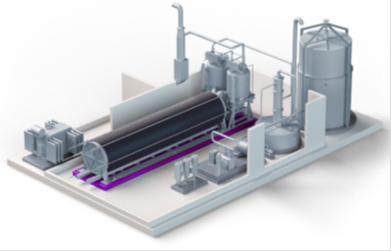
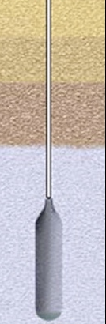

ACES Project
Water Treatment
Electrolysis
Building blocks of approx. 20MW / 360 kg/hr each
Verticals (Users)
Power GT, Fuel Cell, CAES, other
Pipeline Injection
Industrial Gas
For CAES
Energy Supply
Solar
Wind
Hydro
Geo-thermal
Nighttime thermal sources *
Other
Compressed Air
Solar most likely augmented with wind and potentially other sources to improve utilization of Electrolysis and Compression equipment
Air
H2
One cavern can hold approx. 5 million kg H2

Slide 5
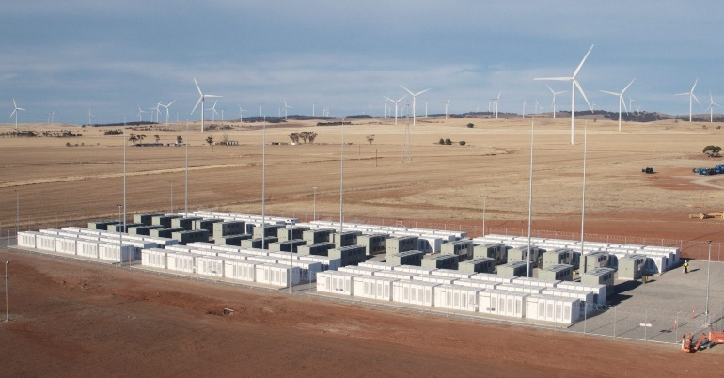

A Single Cavern Stores a Massive Amount of Energy
1 Cavern 5 million kg of H2
Used in an efficient Gas Turbine Combined Cycle 100,000 MWh
That is equivalent to…
775 X
Tesla’s Hornsdale project
100 MW/129 MWh
128 X
Energy storage capacity deployed in the US in 2018 (777 MWh)

Slide 6
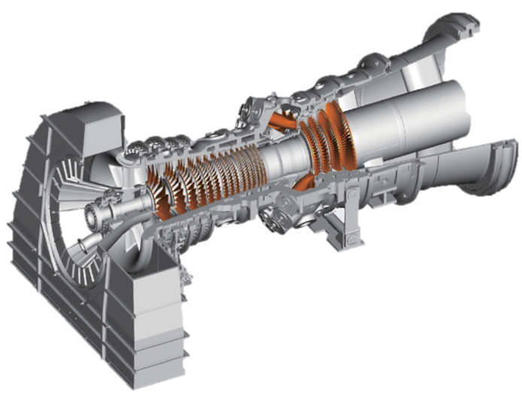
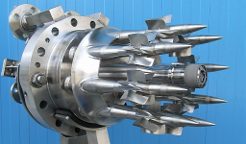
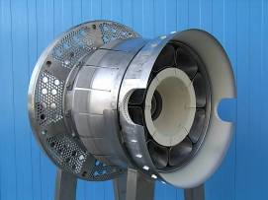
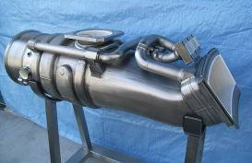
Converting to Hydrogen Gas Turbines
Limited modification required
Modification is limited to the combustor in order to realize Hydrogen GTs in the quickest and most efficient approach
Combustor
Control system
Fuel line
Nozzle
Swirler
assembly
Liner

Slide 7
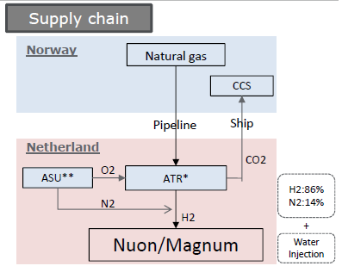
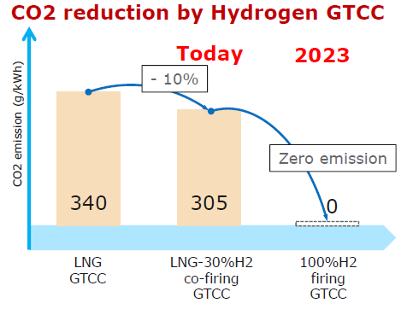
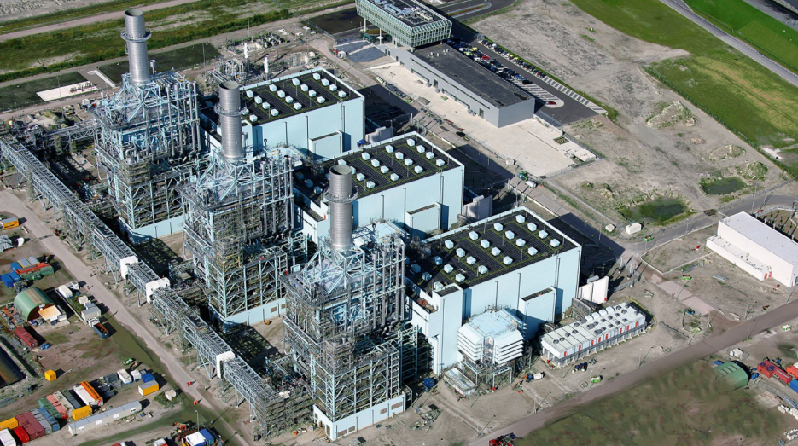
Hydrogen Gas Turbines: A De-Carbonization Enabler
Today, MHPS’ large-scale high efficiency GTCC’s can be fueled by 30% H₂ mix
By 2024, MHPS will have the world’s 1st 100% H₂-fired GTCC in operation @ the Vattenfall/Nuon Plant in the Netherlands
  440 MW
  701F-class GTCC
Today
2024

