Slide 1
Power Generation with Integrated Large-Scale Energy Storage Juan Lopez Director of Solutions Business Development
siemens.com
© Siemens AG 2019

Slide 2
Flexibility is the only way to future-proof generation
Solar
Demand
Wind
Demand
Generation Balancing
Traditionally
Load was relatively predictable
Renewable integration was limited
Majority of generation from dispatchable units
Modern grid
Renewable penetration continues to increase
Peaks are out of sync
Fast, flexible resources required to balance grid

Slide 3
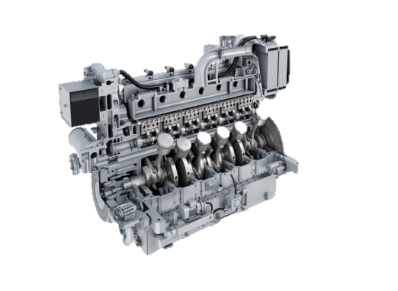
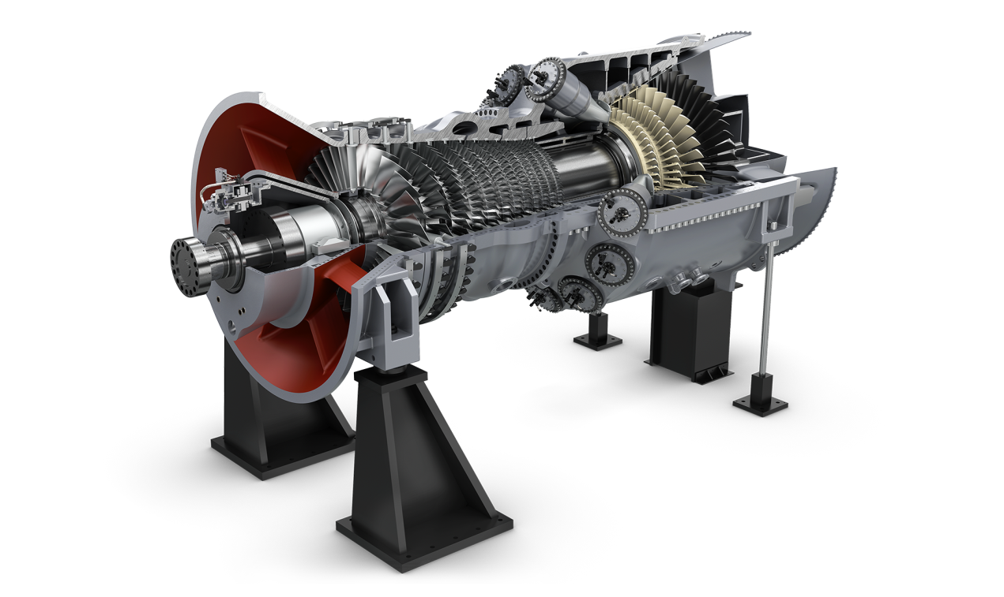
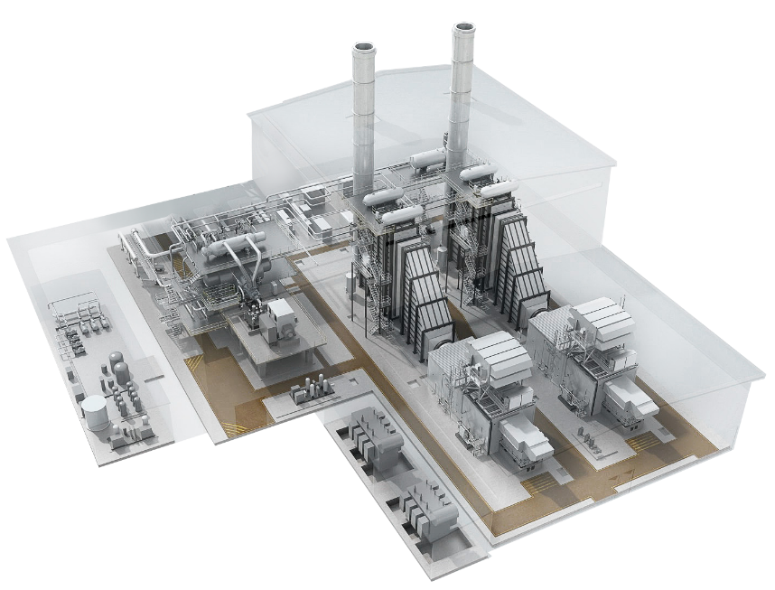
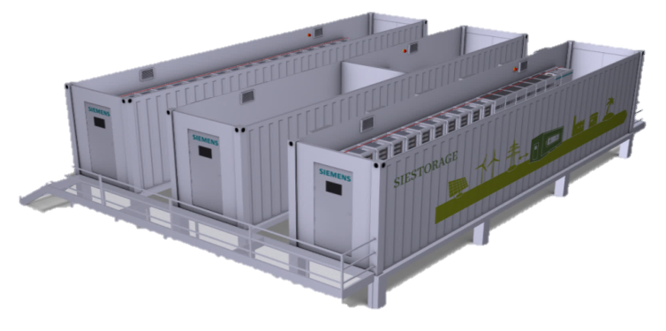
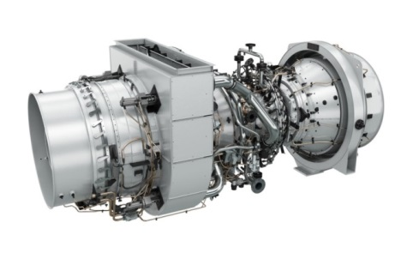
SynerGen Technologies Leveraging strengths via hybrid solutions

Slide 4
Integrated energy storage enables market participation through grid support and ancillary services
Power
Spinning Reserve
Frequency response PFR + SFR
Plant max. load
Fast start, response within < 1s
Fast ramp-up and ramp-down support
Fast start,
stress reduced
Min. environ- mental load
Black start
SynerGen Hybrid Solution operation line
Plant operation line
Time
Black start and support of grid restorage
Fast start-up
Primary frequency response
Secondary frequency response
Acceleration & stabilization of load ramps
Operating reserve for peak power
Minimum load
Islanding off-grid

Slide 5
SynerGen Use Cases – Battery storage + gas-fired generation
Cost Reduction
Plant Capability
Revenue Generation
Extended Turndown
Charge the battery with GT at min load to reduce power supplied to grid
Fast Ramp
The battery can deliver full output in milliseconds to ramp quickly
Resource Adequacy
Battery can deliver additional energy capacity to the grid to maximize revenue.
Minimize Duct-firing
Replace duct-firing with battery – reducing fuel consumption and emissions generated
Grid Balancing Services
Provide grid balancing services by delivering or consuming MWs and VARs.
Energy Arbitrage
Charging the battery during off-peak periods and discharging during on-peak periods.
Black start
Battery provides power to start gas turbine with no external (grid) power supplied.
Ammonia Reduction
Keep GT at steady-state to minimize transient emissions
Fast Start
Battery output is available immediately, bridging the gap between grid demand and gas turbine start-up
Spinning Reserve
Battery is synced to grid and provides output instantly while GT is starting up
Avoid start-up costs
Replace low load / short duration GT starts with the battery resulting in reduced start-up costs, fuel consumption and emissions
Adaptability
Enables plant to diversify capabilities and adapt to changing market conditions
Regulation
Instant battery ramp rate increases revenue from regulation market independent of GT operation.
Provide start-up loads
Supply start-up loads from battery to eliminate grid dependency and energy costs to start
Reliability
Increases plant / grid stability and availability optimizing plant operational performance
Enhanced Peaking
The battery provides power on top of GT output to meet a peaking need or respond to scarcity pricing.

