Slide 1
University Turbine Systems Research
Panel Discussion
Power Generation with Integrated Large - Scale Energy Storage
Florida Power Electronics Center
University of Central Florida
Issa Batarseh
Nov. 5, 2019

Slide 2
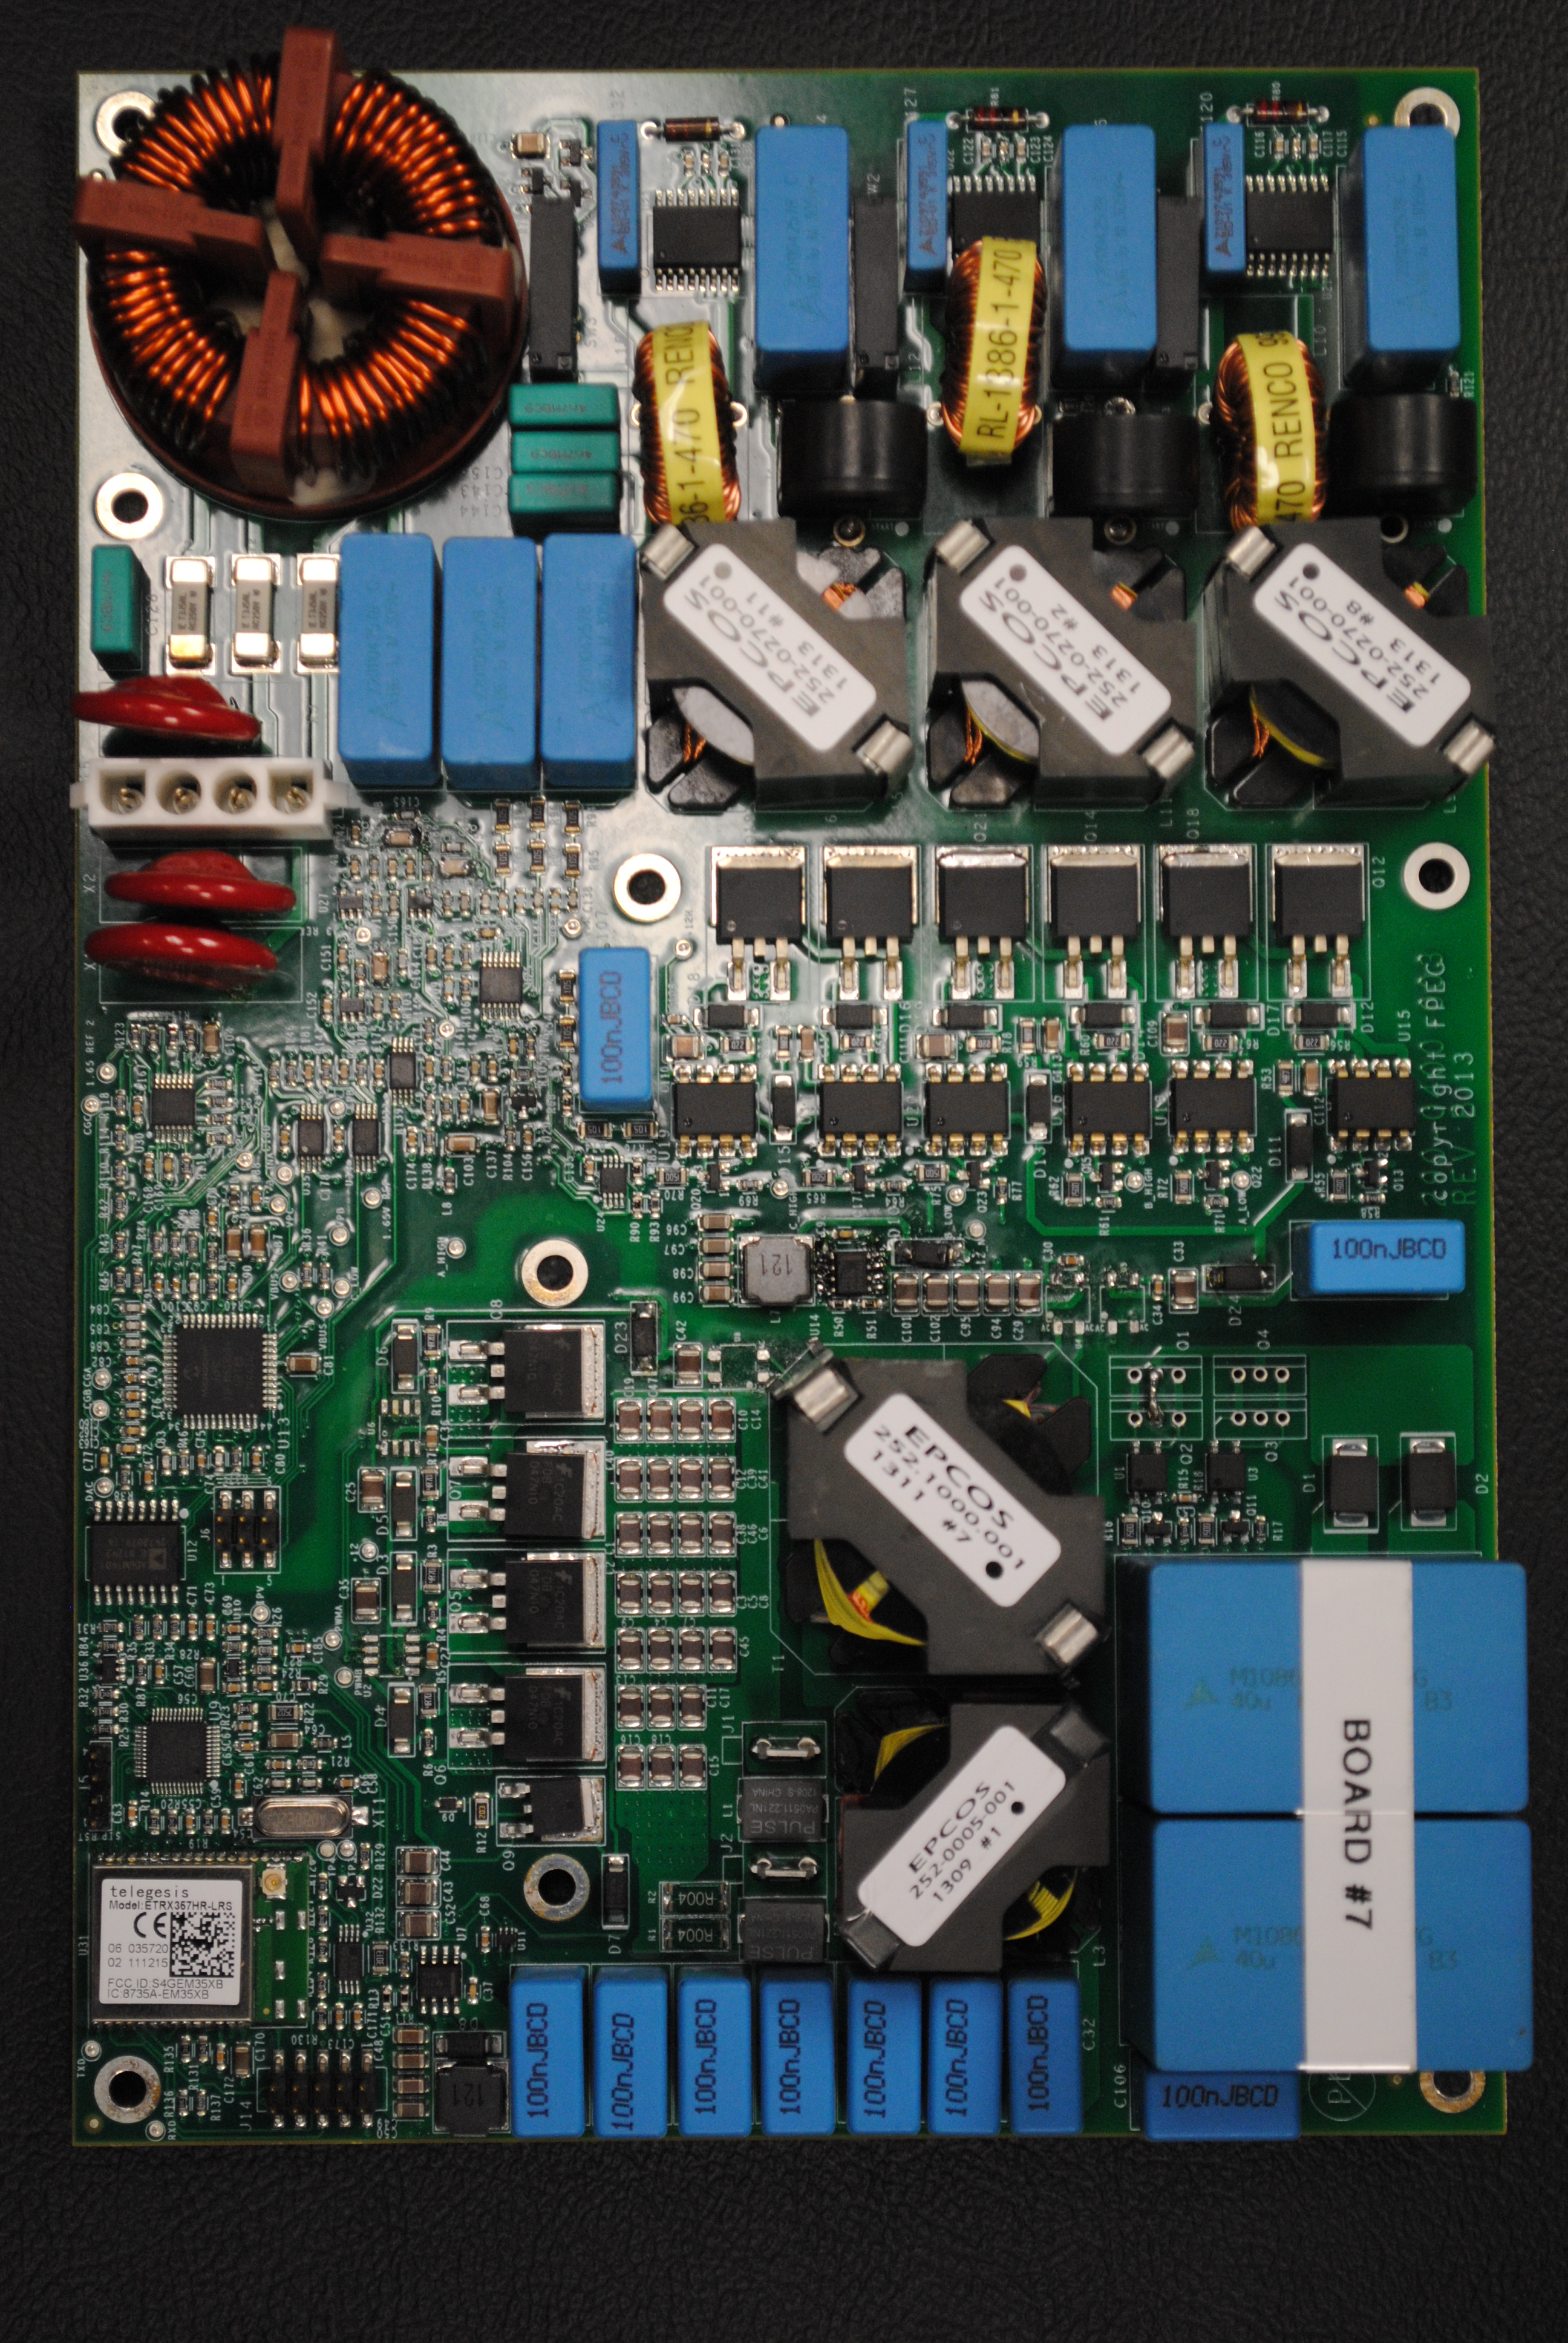
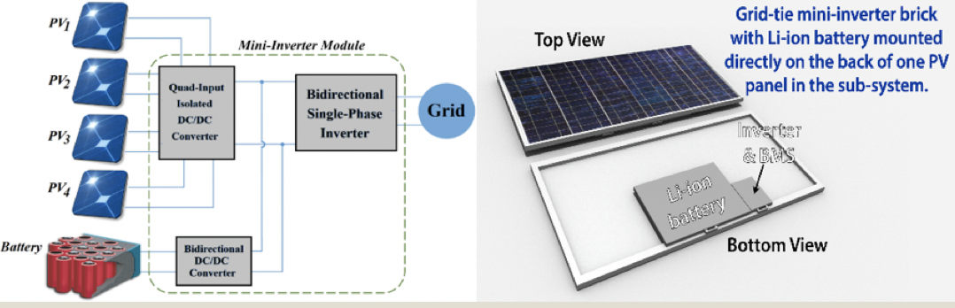

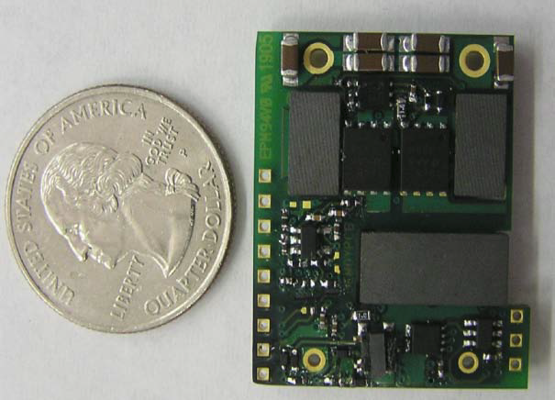
Florida Power Electronics Center (FPEC)
Research Focus: PV System contro, modeling, design and architecture with Storage Integration
The first to develop and commercialize micro-inverter from academia.
Designed and prototyped three-port converter with soft switching and high efficiency intended for space applications.
Developed the highest power density 1/16 brick DC-DC converters for Emerson.
Two successful spin-off companies: Petra Systems and APECOR.
AC-Battery
First 3-phase micro-inverters
First commercialized micro-inverters
Highest power density DC-DC designs
Three-port integrated inverter+storage

Slide 3

U.S. Electric Grid Today
Electrification .. Engine for global growth
100+ years of success
$1T investment
Reliable, dispatchable, affordable
Expanding…total U.S. electricity generation was 4.1T-kWh in ‘15
7,000 operational power plants
3,200 utilities, 60k substations.
850GW baseload, 1250 GW summer peak
642k miles of HV transmission lines, 6.2 million miles of distribution circuit
159 million customers.
Increasing NG and renewable generation (6.1% hydropower and 7.3% from wind and solar)
Sources: EIA, EEI, Babu Chalamala, Sandia National Laboratories

Slide 4
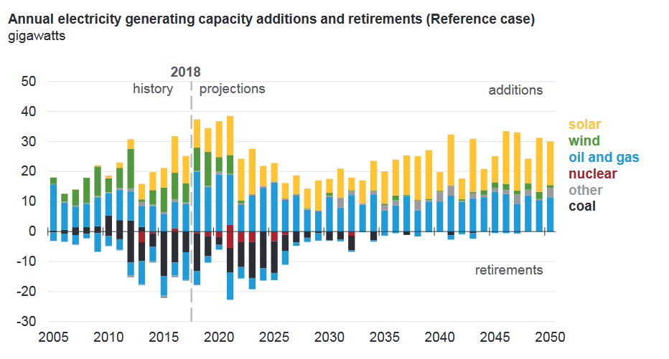
Grid Transformation is in the making
Capacity Additions and Retirements
Major grid infrastructure is aging
Accelerating retirements of coal
fired power plants
Coal-fired unit retirements driven by low NG prices.
T&D congestion starting to
impact deployment of renewables
In California, solar, storage and wind capacity additions expected to exceed NG by 2021.
Sources: EIA, EEI, Babu Chalamala, Sandia National Laboratories

Slide 5
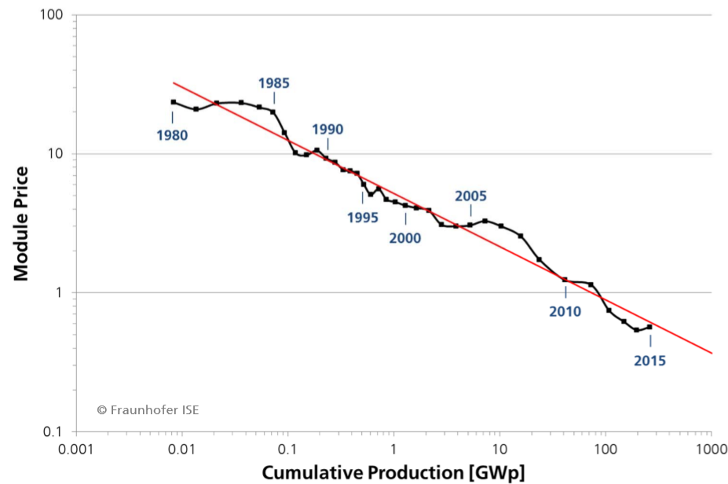
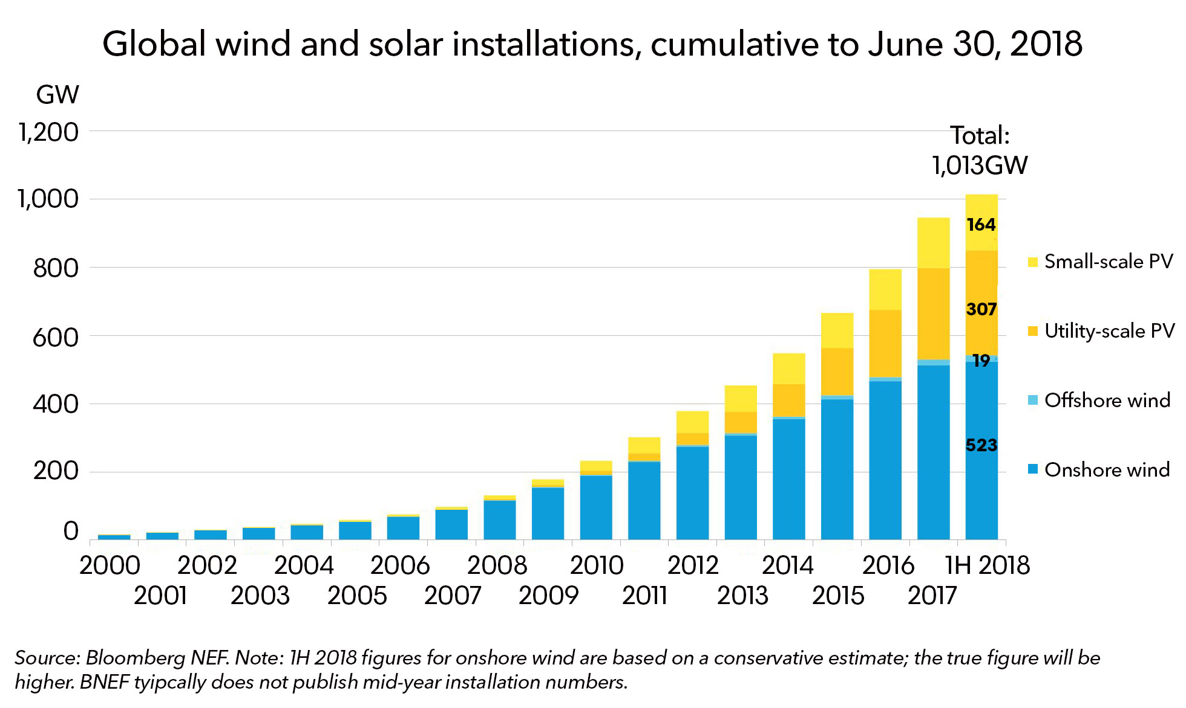
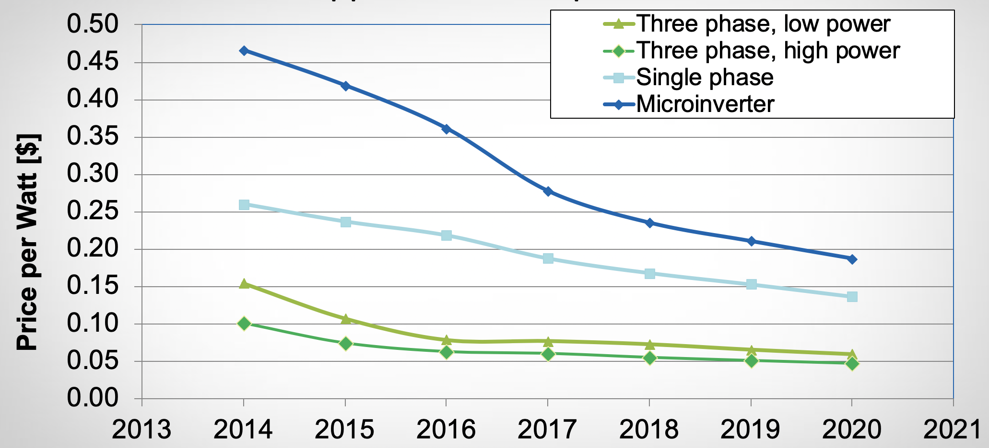
PV-Systems - Exponential technology
Sources: EIA, EEI, B. Chalamala, Sandia NL

Slide 6
Increasing Demand for Electrification
Major change in power electrification for transportation applications is approaching fast - potentially significant effect -
Projections for annual production of EV reaching 20 Million by 2030. With the potential EV fleet of 130M (mostly passenger vehicles) on road.
Electrification will drive demand growth, overloading distribution systems and causing transmission congestion. Total load may double!
Needs major T&D upgrades if EVs are mainly charged from the grid
There is also significant drive to electrify bus and other public transportation, and air planes soon after - EP!
Great opportunities for innovation in batteries, power electronics processing and conversion systems, new power charging infrastructure
Source: BNEF, IEA, 2018

Slide 7
Where the PV market heading ?
The Past (2010)
The Present (2017)
The Future (2025+)
Deployment
Integration
PV Module Prices
$2-$3/W $0.37/W $0.23/W
Global PV Generation
10+ TWh 300+ TWh 2000+ TWh
Global PV Installations
10+ GW 300+ GW 1000+ GW

Slide 8



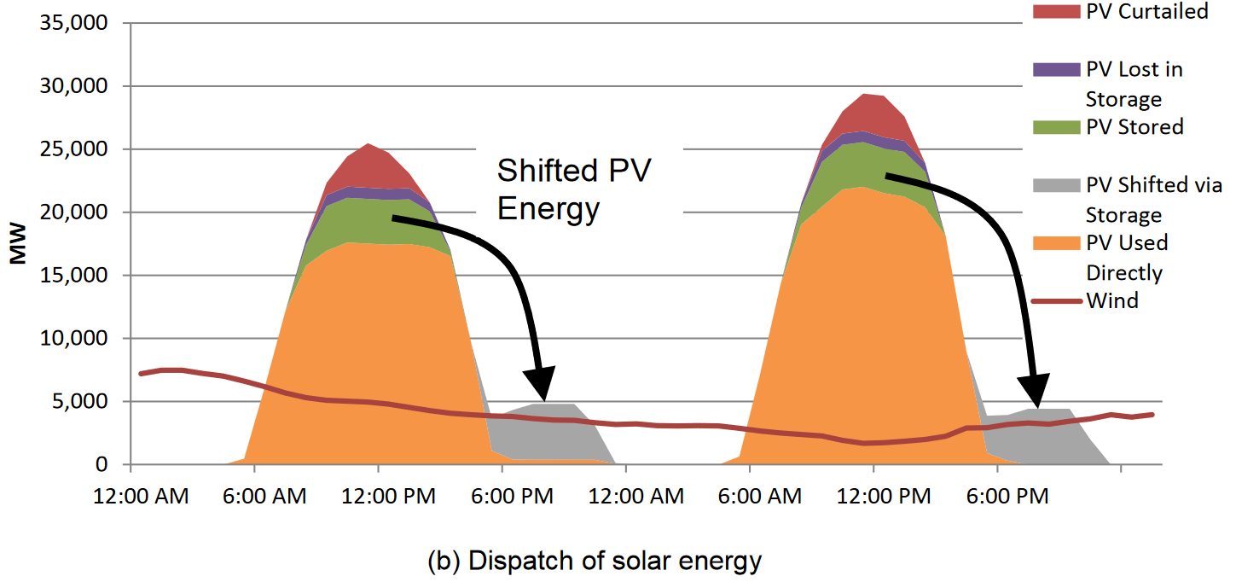
Role of Energy Storage in the Grid
The grid needs energy storage
Grid resiliency and reliability
Improving power quality - frequency regulation
Voltage support
Small signal stability
Capacity firming
Energy Arbitrage
Improving the efficiency of existing generation fleet
Demand management
Renewable integration
Transmission & Distribution upgrade deferral
Off-grid applications
Balance the variability of 825 GW of new renewable generation while improving grid reliability and efficiency.
Sources: B. Chalamala, Sandia NL

Slide 9
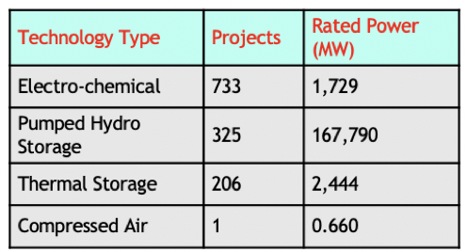
Energy Storage in the Grid Today
 | World Wide Production Capacity | Cost and Performance Improvements
Lead Acid Batteries | 350 GWh | 2%/year (30 year data). $80-150/kWh
Li-ion Batteries | 220 GWh and growing rapidly | 5%/year (20 year data). Cell level price reaching $150/kWh
NaS and NaNiCl | 300 MWh | Mature, but no economies of scale
Flow Batteries | <200 MWh | Potential for lower cost. $400/kWh. Reach $270/kWh
Alkaline chemistries (Zn-MnO2, Zn-air) | <100 MWh | Not fully mature. Lowest cost BOM
Globally, 1.7 GW Battery Energy Storage (BES) & ~170 GW Pumped Hydro
US deployed 0.7 GW BES, 22.6 GW Pumped Hydro Storage
Compared to need, the scale of ES deployments is insignificant
Grid-Scale Energy Storage still < 0.1% of U.S. Generation Capacity
In US, a 1 TW grid, even 1 hr of ES means 1 TWh
Market drivers:
Consumer electronics, mobile
devices and EVs – primarily Li-ion batteries
- Grid energy storage – growing
market, currently modest size.
Sources: B. Chalamala, Sandia NL

Slide 10
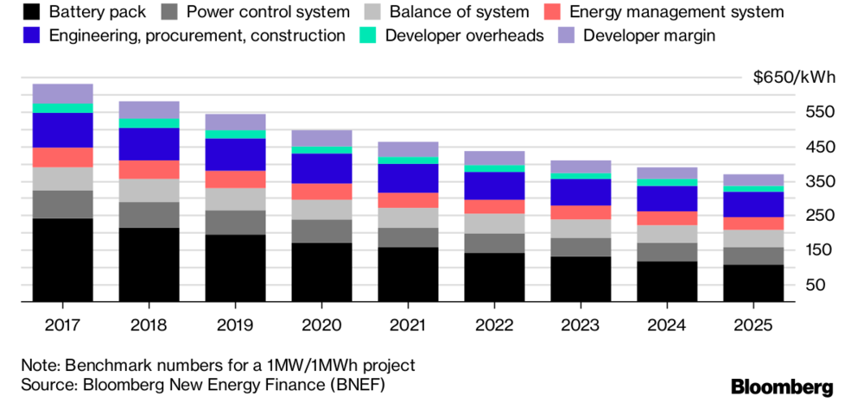
Today’s Barriers to high ES Penetration
Power Conversion System forms a significant part of the cost and performance of energy storage systems
Cell to Battery to a Storage System - Doubling in cost, $250/kWh battery leads to $500-$700/kWh at the System level
Complex installation and Expensive Value Chain
The current energy business model doesn’t pay for services enabled by storage
Battery Operation at high ambient Temperature

Slide 11
Increasing Role of Power Electronics in Future Power Grid Infrastructure
The PCS is at the center of distributed energy sources, energy storage, and EV infrastructure
Approximately 30% of all electric power currently generated uses power electronic circuits between generation to use.
As we make the energy infrastructure smarter, integrate more renewable energy sources, add storage, enrage the EV fleet, more power will flow through power electronics (Est. 80%).
Power electronic provides significant degree of control over how power flows in the system - It will solve the solar intermittence challenge.
Provide opportunity for optimized power supply with increased efficiency.
DC loads can be serviced with DC voltage directly – AC as well
Grid modernization can occur incrementally as more flexible power electronics get integrated

Slide 12
The Challenge for Power Electronics
.
For a future grid, we need significant cost reductions in power electronics, longer duration energy storage - technologies that can scale from microgrids to large transmission applications.
Many technologies that will fulfill requirements of the grid of the future are communication-intensive
Interface with modernized and communication-intensive grid devices/technology.
Coordinated participation of large numbers of small energy resources will require fast and reliable communications.
Improvement in safety and reliability of power converters and energy storage systems
Enable bidirectional power flows and stochastic loads by coordinated sensing and control infrastructure.

Slide 13
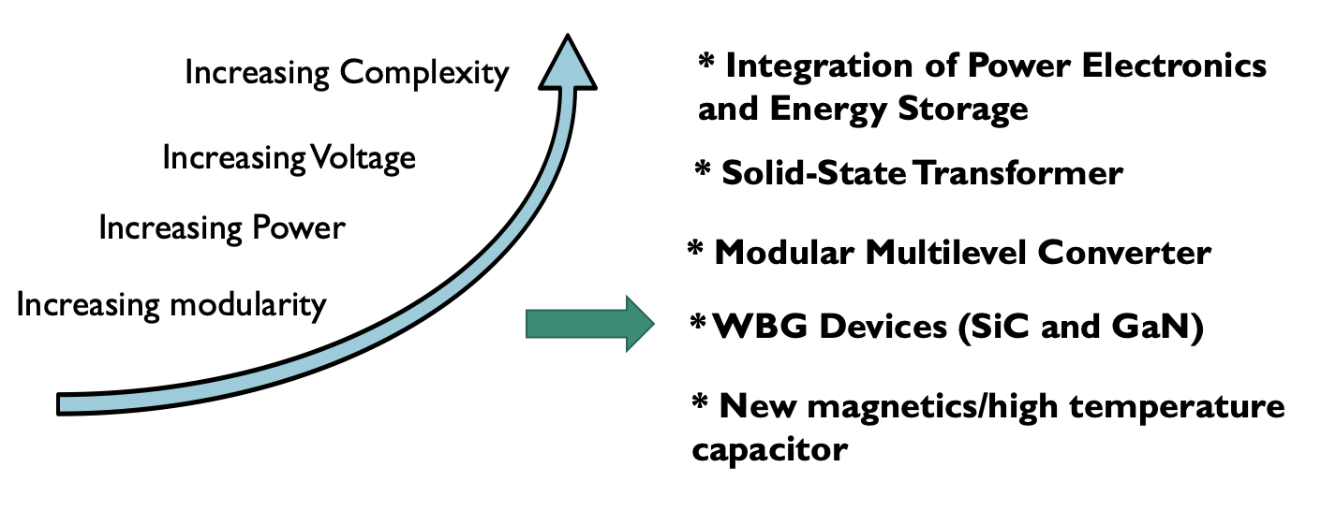
Power Electronics for Future ES
.
New materials, components, topologies and advanced control strategies are needed to introduce large-scale storage in MV grids and beyond

Slide 14
iPV⁺⁺ Module Block Diagram

Slide 15
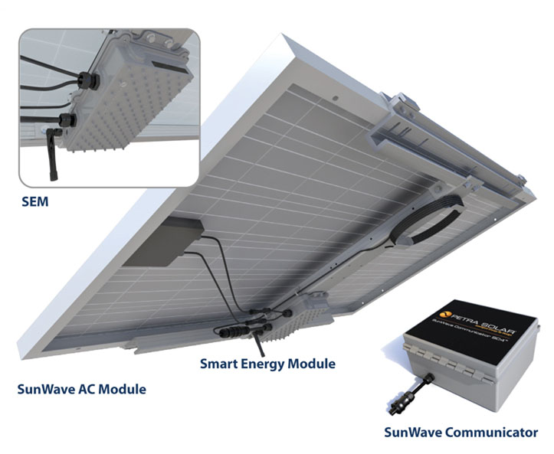
iPV⁺⁺: Integrated AC PV + Battery System
Mini-inverter
4-Panel input - DC/AC inverter
Battery pack @2.4 kwh
Two–Way wireless communications
Highly distributed network
Full grid-interaction
Revenue grade metering
Grid voltage sensors
Courtesy of Petra Systems/Solar
Notes:
Redraw the same panel but the back inverter is now iPV++ that covers bigger area.

Slide 16
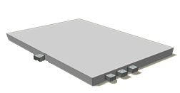
iPV⁺⁺ Module: Mini-inverter + Battery
Grid-tie mini-inverter brick with Li-ion battery mounted directly on the back of one of PV panel in the sub-system
Top view of PV panel
Grid compatible AC output
Sub-system PV panel connectors
Bottom view of PV panel

Slide 17
Thank you

Slide 18
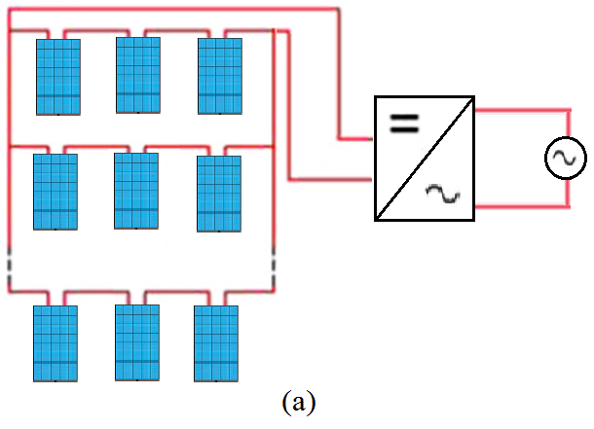
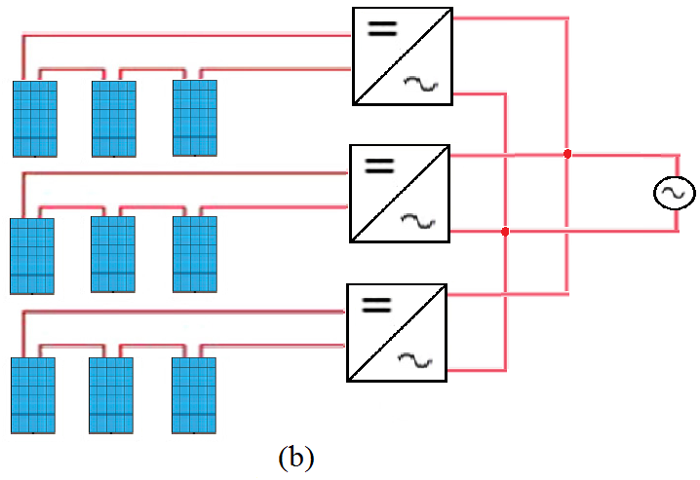
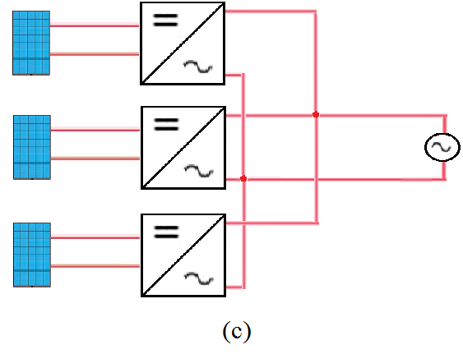
Main Inverter Commercial Architecture
The grid-connected PV system can be classified into centralized inverter, string inverter and microinverter .
Fig. 1. Solar-energy-harvesting approaches continue to advance from (a) central-inverter system to more distributed (b) string-inverter system and lastly (c) microinverters built into individual panels.

Slide 19
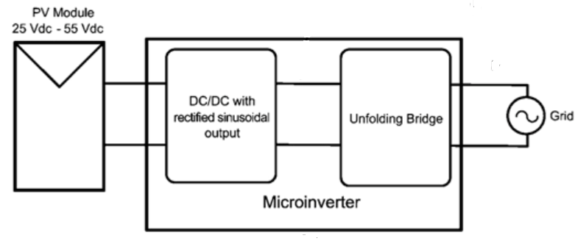
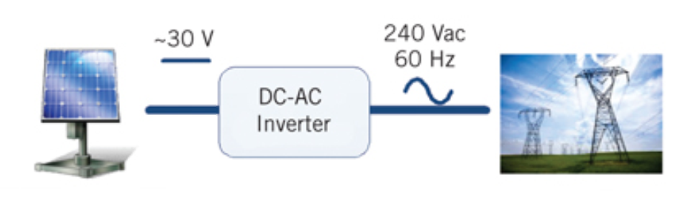
Micro-Inverter Topologies
Single-Stage Topology
The single-stage topology directly converts the power from the PV panel into a rectified sinusoidal waveform which is then converted to the required AC waveform by means of an unfolding circuit.

Slide 20
Micro-inverter Module Benefits
Safe
No high voltage DC
Smart
Monitor and control each panel
Reliable
No single point failure
Powerful
Maximum power for each panel
East to Install
Install & add one panel at a time
Simple
Flexible Design and installation
Modular
Scalable to any size installation

Slide 21
iPV⁺⁺: Integrated AC PV + Battery System
Mini-inverter
4-Panel input - DC/AC inverter
Battery pack @2.4 kwh
Two–Way wireless communications
Highly distributed network
Full grid-interaction
Revenue grade metering
Grid voltage sensors
Courtesy of Petra Systems/Solar
Notes:
Redraw the same panel but the back inverter is now iPV++ that covers bigger area.

Slide 22
iPV⁺⁺ Module: Mini-inverter + Battery
Grid-tie mini-inverter brick with Li-ion battery mounted directly on the back of one of PV panel in the sub-system
Top view of PV panel
Grid compatible AC output
Sub-system PV panel connectors
Bottom view of PV panel

Slide 23
iPV⁺⁺ Module Block Diagram

Slide 24

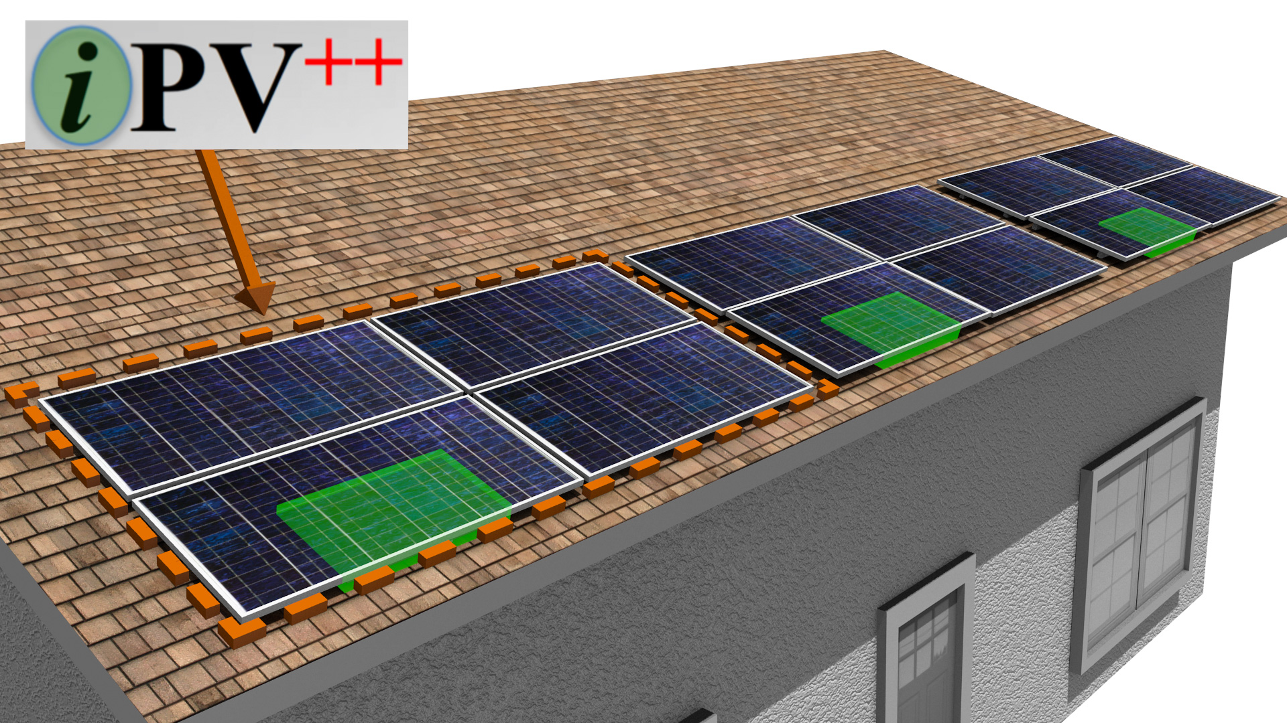

Slide 25
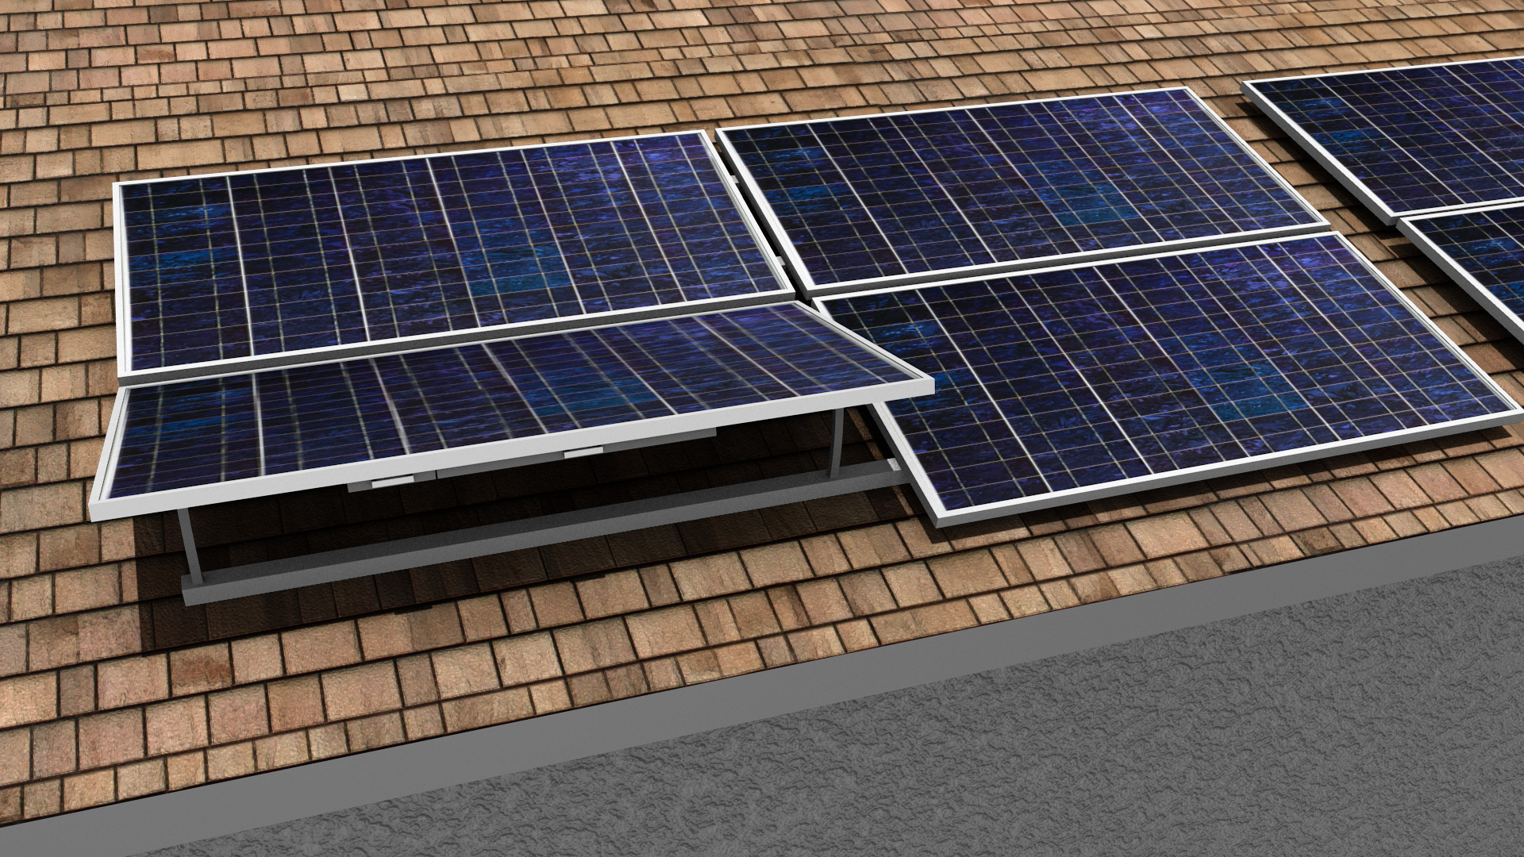

Slide 26
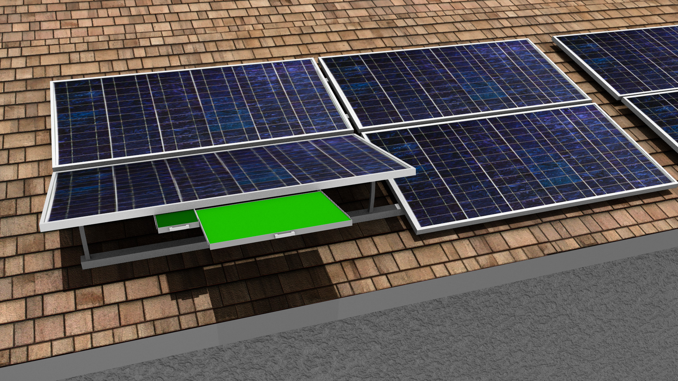

Slide 27
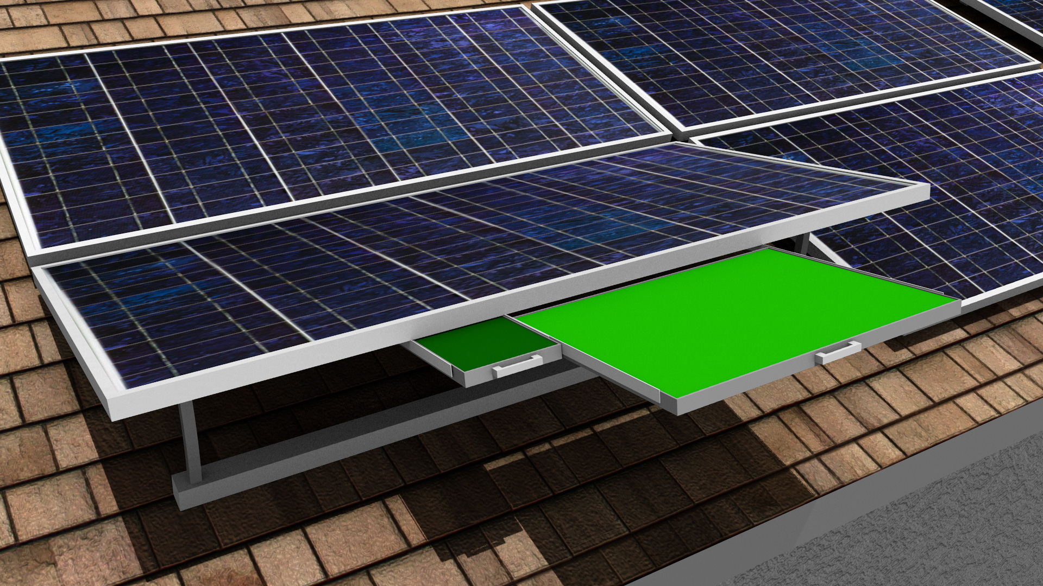

Slide 28
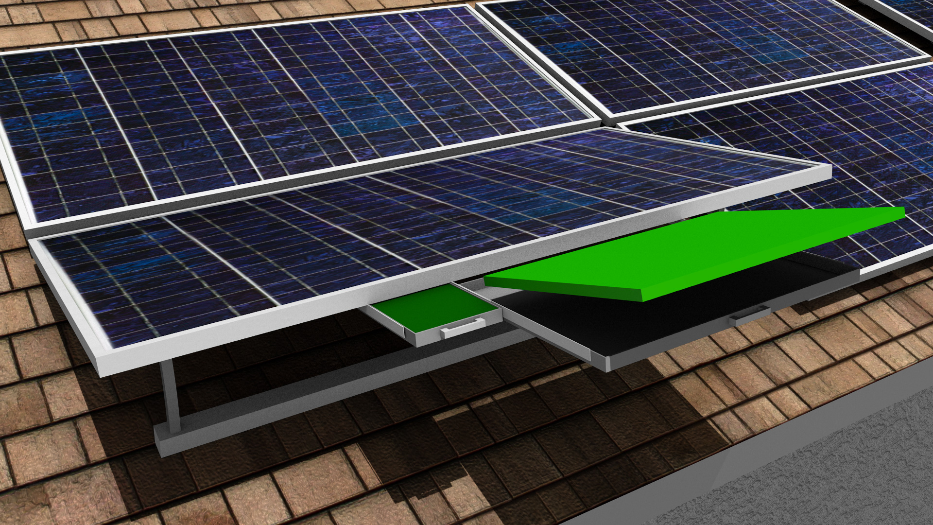

Slide 29
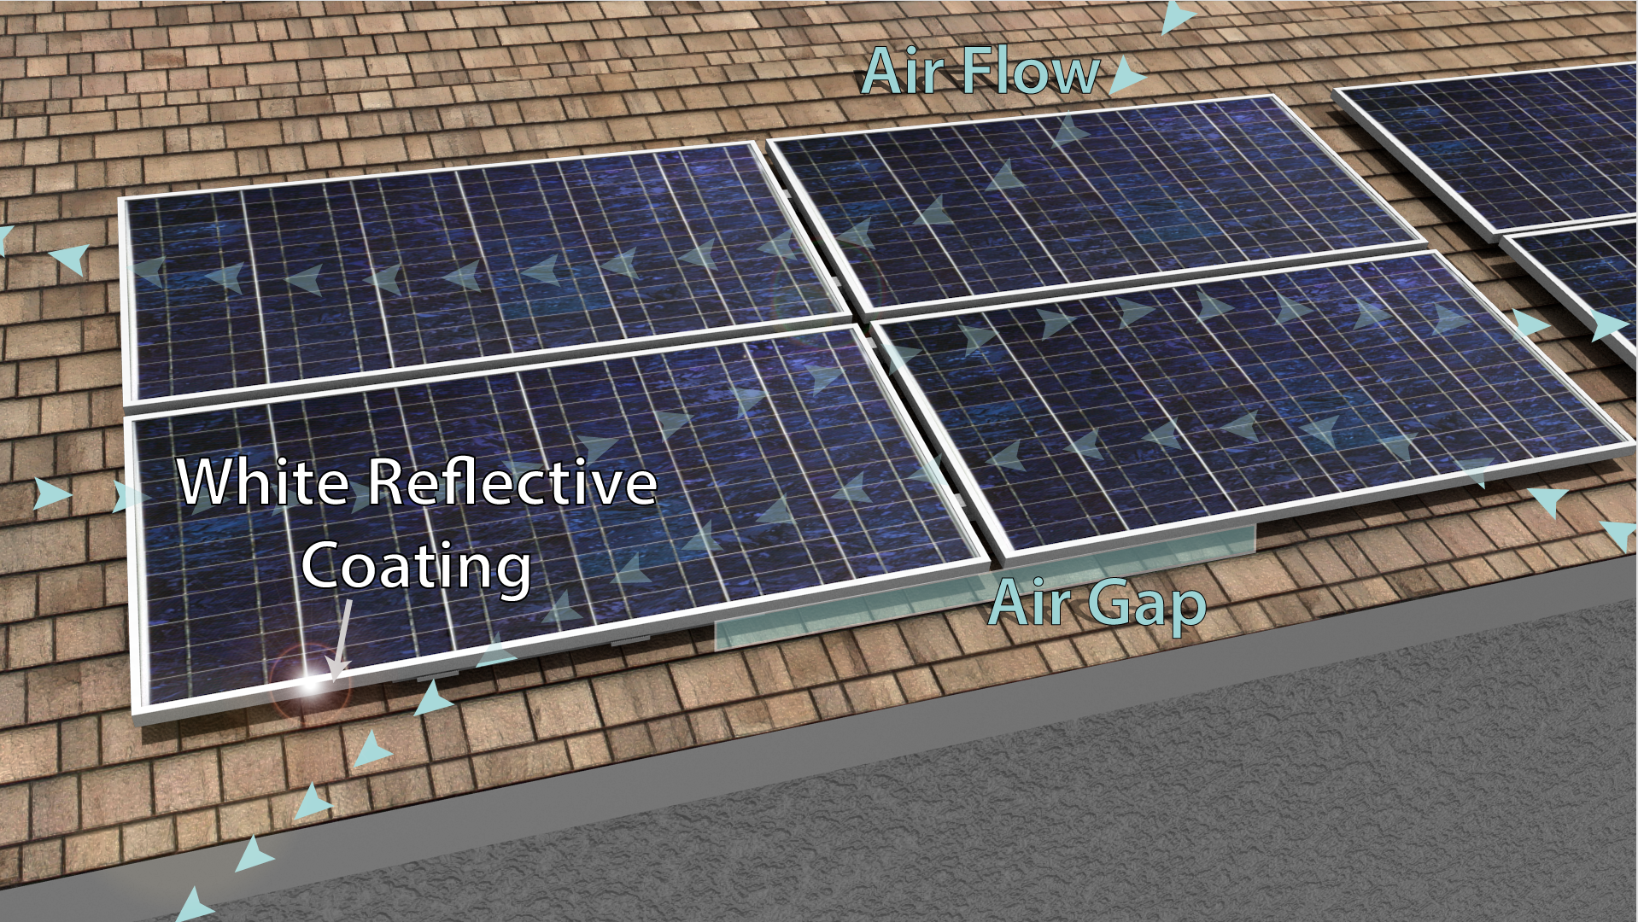

Slide 30
The AC Battery
Distributed AC Battery Micro-grid Systems
2kW/2kWh AC battery storage system, 98.5% efficiency
Designed to emulate a synchronous machine
Applications:
Grid-tied residential microgrids
Off-grid systems
PV-firming
Commercial energy storage systems
AC Battery Innovative Control Techniques
AC Battery for Residential Microgrid

Slide 31
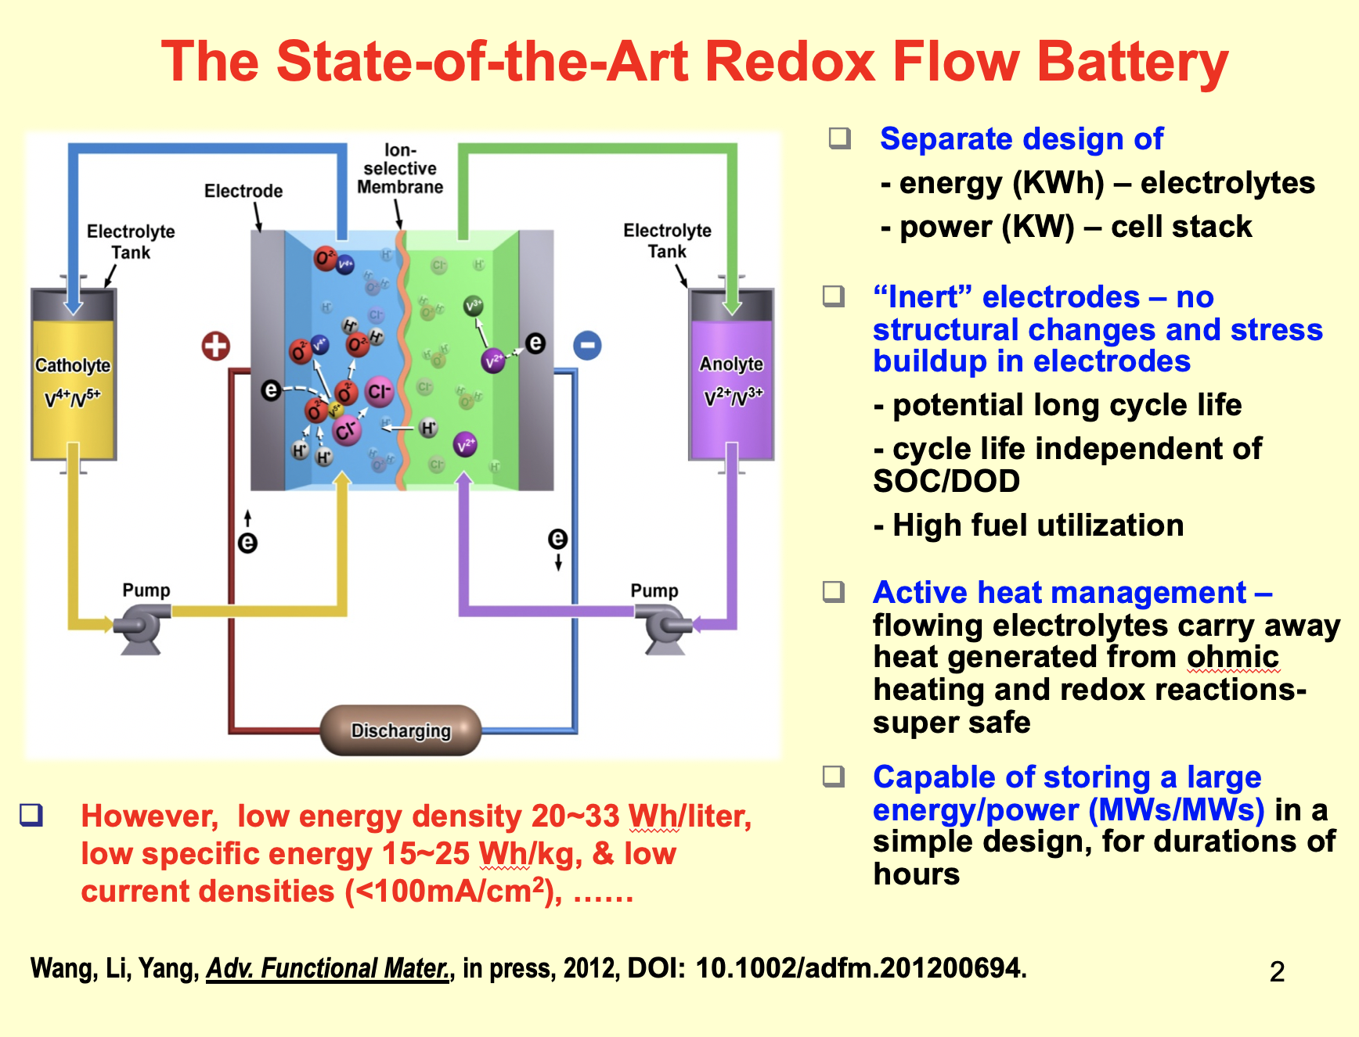
AC Battery for Residential Microgrid

