Slide 1
Improve Performance and Cost for Steam Turbine Maintenance, Repair, and Overhaul Using Additive Manufacturing Award number: DE-FE0031807
Changjie Sun, Ph.D.
Mechanics & Design Organization
GE Research, Niskayuna, NY
November 7, 2019
Acknowledgment: "This material is based upon work supported by the Department of Energy under Award Number DE-FE0031807."
Disclaimer: "This presentation was prepared as an account of work sponsored by an agency of the United States Government. Neither the United States Government nor any agency thereof, nor any of their employees, makes any warranty, express or implied, or assumes any legal liability or responsibility for the accuracy, completeness, or usefulness of any information, apparatus, product, or process disclosed, or represents that its use would not infringe privately owned rights. Reference herein to any specific commercial product, process, or service by trade name, trademark, manufacturer, or otherwise does not necessarily constitute or imply its endorsement, recommendation, or favoring by the United States Government or any agency thereof. The views and opinions of authors expressed herein do not necessarily state or reflect those of the United States Government or any agency thereof."
GE Public
Reserved copyrights

Slide 2
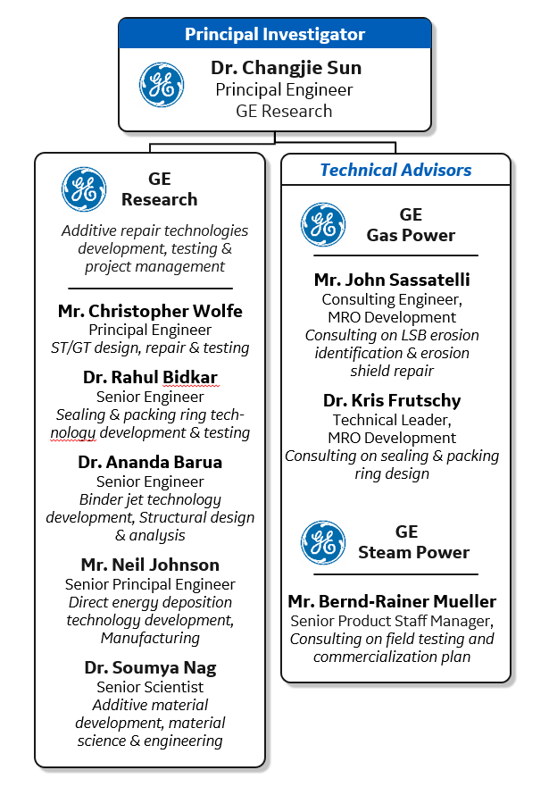
Team
NETL Program Manager: Dr. Seth Lawson
Notes:
Figure 14 . An image of both the current GE RTG® formulation that is sold within PCR reaction tubes (foil sealed) and a custom formulation in which reagents are lyophilized and stored within a glass fiber sheet (where each sheet contains a specific set of PCR reagents and primers). B. (left) Real-time PCR curves obtained for prokaryotic template and no template controls. Template titrations contain one PuReTaq Ready-to-Go PCR bead; 10^5 to 10 copies of genomic DNA from E. coli DH1λ; 20 pmol 16s rRNA primers (forward and reverse); 5 pmol of 16 rRNA FAM-TAMRA probe; 6.1 mM MgCl2; and sterile H2O. Reactions were amplified as follows: 95° C for 300s, then 95° C for 30 s, 55° C for 30 s, and 72° C for 60 s for 40 cycles. (right) Linearity of prokaryotic gDNA template titration described using the TaqMan primers/probes.

Slide 3
Executive Summary
Additive manufacturing technologies for steam turbine maintenance, repair and overhaul (MRO)
39-month program
Binder jet
Binder and sintering process development
Distortion control
Directed energy deposition
Residual stress mitigation
Distortion control
Scan path optimization
Last-stage bucket leading edge erosion shield repair
Reduce cost by 20-50%
Packing ring replacement
Thermally tailored packing ring design
Reduce leakage by 50% for 0.1% efficiency improvement
If successful, developed technologies could be leveraged toward other steam turbine parts such as diaphragms, film-riding seals, valves etc.
Mature technologies to Technology Readiness Level 5 and develop a plan for commercialization
Notes:
Figure 14 . An image of both the current GE RTG® formulation that is sold within PCR reaction tubes (foil sealed) and a custom formulation in which reagents are lyophilized and stored within a glass fiber sheet (where each sheet contains a specific set of PCR reagents and primers). B. (left) Real-time PCR curves obtained for prokaryotic template and no template controls. Template titrations contain one PuReTaq Ready-to-Go PCR bead; 10^5 to 10 copies of genomic DNA from E. coli DH1λ; 20 pmol 16s rRNA primers (forward and reverse); 5 pmol of 16 rRNA FAM-TAMRA probe; 6.1 mM MgCl2; and sterile H2O. Reactions were amplified as follows: 95° C for 300s, then 95° C for 30 s, 55° C for 30 s, and 72° C for 60 s for 40 cycles. (right) Linearity of prokaryotic gDNA template titration described using the TaqMan primers/probes.

Slide 4
Background
DOE objective
Performance improvements in steam-based power cycles applicable to coal boilers
advanced manufacturing applied to steam turbine parts for higher efficiency and lower costs
GE’s fleet
GE’s large steam turbine fleet includes 30% of the world’s fossil power plants
Operating environment
Utilities replace packing rings based on steam path audit results at the beginning of maintenance outages
More plants operate at part load which accelerates last stage blade water erosion
Leveraging GE additive manufacturing experience and ST fleet knowledge

Slide 5
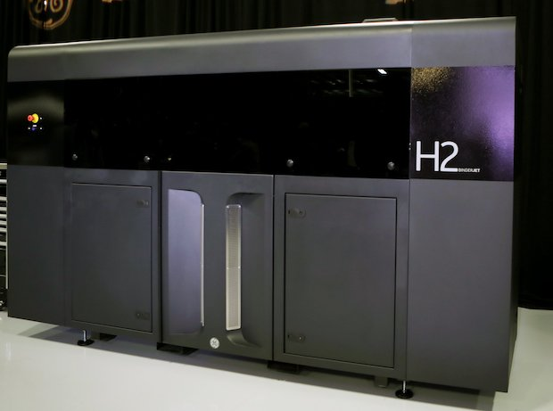
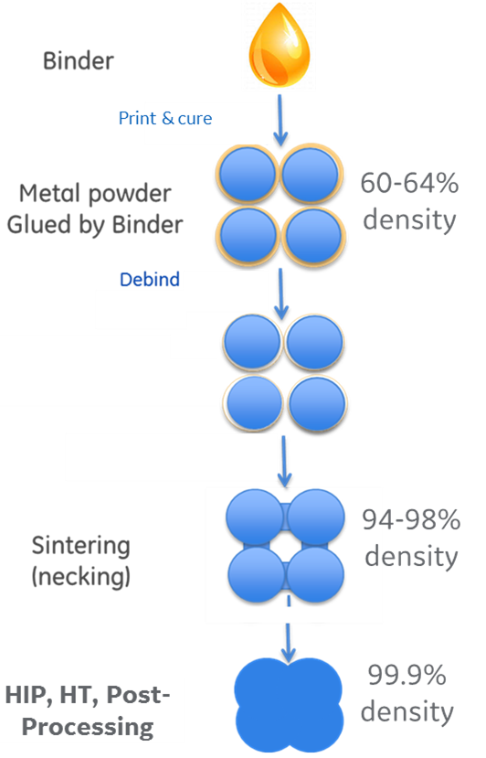
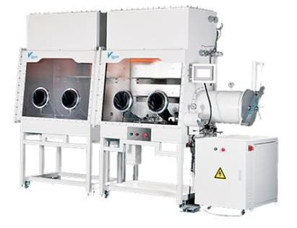
Binder Jet
Print & Cure
BJ advantages:
Good feature fidelity
Fast printing speed – 10X DMLM
Batch sintering
Low residual stresses
Equiaxed microstructures
Binder Jet
De-powder
Sinter

Slide 6
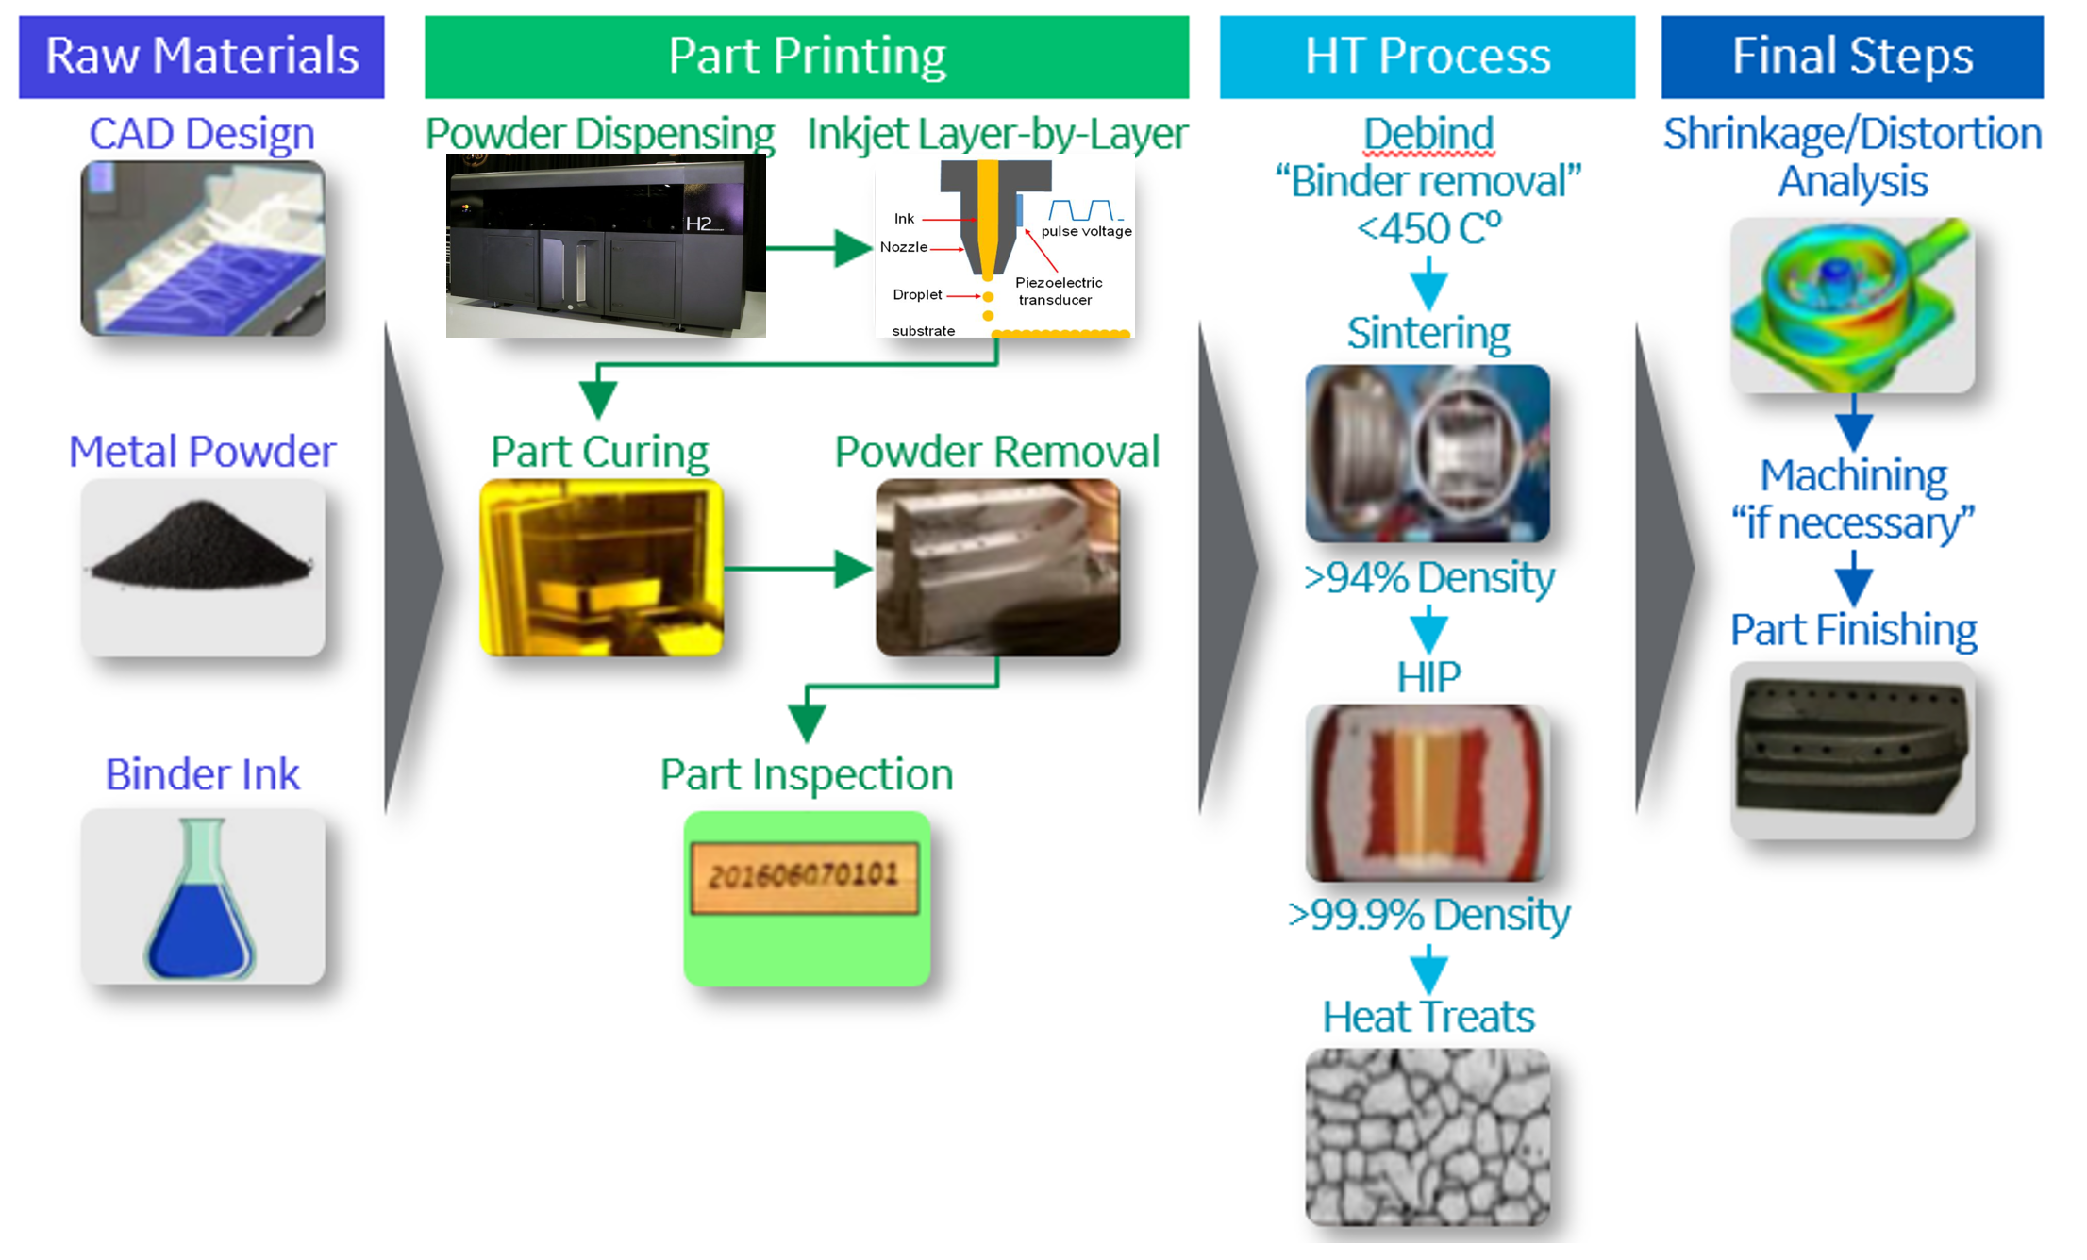
Typical Binder Jet Process

Slide 7
Binder Jet Challenges
Large shrinkage and distortions
Composition of green part ~ 60% metal powder, 39% porosity, 1% binder;
Part shrinks ~20% laterally and 24% in build direction during sintering;
Excellent geometry compensation capability at GER
Binder Development
Dependent on powder used
Green part strength
Binder development at GER
De-powder for small parts with small passages
De-powder technology development at GER
Material development
Optimized powder size distribution and sintering process development at GER
Part dimensions limited by machine size

Slide 8
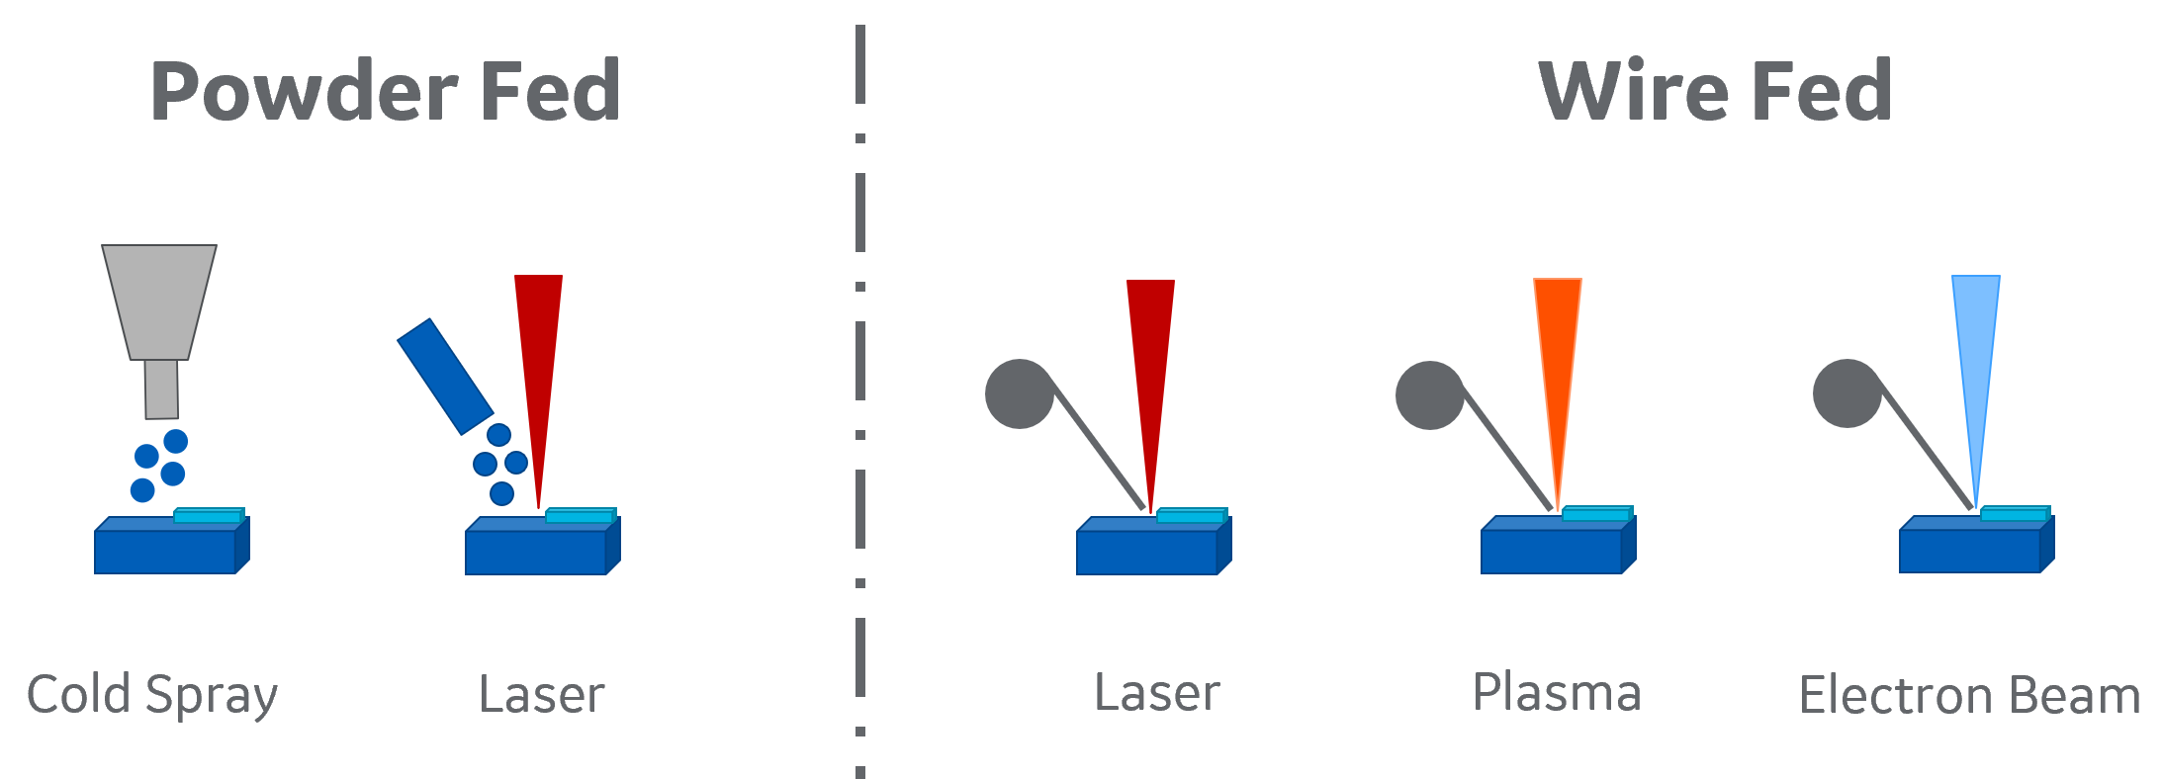
Directed Energy Deposition
What is it ?
ASTM F2792
Directed Energy Deposition (DED) - An additive manufacturing process in which focused thermal energy is used to fuse materials by melting as they are being deposited
DED advantages:
Multi hoppers or changing wires for multiple material printing
Fast printing speed – 10X DMLM
Large parts – up to meters
DED challenges:
Large distortions
Large residual stresses
Relatively low feature fidelity compared to DMLM and binder jet

Slide 9
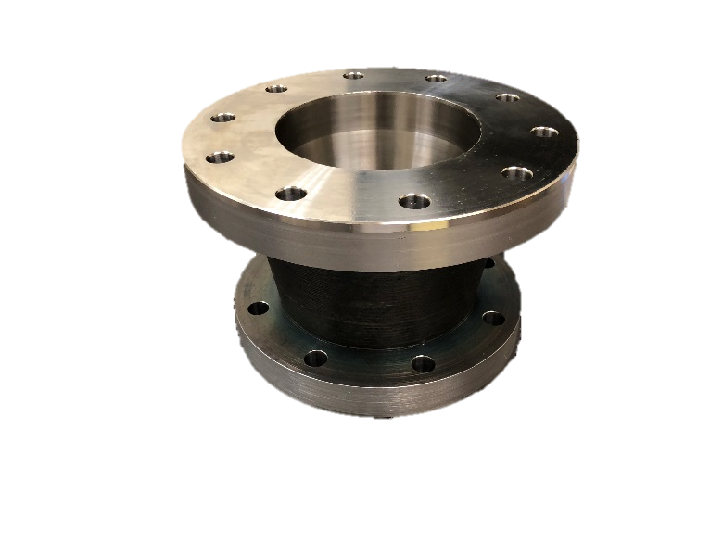
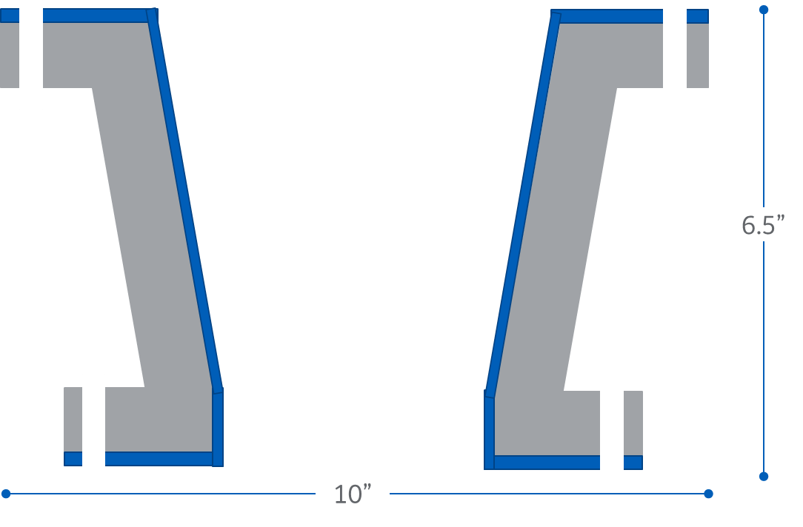
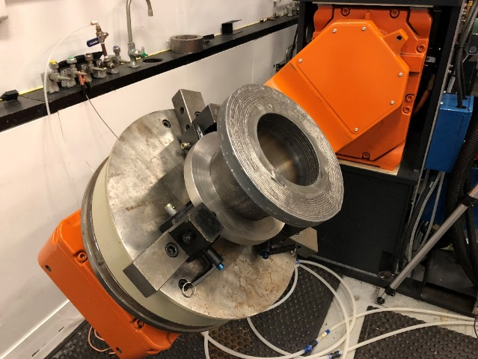
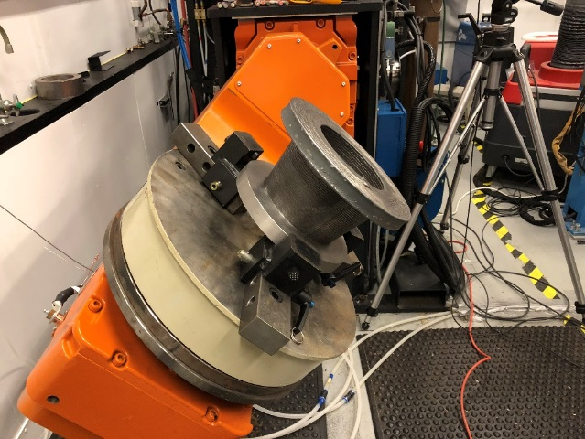
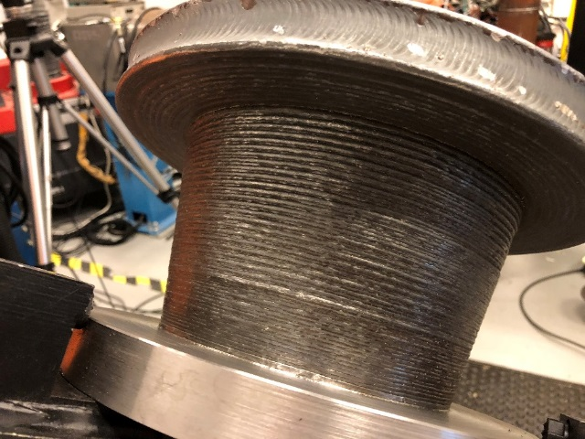
Wire-fed Directed Energy Deposition
Bi Metallic Interface Connector
DED Additive
Total Cost
Process – Single Wire CMT
Inconel – 3lbs - 0.5hr
Carbon Steel Build – 40lbs – 8hr
ER70S-6 – 40lbs - $80
Inconel625 – 3lbs - $75
Time – 10.5hr (process)
Time – 3hr (setup)
Machining time - ~2 hrs.
Complete Conical section Build
Built in place Flange
Two Materials – Steel with Inconel overlay

Slide 10
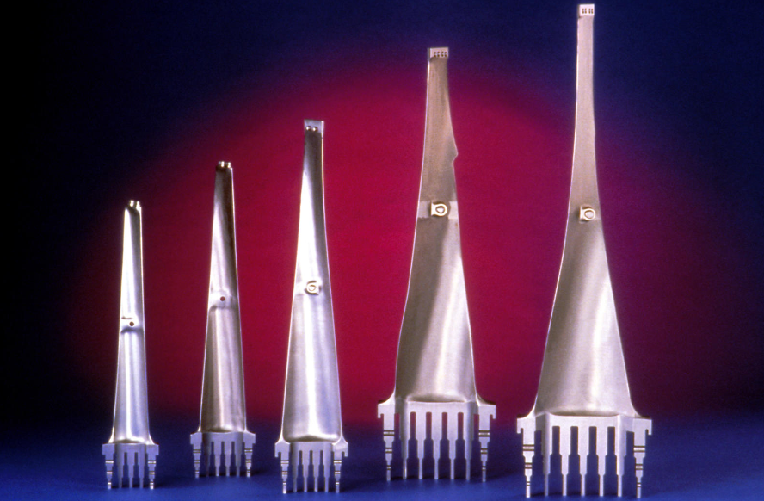
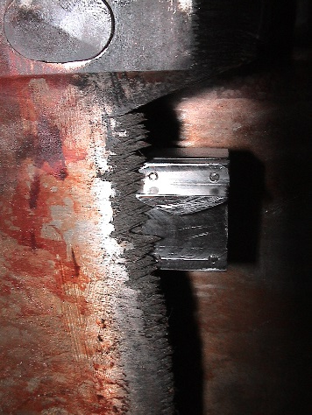
Steam Turbine Last Stage Bucket
Characterize fleet – number of rows vulnerable to erosion, historical and evolving damage rates
Identify current practices – inspection, material removal, repair, replacement
Develop direct energy deposition-based blade repair
Develop binder jet-based repair development
Validate processes with prototype blade repair and material testing – identify preferred process
Notes:
Figure 14 . An image of both the current GE RTG® formulation that is sold within PCR reaction tubes (foil sealed) and a custom formulation in which reagents are lyophilized and stored within a glass fiber sheet (where each sheet contains a specific set of PCR reagents and primers). B. (left) Real-time PCR curves obtained for prokaryotic template and no template controls. Template titrations contain one PuReTaq Ready-to-Go PCR bead; 10^5 to 10 copies of genomic DNA from E. coli DH1λ; 20 pmol 16s rRNA primers (forward and reverse); 5 pmol of 16 rRNA FAM-TAMRA probe; 6.1 mM MgCl2; and sterile H2O. Reactions were amplified as follows: 95° C for 300s, then 95° C for 30 s, 55° C for 30 s, and 72° C for 60 s for 40 cycles. (right) Linearity of prokaryotic gDNA template titration described using the TaqMan primers/probes.

Slide 11
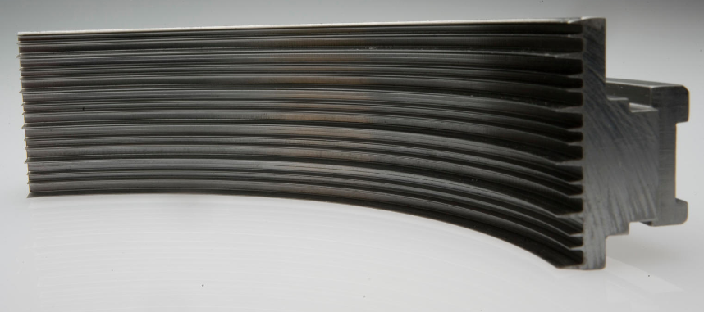
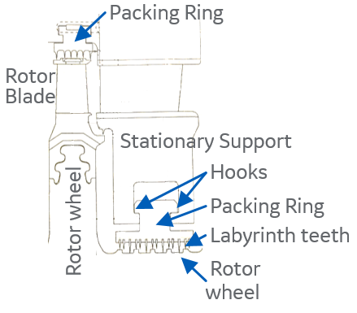
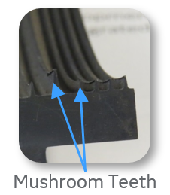
Steam Turbine Packing Ring
Establish design baselines – clearances, costs, design practices
Characterize typical clearance transients
Select candidate packing ring locations
Develop thermally tailored design for tighter operating clearances
Conduct print trials of key features – DED and BJ
Validate performance with rub tests and flow tests
Teeth
Hook
Notes:
Figure 14 . An image of both the current GE RTG® formulation that is sold within PCR reaction tubes (foil sealed) and a custom formulation in which reagents are lyophilized and stored within a glass fiber sheet (where each sheet contains a specific set of PCR reagents and primers). B. (left) Real-time PCR curves obtained for prokaryotic template and no template controls. Template titrations contain one PuReTaq Ready-to-Go PCR bead; 10^5 to 10 copies of genomic DNA from E. coli DH1λ; 20 pmol 16s rRNA primers (forward and reverse); 5 pmol of 16 rRNA FAM-TAMRA probe; 6.1 mM MgCl2; and sterile H2O. Reactions were amplified as follows: 95° C for 300s, then 95° C for 30 s, 55° C for 30 s, and 72° C for 60 s for 40 cycles. (right) Linearity of prokaryotic gDNA template titration described using the TaqMan primers/probes.

Slide 12
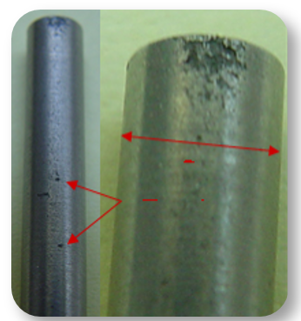
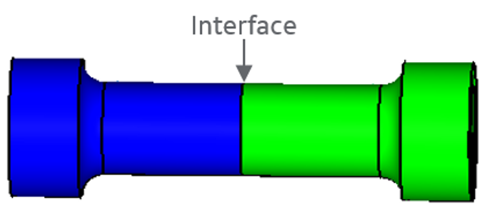
Proposed Tests
Tensile test
Fracture toughness test
Joint strength test
Water erosion test
Flow test
Oxidation test
As printed vs HIPPed
Benchmark against current approach
Notes:
Figure 14 . An image of both the current GE RTG® formulation that is sold within PCR reaction tubes (foil sealed) and a custom formulation in which reagents are lyophilized and stored within a glass fiber sheet (where each sheet contains a specific set of PCR reagents and primers). B. (left) Real-time PCR curves obtained for prokaryotic template and no template controls. Template titrations contain one PuReTaq Ready-to-Go PCR bead; 10^5 to 10 copies of genomic DNA from E. coli DH1λ; 20 pmol 16s rRNA primers (forward and reverse); 5 pmol of 16 rRNA FAM-TAMRA probe; 6.1 mM MgCl2; and sterile H2O. Reactions were amplified as follows: 95° C for 300s, then 95° C for 30 s, 55° C for 30 s, and 72° C for 60 s for 40 cycles. (right) Linearity of prokaryotic gDNA template titration described using the TaqMan primers/probes.

Slide 13
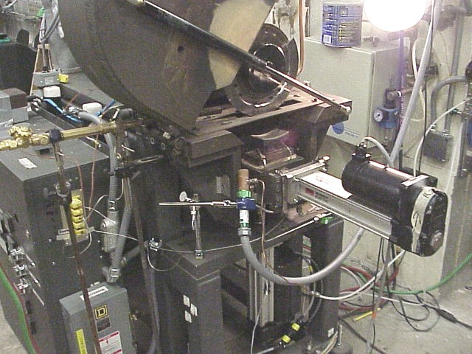
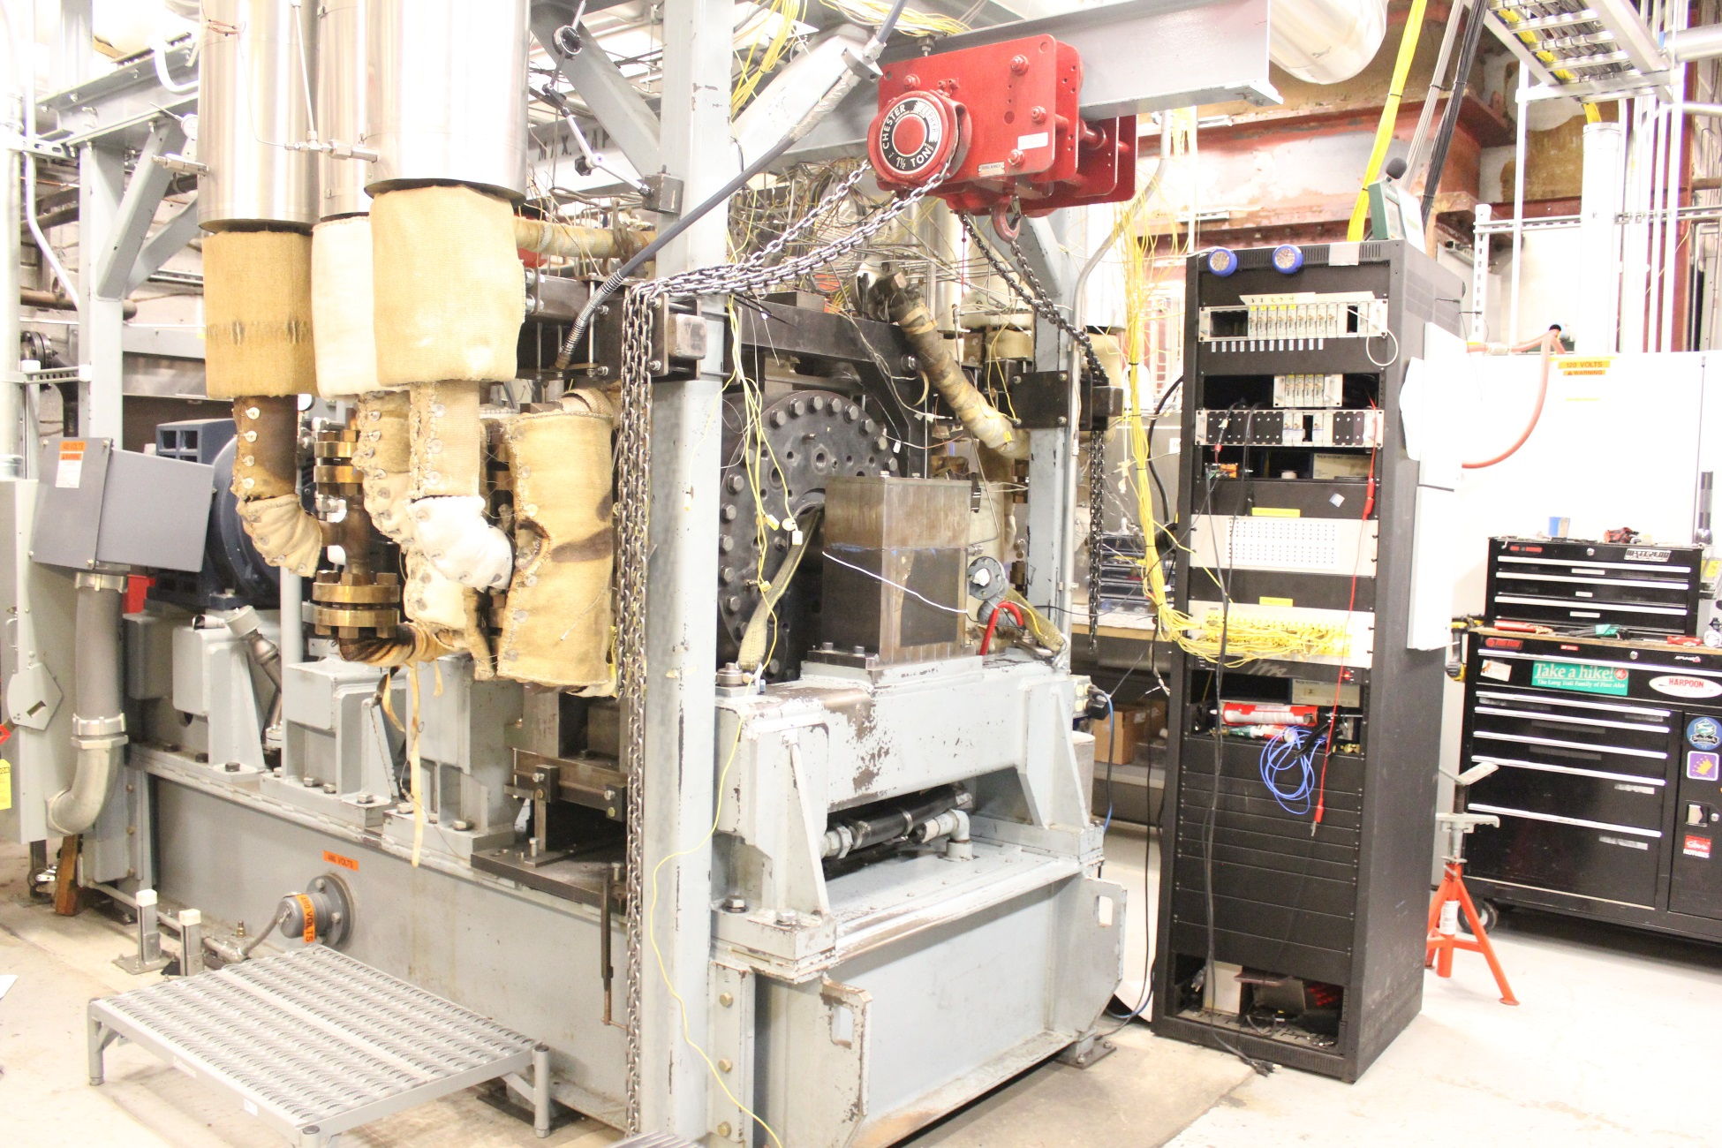
Test Rigs
GER high-speed, pressure and temperature flow rig
GER Water Erosion Test Rig
Notes:
Figure 14 . An image of both the current GE RTG® formulation that is sold within PCR reaction tubes (foil sealed) and a custom formulation in which reagents are lyophilized and stored within a glass fiber sheet (where each sheet contains a specific set of PCR reagents and primers). B. (left) Real-time PCR curves obtained for prokaryotic template and no template controls. Template titrations contain one PuReTaq Ready-to-Go PCR bead; 10^5 to 10 copies of genomic DNA from E. coli DH1λ; 20 pmol 16s rRNA primers (forward and reverse); 5 pmol of 16 rRNA FAM-TAMRA probe; 6.1 mM MgCl2; and sterile H2O. Reactions were amplified as follows: 95° C for 300s, then 95° C for 30 s, 55° C for 30 s, and 72° C for 60 s for 40 cycles. (right) Linearity of prokaryotic gDNA template titration described using the TaqMan primers/probes.

Slide 14
Commercialization and Technology Maturation Plan
Last stage blade repairs
Develop business model for offering repairs versus replacement blades
- Understand historical and evolving industry needs
- Understand impact of evolving utility maintenance practices
- Characterize value of new blade cycle versus current repair cycle
Identify logistic/facility requirements for repair offering
Develop offering introduction plan for risk mitigation
Novel packing rings
Develop business model for offering novel design packing rings
- Identify required delivery cycles
- Characterize value of improved clearance
Identify logistic/facility requirements for product offering
Develop offering introduction plan for risk mitigation

Slide 15
Go/No-go decision
Schedule and Tasks
2019 2020 2021 2022
Novel packing ring design
Commercialization plan
LSB damage identification & material properties targets
Identify candidate packing rings
Binder jet – coupon
Process development for candidate materials
Printing coupons
Coupon tests
Binder jet - subscale
Fabrication of LSB leading edge erosion shield
Fabrication of packing ring
Subscale testing
Directed energy deposition - subscale
Fabrication of LSB leading edge erosion shield
Fabrication of packing ring
Subscale testing
Directed energy deposition - coupon
Process development for candidate materials
Printing coupons
Coupon tests

