Slide 1
Advanced Model Development for Large Eddy Simulation of Oxy-Combustion and Supercritical CO₂ Power Cycles
Joe Oefelein,ª Adam Steinberg,ª Devesh Ranjan,^{b} Jacob Delimont^{c}
ªDaniel Guggenheim School of Aerospace Engineering
^{b}George W. Woodruff School of Mechanical Engineering
Georgia Institute of Technology, Atlanta, GA 30332
^{c}Propulsion and Energy Machinery Technologies
Southwest Research Institute, San Antonio, TX 78238
DE-FOA-0001993 UTSR Project Review Meeting, Project FE0031772, November 5-7, 2019

Slide 2
Objective … Enable detailed predictions and analysis of direct sCO₂ power cycles
Technical Challenges:
sCO₂ cycles rely on a high degree of recuperation compared to traditional Rankine or open Brayton cycles, which results in high combustor inlet temperatures
Large variation in density of inflowing CO₂ occurs between the start-up and design point conditions, which results in high CO₂ concentrations in high-pressure environments
Multiphysics models must handle these atypical conditions to optimize cycle performance
Approach:
Multiphysics model development for LES (Oefelein)
Massively-parallel solver designed to treat high-pressure, high-temperature processes inherent to oxy-fueled combustion in complex geometries (1500 K, 30 MPa turbine inlet conditions)
Combination of laser and optical measurement techniques for model validation applied in two complementary sCO₂ configurations (Steinberg/Ranjan/Delimont)
Quantitative density distributions using 2D burst-mode Raman scattering in sCO₂ loop at G. Tech
Chemiluminescence imaging of H₂O and post-flame CO₂ in the 1 MW sCO₂ combustor at SwRI

Slide 3
Modeling challenges
Physics of interest involves strongly coupled multiscale/multiphysics phenomena
High-Reynolds-number turbulence and multiscalar mixing processes (Re > 100,000)
High-pressure multiregime combustion and thermophysical properties
Compressible, acoustically active flow
Complex fuels, multiphase flow
Complex geometries
No one research approach gives all of the information required for model development and validation
Simulations only treat limited ranges of scales
Experiments provide limited information
Many sources of uncertainty
Costs can be prohibitive
Consequence … easy to identify problems, difficult to derive improvements
Goals: 1) Mitigate challenges through synergistic combination of computational and experimental research, 2) maximize benefits of high performance computing

Slide 4
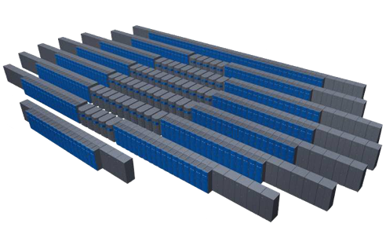
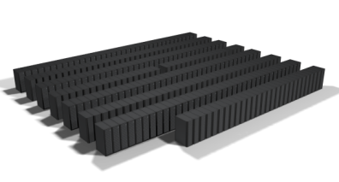
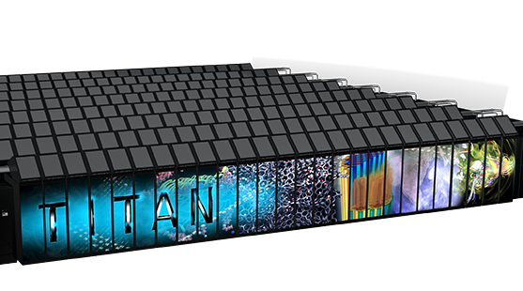

Long term collaborations with Oak Ridge National Laboratory are enabling unique calculations
DOE Innovative and Novel Computational Impact on Theory and Experiment (INCITE) program aimed at Turbulent Scalar-Mixing and Combustion in Supercritical Fluids
OLCF-5
OLCF-4
~1 EF
200PF
500-fold
improvement
in 9 years
2021 Frontier
27 PF
2018 IBM Summit
2012 Cray XK7 Titan

Slide 5
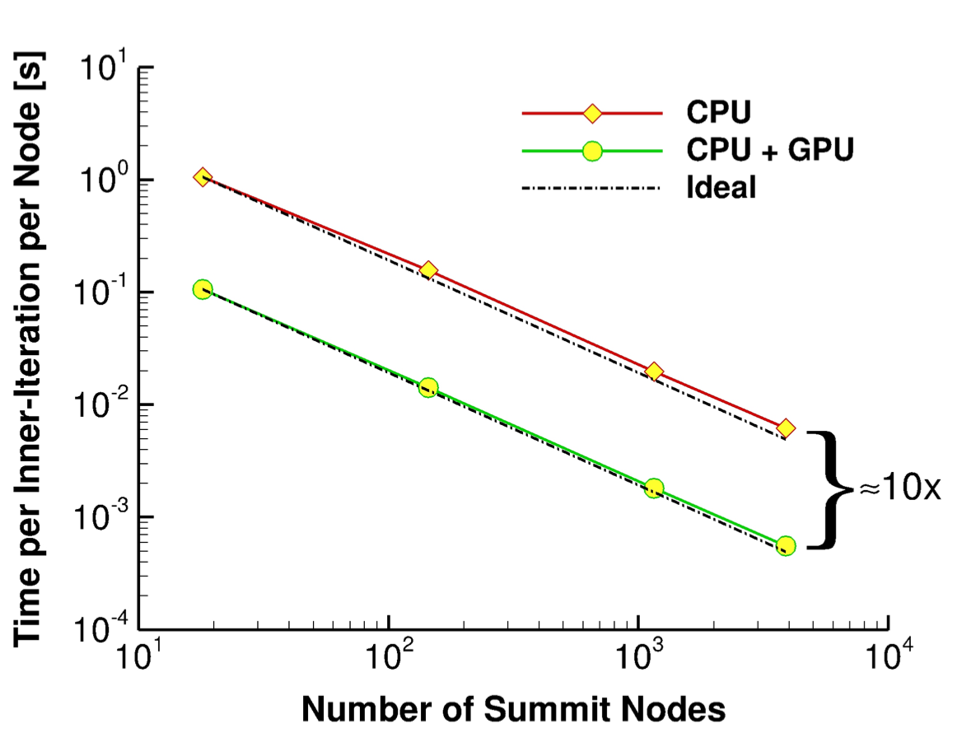
Theoretical – Numerical Framework (RAPTOR)
Theoretical framework (Comprehensive)
Fully-coupled, compressible conservation equations
Nonideal gas/liquid equation of state (high-pressure phenomena)
Detailed thermodynamics, transport and chemistry
Multiphase flow, spray (Lagrangian-Eulerian formulation)
Dynamic subfilter modeling. (no tuned constants)
Numerical framework (High-quality)
Staggered finite-volume differencing (non-dissipative, discretely conservative)
Dual-time stepping with generalized preconditioning (all-Mach-number)
Detailed treatment of geometry, wall phenomena, transient BC’s
Massively-parallel (Highly-scalable)
Hybrid-parallel model for advanced many-core systems with accelerators
Results from scaling studies in July 2019 on ORNL Summit platform … demonstrated 50x speedup relative to Titan

Slide 6
Theoretical – Numerical Framework (RAPTOR)
Theoretical framework (Comprehensive)
Fully-coupled, compressible conservation equations
Nonideal gas/liquid equation of state (high-pressure phenomena)
Detailed thermodynamics, transport and chemistry
Multiphase flow, spray (Lagrangian-Eulerian formulation)
Dynamic subfilter modeling. (no tuned constants)
Numerical framework (High-quality)
Staggered finite-volume differencing (non-dissipative, discretely conservative)
Dual-time stepping with generalized preconditioning (all-Mach-number)
Detailed treatment of geometry, wall phenomena, transient BC’s
Massively-parallel (Highly-scalable)
Hybrid-parallel model for advanced many-core systems with accelerators
Liquid atomization, spray formation
Secondary breakup, two-way coupling
Multicomponent drop vaporization
High-pressure thermodynamics, transport
Real-fluid gas/liquid equations of state
Supercritical, multicomponent mixtures
Major focal points
Turbulent fluid dynamics and scalar mixing
Transient boundary conditions
Compressible, all-Mach-number flow
High-pressure chemistry, emissions, soot
Detailed and skeletal mechanisms
Optimized modeled mechanisms
Multiscalar advection and diffusion
Turbulence-chemistry interactions
Complex fuels, multi-regime combustion
Heat transfer, boundary layer dynamics
Turbulence-radiation interactions
Transient wall-flow interactions

Slide 7
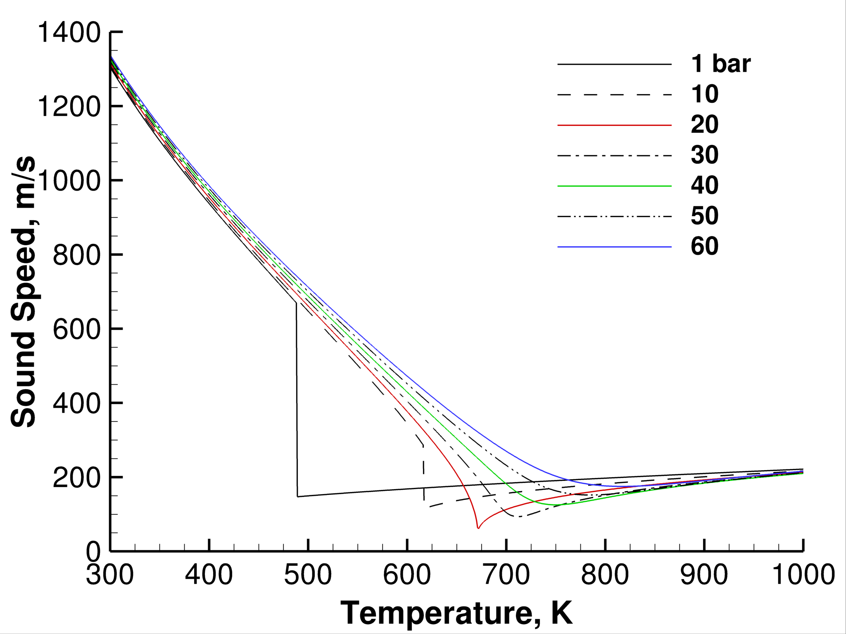
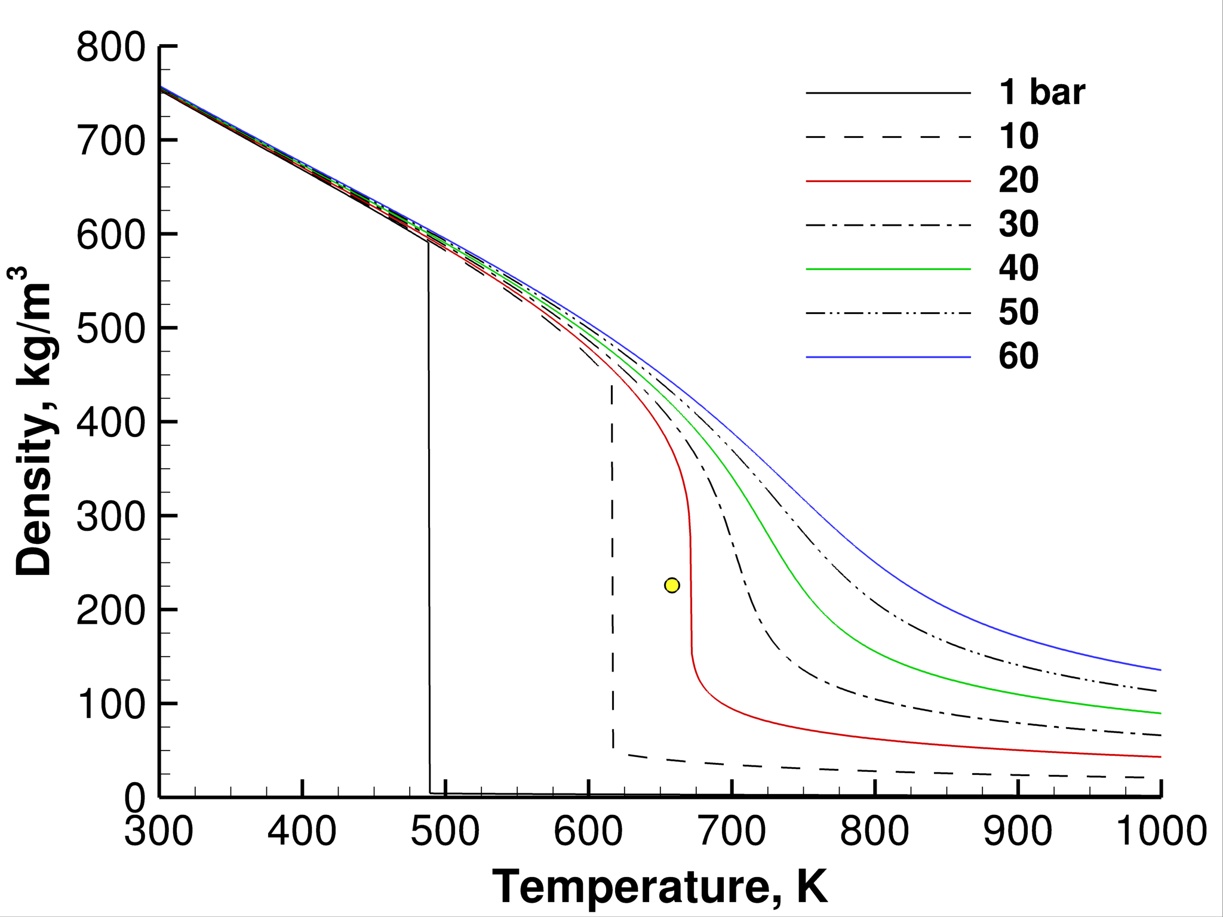
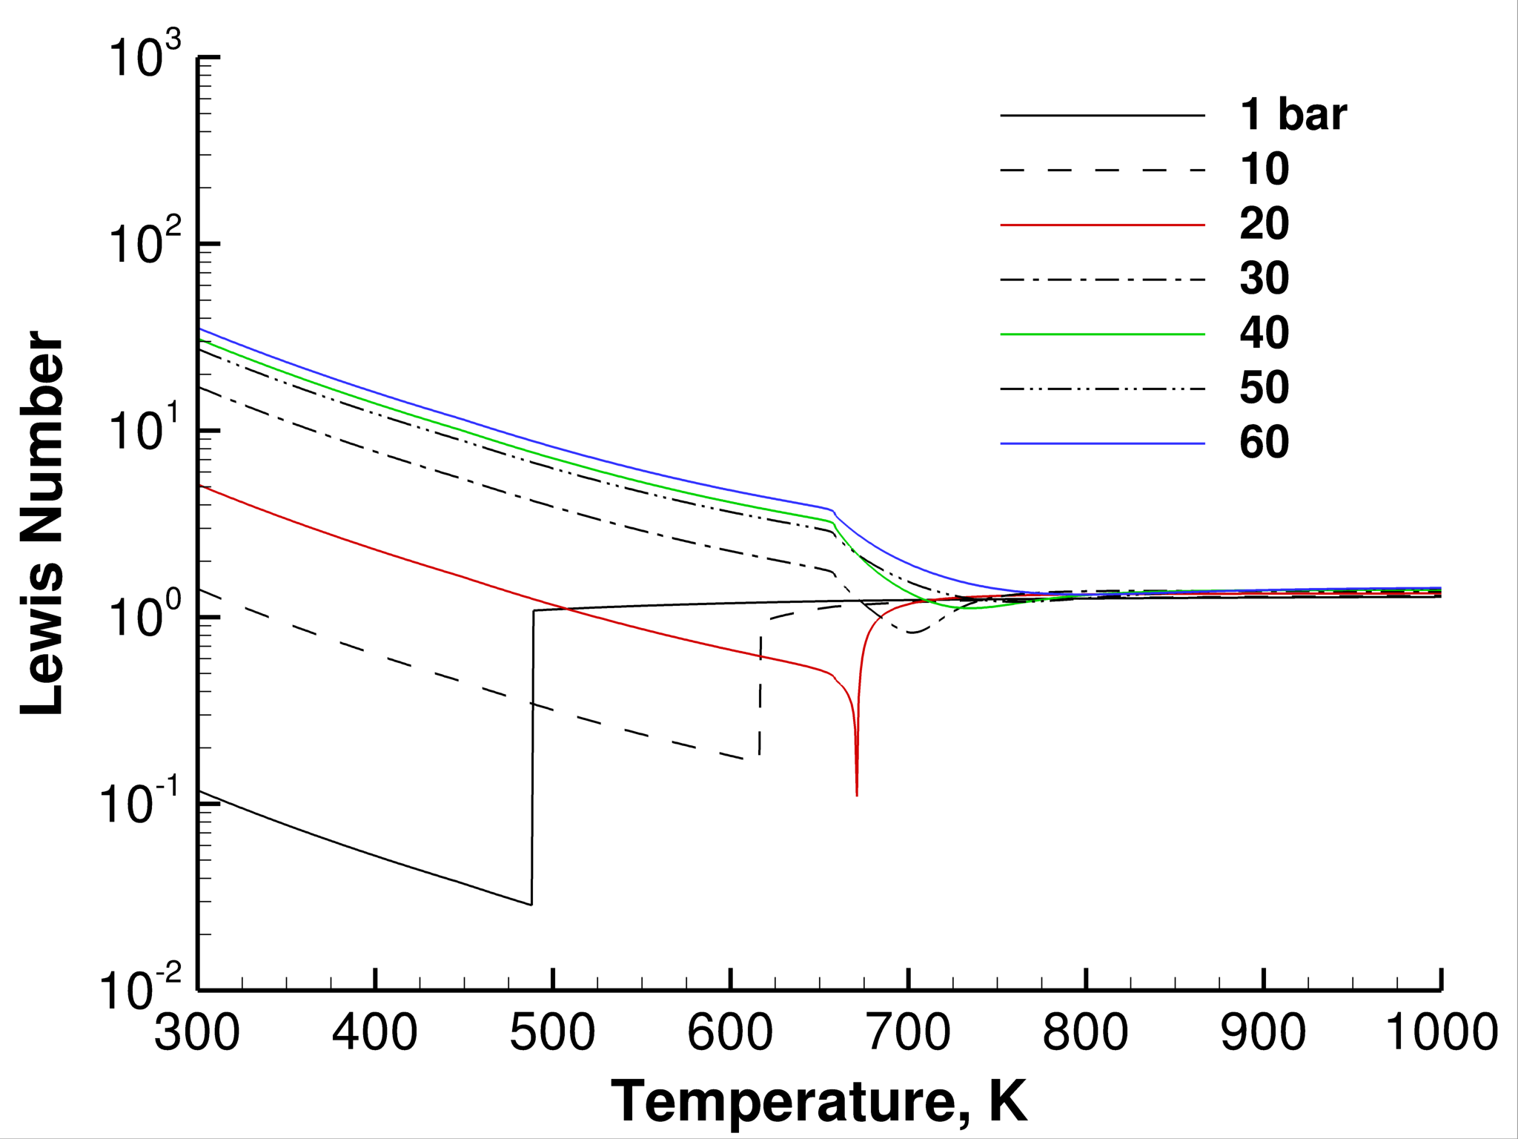
Detailed treatment of multicomponent mixture properties
n-Dodecane
Critical Point
(658 K, 18.2 bar)
Numerical formulation designed to handle any arbitrary set of state equations
Real-fluid gas-liquid mixture properties obtained using Extended Corresponding States model
Multicomponent formulation using cubic or BWR equations of state
Generalized to treat wide range of hydrocarbon-product mixtures (Fuel/Oxidizer/Products)
Validated via NIST, designed to run efficiently on HPC platforms across relevant regimes

Slide 8
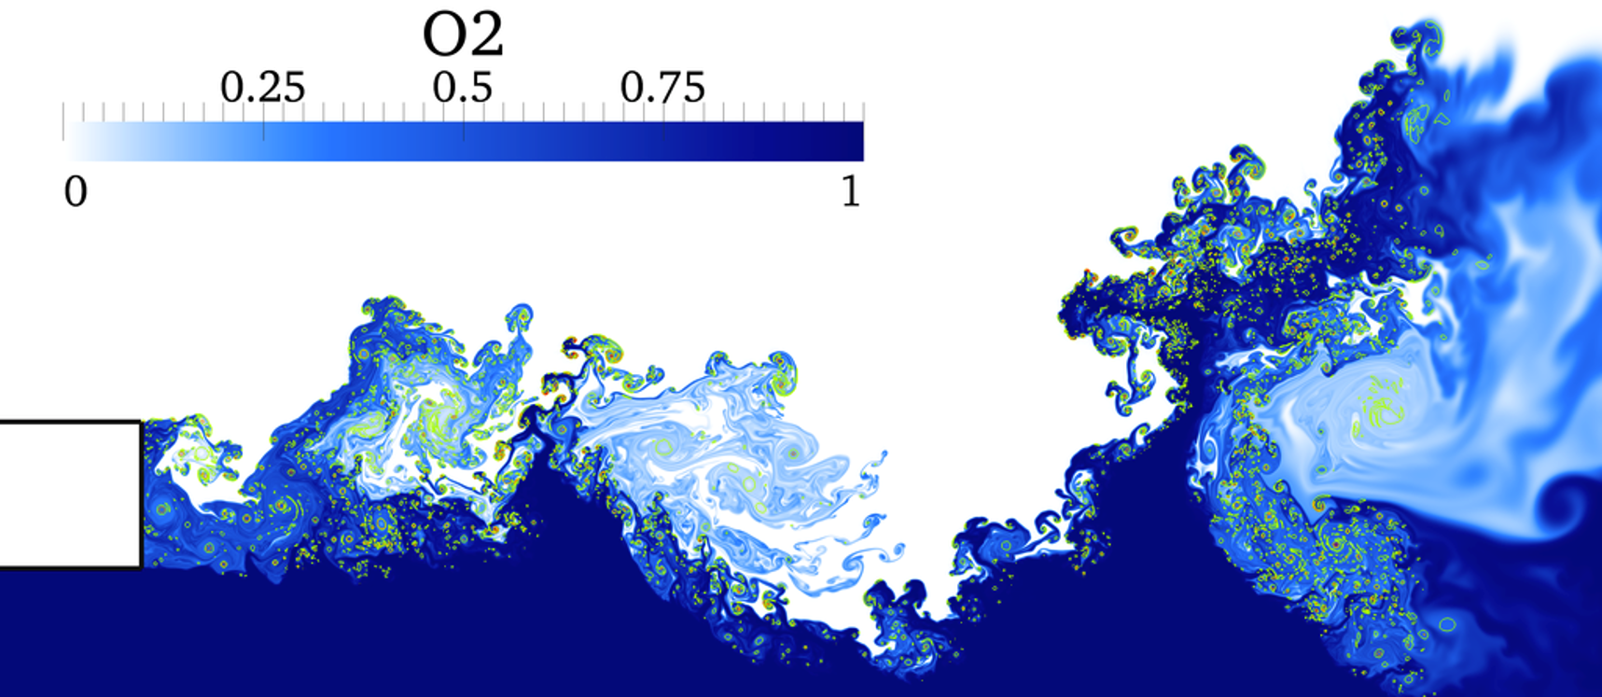
Hierarchy of non-reacting and reacting unit physics cases performed over a range of resolutions (DNS – LES)
Liquid Oxygen

Slide 9
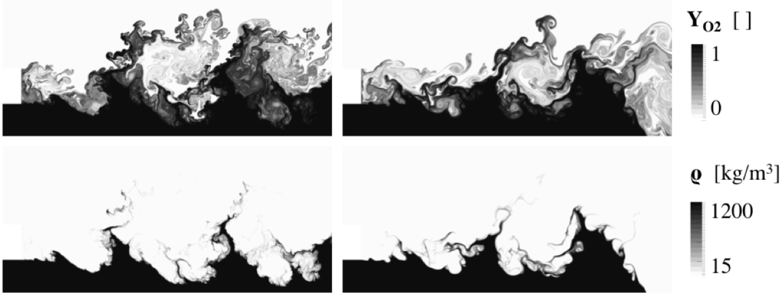
Confidence in solutions have been reinforced using different codes (here RAPTOR and CERFACS AVBP code)
RAPTOR
AVBP

Slide 10
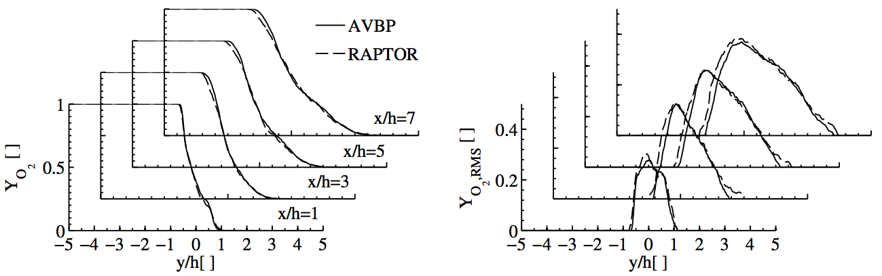
Both solvers produce similar results consistently over relevant ranges of conditions

Slide 11
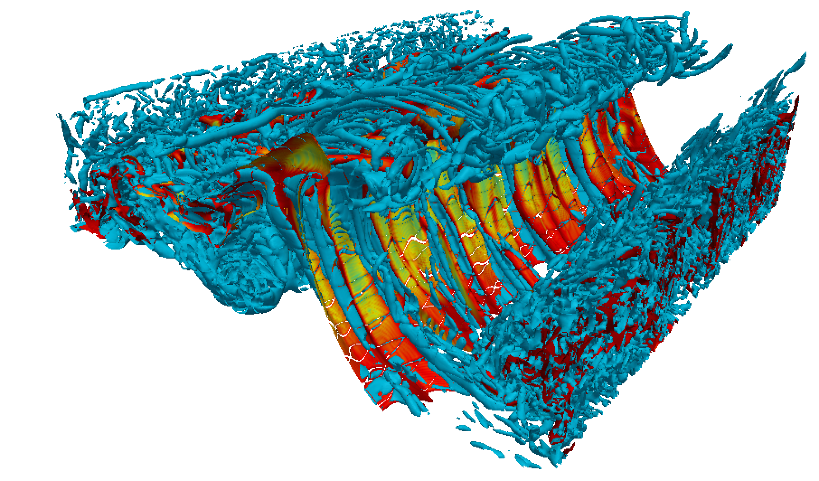
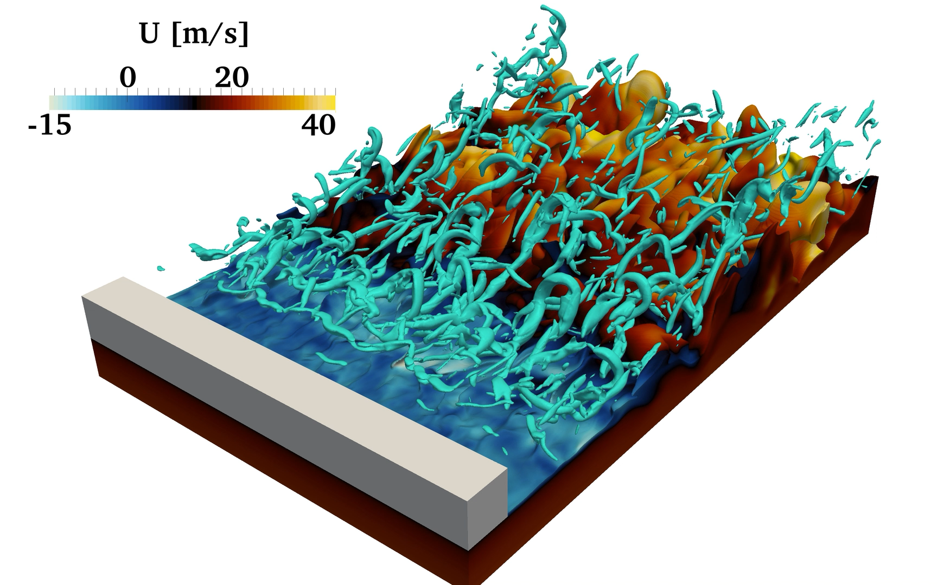
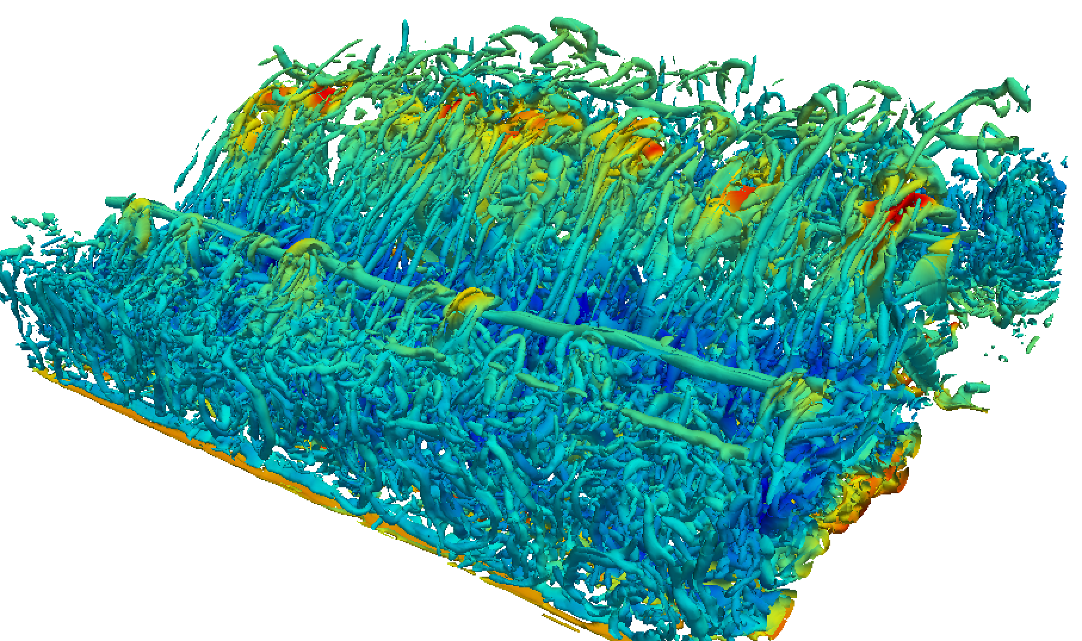
Currently running DNS of methane-oxygen mixing layer at device relevant conditions on Summit
Vorticity and Mixture Fraction
DNS of 3D methane/LOX mixing layer dynamics providing unique data for understanding and modeling liquid-vapor interfacial dynamics, and treatment of nonlinearities associated with real-fluid EOS’s
Scalar-Dissipation Field

Slide 12
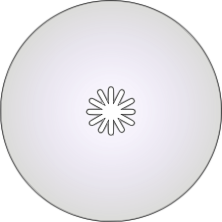
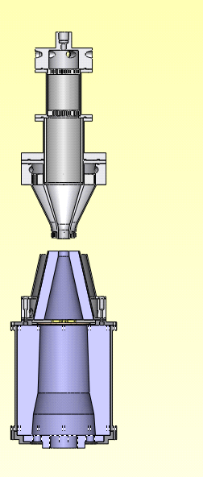
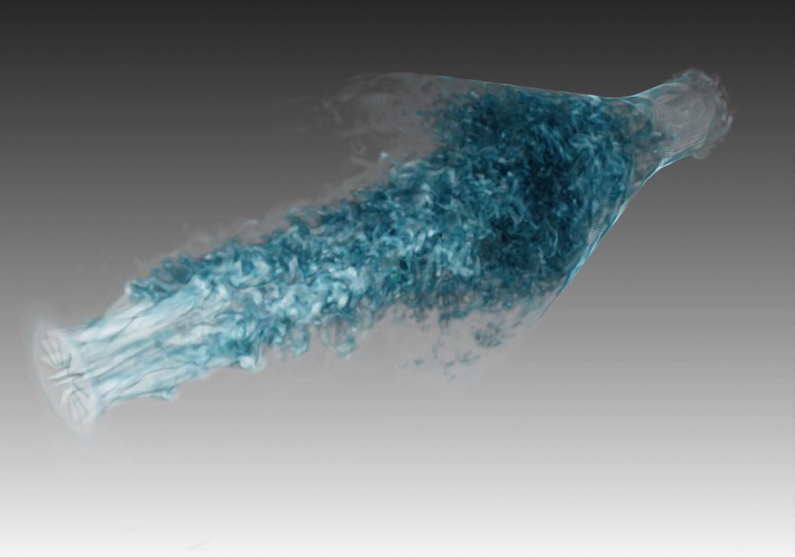
Characterization of turbulent inflow conditions in complex geometries
Fuel (CH4/N2)
Honeycombs
Turbulence
Generator Plate
Co-Flowing
Nitrogen
➔ Low Turbulence (Re_{t} = 600)
➔ High Turbulence (Re_{t} = 1000)
113 mm
94 mm
Nitrogen
Shrouds
Nozzle Diameter
12.7 mm
Pressure | 1 bar
Temperature | 300 K
Fuel/Oxidizer Flow Rate | 85 SLM
Annular Nitrogen Flow Rate | 55 SLM
Grid Spacing | d/30, d/45, d/60
Cells Per Nozzle | 10M, 40M, 120M
Co-Flowing
Nitrogen
Oxidizer (O2)

Slide 13
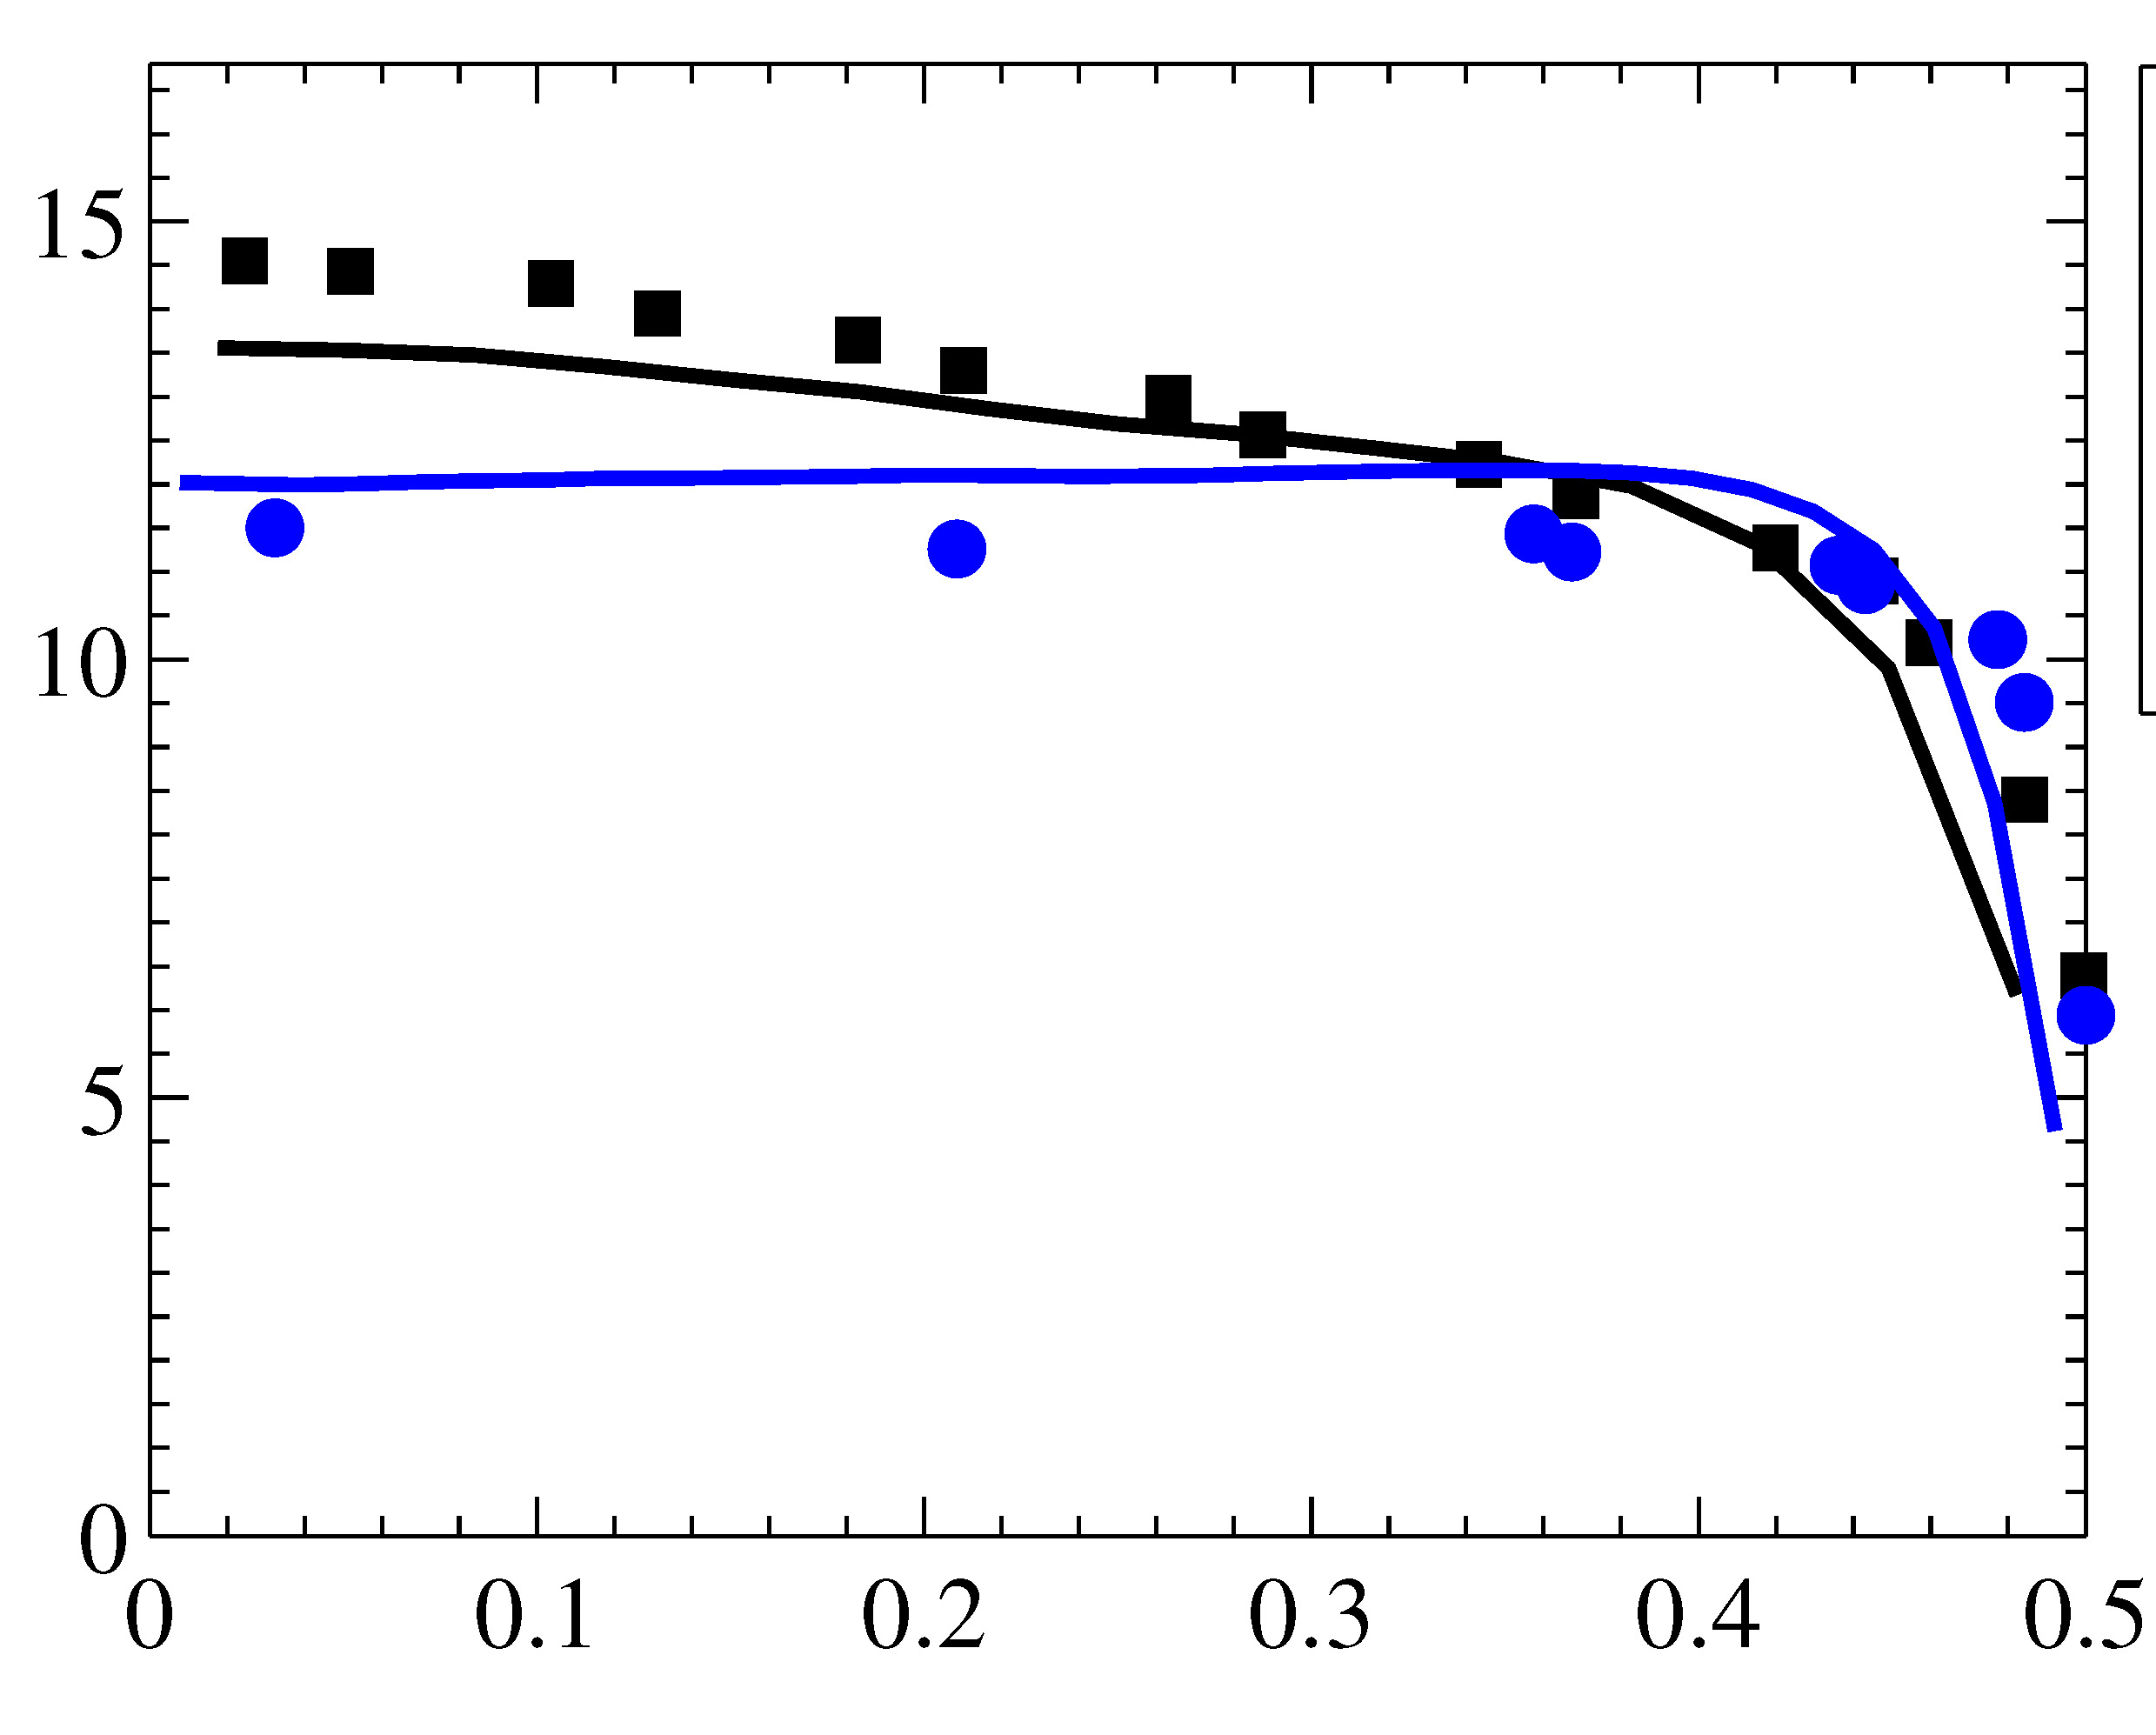
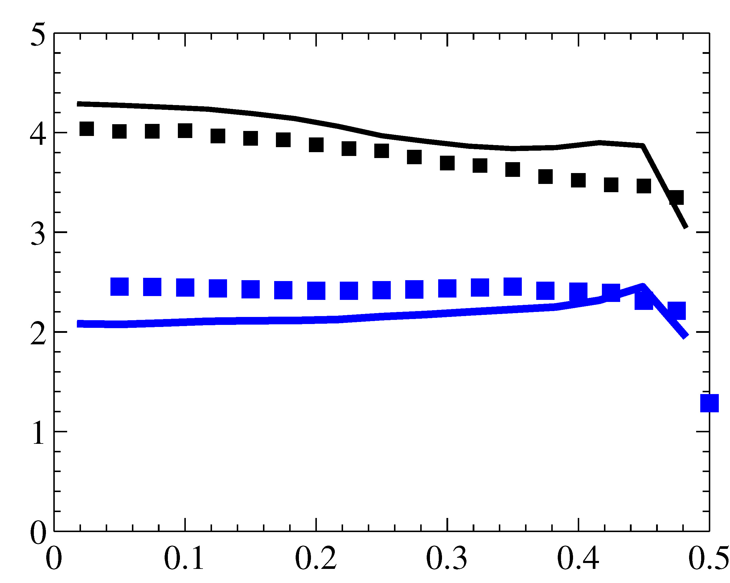
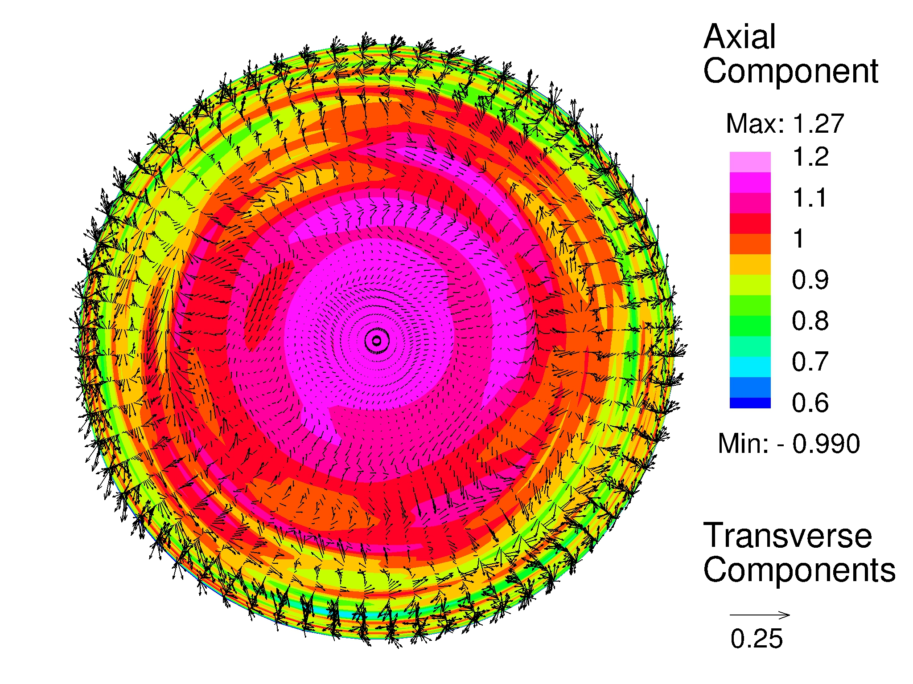
Characterization of turbulent inflow conditions in complex geometries
Fuel (CH4/N2)
Honeycombs
Turbulence
Generator Plate
Mean Velocity (m/s)
RMS Velocity (m/s)
Co-Flowing
Nitrogen
➔ Low Turbulence (Re_{t} = 600)
➔ High Turbulence (Re_{t} = 1000)
113 mm
r/d
r/d
94 mm
Demonstrated good agreement with velocity measurements at nozzle exits by simply changing position of turbulence generator plate
Nitrogen
Shrouds
Nozzle Diameter
12.7 mm
Time-evolving turbulent boundary layer dynamics reconstructed using Synthetic Eddy Method (Jarrin et al., 2008)
Uses assumed, measured, or calculated turbulence properties as input (i.e., integral scale distribution, Reynolds stress tensor, and mean velocity profile)
Pressure | 1 bar
Temperature | 300 K
Fuel/Oxidizer Flow Rate | 85 SLM
Annular Nitrogen Flow Rate | 55 SLM
Grid Spacing | d/30, d/45, d/60
Cells Per Nozzle | 10M, 40M, 120M
Co-Flowing
Nitrogen
Oxidizer (O2)

Slide 14
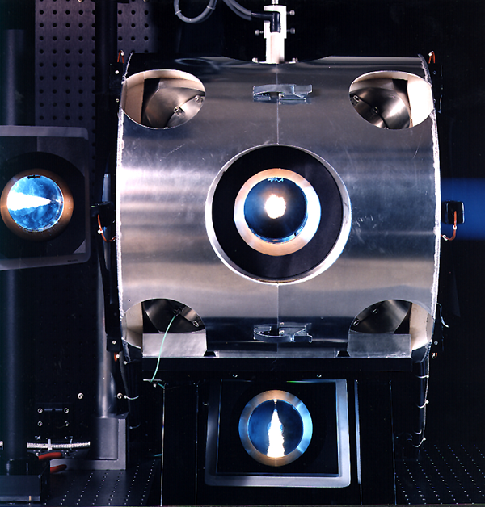
Synergistic coupling of simulations and experiments provides unique insights; e.g., Spray-A experiment
n-Dodecane – Air
Injection and Initial Conditions
Fuel Temperature: 363 K
Chamber Pressure: 30, 60 bar
Chamber Temperature: 450, 900 K
Peak Velocity: 600 m/s
Peak Re_{d}: O(100,000)
Available Data
Rate of injection
Rayleigh scattering images
Schlieren movies
Liquid length versus time
Vapor length versus time
Sandia high-pressure combustion vessel (Pickett et al.)

Slide 15
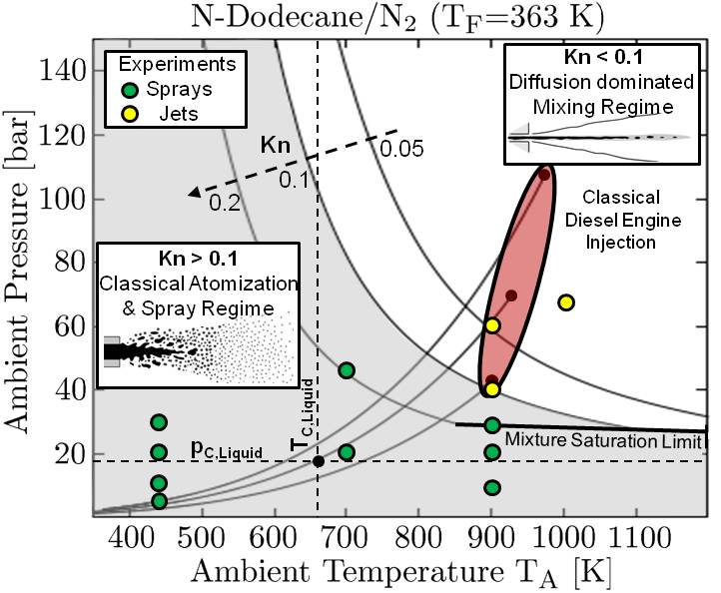
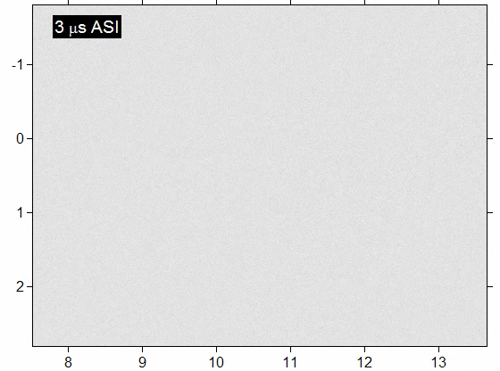
Coupled treatment of complex thermophysics …
We see drops when n-Dodecane is injected at 363 K, 30 bar

Slide 16
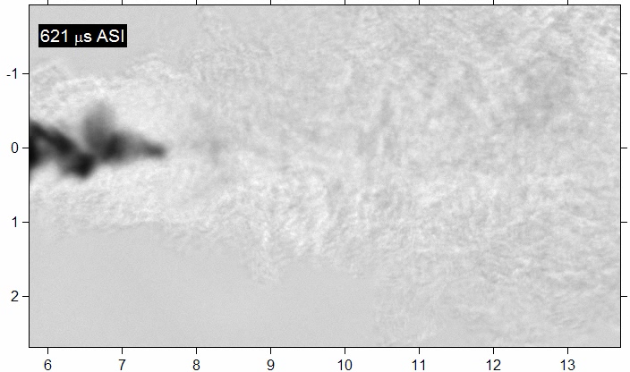
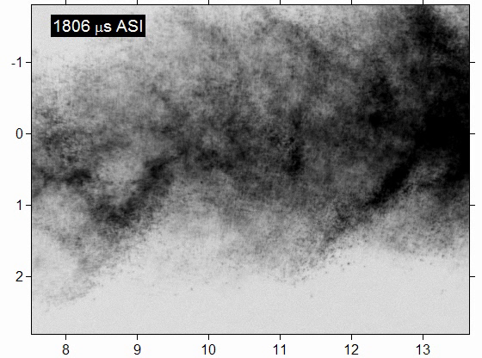
Coupled treatment of complex thermophysics …
We see drops when n-Dodecane is injected at 363 K, 30 bar, but not at 363 K, 60 bar

Slide 17
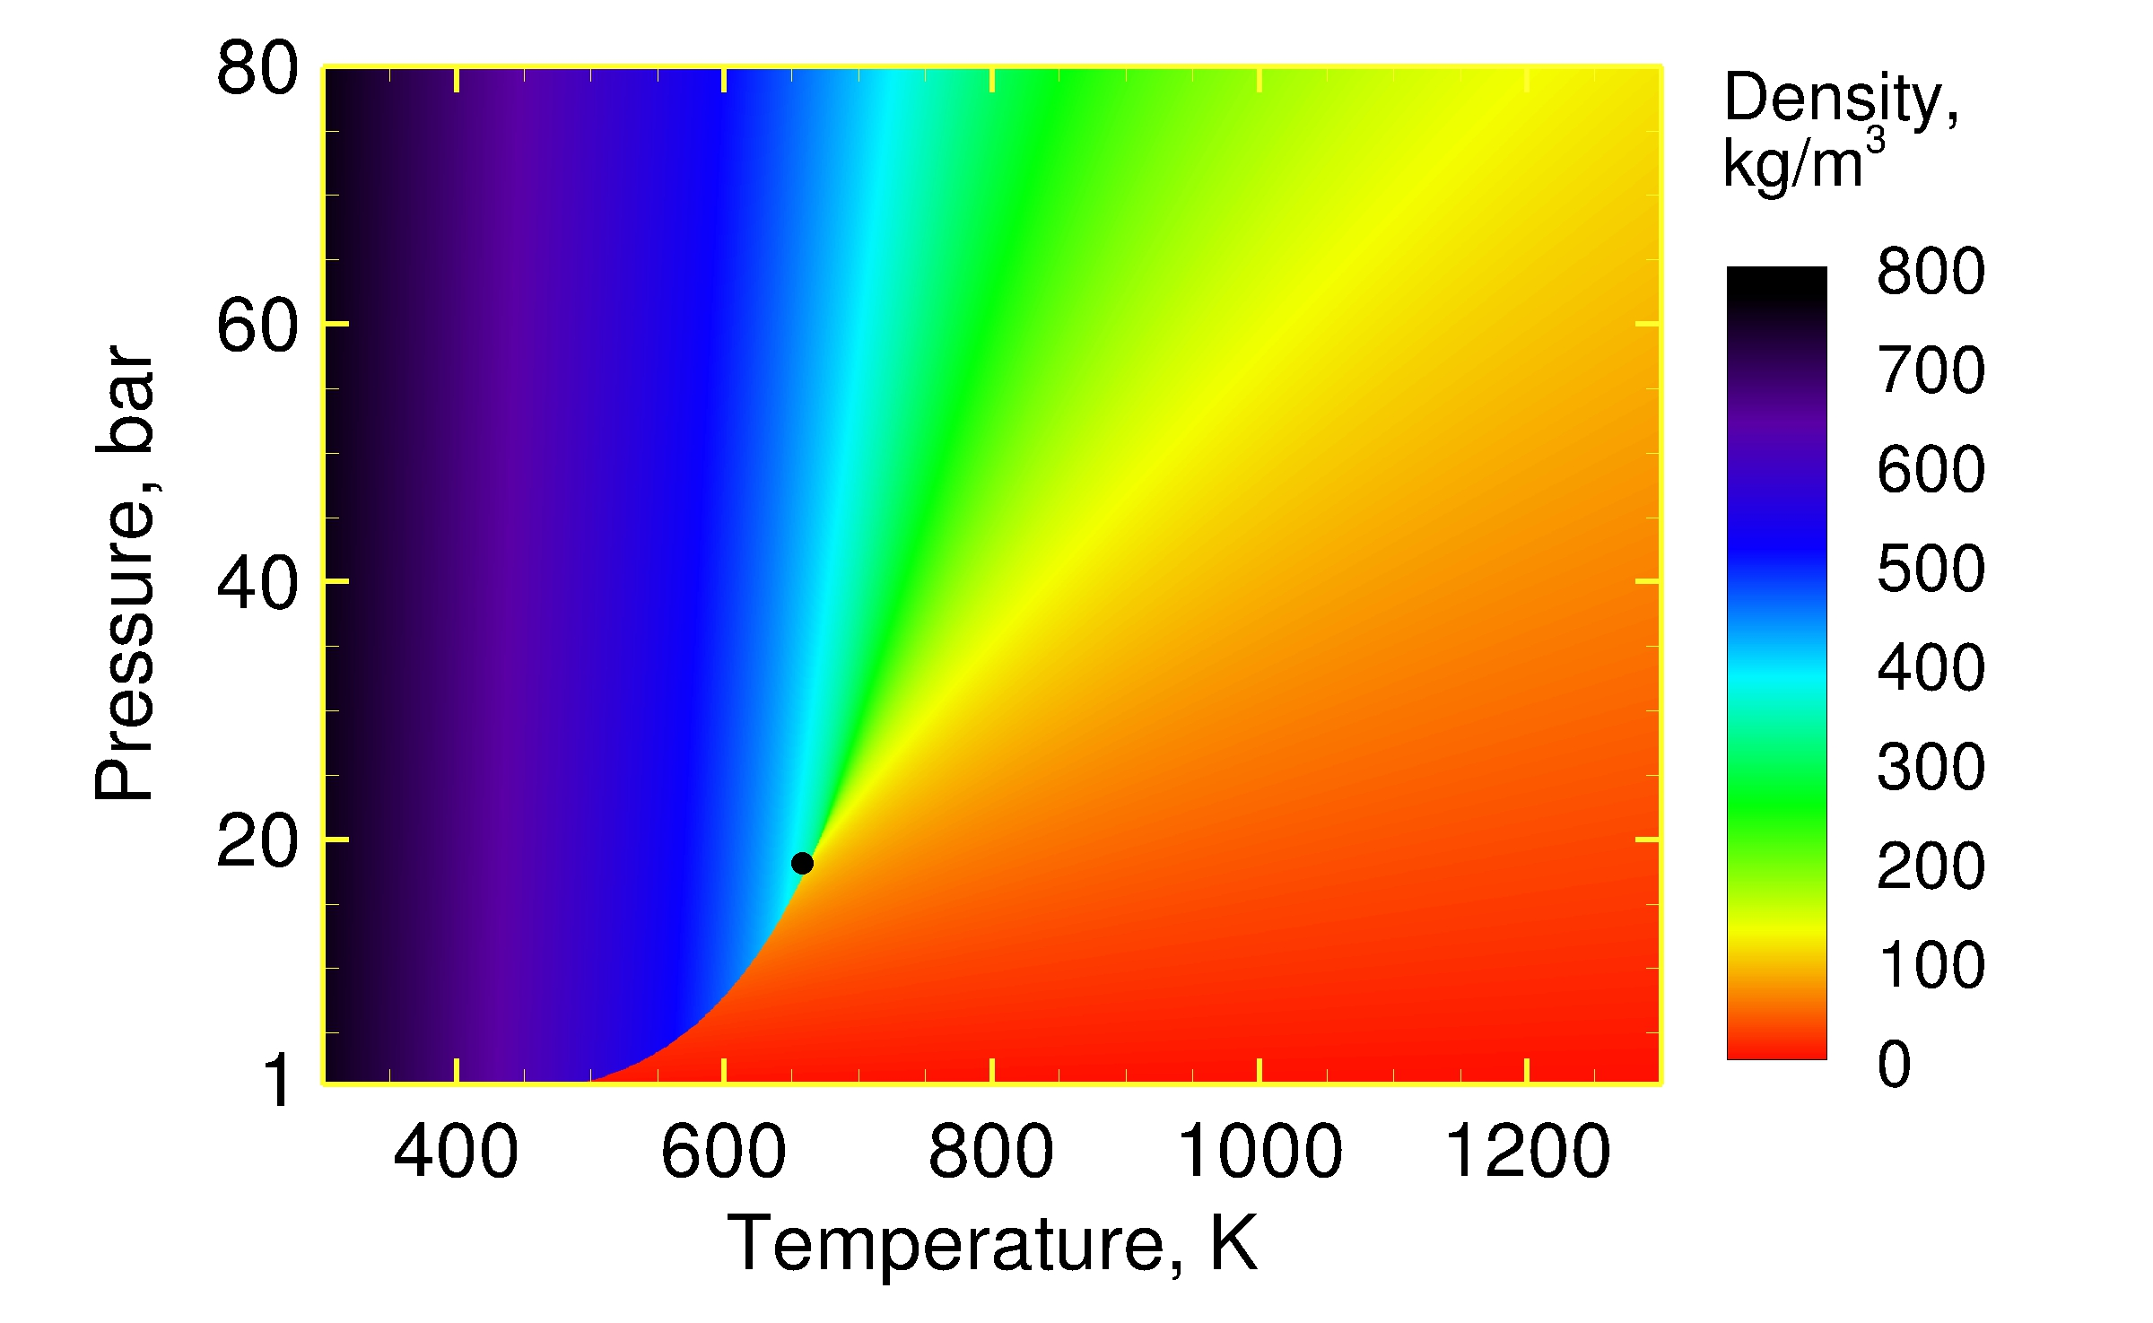
Let’s focus on conditions at 60 bar assuming “transcritical” injection, mixing, combustion
Compressed
Liquid
Supercritical
Fluid
(363, 60)
… No Drops
Critical Point
(658, 18.2)
(363, 30)
… Drops
Ideal Gas
Sandia high-pressure combustion vessel (Pickett et al.)

Slide 18
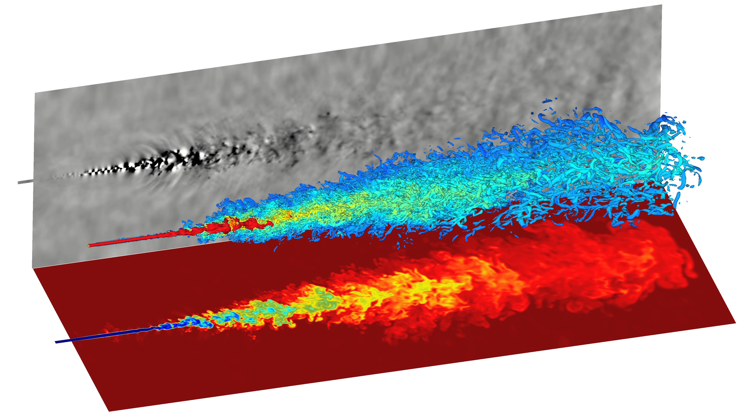
Detailed treatment of BC’s, thermophysics, dynamic modeling, appropriate resolution provides unique insights
Turbulent Flow Structures
500 m/s (yellow) – 50 m/s (blue)
Pressure (± 5 bar)
Liquid Core
Temperature
(363 – 900 K)

Slide 19
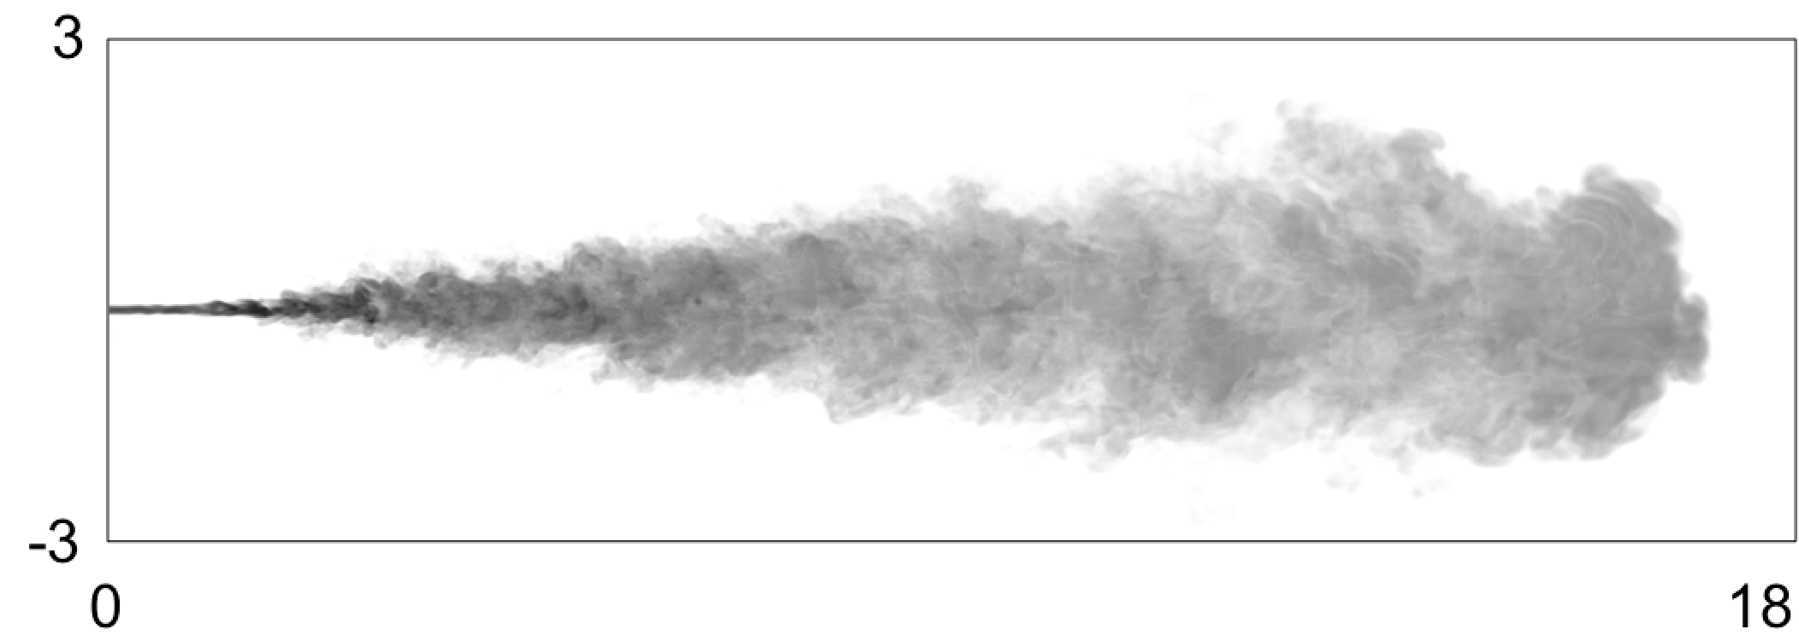
Good agreement with available data using no adjustable parameters except resolution and BC’s
Jet Spreading Angle: 7.1° ± 0.8°
LES
Jet Penetration

Slide 20
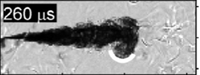
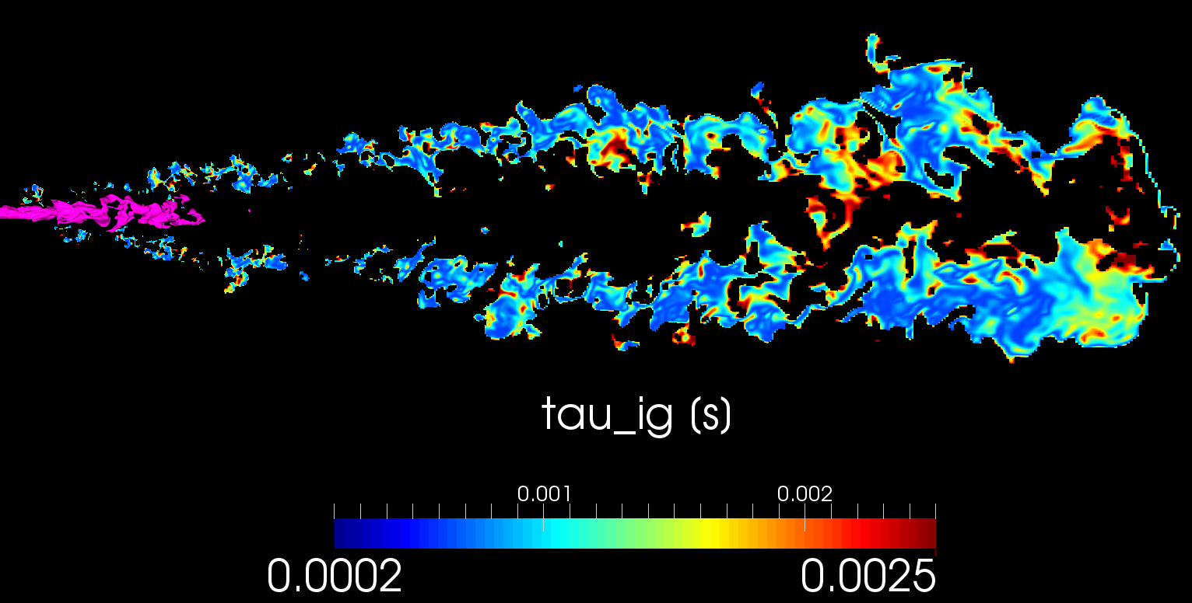
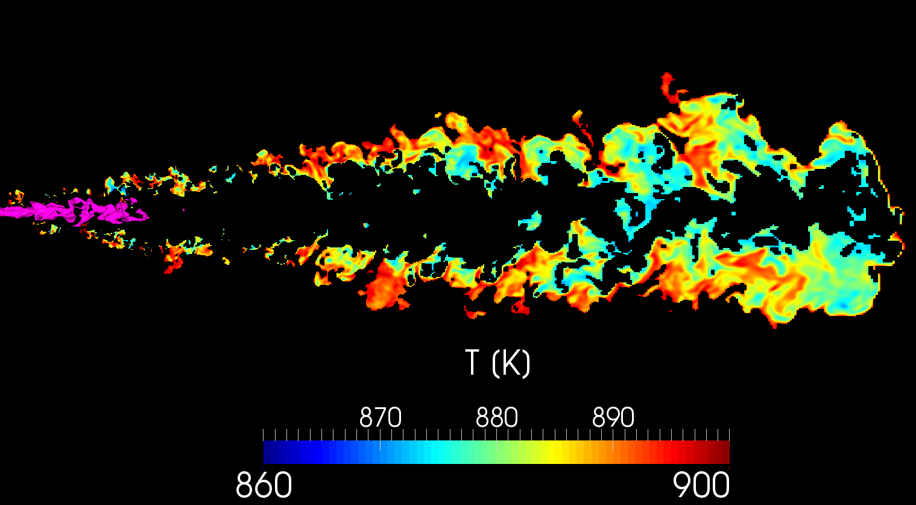
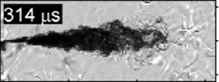
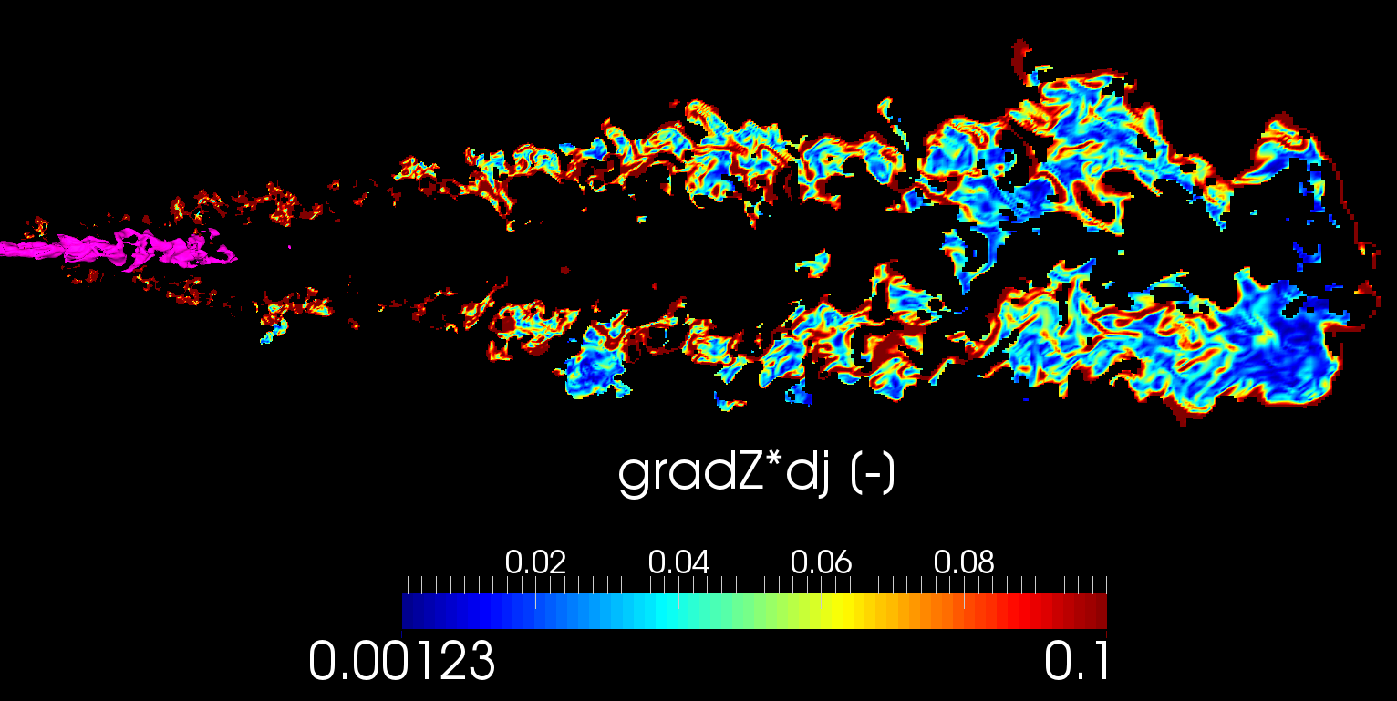
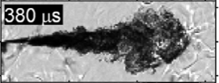
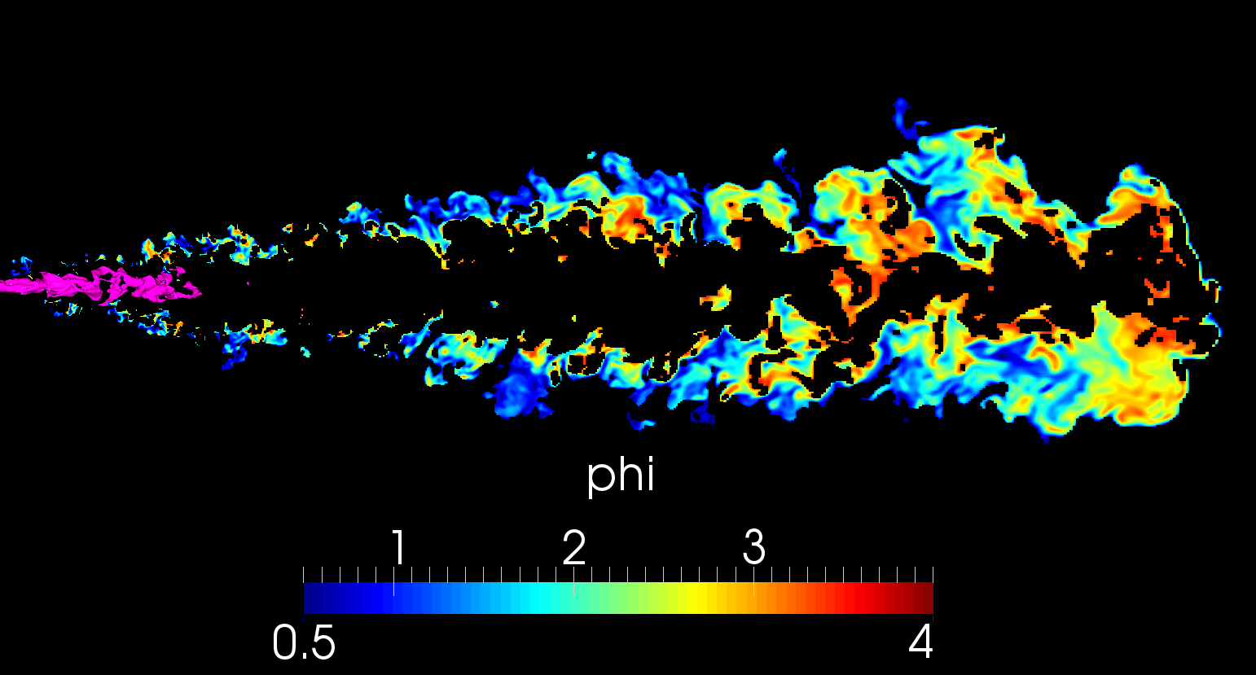
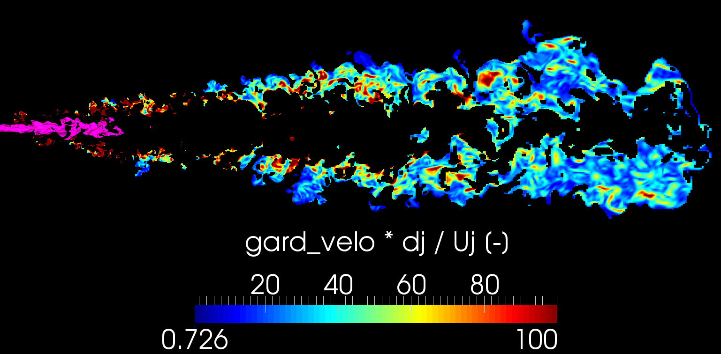
Results reveal transient mixture state just prior to autoignition
Temperature, K (700 < T < 900)
Flow just prior autoigniton
Ignition Delay
Identification of flammable regions quantifies range of conditions where chemical mechanism must be accurate
Temperature, K (700 < T < 900)
Equivalence Ratio (0.5 < Φ < 4)
Pressure: 60±5 bar
Cool-flame ignition
Equivalence Ratio (0.5 < Φ < 4)
Scalar Dissipation
Hot ignition
Skeen et al., PCI, 2014
Autoignition most likely to occur where
Ignition delay time
Scalar dissipation rate
Strain rate
are simultaneously minimized
Strain Rate
Pressure: 60±5 bar

Slide 21
Selection of candidate mechanisms presents interesting questions
Sarathy et al., 2011
2-methyl-alkanes and n-alkanes up to C12
2755 species
11173 reactions
Narayanaswami et al., 2013
Skeletal mechanism
255 species
2289 reactions
Luo et al., 2014
Skeletal mechanism
105 species
420 reactions
All designed for up to 20 bar, 600 – 1500 K
n-Dodecane – Air
φ = 1, p = 20 bar
There is a wide range of variability between mechanisms with no monotonic convergence in accuracy

Slide 22
Reduced order modeling applied to design chemical “model” for specific sets of operating conditions
Reduces computational cost of finite-rate chemistry while maintaining quantified level of accuracy in key chemical properties
L. Hakim, G. Lacaze, M. Khalil, K. Sargsyan, H. Najm, and J. Oefelein. Probabilistic parameter estimation in a 2-step chemical kinetics model for n-dodecane jet autoignition. Combustion Theory and Modelling, 22:446–466, 2018.

Slide 23
We are investigating the merits of a new combustion closure based on space-time filtering
Turbulent stresses
and fluxes
Filtered chemical
source terms

Slide 24
We are investigating the merits of a new combustion closure based on space-time filtering
∆t_{LES}
Hypothesis … space-time filtering can be used to close the filtered chemical source terms directly
Apply approximate deconvolution model with assumed scalar spectrum to calculate subfilter variance/covariance matrix
Variance/covariance matrix used as input to generate correlated scalar fluctuations on subfilter scales in time
Modeled instantaneous signal used to evaluate filtered chemical source terms directly
Benefits … 1) conceptually regime independent, 2) minimizes assumptions required for closure, 3) approaches correct behavior in limit of DNS (i.e., facilitates hybrid-DNS/LES approach)
Mass Fraction
n-dodecane
Time, 𝜇s
e.g., Modeled instantaneous fluctuations of fuel on centerline at 100 diameters downstream of injection

Slide 25
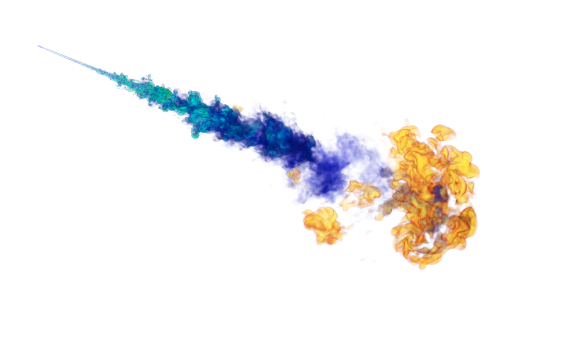
Modeled instantaneous fluctuations facilitate formation of ignition kernels
Volume rendered fuel mass fraction
Highlighting mixing
Volume rendered temperature
Highlighting ignition kernel development

Slide 26
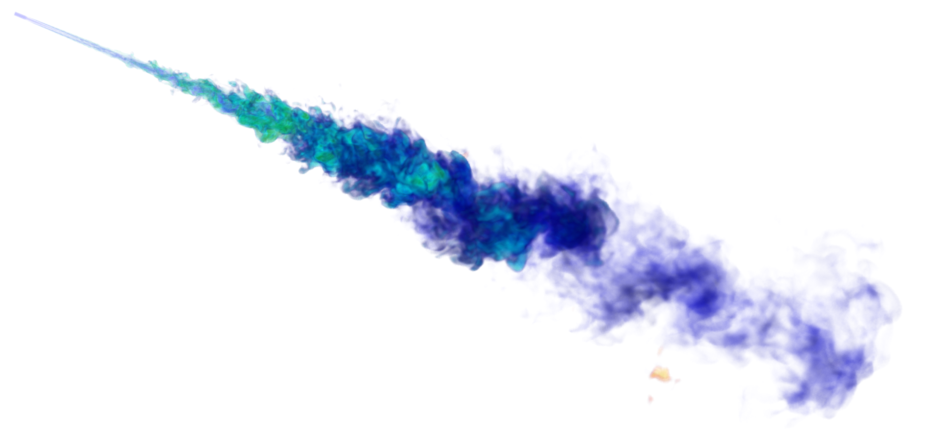
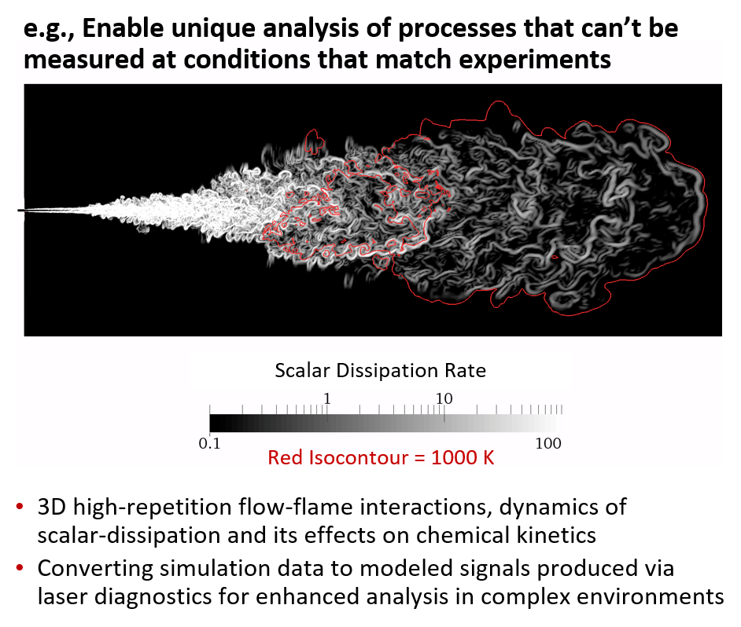
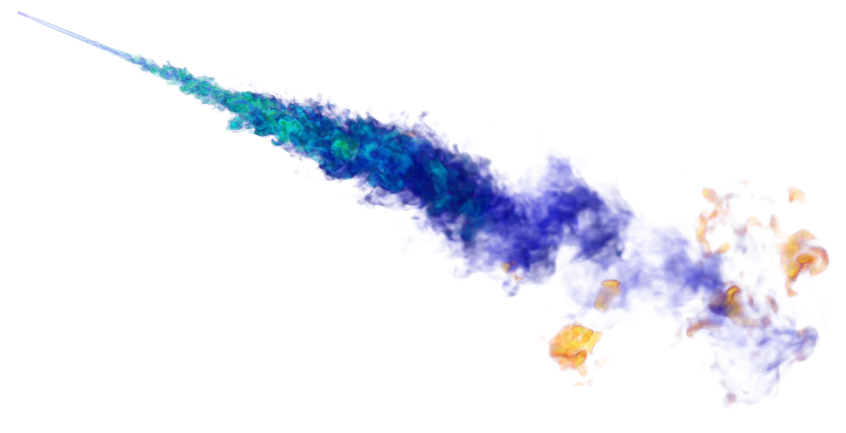
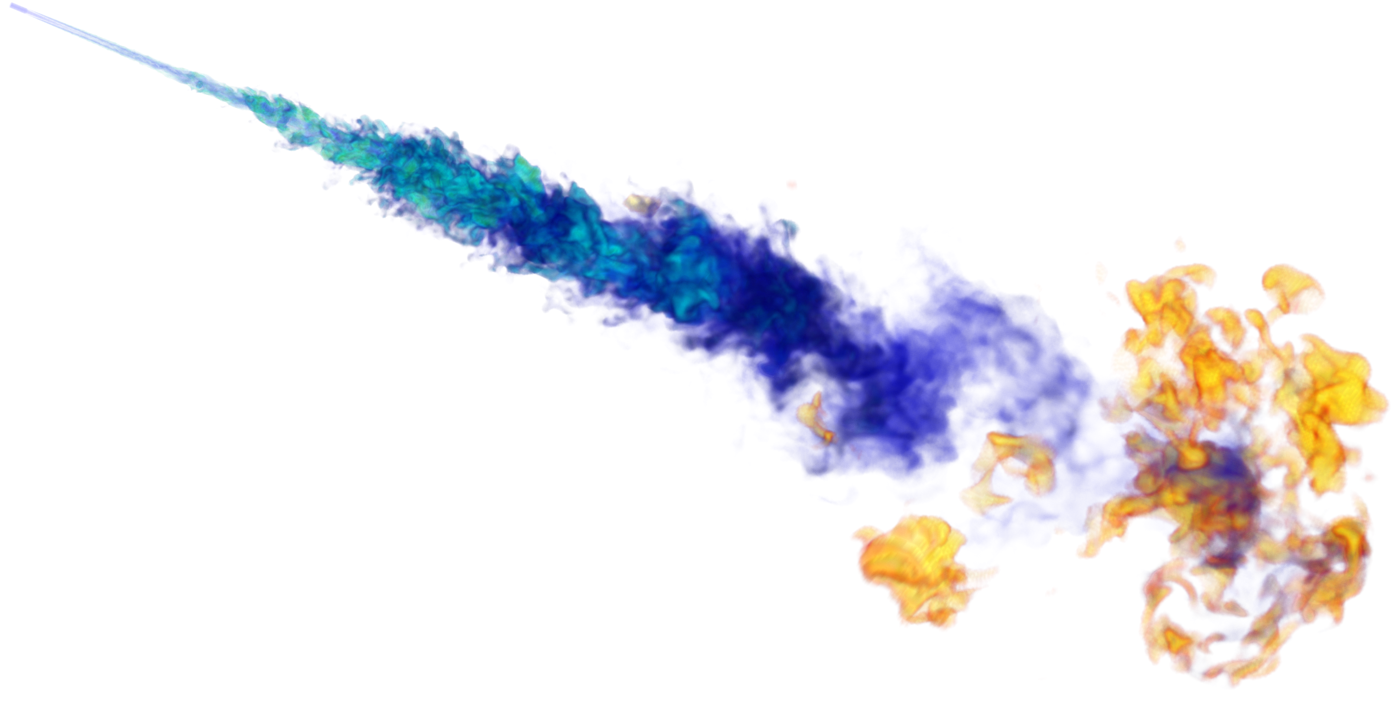
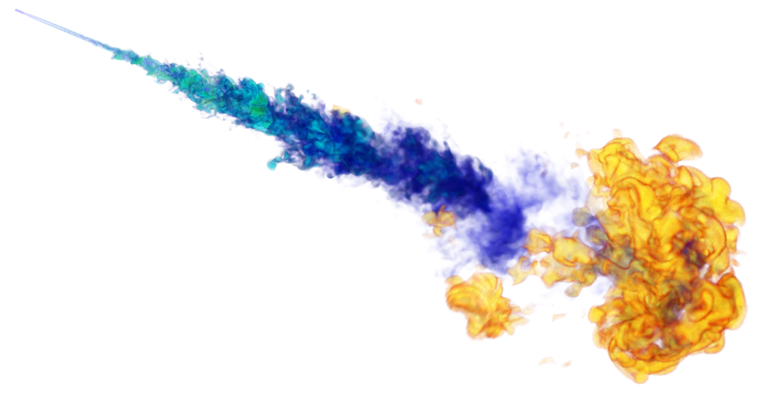
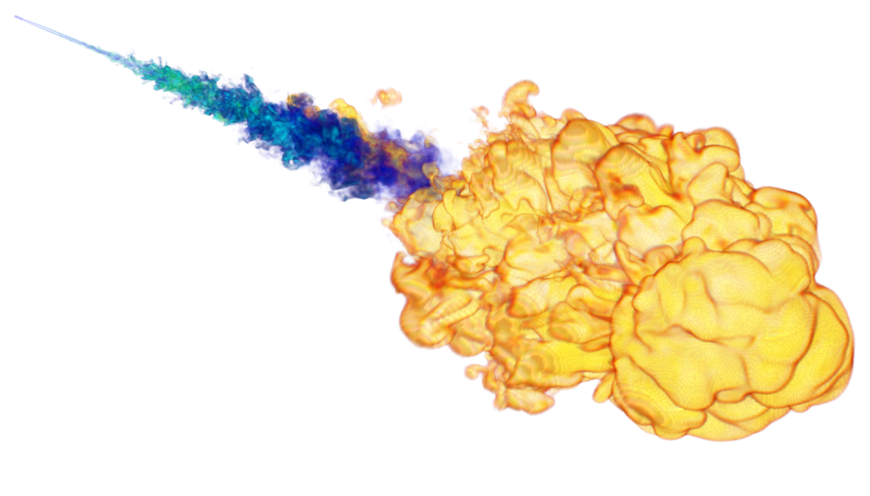
Major goal moving forward is to tightly couple simulations to key companion experiments
First kernel, diameter ≈ 500 μm (too small to be optically detected)
Location: tip of the jet, off-axis
220 μs
Independent kernels appear, diameter ≈ 500μm to 2mm (still very small for optical detection)
Location: tip of the jet, off-axis
250 μs
270 μs
Many small kernels present in the “jet edge” region, what is the impact on Schlieren?
Single flame structure with upstream independent kernels, flame expands through dilatation and autoignition
300 μs
Main flame region at the jet extremity, autoignition locations observed ahead of main front
380 μs
Schlieren images by Skeen et al., PCI, 2015

Slide 27
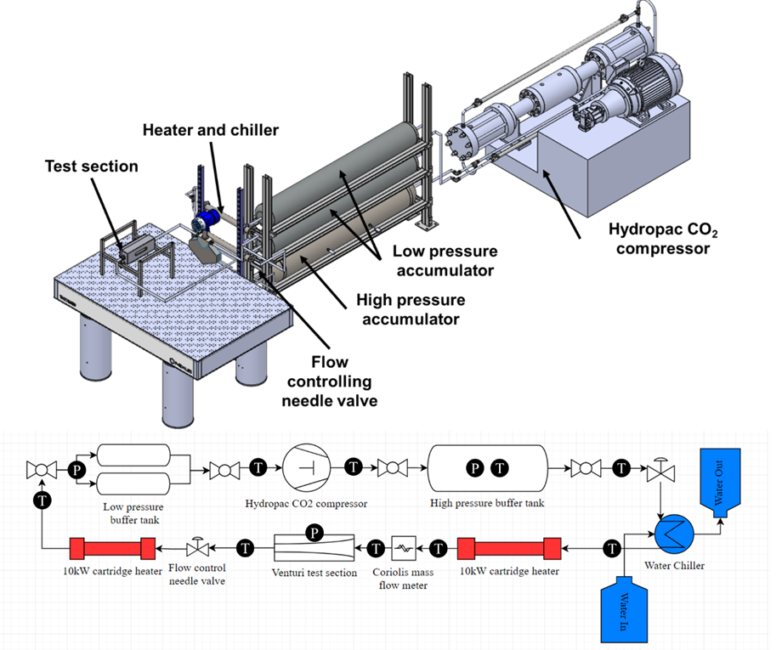
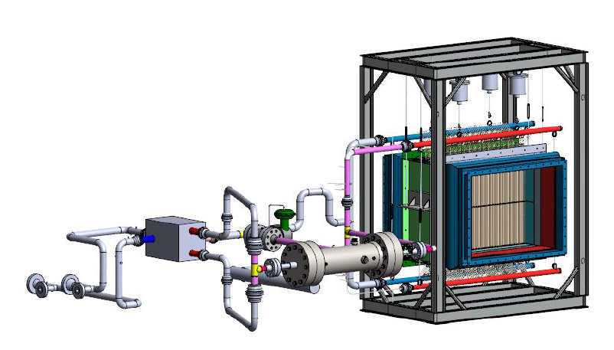


Current project goals … apply same approach via two complementary experiments …
Phase 1 – Non-Reacting sCO₂ Loop
Phase 2 – SwRI sCO₂ Combustor
Physics + Validation Data
Physics + Validation Data
Year 1
Years 2-3

Slide 28
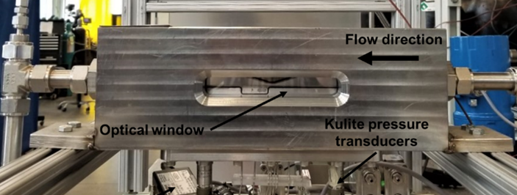
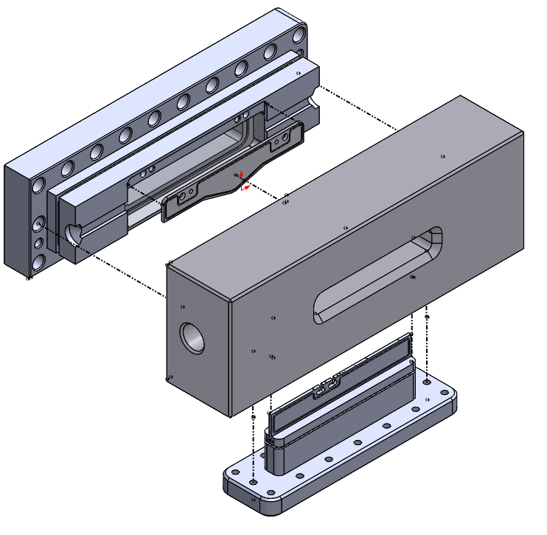
Non-reacting sCO₂ loop
Objectives … generate progressive set of high-quality quantitative data for validation
Focus on fluid mechanics, heat transfer, and turbulence in vicinity of vapor dome and at supercritical flow conditions
Investigate nuances with respect to coupled treatment of turbulence, equation of state, thermodynamics, and transport
E.g., scalar-scalar variance/co-variance fields
Diagnostics and measurement plan …
Raman scattering measurements of sCO₂ density fields
Manufacture new test section to investigate scalar mixing processes (e.g., heated cylinder)
Apply new “pulse burst” laser (1 J/pulse, 532 nm, 10 kHz repetition-rate, 100 pulses per burst)
Current optical windows
Back flange
3mm slot
New 3-window test section (currently in design)
Bottom flange

Slide 29
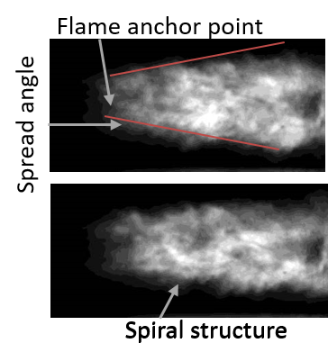
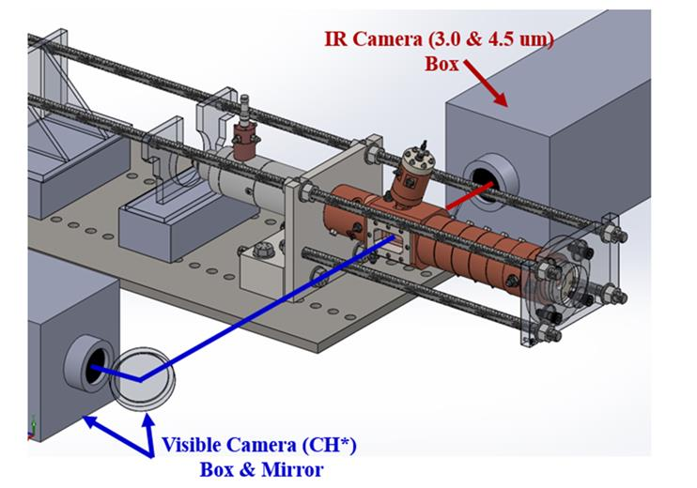
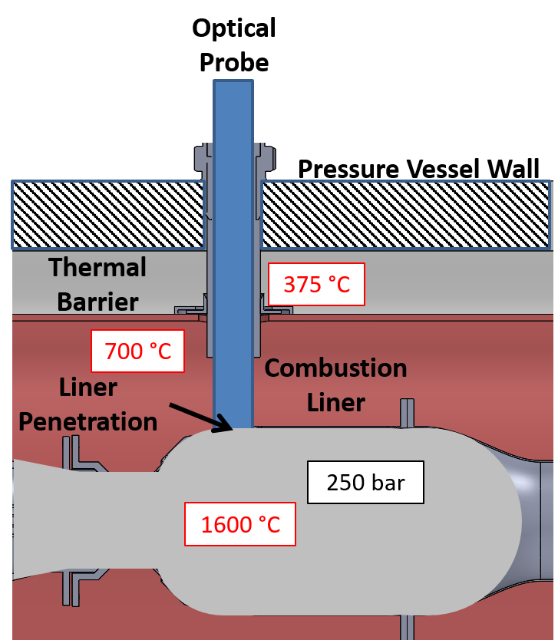
SwRI sCO₂ combustor measurements
Objectives … generate reacting flow data for model validation at relevant operating conditions
Flame holding dynamics, anchoring location, shape and structure
Scalar mixing, turbulence-chemistry interactions
Diagnostics and measurement plan
Preliminary focus on spectrally-resolved imaging across UV-IR
Perpendicular viewing angles to capture 3D distribution
Multiple wavelengths to look at different species
Ballance et al., AIAA 2017-5014
SwRI sCO2 combustor

Slide 30
Major outcomes
Development of a validated LES model framework that supports oxy-combustion experiments relevant to direct cycles
Creation of a synergistic combination of computational and experimental research with substantive impact on the practical design and implementation of sCO₂ power cycles
Incorporation of research results into the Southwest Research Institute internal technology development process with the goal of advancing the TRL to 3 or 4

Slide 31
Thank You

Slide 32
Summit is currently the fastest computer in the world

Slide 33
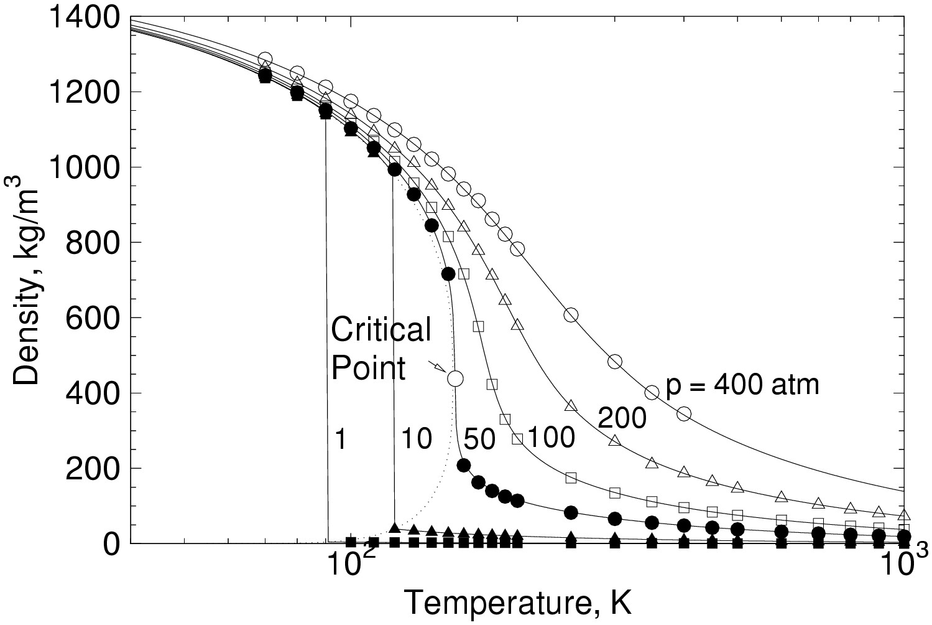

Validation via NIST, custom software designed to run efficiently on HPC platforms across relevant regimes
Oxygen

Slide 34

Both solvers produce similar results consistently over relevant ranges of conditions

Slide 35


Statistical grid convergence easily established, but level of structural dynamics required by models not clear
h30
Vorticity – Strain
h100
h250
h500

Slide 36


Let’s focus on conditions at 60 bar assuming “transcritical” injection, mixing, combustion
Sandia High-Pressure
Combustion Vessel
Initial Conditions
Pressure: 60 bar
Temperature: 900K
Composition: 15% O2
1050 d
Spray-A injector
(n-Dodecane)
1080 d
0.09 mm
Injection Conditions
Peak Velocity: 600 m/s
Peak Re_{d}: 117,000
Density: 650 kg/m³
Temperature: 363 K
Computational Domain

Slide 37
Turbulent flow dynamics at nozzle exit modeled using Synthetic Eddy Method
Spray-A injector
(n-Dodecane)
Synthetic Eddy Method (Jarrin et al., 2008) uses measured or calculated
Mean velocity profile
Integral scale distribution
Reynolds stress tensor
Provides tractable way to specify inflow boundary conditions for anisotropic, nonequilibrium, rough wall conditions, etc.
0.09 mm
Injection Conditions
Peak Velocity: 600 m/s
Peak Re_{d}: 117,000
Density: 650 kg/m³
Temperature: 363 K

Slide 38
ROM/UQ applied to optimize chemical “model” for specific sets of operating conditions
Objective
Design model for specified range of operating conditions (p, T, phi) using selected reference mechanism
Optimize model to capture specific chemical characteristics
Approach
Start with simplest model form; e.g., equations based on Arrhenius laws for reaction rates
Functionalize pre-exponential factors and activation energies w.r.t. operating conditions
Use Bayesian inference to fit the most probable surfaces over specified range of conditions

