Slide 1

Supercritical Transformational
Electric Power (STEP)
10 MW_{e} sCO2 Pilot Plant Demonstration
DE-FE0028979
Brian Lariviere, GTI, STEP Program Director
November 7, 2019

Slide 2
Acknowledgement
This report was prepared as an account of work sponsored by an agency of the United States Government. Neither the United States Government nor any agency thereof, nor any of their employees, makes any warranty, express or implied, or assumes any legal liability or responsibility for the accuracy, completeness, or usefulness of any information, apparatus, product, or process disclosed, or represents that its use would not infringe privately owned rights. Reference herein to any specific commercial product, process, or service by trade name, trademark, manufacturer, or otherwise does not necessarily constitute or imply its endorsement, recommendation, or favoring by the United States Government or any agency thereof. The views and opinions of authors expressed herein do not necessarily state or reflect those of the United States Government or any agency thereof.

Slide 3
Agenda
Promise of sCO2 Power Cycles
Program Description, Objectives & Approach
STEP Site Overview
STEP Component & System Status
STEP Program Accomplishments
Beyond STEP
Program Summary
Acknowledgements

Slide 4

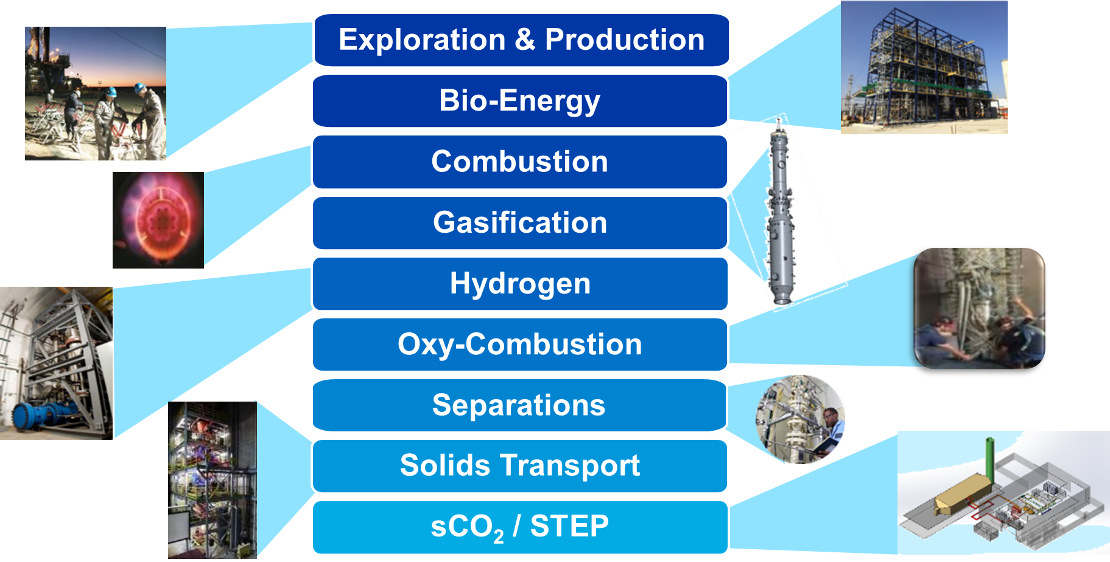
Energy Supply & Conversion Programs

Slide 5
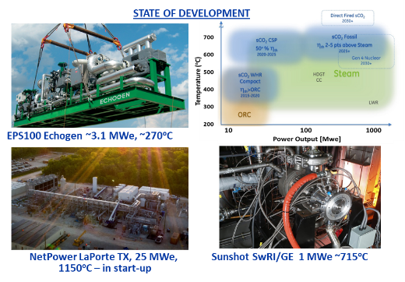
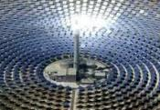
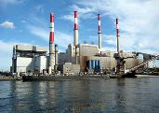
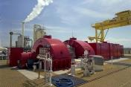
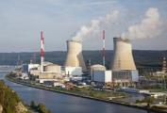
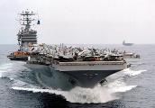
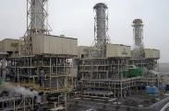
Promise of sCO₂ Power Cycles
Promise:
Efficient, Compact, Scalable, low water, low-carbon power generation
Challenges:
Operability, Transients, Turbomachinery Aero Performance, Seals, Recuperator Size & Durability, Materials, Corrosion, Cost
Versatile Technology – Broad Applicability:
Concentrated Solar
Fossil Fuel
Geothermal
Nuclear
Ship-board Propulsion
Waste Heat Recovery

Slide 6
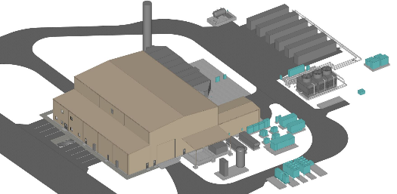



Supercritical Transformational Electric Power (STEP) Project DE-FE0028979
Scope:
Goal:
Team:
Schedule:
Cost:
  Design, construct, commission, and operate a 10 MWe sCO₂ Pilot Plant Test Facility - reconfigurable to accommodate other testing
  Advance state of the art for high temperature sCO₂ power cycle performance from Proof of Concept (TRL3) to System Prototype validated in an operational system (TRL7)
  U.S. Department of Energy (DOE NETL)
  Gas Technology Institute (GTI®)
  Southwest Research Institute (SwRI®)
  General Electric Global Research (GE-GR)
  Joint Industrial Partners:
  Three budget phases over six years (2016-2022)
  $122MM Total* / $84MM Federal Funding (currently in BP2)
* Total cost is DOE STEP project + general purpose building

Slide 7
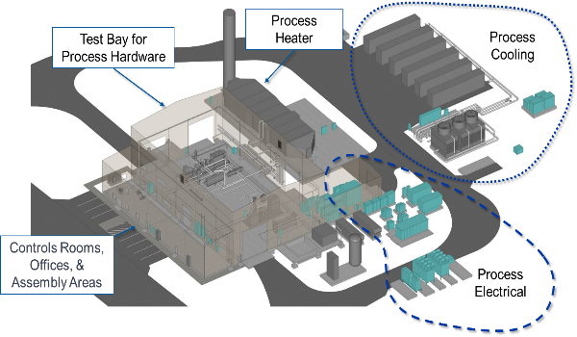
STEP Program Objectives
STEP Demo will demonstrate a fully integrated functional electricity generating power plant using transformational sCO2-based power cycle technology
Demonstrate pathway to efficiency > 50%
Demonstrate cycle operability >700°C turbine inlet temperature and 10 MWe net power generation
Quantify performance benefits:
  2-5% point net plant efficiency improvement
  3-4% reduction in LCOE
  Reduced emissions, fuel, and water usage
Demonstrate Reconfigurable flexible test facility
Beyond STEP - sCO2 Technology Test Bed Available
  Available for Testing future sCO2 equipment & systems
STEP will be among the largest demonstration facilities for sCO2 technology in the world

Slide 8
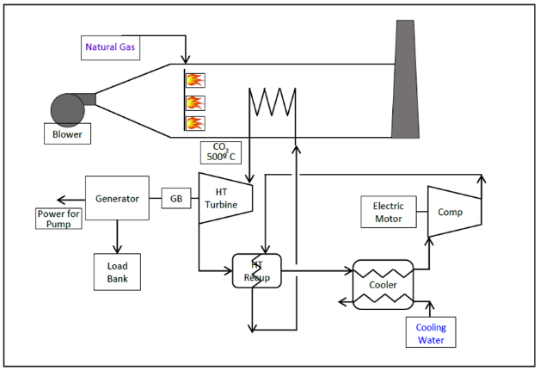
Test Approach – System Verification in Two Steps
STEP 1 - Simple Cycle Configuration (Lower Risk)
  Commissioning
    Initial Equipment Performance
    Op Procedures (Start, Stop, Secure)
  Tests - Turbine Inlet to 250 bar to 500°C
    System Start, Stop & Secure
    Initial Equipment Interactions
    System Control & Data Collection
    System Safety Verifications
    Steady & Transient Cycle Performance Data

Slide 9
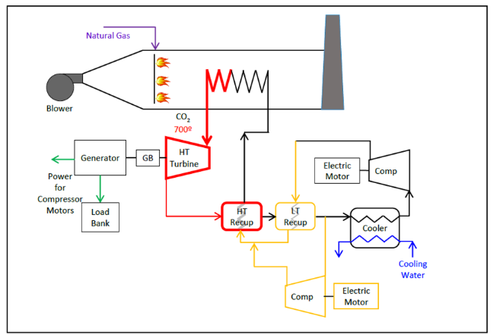
Test Approach – System Verification in Two Steps
STEP 2 - Recompression Closed Brayton Cycle (RCBC)
  Reconfigure to RCBC
    Add Bypass Compressor & Cooler
    Add Low Temperature Recuperator
  Tests - Turbine Inlet to 250 bar at >700°C
    Overall System Performance
    System Control & Equipment Interactions
    System Safety
    Steady & Transient cycle data
    System Durability

Slide 10
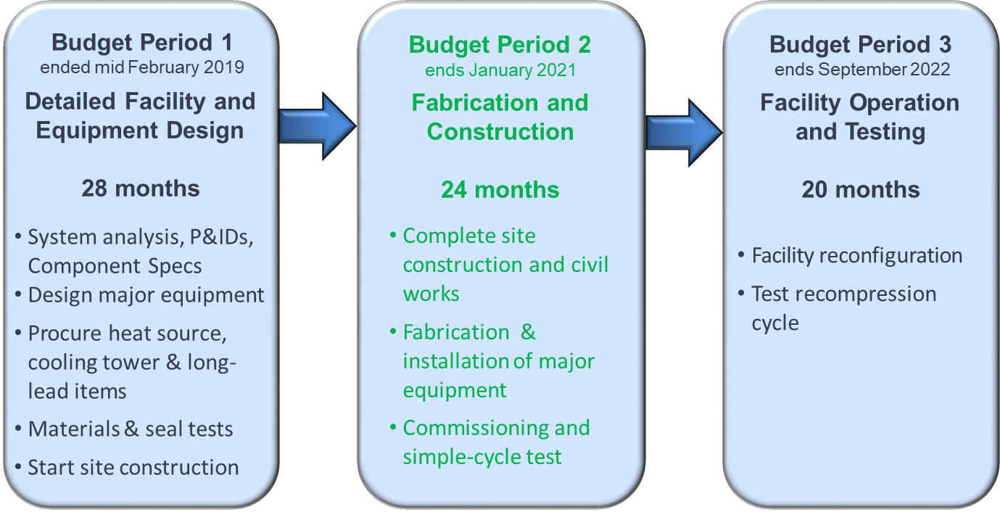
STEP Plan – Currently Mid-way through BP2
Status:
  Completed System & Major Equipment Design (BP1)
  Facility Site Construction Well Underway
  Procurement & Fabrication of major equipment progressing
  Delivery of Major Equipment starting Nov 2019
  Commissioning and Simple Cycle Testing late in 2020
Completed
In Progress

Slide 11

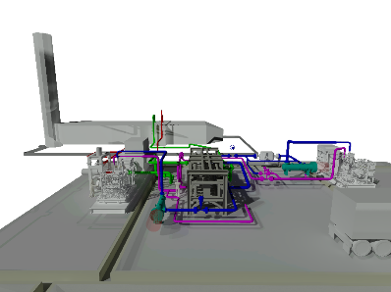
STEP Site Overview
Test Bay for Process Hardware – RCBC Configuration
Process Heater
Process Cooler
Main Compressor
Cooling Tower
Turbine with Bypass Compressor
High Temp Recuperator (HTR)
Filters (2plcs)
Inventory Management System
Low Temp Recuperator (LTR) & BC Cooler not shown

Slide 12
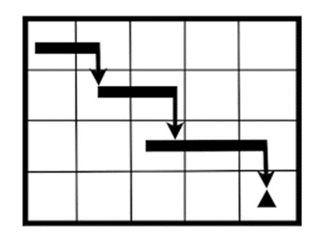




Main Equipment & System Status & Challenges
Key Equipment Challenges
  = Design/Technical
  = Cost
  = Schedule
4.11 Turbine Stop Valve (TSV)
4.16 Power Cycle Electrical Distribution Equipment
4.12 DCS

Slide 13
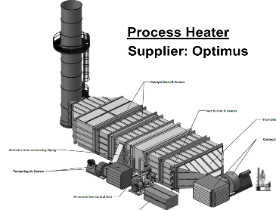
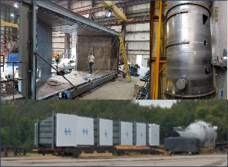
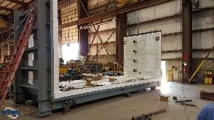
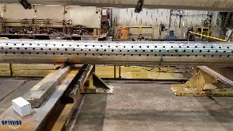
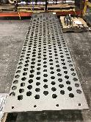
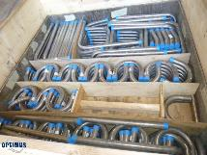
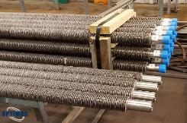
STEP Process Heater
Heat Recovery Steam Gen (HRSG) style “boiler”
  Duct NG burner ~ 50 MWth
  Multi-pass IN740H heat exchanger
  Designed to ASME BPV Section 1
  Designed for 100 kg/s at 255 bar, 715°C
  Size: 14’W x 133’L x 18’H (Stack 70’H)
Provided by Optimus Industries, LLC
Burner Section module being fabricated
IN740H header pipe 11.25” OD, 7.5” ID with holes for tubing drilled
Cast tube sheet
IN740H tubing bends
IN740H tubing with fins

Slide 14
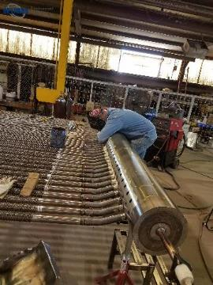
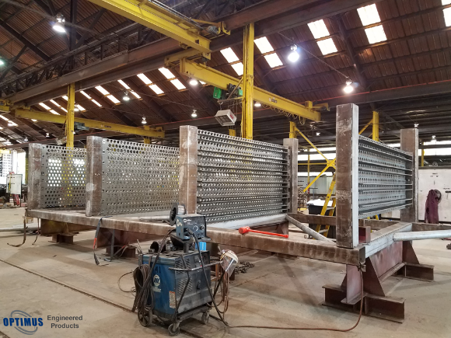
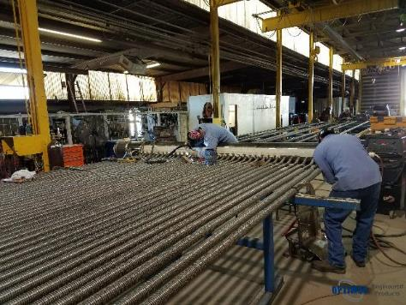
Critical Heat Transfer / Coil Module (A45) in Fabrication
  Process heater stack being manufactured. Module A45, Heater Coil Framing with Tube Sheet.

Slide 15

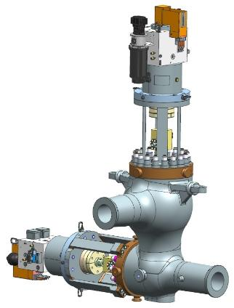
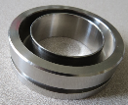
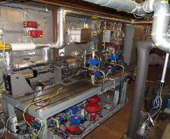
STEP Turbine Stop/Control Valve (TSV)
Challenging Thermal Gradients
TSV produced by GE Power is similar to conventional steam valves with sCO2 specific features
  Leverages Haynes 282 material development under DOE AUSC program
  Advanced seals leveraging BHGE O&G capability
  Self-contained actuators leveraging BHGE O&G experience
  Valve body casting in work
Seal & shaft testing at GE

Slide 16
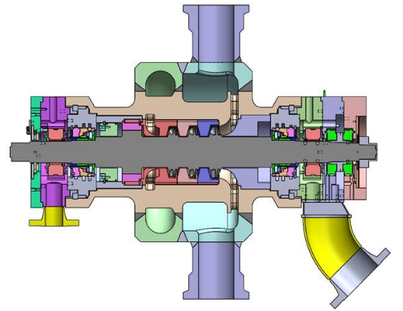
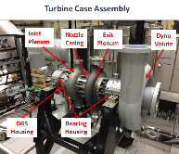

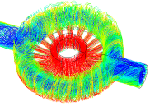
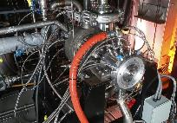
STEP Turbine - Builds on successful SunShot
Detail design review scheduled for Winter
Three stage gas path defined
Increased performance inlet/exit volutes
SunShot 1 MWe demonstration [700°C]
Procurement of long lead materials on-going
Monolithic Rotor Fabrication scale up challenge
Turbine Cross-Section
Aero analysis
Sunshot Turbine

Slide 17
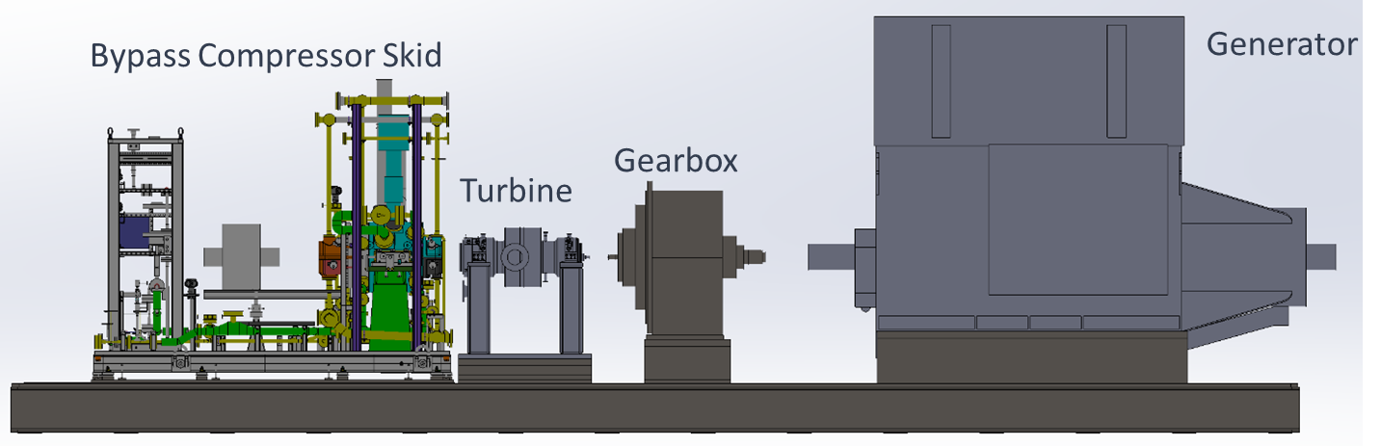
STEP Turbine Skid Configuration
Compact turbine (SwRI & GE)
Direct turbine drive for bypass compressor (Baker-Hughes)
Gearbox (Voith)
Generator (TDPS)

Slide 18
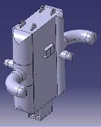
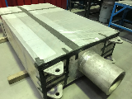
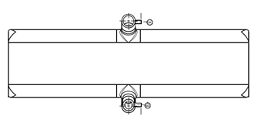
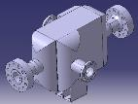
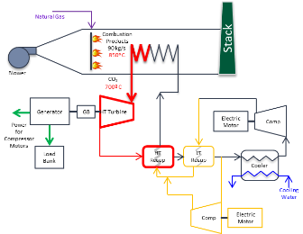
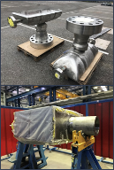

STEP Heat Exchangers
  HTR (High Temp Recuperator) – Heatric, Inc.
    sCO2/sCO2 service
    49 MWth duty, 600ºC design temp
    Design Challenges meeting both Simple Cycle & RCBC range of duties
  LTR (Low Temp Recuperator) – Heatric, Inc.
    sCO2/sCO2 service
    13 MWth duty, 250ºC design temp
  Main Process Cooler – Heatric, Inc.
    sCO2/clean water service
    16 MWth duty, 150ºC design temp
  Bypass Process Cooler – VPE
    In Final Design
HTR Approaching Final Design Review
LTR
LTR Core Fab Completed
Main Cooler
All STEP heat exchangers are compact Printed Circuit Heat Exchangers (PCHEs)
BP Cooler
RCBC (>700ºC, 250 bar)
MPC Core & Headers Fab Completed

Slide 19
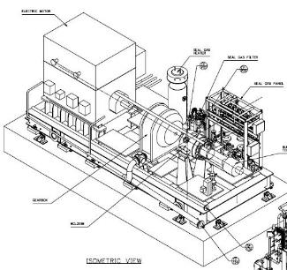
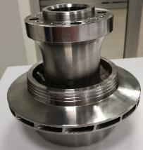

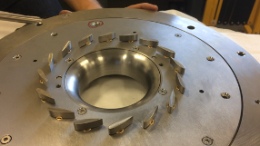
STEP Compression System
Baker-Hughes fabricator of Main & Bypass Compressors
Main Compressor driven by electric motor
Bypass Compressor directly driven by STEP sCO2 turbine
Radial impeller and compressor hardware in work
Compact Integral Guide Vanes (IGV) with large angle variation
Design basis from industrial CO2 compressors and DOE Apollo project DE-EE-0007109

Slide 20
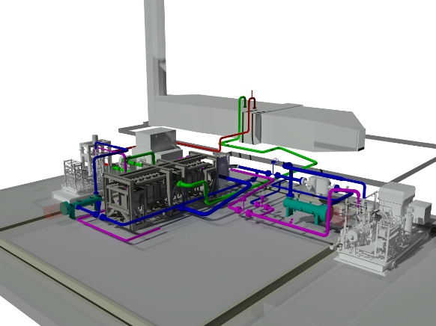
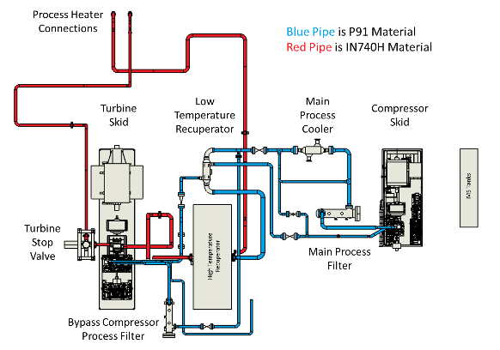
STEP Facility Piping Layout
BC Cooler & IMS Piping not shown

Slide 21
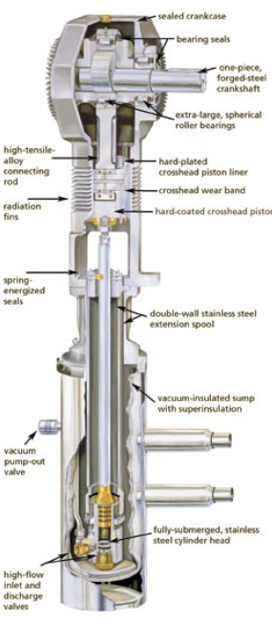
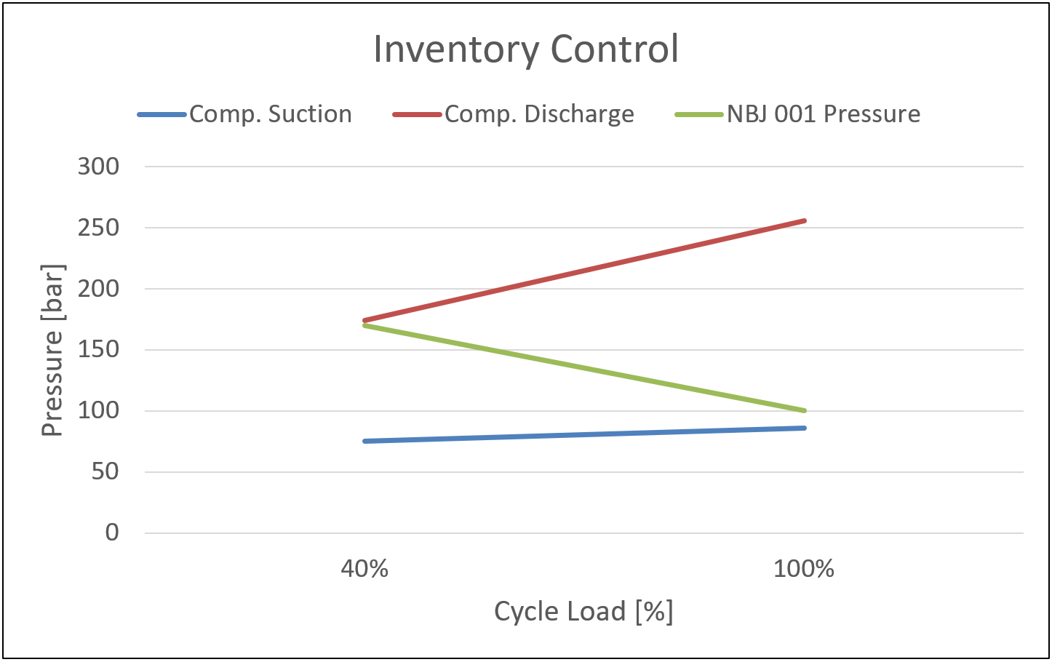
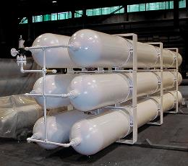
STEP Inventory Management System
Controls flow of working fluid into and out of closed Brayton Cycle to manage turbine load
  Filling of cycle
  Add or remove mass to pressure control system
    Accommodates achieving cycles of interest
    Accommodates load steps and system transients
  Supporting auxiliary supply flows:
    Dry Gas Seal supply, Turbine Stop Valve Stem Seals
  Replenish inventory vented to atmosphere
Status of the IMS System
  Equipment selection is complete (pressure vessels, pumps, vaporizers, valves, instrumentation, and tubing)
  Procurement is in process with delivery lead times to support plant construction
Inventory storage tanks maintained between the compressor suction and discharge pressures during plant power load changes
Liquid CO2 pump boosts pressure from storage tank to system
Inventory storage tanks

Slide 22
Significant Accomplishments by STEP Team
Test Site Ground Breaking (Oct 2018) and Foundations Poured for Turbine & Compressor (Sep 2019) – (SwRI lead – Construction by Joeris)
Large Scale Fabrication of Alloy 740H tubing welds successful on Process Heater (GTI lead – Heater Fab by Optimus)
Completion of 1st Major Components – Delivery to Site imminent
  Cooling Tower completed (produced by TAS) – Delivery scheduled for Nov 6
  Process Heater Modules (produced by Optimus) – 6 of 10 modules completed. Stack Delivery to San Antonio scheduled for 2 Dec

Slide 23
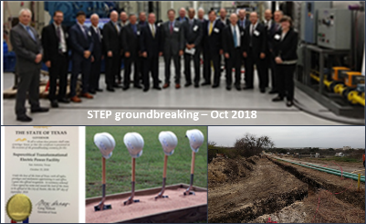
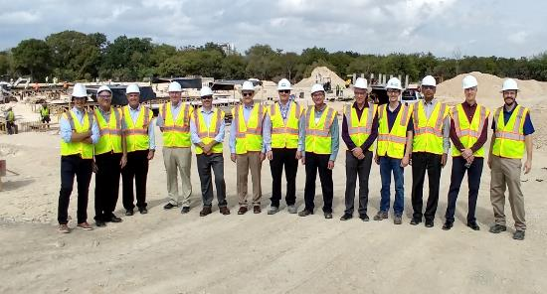
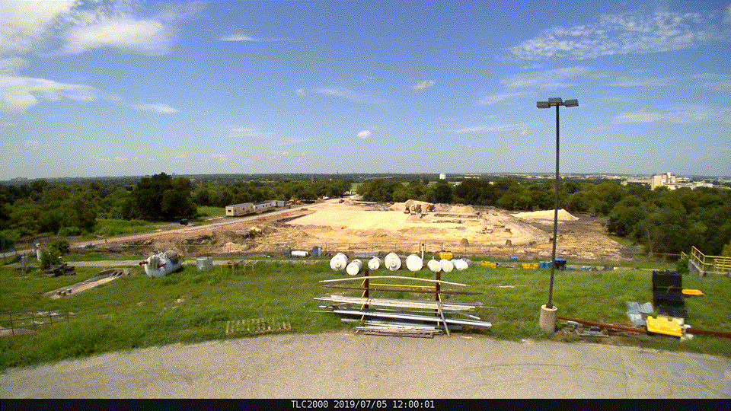
Accomplishments –Progress at STEP Site in San Antonio, TX – Turbine Skid Pad Poured
DOE HQ & NETL, GTI, SwRI & GE-GR at the construction site Sep 29, 2019
Site Construction Weekly from July through October

Slide 24



Accomplishments – Successful demonstration of Large Scale Fabrication using Alloy 740H
“U” tubing being welded to tube ends in Heat Transfer Module
Heavy wall manifold and tubing-to-manifold welds

Slide 25



Accomplishments – Large Equipment Completed & 1st System Delivered!
Module A85, Outlet Transition
STACK - 10’diam by 70’ tall
ceramic fiber insulation & internal liner
Cooling Tower System
Delivered to Site on Nov 6
6 of 10 Process Heater Modules Completed

Slide 26

Beyond STEP – Flexible Platform
Near-term:
  Turbomachinery and other equipment verification testing
  Compressor characterization near/below saturation
  Longer-duration simulated dispatch operation (RCBC)
  Application reference studies
Longer-term:
  Product improvement & cost reduction [ 500 < T(ºC) < 715 ]:
    Hermetically sealed turbomachinery
    Advanced lower cost materials and manufacturing
  In-direct Oxy-PFBC solid fuel demo [ 585 < T(ºC) < 715 ]
  Direct fired high-temperature sCO₂ demo [ 715 < T(ºC) < 1200 ]

Slide 27
Program Summary
Significant Progress on Major Equipment Design & Fabrication
  Technical Success with Large Scale Alloy 740H fabrication on Heater
  Delivery of first major equipment elements starting in Nov 2019
Site Construction Progressing
  Critical turbine and compressor skid foundations poured, Building Steel Installation imminent
  Building Occupancy planned for mid-2020
Technical challenges identified on two critical components - Recovery efforts in work
  HTR – Taking longer to complete design due to wide operating range for Simple Cycle & RCBC Tests
  Turbine Rotor – Challenges with monolithic rotor producibility (limited machines due to size)
Focus on System Installation & Simple Cycle Commissioning in late 2020
STEP is a Flexible, Reconfigurable Facility to Test New large scale Components and Technologies for future sCO2 systems

Slide 28
Acknowledgements
DOE Leadership
  Dr. Bhima Sastri, DOE HQ
  Richard Dennis, DOE/NETL
  Robin Ames, DOE/NETL, Program Manager
STEP Team
  Dr. Aaron McClung, SwRI Principal Investigator
  Jason Mortzheim, GE-GR Principal Investigator
  Michael Kutin, GTI Deputy PI

Slide 29
Questions

