Slide 1
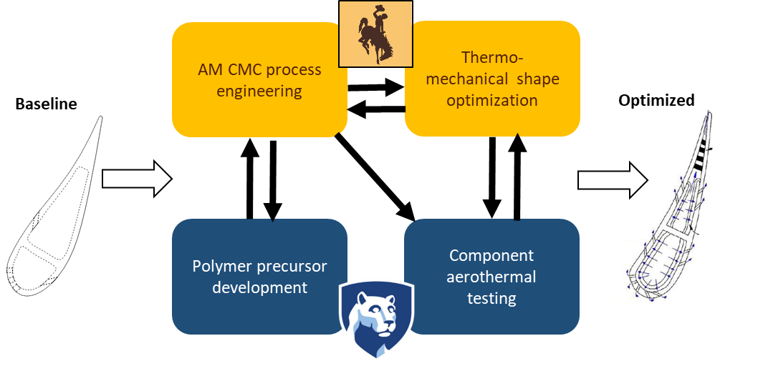

Development of Additive Manufacturing for
Ceramic Matrix Composite Vanes
Dr. Stephen Lynch
Dr. Michael Hickner
Dr. Carl Frick
Dr. Ray Fertig
Students: Alex Rusted, Yifan Deng
Post-doc: Dr. Will White
Students: Stephan Brinckmann, Jackson Rambough, Kyle Kuhn
Project: DE-FE0031758

Slide 2
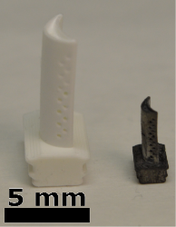
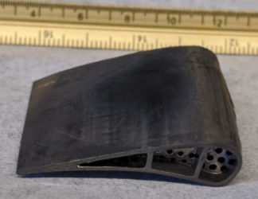
This review covers the motivation, prior technical work, project plan, and the current progress on our UTSR-supported project
Motivation: enable superalloy-like cooling features in CMC-like materials
Approach: develop polymer-derived ceramics and validate cooling potential
Project plan
Current progress

Slide 3
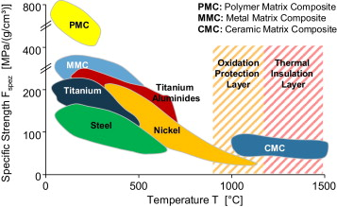
The motivation for this work is that even advanced CMC materials will require some cooling, to achieve DOE firing temperature targets
DOE FE Program Goal:
3100°F (1700°C) turbine entry temperature
Klocke, et al., CIRP Annals, 2014

Slide 4
Highly effective internal cooling technologies used in superalloy cast parts are difficult to implement in conventional CMC’s
DOE NETL Advanced Cooled Blade
(PSU START Lab)
Melt-infiltrated woven CMC
Town, et al., JTurbo 2018
https://technology.nasa.gov/patent/LEW-TOPS-25
Example superalloy internal/external cooling
Binder-jet CMC with pass-through cooling
https://mdx.plm.automation.siemens.com
https://ntrs.nasa.gov/search.jsp?R=20160010285 2019-02-28T01:25:33+00:00Z
Project goal: enable complex cooling features in CMC-like materials for realistic airfoils and confirm cooling benefit

Slide 5

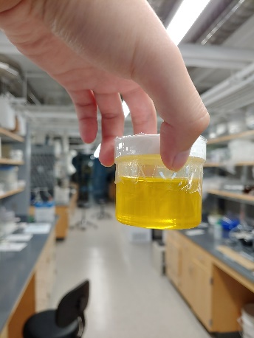
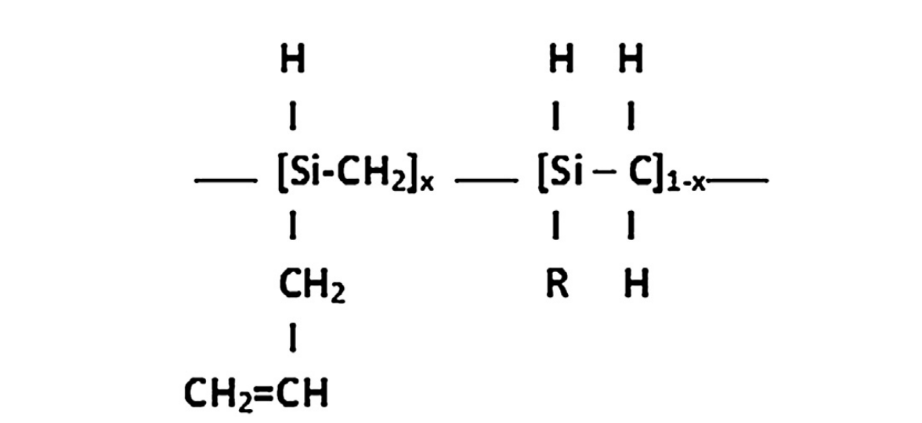
Our approach is to utilize development of AM of polymer-derived ceramics (PDCs), coupled with embedded SiC whiskers
PSU: Hickner Group
U of Wyoming: Frick Group

Slide 6
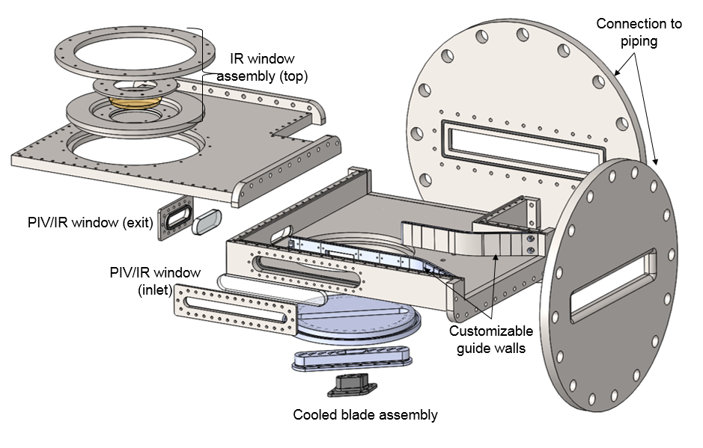
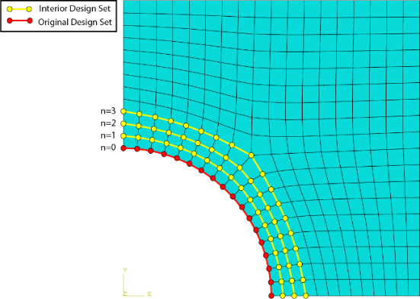
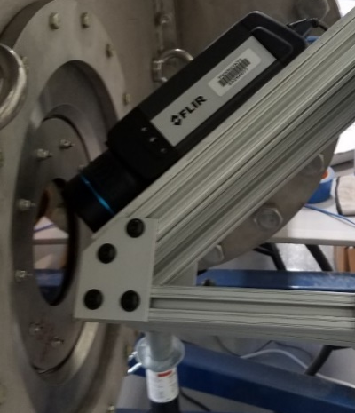
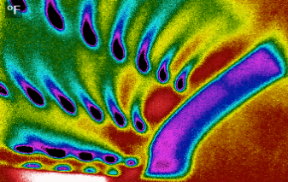
Novel topology optimization tools will be used to get largest benefit, and cooling effectiveness for actual parts will be tested at high speed
U of Wyoming: Fertig Group
PSU: ExCCL Lab (Lynch)
Exit Ma=0.4-1.2
Lv & Liu, 2018, Meccanica, 53(15).

Slide 7
The project has five technical tasks that address process engineering, material development, modeling, and validation of cooling technologies
Task 1: Project management
  Success criteria: Project Coordinator delivers all required reports to NETL
Task 2: Design, fabrication, and testing of SiOC/SiC baseline vane
  Success criteria: project team is able to obtain surface temperatures on baseline SiOC/SiC internally cooled vane test articles tested in the transonic cascade at Penn State
Task 3: Modeling and optimization of CMC turbine vane designs
  Success criteria: mechanical and thermal stresses reduced by 10%; increase overall cooling effectiveness by 0.05 relative to baseline
Task 4: Development of new SiC precursor chemistries
  Success criteria: demonstrate that new precursors have equivalent or better material properties than SiC formed through traditional methods
Task 5: Integrate SiC precursor chemistry into AM process
  Success criteria: project team is able to deliver a baseline vane part for transonic cascade testing using new SiC/SiC chemistry
Task 6: Fabricate and test optimized vane with SiC/SiC chemistry
  Success criteria: project team obtains surface temperatures on optimized AM vane and shows overall cooling effectiveness increase relative to baseline

Slide 8
The project schedule is designed to produce improved airfoil cooling geometries and chemistries at regular intervals throughout
2019 Q3
Q4
2020 Q1
Q2
Q3
Q4
2021 Q1
Q2
Q3
Q4
2022 Q1
Q2
Q3

Slide 9
The project schedule is designed to produce improved airfoil cooling geometries and chemistries at regular intervals throughout
2019 Q3
Q4
2020 Q1
Q2
Q3
Q4
2021 Q1
Q2
Q3
Q4
2022 Q1
Q2
Q3

Slide 10
The project has several milestones that will be tracked for progress, with annual updates to the airfoil test articles
Task/ Subtask | Milestone Title & Description | Planned Completion
2.1 | M1: Baseline cooled vane design complete | Feb 2020
2.2 | M2: Fabrication of baseline cooled SiOC/SiC vane complete | Aug 2020
3.1 | M3: Topology optimization code for mechanical loading complete | Aug 2020
4.1 | M4: First generation SiC precursor chemistry delivered from PSU to UWYO | Aug 2020
3.2 | M5: Topology optimization code for thermal stress/cooling complete | Aug 2021
4.2 | M6: Detailed property characterization for SiC precursor complete | Aug 2021
5.2 | M7: Fabrication of baseline cooled vane with new SiC/SiC complete | Aug 2021
5.3 | M8: Comparison of SiOC/SiC to SiC/SiC vane temperatures | Nov 2021
6.2 | M9: Comparison of baseline SiC/SiC vane temperature to optimized design | Aug 2022
Color key: process engineering, material development, modeling, validation of cooling technologies

Slide 11
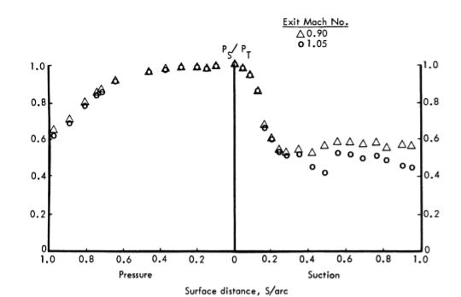
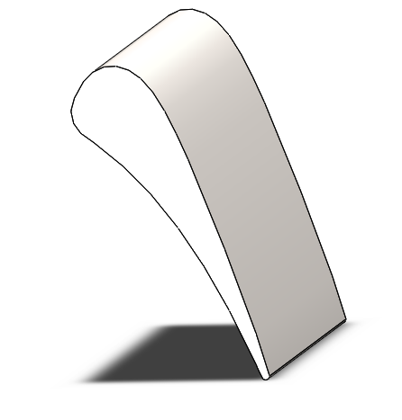
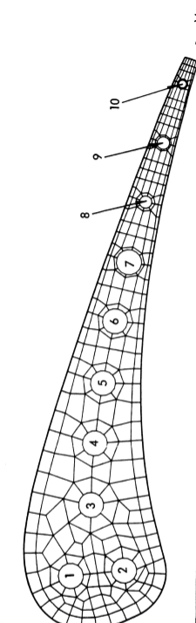
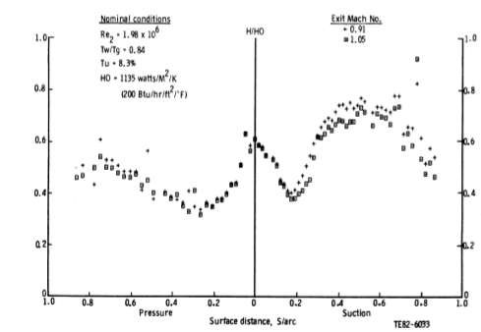
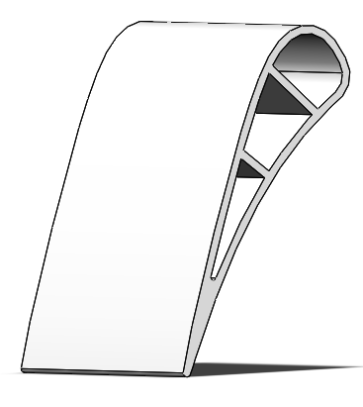
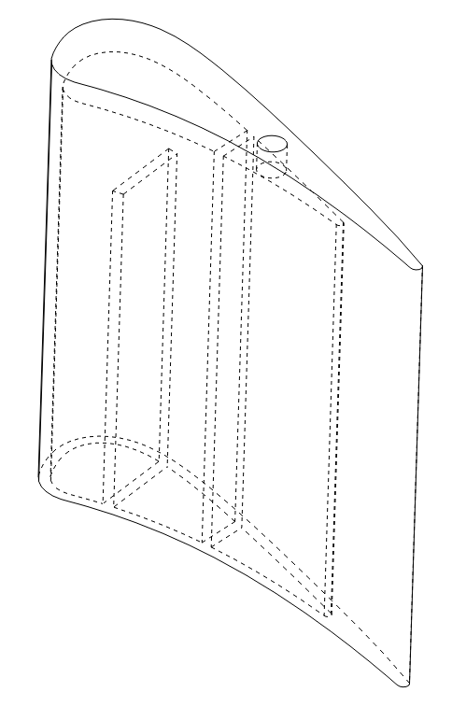
Task 2.1: The airfoil geometry selected for study is the NASA C3X turbine vane, scaled at 0.3X from the original study
True Chord
1.7” (4.3 cm)
Pressure
Distribution
Height
2” (5.1 cm)
Axial Chord
0.92” (2.3 cm)
Heat Transfer
Coefficients
Dees, Bogard, Ledezma, Laskowski, Tolpadi, 2012, “Experimental Measurements and Computational Predictions for an Internally Cooled Simulated Turbine Vane”, J Turbo.
Hylton, Mihelc, Turner, Nealy, York, 1983, “Analytical And Experimental Evaluation Of The Heat Transfer Distribution Over The Surfaces of Turbine Vanes”, NASA Technical Report.

Slide 12
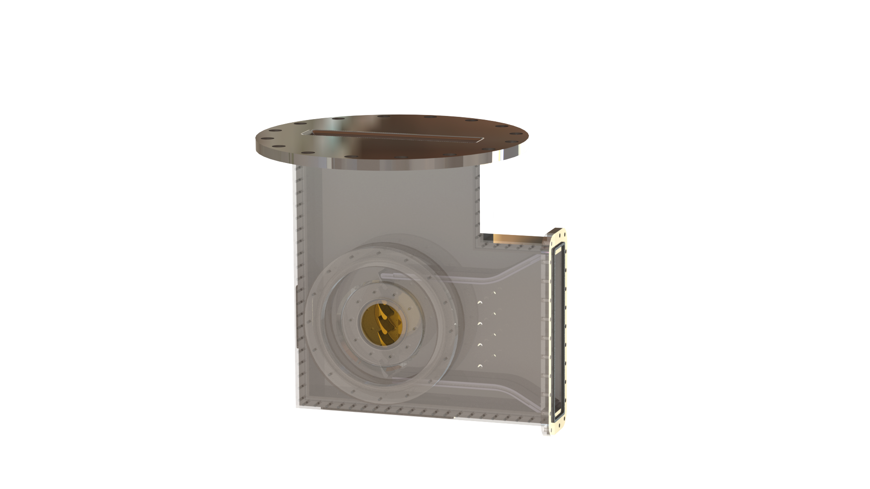
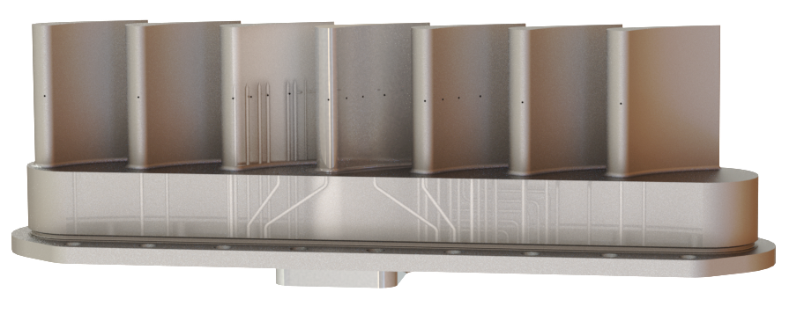
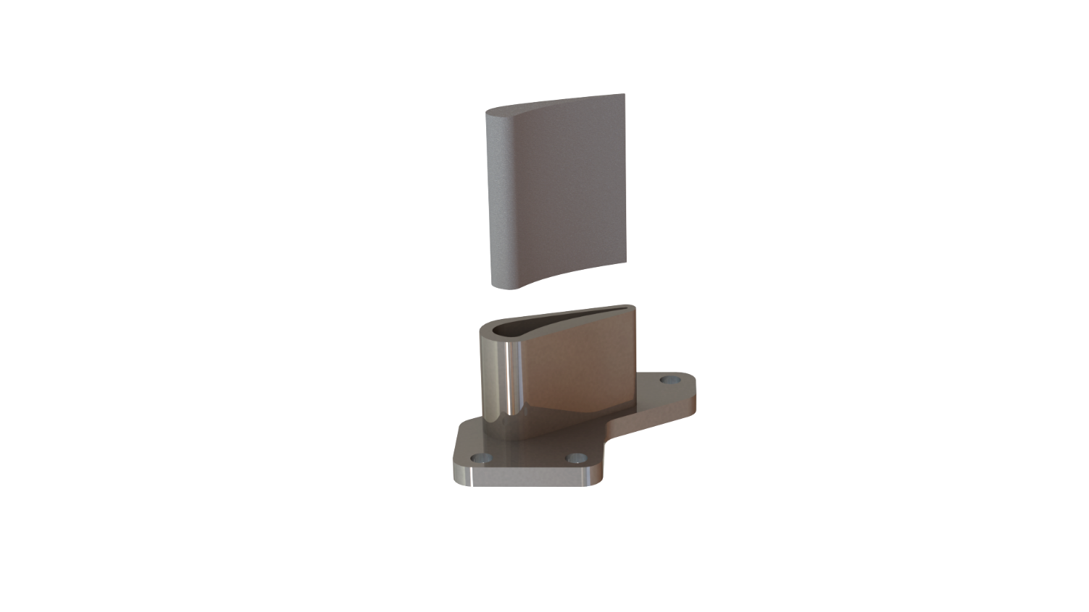
Task 2.1: test airfoil mounting system and instrumented airfoils are being designed for the PSU transonic cascade
3D printed metal periodicity airfoils with integrated static pressure taps
16”
flow
Test Capabilities
M_{exit} | 0.4 - 1.2
Re_{exit} | 1x10⁵ – 9x10⁵
T_{in} | ~120°C (393K)
T_{cool} | ~-70°C (203K)
flow
Windows for PIV, LDV, and IR measurements
Current design of a 3D printed socket to hold ceramic vanes

Slide 13
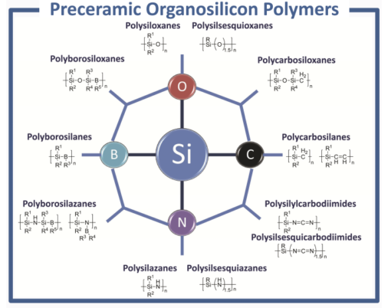
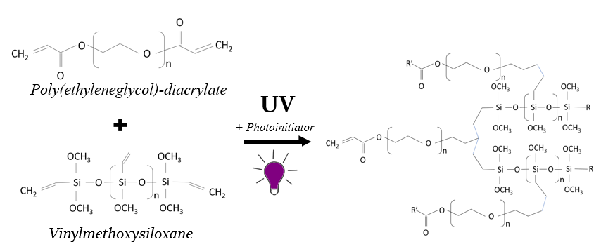
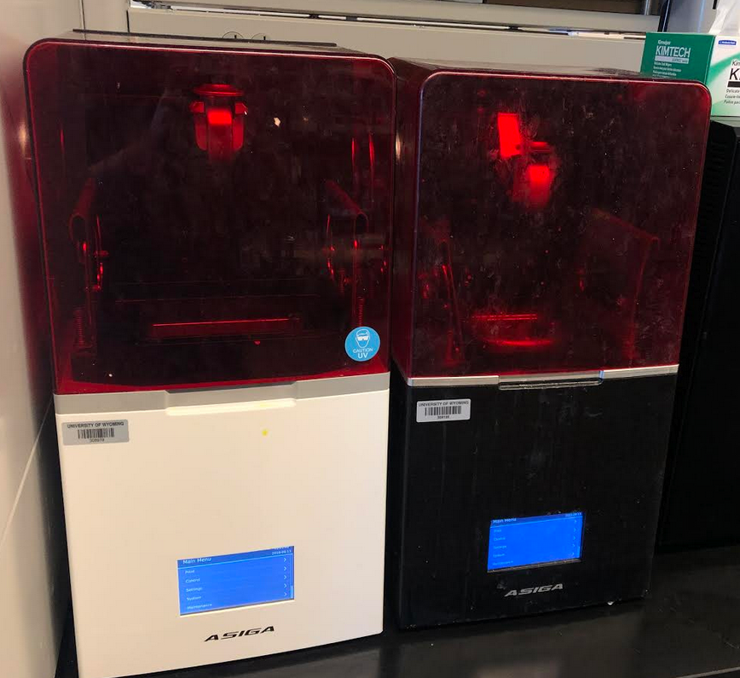
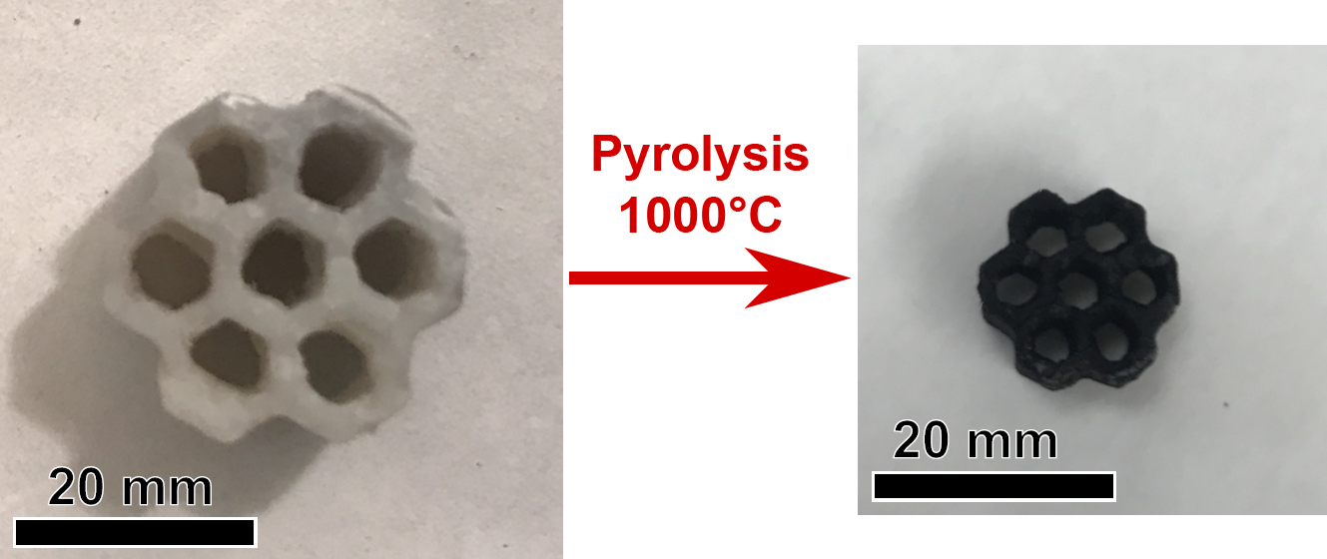
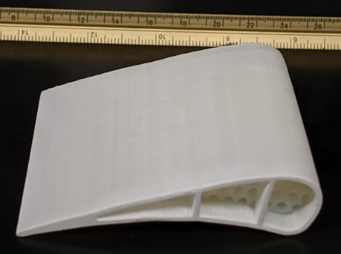
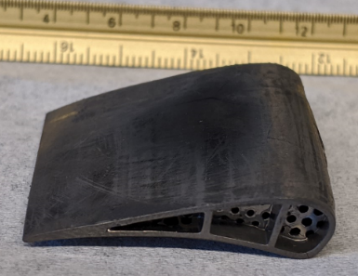
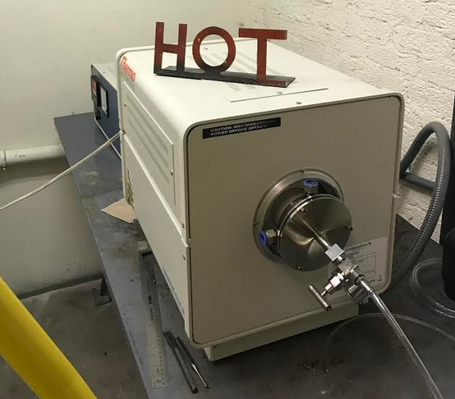

Task 2.2: refinement of precursor and post-processing for SiOC; test prints are underway and show very promising dimensional control
SiOC
Current pre-ceramic resin formulation yielding SiOC
SiC - Future Goal
Pyrolysis control
Sample turbine vane pre and post pyrolysis
~13 cm
~6.5 cm

Slide 14
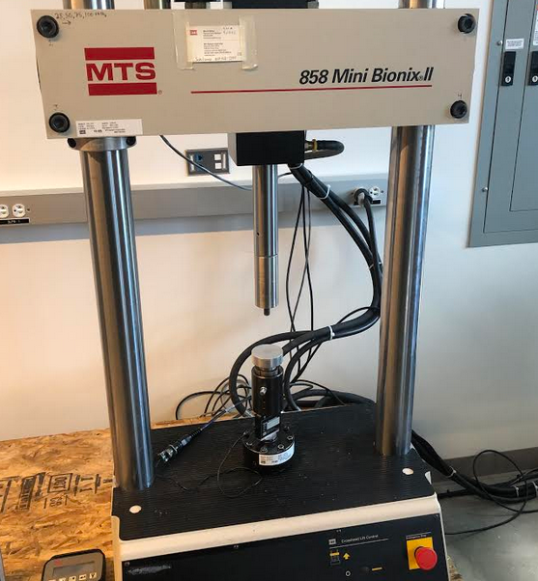
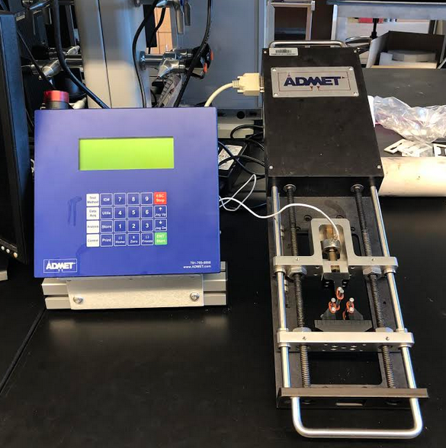
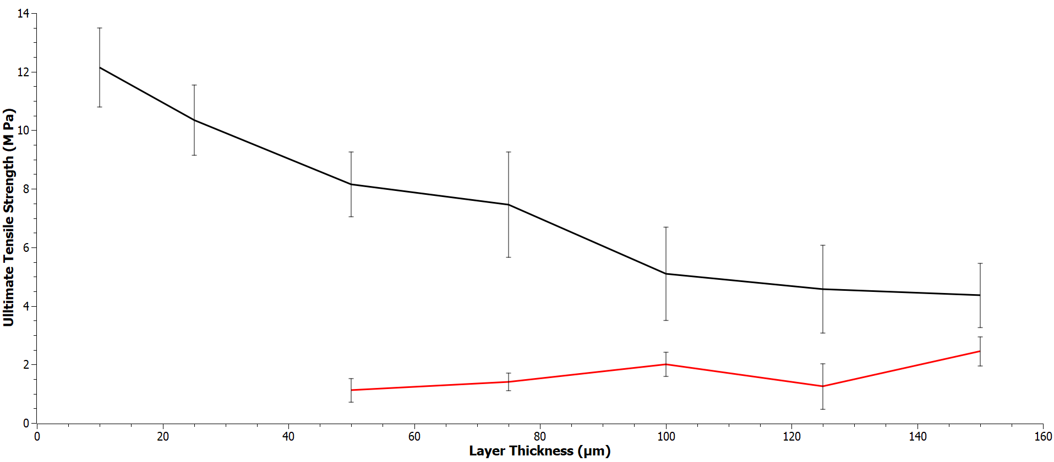

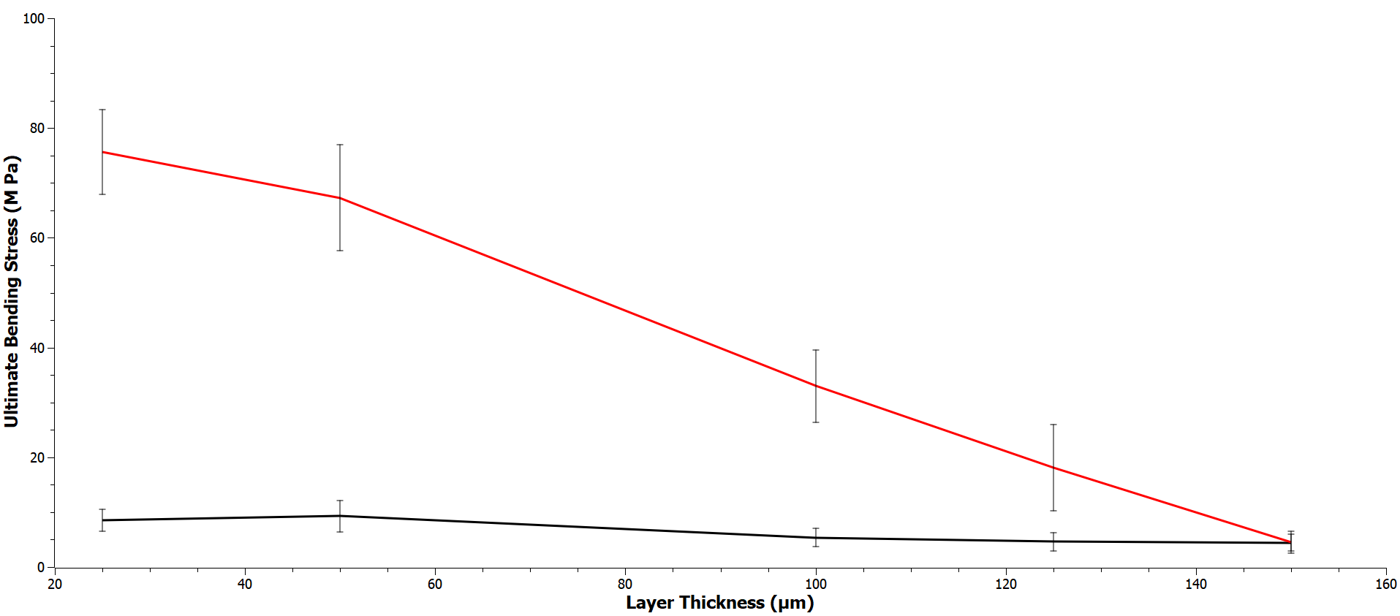
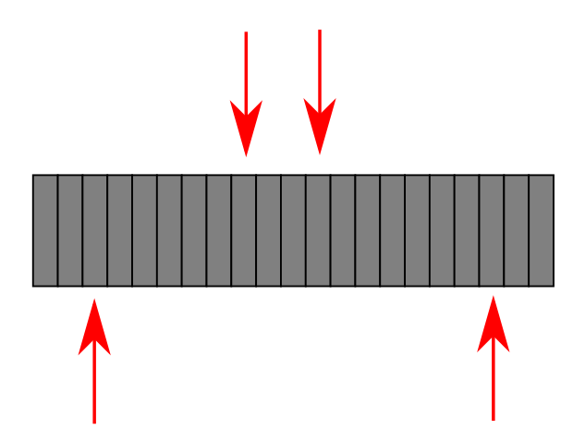
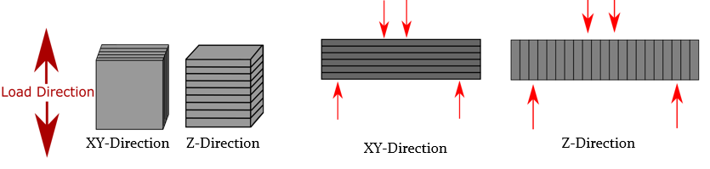
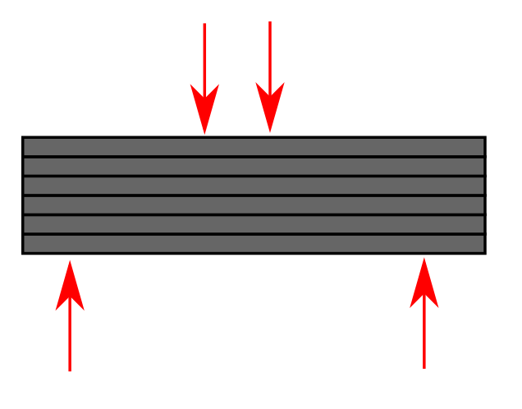
Task 2.2: impact of layer thickness and orientation on strength is being tested for both the pre-ceramic polymer and the pyrolyzed material
MTS Servo-Hydraulic Load-frame
ADMET Micro four point bend
Strength testing, indicating anisotropic properties that vary with layer thickness
XY-Direction
Z-Direction
N= min 6
Pre-ceramic polymer characterization
Ceramic characterization
Z-Direction
XY-Direction
N= min 12
Notes:
Printing orientations and processing parameters (e.g. layer thickness of print) have been tested to ensure optimal mechanical properties are achieved for the turbine blades.
Print direction leads to anisotropic effects in both polymer and ceramic printed parts. Smaller layer thicknesses yield increased green and pyrolyzed part strength

Slide 15
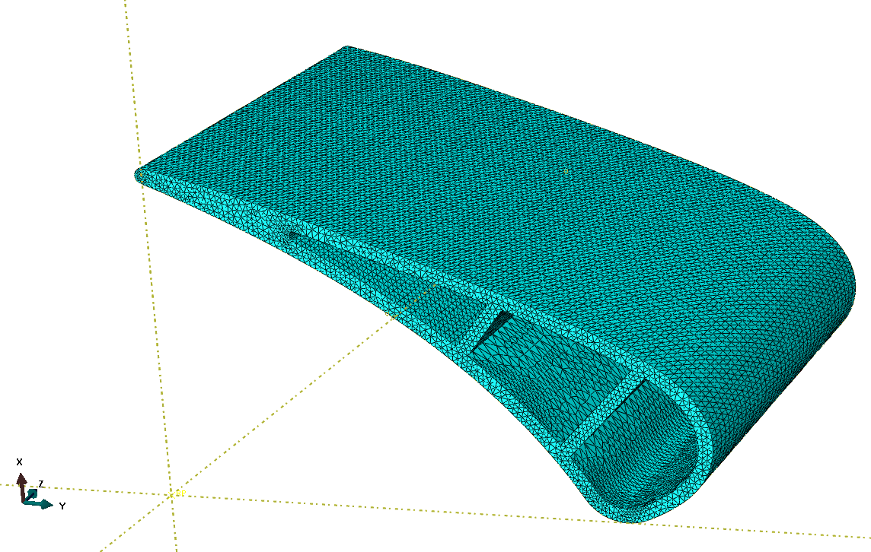

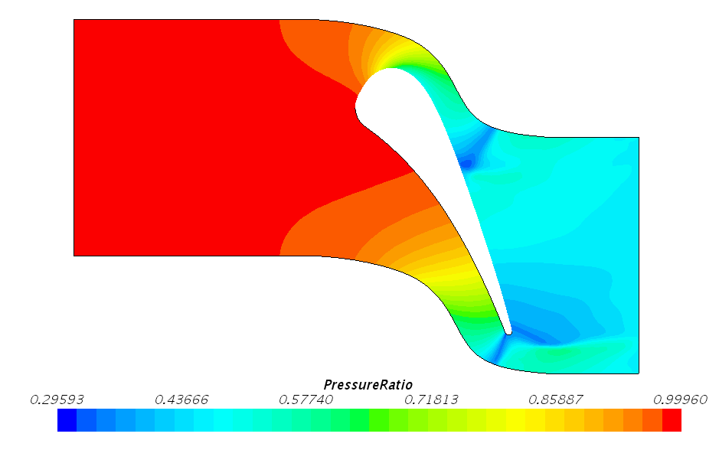
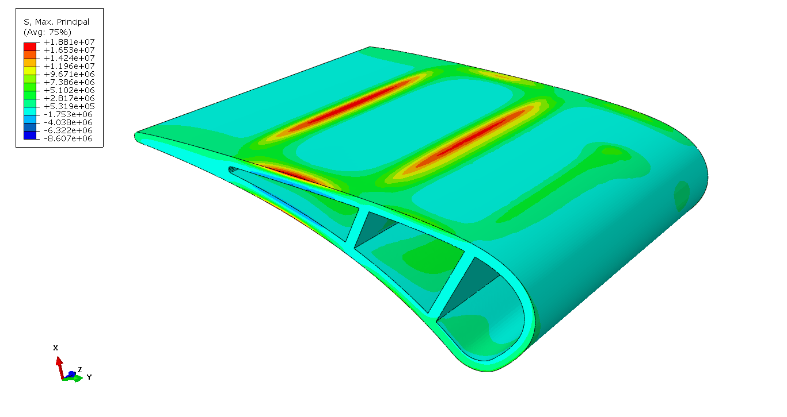
Task 3.1: modeling of the vane with expected pressure levels is underway; iterating on design based on early model results
FEA modeling showing stress concentration areas
External pressure from CFD

Slide 16
Task 4.1: Investigating SiOC stoichiometry and ceramic yield for various precursors
 | MW | Repeat units
MAcrylPMS
Acryl | 186 | 7
C2H6OSi | 74 | 93
EW | 82
Max ceramic yield - MAcrylPMS | 68 %
 | MW | Repeat units
VMS | 300 | 700
MeOSi-ene | 102 | 0.3 or 4.3
MeO2SI-ene | 133 | 2
EW | 129 | 112
Max ceramic yield - VMS | 44% | 50
VMS
MAcrylPMS
PEGDA, Mn 700
Starfire polymer
 | MW | Repeat units
MeAcrylMS | 25000
Acryl | 127 | 2.00
C2H6OSi | 74 | 334
EW | 74
Max ceramic yield - MeAcrylMS | 75 %
MeAcrylMS
 | MW | Repeat units
AcrylOHMS | 600 | 900
Acryl | 187 | 2
C2H6OSi | 74 | 3
EW | 119 | 99
Max ceramic yield AcrylOHMS | 47 % | 57
AcrylOHMS

Slide 17
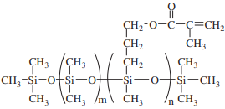

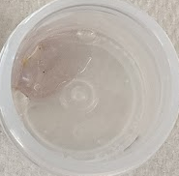
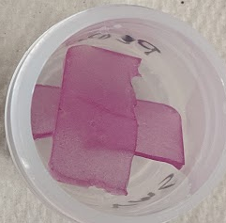
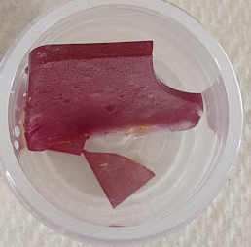
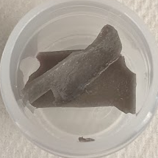
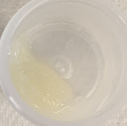
Task 4.1: Investigating resin processing and ceramic yield for new precursor materials via thermogravimetric (TGA) analysis and pyrolysis
MAcrylPMS
MeAcrylMS
 | wt%
MAcrylPMS | 75
MeAcrylMS | 25
PhtrimPO | 0.3
thymol blue | 0.053
 | wt%
VMS | 49.91
MAcrylPMS | 37.43
MeAcrylMS | 12.48
PhtrimPO | 0.15
thymol blue | 0.03
 | wt%
VMS | 50
PPGDMA | 20
MAcrylPMS | 29
PhtrimPO | 0.3
Thymol blue | 0.053
 | wt%
MAcrylPMS | 75
VMS | 25
PhtrimPO | 1
SiC whiskers | 0.5
 | wt%
Starfire 877 | 59.41
MAacrylPMS | 39.60
PhtrimPO | 0.99
Photoinitator insoluble
or poor mixing
Acceptable
Acceptable
Acceptable
poor mixing
Ceramic yield
50%
Ceramic yield
~16 % from both TGA and furnace
TGA

Slide 18
Future work is directed toward refinement of a baseline airfoil with current SiOC/SiC chemistry
Task 2 (PSU):
Finish mechanical design and instrumentation design for cascade airfoils
3D print metal airfoil pack by year end
Perform baselining tests of aerodynamics
Task 2 (UWYO):
Continue to develop PDC printing process, including SiC whisker dispersion
Material strength characterization
Task 3 (UWYO):
Improve FEA model based on measured material properties
Start developing topology optimization code for internal supports
Task 4 (PSU):
Investigate processing of interlayer linking to improve strength of SiOC
Continue to work on selection of appropriate precursors toward SiC
Color key: process engineering, material development, modeling, validation of cooling technologies

Slide 19

In conclusion, promising dimensional control and novel internal cooling features, with work needed on material properties
Airfoil selection and mechanical design is progressing
Initial test prints show good control of internal features with proper support
Novel design tools for shape optimization are being built
Questions?

Slide 20
Appendix

Slide 21
We expect financial and schedule risks will be easily manageable with outlined research plan
Perceived Risk | Risk Rating |  |  | Mitigation/Response Strategy
 | Probability | Impact | Overall
 | (Low, Med, High)
Financial Risks:
High cost for polymer precursor materials (Task 2, 4, 5, 6) | Low | Med | Low | Fewer extra test parts will be produced and materials will be conserved.
Cost of vane test hardware is high (Tasks 2.3, 5.3, 6.2) | Low | Low | Low | Fewer extra test parts will be produced, or will be sourced through lower-cost vendors.
Schedule Risks:
Unable to schedule time in transonic testing facility (Tasks 2.3, 5.3, 6.2) | Low | Low | Low | There is plenty of buffer in schedule to account for conflicts with other facility users
Shape optimization tool development takes longer than planned (Task 3.1-3.3) | Low | Low | Low | Existing structural optimizers can be used as a backup, or a design can be developed manually and model can be validated with that design.
Novel SiC precursor material development takes longer than planned (Task 4.1) | Med | Low | Low | Intermediate precursor recipes can be provided early to build expertise.

Slide 22
There are some technical risks for this low-TRL project but high payoff if the technology is successful
Perceived Risk | Risk Rating |  |  | Mitigation/Response Strategy
 | Probability | Impact | Overall
 | (Low, Med, High)
Technical Risks:
Unable to fabricate cooled SiOC CMC vane with large internal cavity (Task 2.2) | Low | Med | Med | UWYO has fabricated turbine-like test parts previously, but if thin walls are an issue, can resort to thicker walls. If film cooling is a problem, can be removed from design without impact to technical goals.
Unable to integrate new SiC material into SLA process (Task 5.1) | Low | Med | Med | 3D printable variants of the SiC precursor formula would be investigated although may not have the same desired material capabilities of SiC.
Unable to fabricate optimized vane shape using SiC/SiC (Task 6.1) | Med | Low | Low | This risk is avoided early by creating intermediate test prints as novel designs are developed, so that final design fits within manufacturing constraints.
Management, Planning, and Oversight Risks:
None |  |  |  | Organizational team is collaborative and all PI’s have management experience.
ES&H Risks:
None |  |  |  | Co-PI’s have expertise and facilities to handle volatile chemicals and hot furnace objects.
External Factor Risks:
None identified

