Slide 1
Multiphysics Multiscale Simulation Platform for Damage, Environmental Degradation and Life Prediction of CMCs in Extreme Environments
PI: Dr. Aditi Chattopadhyay
School for Engineering of Matter, Transport and Energy (SEMTE)
Arizona State University, Tempe, AZ
Major Participants: Dr. Luke Borkowski & Dr. G.V. Srinivasan
United Technologies Research Center
East Hartford, CT
2019 University Turbine Systems Research (UTSR) Project Review Meeting
Orlando, Florida
November 5-7th, 2019
U.S. Department of Energy (DOE)
Program Manager: Dr. Patcharin (Rin) Burke
Grant Number: DE‐FOA‐0001993

Slide 2
Outline
Relevance and Background
Project Objectives
Project Structure
Technical Approach
Progress and Accomplishments
Collaboration with Other Institutions
Project Schedule & Resources

Slide 3
Relevance
Next generation CMCs must meet challenges of DOE’s advanced turbine concepts with inlet temperatures up to 3100°F
Operating environment: high temperatures, thermal gradients, oxidation & mechanical loading over long duration
Limited knowledge on material response & damage in such harsh environments
An integrated computational and experimental framework to understand time, temperature and scale dependent deformation and damage mechanisms, and their interactions in turbine environment; improve performance, reliability and endurance

Slide 4
Background
Key Issues
Manufacturing induced flaws & scale-dependent architectural variability
Temperature-dependent damage mechanisms & failure modes
  Matrix progressive damage creates pathways for gaseous oxidants- effect different in intermediate & high temperature
Load sharing between constituents
Components likely to experience transients where PEL is exceeded*
Creep, fatigue, & creep-fatigue interaction
Model that considers oxidation, creep, fatigue, constituent level damage and failure, and their coupled interactions is necessary for accurate life prediction of CMCs
* Lara-Curizo et al., (1999)

Slide 5
Project Objectives
Develop concurrent multiscale framework to characterize, model & predict damage & failure in CMC components operating in turbine service environments
Incorporate developed models into life prediction methodologies for more accurate estimate of service life
The framework will include
Uncertainty quantification
Multiphysics constitutive model
  Oxidation
  Creep-fatigue
  Progressive damage at elevated temperatures
Integration with FEA software
Experimental characterization & testing
Improve understanding of material degradation & failure in operating conditions
Enhance fidelity & reduce empiricism in predicting component life

Slide 6
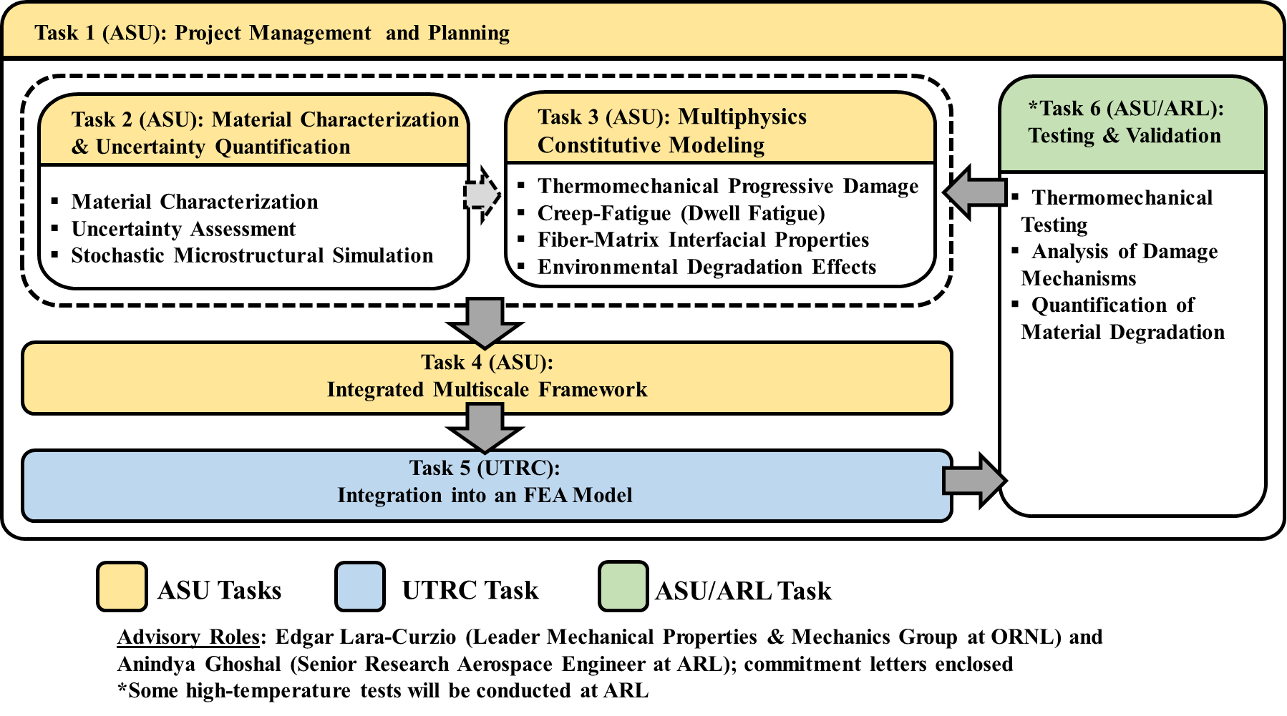
Project Structure

Slide 7
Technical Approach
Project Management and Planning
Material Characterization and Uncertainty Quantification (UQ)
  Capture effects of length-scale dependent variability on thermomechanical deformation, damage, & inelasticity
Multiphysics Constitutive Modeling with Thermomechanical Damage
  Develop constitutive and damage models
  Capture scale-dependent phenomena associated with CMC deformation across range of temperatures
4. Integrated Multiscale Framework
Integration into FEA Model – Assessment and Feedback
Testing and Validation
  Conduct thermomechanical testing & quantify material degradation

Slide 8
Task 1: Project Management
Project Team
Arizona State University:
  Dr. Aditi Chattopadhyay (Principal Investigator)
  Dr. Kranthi Balusu (Postdoctoral Research Assistant)
  Christopher Sorini (PhD Student)
  Khaled Khafagy (PhD Student)
United Technologies Research Center (UTRC)
  Dr. Luke Borkowski
  Dr. G.V. Srinivasan
DOE Advisor:
  Dr. Edgar Lara-Curzio, Distinguished Research Staff Member, Leader Mechanical Properties & Mechanics Group at Oak Ridge National Lab (ORNL)
Army Research Lab (ARL)
  Dr. Anindya Ghoshal, Senior Research Aerospace Engineer in ARL’s Propulsion Division
  Access to ARL’s High-Temperature Propulsion Materials Laboratory (HTPML) facilities (no cost to grant)

Slide 9
Progress and Accomplishments

Slide 10
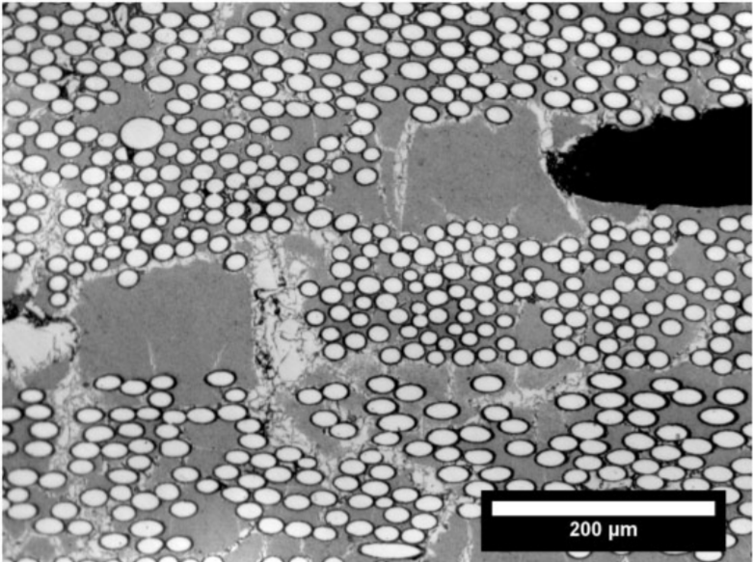

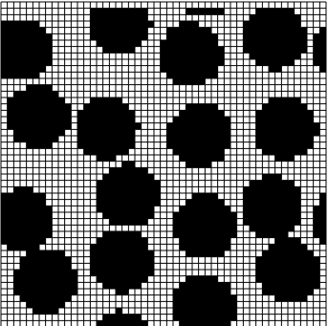
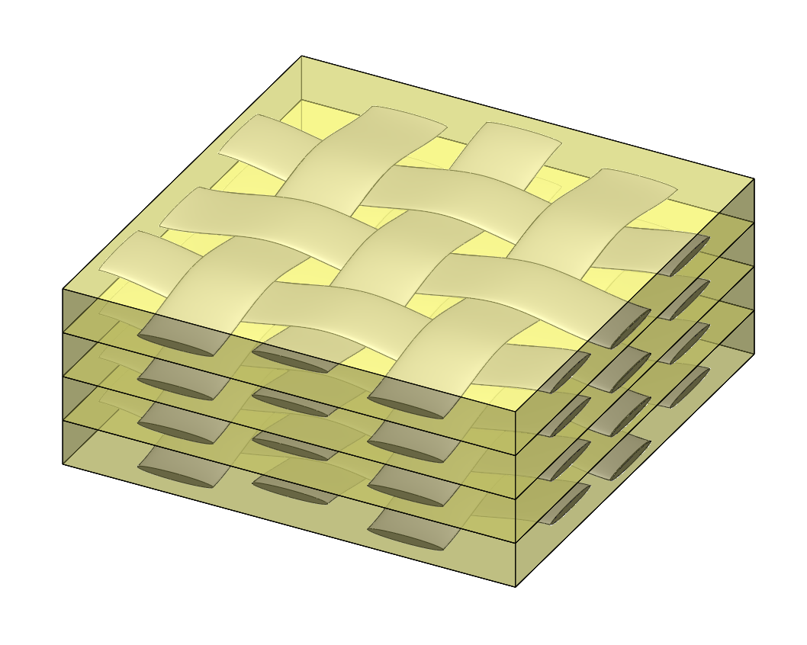
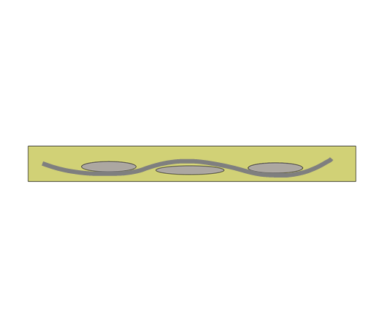
Task 2: Material Characterization and Uncertainty Quantification
Systematically factor in uncertainty into the model; capture effects of length-scale dependent variability on CMC response
  Task 2.1 Material characterization
  Task 2.2 Uncertainty assessment
  Task 2.3 Stochastic microstructural simulation & RVE
Microscale response
Matrix cracking
Fiber failure
Fiber/matrix debonding
+
Model Input
Output
3D Statistical characterization and material variability
3D High-fidelity microscale model
Mesoscale response
Tow/matrix debonding
Intratow matrix cracking
Composite Weave
Model Input
Output
Material/architectural stochasticity
3D Mesoscale model

Slide 11
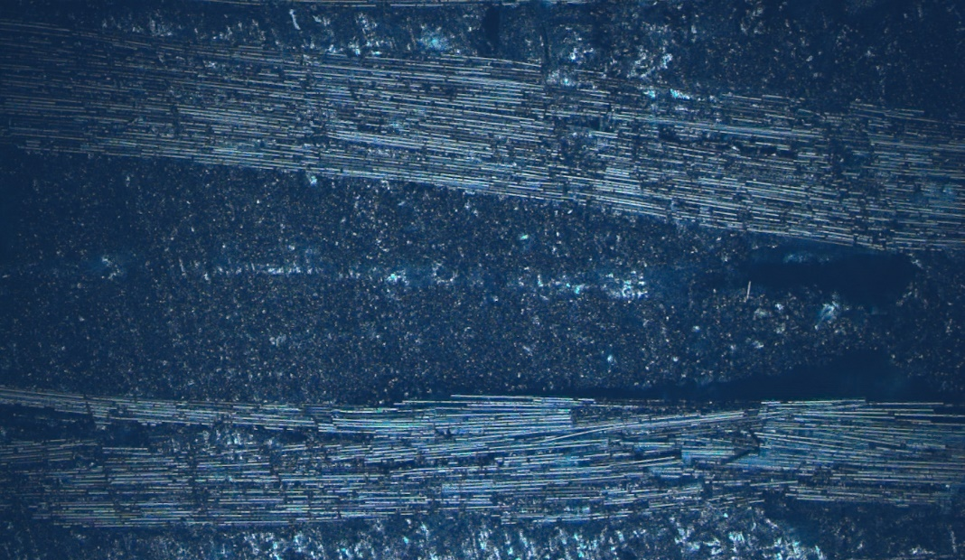
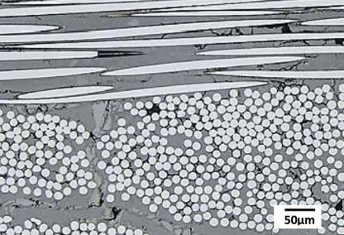
Task 2.1: Material Characterization
Characterization of C/SiC CMC using Confocal Microscopy
x20
1.42x1.06 mm
Gowayed et al. (2018)
Weft Tows
Warp Tows
Voids
Individual fibers
Mesoscale features
Microscale features
Will use SEM to detect features such as micro porosity, microcracks & fiber-matrix interphase conditions
The information can be “mined” to study correlations between material morphology & variability, as well
as their susceptibility to crack nucleation
Gowayed et al., Composites Part B (2018)

Slide 12
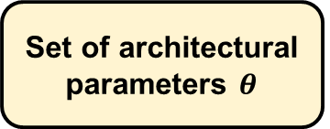
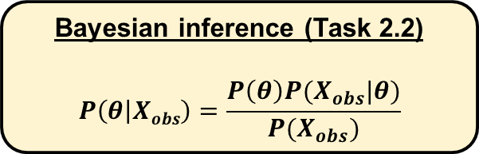
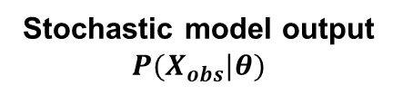
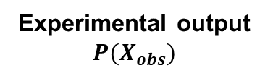
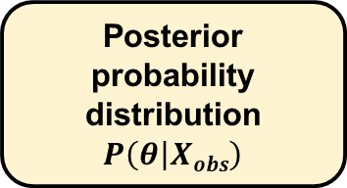
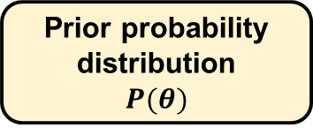
Task 2.2: Uncertainty Assessment
Bayesian Parameter Estimation
Loading or environmental conditions
Model parameters
Set of architectural parameters $θ$
Experimental testing
(Task 6)
Multiscale model
(Task 3)
Prior probability distribution
$$P(θ)$$
Sparse dataset obtained from material characterization and full-scale model simulation will provide statistical distributions of architectural parameters
Experimental output $P(X_{obs})$
Stochastic model output $P(X_{obs}|θ)$
Bayesian inference (Task 2.2)
$$P\left(θ | Xobs\right)=\frac{P\left(θ\right)P(X_{obs}|θ)}{P(X_{obs})}$$
Posterior probability distribution
$$P\left(θ | Xobs\right)$$

Slide 13


Task 2.3: Stochastic Microstructural Simulation
Moduli Variation with Degree of Randomness
As spatial randomness increases, transverse tensile modulus decreases by ~5%; shear modulus increases by ~10%

Slide 14
Task 2.3: Stochastic Microstructural Simulation, Contd.
Transverse Tensile Loading
von Mises stress (GPa)
Effective inelastic strain
Ordered
Hard-core
High stress concentration in areas of high fiber density
Fiber alignment & inter-fiber spacing play major role in stress concentration between & within fibers
Inelastic behavior initiation & viscoplastic flow prevalent where fibers are aligned favorably with loading direction and with small inter-fiber spacing
Borkowski et al., AIAA (2014)
14

Slide 15
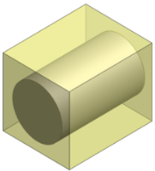
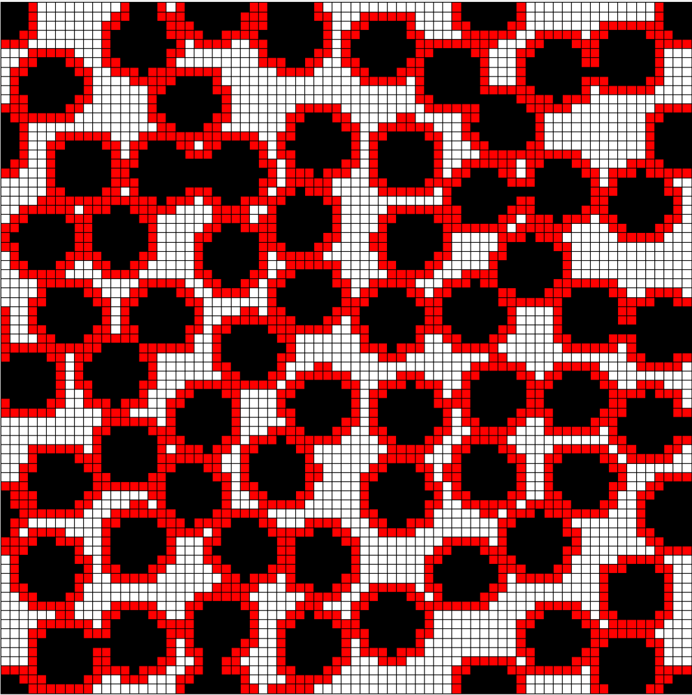
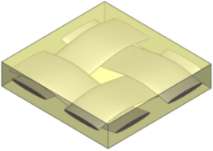
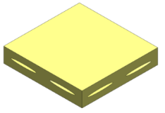
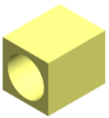
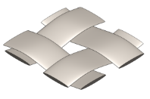
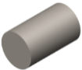
Task 3: Multiphysics Constitutive Modeling
Develop & integrate constitutive & damage models to capture relevant scale-dependent phenomena associated with CMC deformation across a range of temperatures
  Task 3.1. Thermomechanical Progressive Damage Model
  Task 3.2. Creep-fatigue
  Task 3.3. Fiber-matrix Interfacial Debonding
  Task 3.4. Environmental Degradation Effects
Fiber/tow oxidative degradation
Microscale RUCs
Intratow Matrix
Mesoscale RUC
Intertow Matrix
Fiber
Interfacial debonding
Matrix progressive damage and creep

Slide 16
Task 3.1: Thermomechanical Progressive Damage Model
The model will be applied apply at constituent level to model intertow & intratow matrices - capture stiffness reduction due to progressive cracking
Track initiation & evolution of matrix damage through the constituent, ply, & weave scales to the structural scale
Investigate processing induced damage & residual stresses in the composite caused by CTE mismatch between constituents
Simulate global nonlinear mechanical behavior, caused by multiscale damage & the release of thermal residual stresses in the material system, under mechanical loading
Calibrate using uniaxial quasi-static tensile tests conducted at room, intermediate & high temperatures

Slide 17

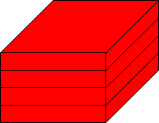
Thermomechanical Progressive Damage Model, Contd.
Physical model development – macro/mesoscale architecture:
Plain Weave
3D fiber tow & matrix subcell stacks:
Weft Tow Undulation Stack
Overlapping Tow Stack
Macroscale plain weave architecture represented through assembly of subcells stacks
Matrix
Subcell Stack

Slide 18
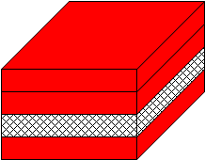
Task 3.1: Thermomechanical Progressive Damage Model, Contd.
Mesoscale Unit Cells & Voids
Inter-tow voids modeled as locally distributed & sheet-like as seen in micrographs
Red Subcells: Matrix
Hatched Subcells: Voids
Microscale Unit Cells & Voids
Low-fidelity fiber subcell w/ interphase
High-fidelity fiber subcell
Intra-tow voids modeled as evenly distributed & cube-like as seen in micrographs
Red: Matrix
Hatched: Voids
Voids accounted for at smaller length scale
Size & location are both important

Slide 19
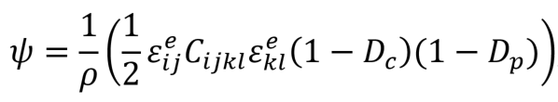
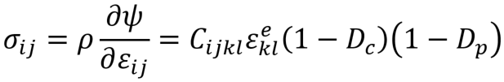
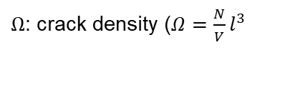
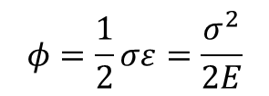
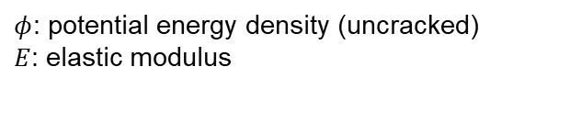

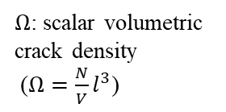
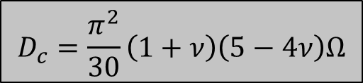

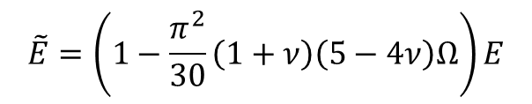


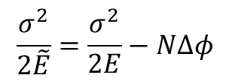

Task 3.1: Thermomechanical Progressive Damage Model, Contd.
Thermoelastic constitutive response modeled using internal state variable (ISV) theory
Evolution of damage ISV captured using fracture mechanics based crack initiation and propagation criteria
Damage ISV
Damage ISV derived using self consistent scheme
$$φ=\frac{1}{2}σε=\frac{σ^{2}}{2E}$$
$$\frac{σ^{2}}{2\tilde{E}}=\frac{σ^{2}}{2E}−NΔφ$$
$$\tilde{E}=\left(1−\frac{π^{2}}{30}\left(1+ν\right)\left(5−4ν\right)Ω\right)E$$
$$D_{c}=\frac{π^{2}}{30}\left(1+ν\right)\left(5−4ν\right)Ω$$
  $ψ$: Helmholtz free energy
  $D_{p}$: Porosity ISV
$Ω$: scalar volumetric crack density
($Ω=\frac{N}{V}l^{3}$)
  $φ$: potential energy density (uncracked)
  $E$: elastic modulus
  $Ω$: crack density ($Ω=\frac{N}{V}l^{3}$
  $D_{c}$: Matrix cracking ISV
  $ρ$: density
  $N$: Number of inclusions

Slide 20
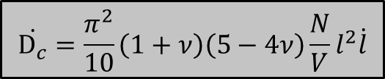
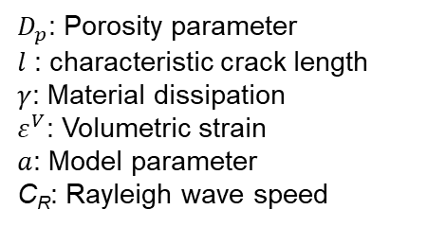

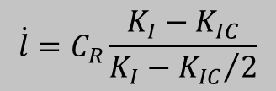
Task 3.1: Thermomechanical Progressive Damage Model, Contd.
Damage Evolution
Temporal evolution determined using fracture mechanics, crack growth kinetics
Matrix cracks activate when stress intensity factor exceeds critical value
Θ
$$\dot{D_{c}}=\frac{π^{2}}{10}\left(1+ν\right)\left(5−4ν\right)\frac{N}{V}l^{2}\dot{l}$$
$$\dot{l}=C_{R}\frac{K_{I}−K_{IC}}{K_{I}−{K_{IC}}/2}$$
Porosity Effects
Microstructural pores form due to material diffusion around grain boundaries
Porosity nucleation and growth is critical deformation/damage mechanism in ceramics, causing nonlinearity at low strains
Additional ISV introduced to capture porosity effects
  $D_{p}$: Porosity parameter
  $l$ : characteristic crack length
  $γ$: Material dissipation
  $ε^{V}$: Volumetric strain
  $a$: Model parameter
  C_{R}: Rayleigh wave speed
$\dot{D_{p}}=a\left(1−D_{p}\right)γε^{V}$
Θ Paliwal et al., (2007)

Slide 21
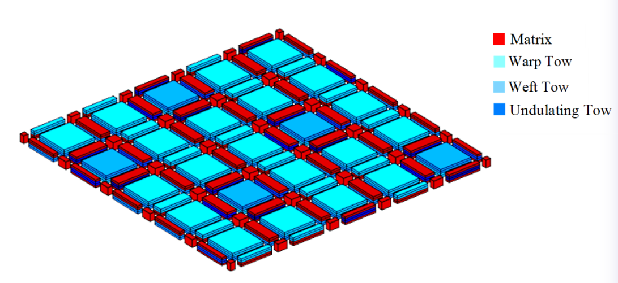
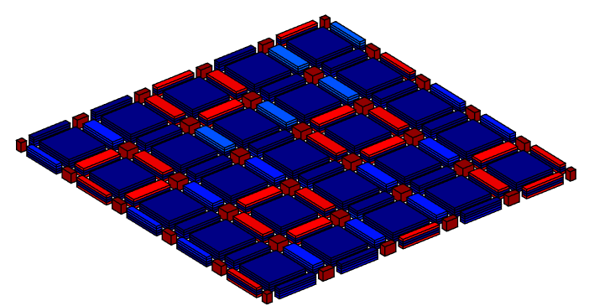

Task 3.1: Thermomechanical Progressive Damage Model, Contd.
Comparable fiber and matrix stiffness leads to significant fiber damage and failure in SiC/SiC CMCs at relatively low strains
Curtin progressive fiber failure model applied to account for stiffness degradation in fiber
  Based on Weibull statistics combined with shear lag analysis
  Treats single fiber as effective fiber
Damage initiates in undulating tows at weave and tow level followed by inter-tow matrix subcells
Matrix
Weft Tow
Warp Tow
Undulating Tow
Simulated 5HS weave architecture
Microcracking damage

Slide 22
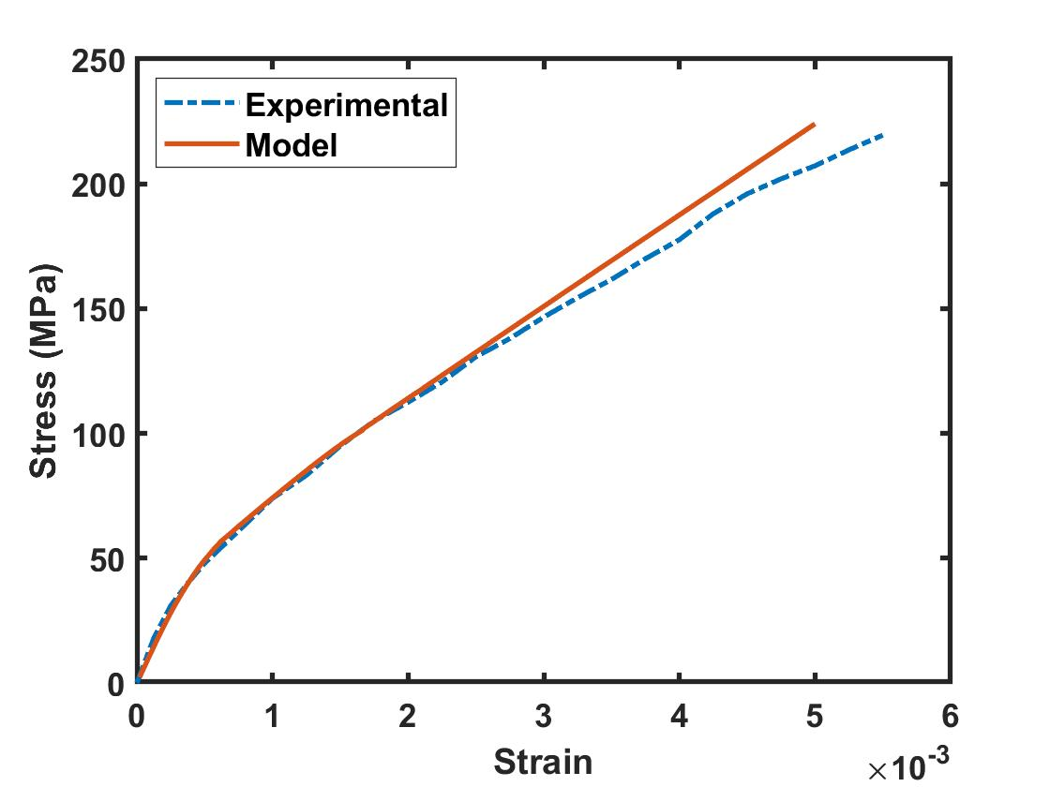
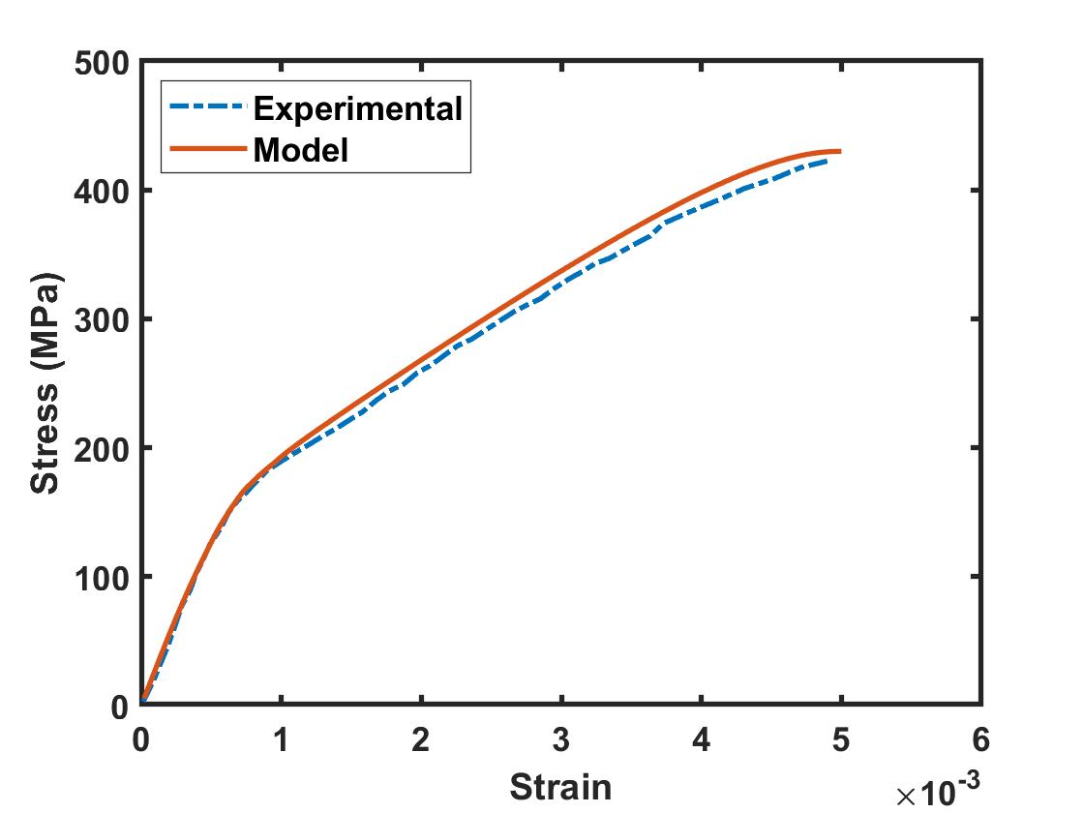
Task 3.1: Thermomechanical Progressive Damage Model , Contd.
Comparison with Experiment
Loading direction: Longitudinal
*
**
Material: 5HS C/SiC CMC
5HS SiC/SiC CMC
Damage model captures nonlinear elastic material behavior and first matrix cracking. Good correlation with experimental results at low to intermediate strains.
* Yang et al. (2017); **Morscher et al., (2007)

Slide 23




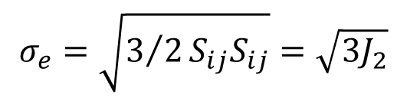
Task 3.2: Creep-fatigue
Modeling of viscoplastic creep deformation and load transfer between constituents
Time-hardening Norton-Bailey creep law with temperature dependence
Accumulated creep strains:
Computational parametric studies to identify constituent primarily responsible for creep behavior
$$σ_{e}=\sqrt{3/2S_{ij}S_{ij}}=\sqrt{3J_{2}}$$
$${\dot{ε}}_{ij}^{I}=\frac{3{\dot{ε}}_{e}^{I}}{2σ_{e}}S_{ij}$$
where
$${\dot{ε}}_{e}^{I}=Aσ_{e}^{n}mt^{m−1}exp\left(−\frac{Q}{RT}\right)$$
$$ε_{kl}^{I}=\int_{0}^{t}{{\dot{ε}}_{kl}^{c}}dt$$
Time hardening
Arrhenius term captures temperature dependence
$$σ_{ij}=\left(1−D\right)C_{ijkl}\left(ε_{kl}^{tot}−ε_{kl}^{th}−ε_{kl}^{I}\right)$$
A, n, m: Model constants
Q: Activation energy
R: Universal gas constant
Model parameters for fiber and matrix will be determined from creep-fatigue tests

Slide 24
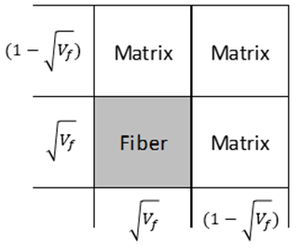
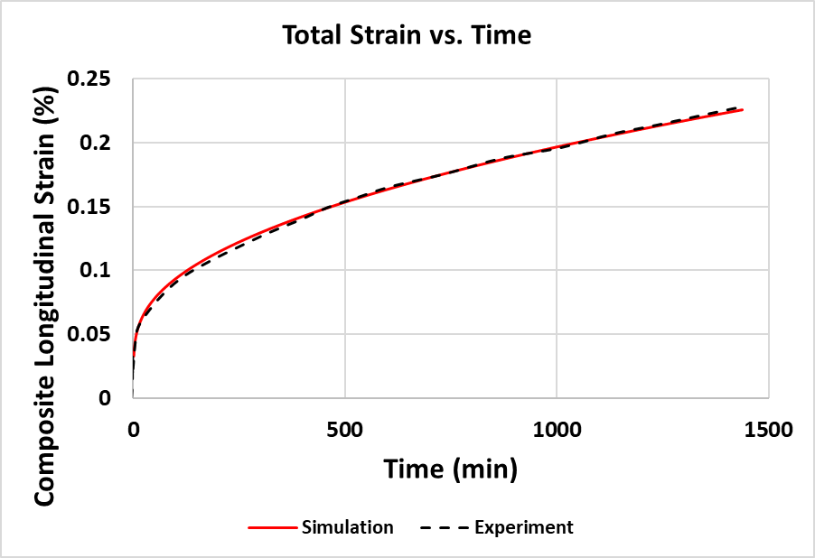
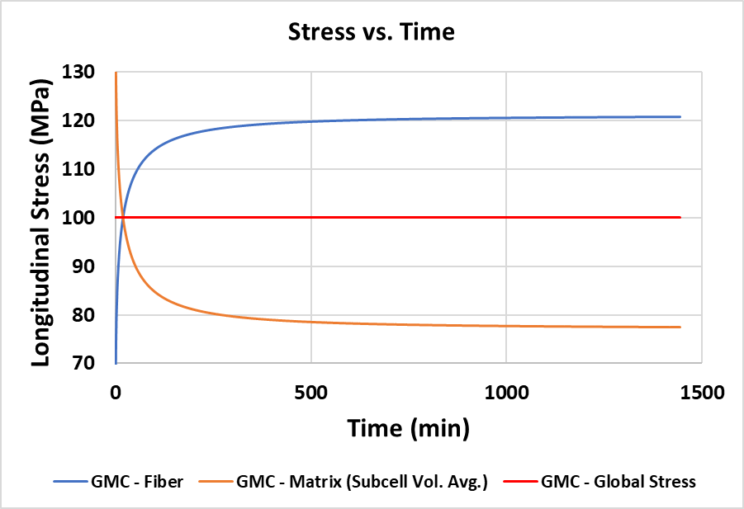

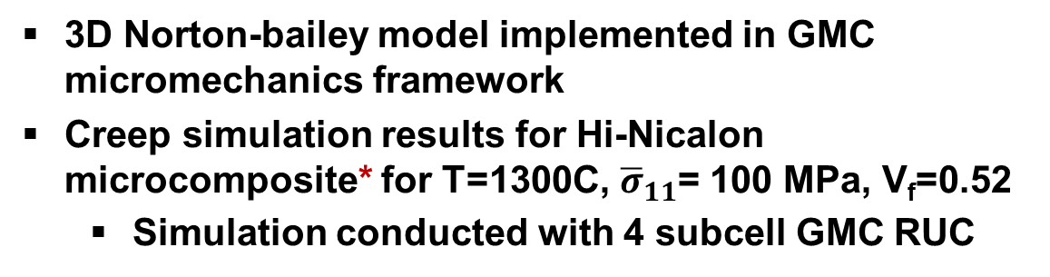
Task 3.2: Creep-fatigue, Contd.
3D Norton-bailey model implemented in GMC micromechanics framework
Creep simulation results for Hi-Nicalon microcomposite* for T=1300C, ${\overline{σ}}_{11}$= 100 MPa, V_{f}=0.52
  Simulation conducted with 4 subcell GMC RUC
3
2
4 subcell GMC RUC
Fiber
Composite
Matrix
Micromechanics-based simulation able to capture constituent load transfer; not possible with macroscopic constitutive models
*Rugg, K. L. et al., Jo of European ceramic society (1999)

Slide 25
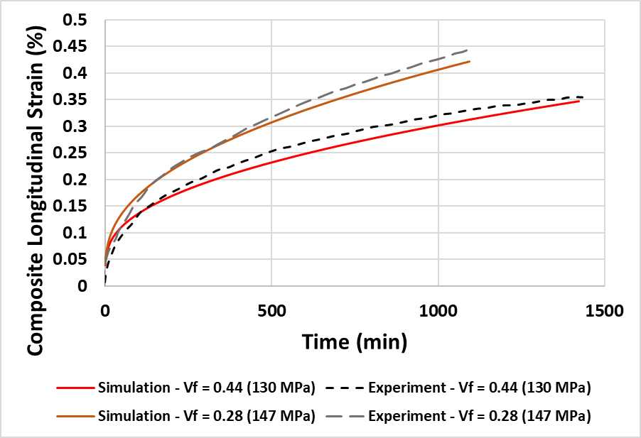
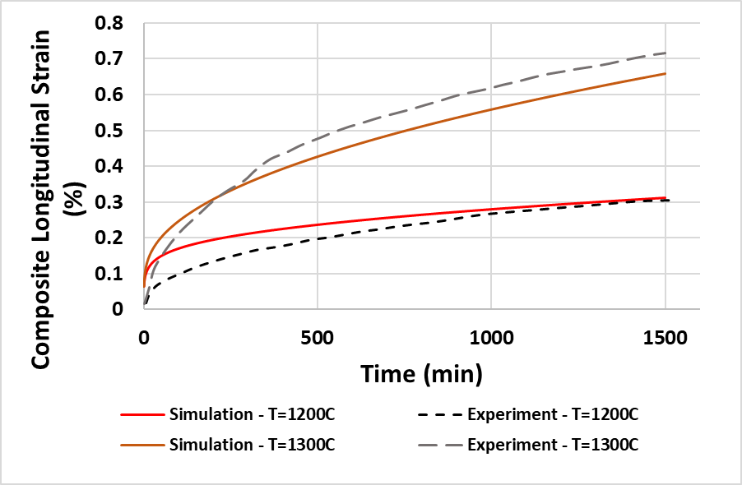



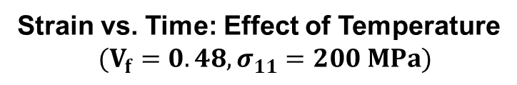

Task 3.2: Creep-fatigue, Contd.
Effect of V_{f} and temperature on creep response of Hi-Nicalon microcomposite*
Strain vs. Time: Effect of Temperature
$$(V_{f}=0.48, σ_{11}=200 MPa)$$
Strain vs. Time: Effect of $V_{f}$ (T=1300C)
$$Strain vs Time:Effect of Temperature$$
$$(Vf=0.48, σ_{11}=200 MPa)$$
$$V_{f}=0.28, {\overline{σ}}_{11}=147 MPa$$
T=1300C
$$V_{f}=0.44, {\overline{σ}}_{11}=130 MPa$$
T=1200C
Creep strain for Hi-Nicalon microcomposite increases with increasing temperature and decreasing fiber volume fraction
*Rugg, K. L. et al., Jo of European ceramic society (1999)

Slide 26
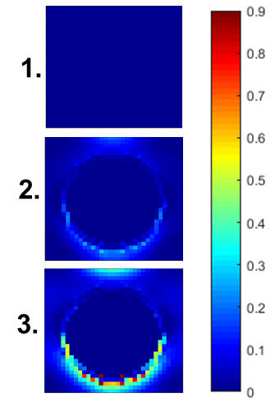
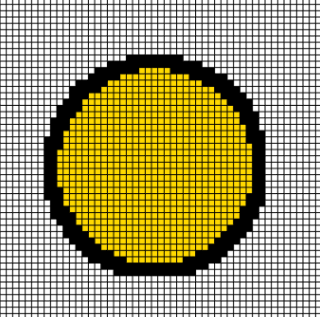
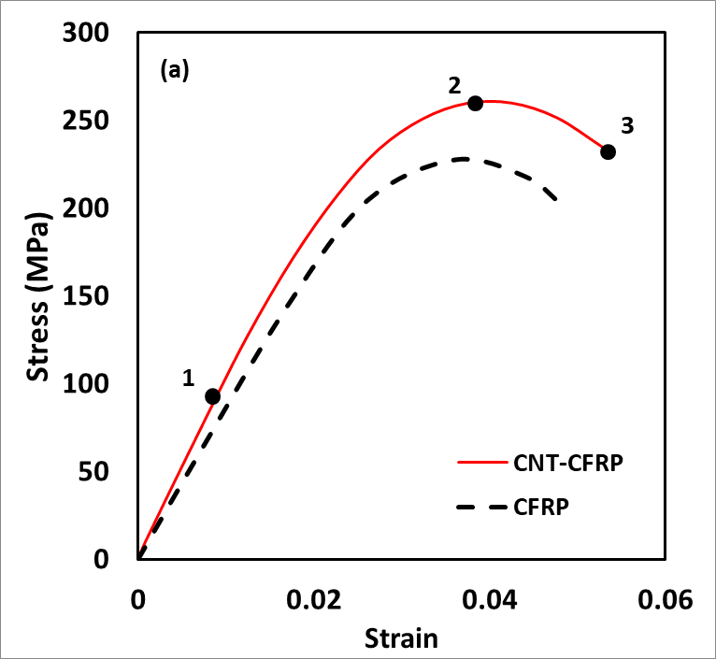
Task 3.3: Fiber-matrix Interfacial Debonding
Nonlinear physics of fiber-matrix interface modeled at constituent level using high-fidelity micromechanics theory
  Interface debonding modeled using evolving proportionality parameter for displacement jump
  Parameters will be calibrated based on experiments that measure interfacial shear resistance
Matrix
Interphase
Fiber
or
Matrix
Fiber/matrix system
Fiber
Displacement jump
Unit cell damage contours showing interface debonding*
Weak interfaces increase fracture resistance, but creep & fatigue resistance at high temperature demands strong interfaces that resist nucleation & growth of cavities
*Venkatesan. et al., Carbon (2019)

Slide 27




Task 3.4: Environmental Degradation Effects
Fibers show time dependent failure under oxidative conditions
Classic model accounts for variability in stress rupture of individual fibers*
Stress rupture: failure probability ($F$) ≥ critical value (P_{f})
Fibers have randomly assigned critical values of probability of failure (P_{f})
$$F\left(t: σ\right)=1−exp\left[−{\left(\int_{0}^{t}{{\left(\frac{σ_{11}\left(t\right)}{σ_{ref}}\right)}^{ρ}}\frac{1}{t_{ref}}dt\right)}^{β}\right]$$
$F(t:σ)$ : Failure probability
$t$ : Time (s)
$tref$ : Reference time (s)
$σ_{11}\left(t\right)$ : Fiber tensile stress (MPa)
$σref$ : Longitudinal tensile strength (MPa)
P_{f} : Probability of failure
Simulated stress-rupture response of single SiC fiber
* Mital et al., (2014)

Slide 28


Task 3.4: Environmental Degradation Effects, Contd.
Variability in Stress-Rupture Time
Four representative unit cells (RUC)
Fibers modeled as single subcell
Variability in each configuration due to randomly assigned probability of fiber failure$Pf$
Longitudinal Loading: 480 MPa
RUC#1
RUC#2
Fiber
Matrix
Rupture time (s)
RUC#3
RUC#4
RUC#
Necessary to model variability in fiber arrangement to accurately capture stress rupture

Slide 29










Task 4: Integrated Multiscale Framework
Intratow Void
Intertow Matrix & Voids
Woven/Braided Composite Architecture
Fiber
Intratow Matrix
Micro-
scale RUC
Plain weave
Fiber Tows
CMC Combustion Chambers
(Schmidt et al. 2005)
8HS
weave
MICRO
Mesoscale RUC
CMC
Rocket
Nozzle
(astrium.
eads.net)
Macroscale
RUC
Localization
MESO
Multiscale
Generalized Method
of Cells (MSGMC) developed
in PI’s group (Liu et al. (2011)
Homogenization
MACRO
MSGMC will be extended to higher order displacement field; allows for concurrent analysis of woven or braided composite systems
STRUCTURAL

Slide 30




Task 5: Integration into an FEA Model – Assessment and Feedback
UTRC will provide guidance on model development, evaluate framework capabilities, and assess its TRL
Multiscale analysis module
(Task 4)
Life assessment under turbine service conditions
Integration points
(Task 4)
FEA integration
Outcomes
Accuracy and efficiency of lifing model assessed for materials, geometries, and loads relevant to UTC
Simulation results compared against in-house tools
Maturity of modeling framework evaluated

Slide 31


Task 6: Closed Loop Testing and Validation
High-fidelity Multiscale Model (Task 4)
Task 6.1: Thermomechanical Testing
Low, intermediate & high test temperatures
Environment: Air and inert gas (Argon)
Loading: Quasi static, creep-fatigue
Materials: SiC/SiNC
Calibrate creep model parameters
Inform/update damage model
Identify key micro mechanisms that govern creep-fatigue
Identify PEL change
Task 6.2: Analysis of Damage Mechanisms & Quantification of Material Degradation
Analysis of fracture surfaces & thermo-oxidative degradation
Characterization using 3D X-ray Micro Computed Tomography & Scanning Electron Microscopy

Slide 32




Task 6: Closed Loop Testing and Validation, Contd.
Quasi static and creep-fatigue tests up to intermediate temperatures and in air will be conducted at ASU HT facility and ARL High Temperature Propulsion Materials Laboratory (HTPML) lab
Tentative test plan
Quasi static tension
(until failure)
Creep fatigue
(stress level 1-4)
Ply orientation
$0°/90°$, $±45°$
Temperature
Room, intermediate and 1200$°$ C
Ply orientation
$0°/90°$, $±45°$
Temperature
Intermediate and 1200$°$ C
Environment
Air / inert
Environment
Air / inert
Creep-fatigue tests in both air and inert atmosphere can identify contribution of thermo-oxidative degradation

Slide 33




Acknowledgment
Dr. Patcharin Burke
  Dr. Edgar Lara-Curzio
  Dr. Anindya Ghoshal
Dr. Luke Borkowski
&
Dr. G.V. Srinivasan

Slide 34
Backup Slides

Slide 35
Background, Contd.
State-of-the-art
Time dependent deformation and/or damage modeling
Microscale
    Halverson & Curtin (2002), Baxevanis & Charalambakis (2010) – matrix elastic & fully cracked
    Baxevanis & Plexousakis (2010) – models fiber progressive damage; no matrix progressive damage
    Santhosh et al. (2013), Santhosh et al. (2018) – creep is only modeled in one constituent
    Macroscale
    Bessho et al. (2005), Gowayed et al. (2011) – load transfer between constituents ignored
Oxidation
  Lara-Curzio (1999) – matrix oxidation not considered
  Sullivan (2005) – material orthotropic continuum
  Xu et al. (2014) – accounts for competing mechanisms, limited to simple stress states and unidirectional composites
  Parthasarathy et al. (2018) – significant implementation challenges, nonconservative prediction of life, partial validation

Slide 36
Project Management
Project Team
Arizona State University:
  Dr. Aditi Chattopadhyay (Principal Investigator)
  Dr. Kranthi Balusu (Postdoctoral Research Assistant)
  Christopher Sorini (PhD Student)
  Khaled Khafagy (PhD Student)
  Jake Schitchel (PhD Student, NDSEG Scholar)
United Technologies Research Center (UTRC)
  Dr. Luke Borkowski
  Dr. GV Srinivasan
DOE Advisor:
  Dr. Edgar Lara-Curzio, Distinguished Research Staff Member, Leader Mechanical Properties & Mechanics Group at Oak Ridge National Lab (ORNL)
Army Research Lab (ARL)
  Dr. Anindya Ghoshal, Senior Research Aerospace Engineer in ARL’s Propulsion Division
  Access to ARL’s High-Temperature Propulsion Materials Laboratory (HTPML) facilities (no cost to grant)

Slide 37
Project Management, Contd.
PI will lead research team, in close collaboration with UTRC to accomplish research tasks proposed in Statement of Project Objectives (SOPO)
Team will maintain close collaboration with:
  Dr. Edgar Lara-Curzio, ORNL, for technical feedback & guidance
  Dr. Anindya Ghoshal, ARL, Aberdeen
    Access to ARL’s High-Temperature Propulsion Materials Laboratory at no cost to the grant
    Actively engage in technical discussions; proposed models will benefit ARL’s research efforts
    Will host a graduate student at ARL

Slide 38
R&D Resources and Capabilities
Project Management, Contd.
PI’s laboratory equipped with a wide range of
thermomechanical test frames, DICs, microscopy, & X-ray CT
Mechanical Testing: Dynamic, static, multiaxial, thermomechanical, ultrasonic fatigue, noncontact measurement
Material Fabrication: Composite ovens, hot press, carbon nanotubes, nanoparticles
Nondestructive Evaluation (NDE) & Structural Health Monitoring: Ultrasonic, acoustic, laser based, piezoelectric, FBG, X-ray micro-CT
Material Characterization: Multiphoton imaging, viscosity and viscoelasticity, thermal analysis, confocal microscopy
Team has access to ASU’s high resolution electron microscopy & high-performance computing
Cost share funds to acquire Instron high temperature furnace
Access to HTPML facility at no cost to the grant

Slide 39
Risk Management
Financial Risks
  Meetings with ASU research administration offices to ensure compliance
Cost/Schedule Risks
  Detailed planning and experience with large funded research projects
Technical/Scope Risks
  PI expertise in this domain
  Technical collaborators from UTRC, ONRL and ARL
Management, Planning, and Oversight Risks
  PI experience and regular review meetings
ES&H Risks
  ASU ES&H office conducts training and ensures compliance
External Factor Risks
  Careful scheduling in advance

Slide 40
Task 3.1: Thermomechanical Progressive Damage Model
Extension of thermomechanical progressive damage model developed by PIs
Capture stiffness reduction due to progressive cracking in inter-tow and intra-tow matrices
Track initiation & evolution of matrix damage through the constituent, ply, & weave scales to structural scale
Investigate processing induced damage & residual stresses in composite due to CTE mismatch between constituents
Simulate global nonlinear mechanical behavior due to multiscale damage & release of thermal residual stresses in material system, under mechanical loading
Calibrate using uniaxial quasi-static tensile tests conducted at room, intermediate & high temperatures

Slide 41




Task 2.2: Uncertainty Assessment
Bayesian Inference
Markov Chain Monte Carlo (MCMC)
3D Microscale Model
Stochastic Response Surface (SRS)
Ghirlanda et al., Jo of Science (2019)
Obtain statistical distribution of input parameters (microstructural features) & update data set using Bayesian probabilistic scheme
Utilize Markov Chain Monte Carlo to effectively draw samples from posterior distribution
Construct stochastic response surface to establish relationship between input space & output model parameters

Slide 42






Task 3.2: Creep-fatigue, Contd.
Isotropic Norton-Bailey power law will be modified to simulate anisotropic creep behavior
Von-mises potential will be replaced with Hill potential
1. Hill’s quadratic anisotropic plastic potential
$$f\left(\overline{σ}\right)=\sqrt{\begin{aligned}F{\left(σ_{22}−σ_{33}\right)}^{2}+G{\left(σ_{33}−σ_{11}\right)}^{2}+H{\left(σ_{11}−σ_{22}\right)}^{2} \\ +2Lτ_{31}^{2}+2Mτ_{31}^{2}+2Nτ_{12}^{2}\end{aligned}}$$
F, G, H, L, M, N: Anisotropy parameters
A, n, m: Materials constant
Q: Activation energy
R: Universal gas constant
2. Viscoplastic flow rule
$$dε_{ij}^{cr}=dλ\frac{𝔡f(\overline{σ})}{𝔡σ_{ij}}$$
$$dλ=A{ e}^{\frac{−Q}{RT}}{\left(f\left(\overline{σ}\right)\right)}^{n}t^{m}$$
$${dε}_{ij}^{cr}=A{ e}^{\frac{−Q}{RT}}{\left(f\left(\overline{σ}\right)\right)}^{n}t^{m}\frac{\left.𝔡f(\overline{σ}\right)}{𝔡σ_{ij}}$$
Wand, Z.C et al., Int J Geomech (2018)

Slide 43

Stress Rupture Response of Tows
Generalized method of cells simulation of uniformly spaced 500 fibers in a tow by Mital et. al 2019
At each stress level, multiple sets of random Pf are assigned to the fibers
Source of variability
  Considered: Fiber-stress rupture
  Not considered: Fiber diameters and fiber spacing
Blue circles: Tests
Filled circles: Simulation
Tow stress rupture time (sec)
From Mital et al., 2019.
Variability in the time to failure of tows has been underestimated in these simulations
Other sources of variability need to be considered

Slide 44
Stress Rupture Response of Tows: Simulation
HFGMC: High Fidelity GMC instead of GMC to model subcell arrangements
HFGMC routine
for tow
stress-rupture
simulation
Construct RVE with fiber and matrix subcells
Assign random critical Pf from 0 to 1 for each fiber
Apply time step (strain load) to reach a constant stress
Reduce stiffness
Calculate stresses in the subcells;
Compute F of every fiber
No
Check for failure; F>Pf ?
No
Yes
All fibers failed ?
STOP
Yes

Slide 45
Variability in stress rupture times from no. of fibers in the RUC
Memory limitations prevent simulation of 500 fibers in a tow as in the exp.
HFGMC routines needs to be parallelized to overcome memory limitations
Would allow meshing of individual fibers with multiple subcells
Rupture time (s)
Increasing fibers in the tows reduces variability in the rupture time
No. of fibers in the RUC needs to be considered to accurately model the variability in responses

Slide 46

Fiber stress-Rupture: test and model data
Solid dots: tests.
Lines: simulation model with various Pf
Single fiber stress rupture time (sec)
From Mital, S. K., Arnold, S. M., Murthy, P. L. N., Bednarcyk, B. A., & Pineda, E. J. (2019). Modeling of Time-Dependent Strength Degradation of SiC / SiC Ceramic Matrix Composites via MAC / GMC Computer Code, (August 2018). Retrieved from http://www.sti.nasa.gov

Slide 47
Task 6.0: Closed Loop Testing and Validation, Contd.
Quasi static and creep-fatigue tests up to intermediate temperatures and in air will be conducted at ASU HT facility
Quasi static and creep fatigue tests above 800 °C and in inert atmosphere to be conducted at ARL HT facility
Creep-fatigue tests will be conducted in both air as well as inert atmosphere to identify contribution of thermo-oxidative degradation in creep-fatigue failure
Tentative Test Matrix – Quasi Static
Test | Ply Orientation | Temperature | Environment | Max stress | No of repeat tests
Woven coupon tests
Quasi Static Tension | 0/90 | RT | air | until failure | 3
Quasi Static Tension | 0/90 | Intermediate temperature | air | until failure | 3
Quasi Static Tension | 0/90 | High temperature (1200C) | air | until failure | 3
Quasi Static Tension | 0/90 | Intermediate temperature | inert | until failure | 3
Quasi Static Tension | 0/90 | High temperature (1200C) | inert | until failure | 3
Quasi Static Tension | +/-45 off axis | RT | air | until failure | 3
Quasi Static Tension | +/-45 off axis | Intermediate temperature | air | until failure | 3
Quasi Static Tension | +/-45 off axis | High temperature (1200C) | air | until failure | 3
Quasi Static Tension | +/-45 off axis | Intermediate temperature | inert | until failure | 3
Quasi Static Tension | +/-45 off axis | High temperature (1200C) | inert | until failure | 3

Slide 48
Task 6.0: Closed Loop Testing and Validation, Contd.
Tentative Test Matrix – Creep-fatigue
Creep-fatigue (in plane), 2 hr hold time | 0/90 | High temperature (1200C) | air | Stress Level 1 | 3
Creep-fatigue (in plane), 2 hr hold time | 0/90 | Intermediate temperature | air | Stress Level 1 | 3
Creep-fatigue (in plane), 2 hr hold time | 0/90 | High temperature (1200C) | inert | Stress Level 1 | 3
Creep-fatigue (in plane), 2 hr hold time | 0/90 | Intermediate temperature | inert | Stress Level 1 | 3
Creep-fatigue (in plane), 2 hr hold time | 0/90 | High temperature (1200C) | air | Stress Level 2 | 3
Creep-fatigue (in plane), 2 hr hold time | 0/90 | Intermediate temperature | air | Stress Level 2 | 3
Creep-fatigue (in plane), 2 hr hold time | 0/90 | High temperature (1200C) | inert | Stress Level 2 | 3
Creep-fatigue (in plane), 2 hr hold time | 0/90 | Intermediate temperature | inert | Stress Level 2 | 3
Creep-fatigue (in plane), 2 hr hold time | 0/90 | High temperature (1200C) | air | Stress Level 3 | 3
Creep-fatigue (in plane), 2 hr hold time | 0/90 | Intermediate temperature | air | Stress Level 3 | 3
Creep-fatigue (in plane), 2 hr hold time | 0/90 | High temperature (1200C) | inert | Stress Level 3 | 3
Creep-fatigue (in plane), 2 hr hold time | 0/90 | Intermediate temperature | inert | Stress Level 3 | 3
Creep-fatigue (in plane), 2 hr hold time | 0/90 | High temperature (1200C) | air | Stress Level 4 | 3
Creep-fatigue (in plane), 2 hr hold time | 0/90 | Intermediate temperature | air | Stress Level 4 | 3
Creep-fatigue (in plane), 2 hr hold time | 0/90 | High temperature (1200C) | inert | Stress Level 4 | 3
Creep-fatigue (in plane), 2 hr hold time | 0/90 | Intermediate temperature | inert | Stress Level 4 | 3
Creep-fatigue (in plane), 3 hr hold time | 0/90 | High temperature (1200C) | air | Stress Level 1 | 3
Creep-fatigue (in plane), 3 hr hold time | 0/90 | Intermediate temperature | air | Stress Level 1 | 3
Creep-fatigue (in plane), 3 hr hold time | 0/90 | High temperature (1200C) | inert | Stress Level 1 | 3
Creep-fatigue (in plane), 3 hr hold time | 0/90 | Intermediate temperature | inert | Stress Level 1 | 3
Creep-fatigue (in plane), 3 hr hold time | 0/90 | High temperature (1200C) | air | Stress Level 2 | 3
Creep-fatigue (in plane), 3 hr hold time | 0/90 | Intermediate temperature | air | Stress Level 2 | 3
Creep-fatigue (in plane), 3 hr hold time | 0/90 | High temperature (1200C) | inert | Stress Level 2 | 3
Creep-fatigue (in plane), 3 hr hold time | 0/90 | Intermediate temperature | inert | Stress Level 2 | 3
Creep-fatigue (in plane), 3 hr hold time | 0/90 | High temperature (1200C) | air | Stress Level 3 | 3
Creep-fatigue (in plane), 3 hr hold time | 0/90 | Intermediate temperature | air | Stress Level 3 | 3
Creep-fatigue (in plane), 3 hr hold time | 0/90 | High temperature (1200C) | inert | Stress Level 3 | 3
Creep-fatigue (in plane), 3 hr hold time | 0/90 | Intermediate temperature | inert | Stress Level 3 | 3
Creep-fatigue (in plane), 3 hr hold time | 0/90 | High temperature (1200C) | air | Stress Level 4 | 3
Creep-fatigue (in plane), 3 hr hold time | 0/90 | Intermediate temperature | air | Stress Level 4 | 3
Creep-fatigue (in plane), 3 hr hold time | 0/90 | High temperature (1200C) | inert | Stress Level 4 | 3
Creep-fatigue (in plane), 3 hr hold time | 0/90 | Intermediate temperature | inert | Stress Level 4 | 3

Slide 49
Project Schedule
: Decision Point
*
*
: Milestone

Slide 50
Project Schedule, Contd.
MILESTONE LOG
Budget Period | Milestone Number | Task/Subtask Number | Milestone Title/Description | Planned Start Date | Planned Completion Date | Actual Completion Date | Verification Method (bold indicates highlighted method)
1 |  |  |  | 8/16/2019 | 9/30/2019
2 | 1 | 2.1 | Characterize microstructural effect on material behavior using Micro CT | 10/1/2019 | 9/30/2020 |  | Information transfer to program manager Quarterly reports: 31759RPR_Q123119 31759RPR_Q033120 31759RPR_Q063020 31759RPR_Q093020
3 | 8 | 4 | Develop multiscale model framework bridging length scales | 10/1/2020 | 9/30/2021 |  | Verification and validation of the multiscale framework through response analysis Model validation and refinement using test data Assessment of interface model on CMC response Transfer of information to program manager Quarterly reports: 31759RPR_Q123120 31759RPR_Q033121 31759RPR_Q063021 31759RPR_Q093021
 | 4 | 3.1 | Develop thermomechanical progressive damage model using experimental results
 | 10 | 6.1 | Complete thermomechanical testing
 | 5 | 3.2 | Model creep-fatigue phenomena using experimental results
 | 6 | 3.3 | Develop fiber-matrix interface model of CMC composites

Slide 51
Project Schedule, Contd.
MILESTONE LOG
Budget Period | Milestone Number | Task/Subtask Number | Milestone Title/Description | Planned Start Date | Planned Completion Date | Actual Completion Date | Verification Method (bold indicates highlighted method)
4 | 2 | 2.2 | Perform uncertainty assessment using Micro CT | 10/1/2021 | 8/15/2022 |  | Evaluation of the fidelity of the uncertainment assessment techniques Micromechanical analyses using developed RVEs Model validation and refinement using test data Transfer of developed analysis tools to UTRC Assessment of model accuracy and applicability Transfer of information to program manager Quarterly reports: 31759RPR_Q123121 31759RPR_Q033122 31759RPR_Q063022 Final Report
 | 3 | 2.3 | Develop Representative Volume element for higher length scales
 | 7 | 3.4 | Model the environmental effect on material degradation
 | 9 | 5 | Integrate the multiscale framework with FE tool
 | 11 | 6.2 | Perform experiments and validate the multiscale modeling framework with the experimental results

Slide 52
Project Budget
 | Year 1 |  | Year 2 |  | Year 3 |  | Total Project
 | 8/16/19-8/15/20 |  | 8/16/20-8/15/21 |  | 8/16/21-8/15/22
 | Gov’t Share | Cost Share | Gov’t Share | Cost Share | Gov’t Share | Cost Share | Government Share | Cost Share
ASU | $267,654 | $141,754 | $262,823 | $27,458 | $271,924 | $31,388 | $802,400 | $200,600
Percentage | 65% | 35% | 91% | 9% | 90% | 10% | 80% | 20%
Baseline Reporting Quarter | 8/16/19-09/30/19 | Total
 | FY19
 | Q1
Federal Share | $15,190 | $15,190
Non-Federal Share | $1,636 | $1,636
Total Planned | $16,826 | $16,826
Baseline Reporting Quarter | 10/01/19-12/31/19 | 01/01/20-03/31/20 | 04/01/20-06/30/20 | 07/01/20-09/30/20 | Total
 | FY20
 | Q1 | Q2 | Q3 | Q4
Federal Share | $73,348 | $73,348 | $73,348 | $73,348 | $293,392
Non-Federal Share | $35,644 | $35,644 | $35,644 | $35,644 | $142,577
Total Planned | $108,992 | $108,992 | $108,992 | $108,992 | $435,969
Baseline Reporting Quarter | 10/01/20-12/31/20 | 01/01/21-03/31/21 | 04/01/21-06/30/21 | 07/01/21-09/30/21 | Total
 | FY21
 | Q1 | Q2 | Q3 | Q4
Federal Share | $66,656 | $66,656 | $66,656 | $66,656 | $266,623
Non-Federal Share | $7,159 | $7,159 | $7,159 | $7,159 | $28,637
Total Planned | $73,815 | $73,815 | $73,815 | $73,815 | $295,260
Baseline Reporting Quarter | 10/01/21-12/31/21 | 01/01/22-03/31/21 | 04/01/21-06/30/22 | 07/01/21-08/15/22 | Total
 | FY22
 | Q1 | Q2 | Q3 | Q4
Federal Share | $64,913 | $64,913 | $64,913 | $32,456 | $227,195
Non-Federal Share | $7,929 | $7,929 | $7,929 | $3,964 | $27,750
Total Planned | $72,842 | $72,842 | $72,842 | $36,421 | $254,945

