Slide 1
Integrated Optimization and Control of a Hybrid Gas Turbine/sCO₂ Power System

Slide 2
Background and overview
FOA objective: Develop modular turbine-based hybrid heat engines for FE applications that:
Integrate with modular gasifiers
Promote the clean and efficient use of stranded fuel assets
Help to better manage grid demand response for load-following
Improve the efficiency and environmental performance of natural gas compression stations
Echogen project – Hybrid Gas Turbine/sCO₂ Power Cycle
Leverages Echogen commercial sCO₂ power cycle development
Allows for tighter integration and optimization of gas turbine and sCO₂ bottoming cycles for steady-state and transient operations
Goals:
Better overall cycle efficiency than standalone optimization
Improved transient performance to achieve faster demand response of combined system

Slide 3
Team
Echogen Power Systems (EPS)
Prime recipient
GTsCO2 design
Power cycle modeling and simulation
Siemens Finspång
Gas turbine (SGT-750) transient model and control simulation
Siemens PTI
Grid simulation

Slide 4

Echogen Background
2007 Echogen founded
2011 Partnership with Dresser-Rand (now
Siemens) for oil & gas market; development of EPS100 7.5 MW engine begins
2013 Partnership with GE Marine;
development of EPS30 1.35 MW engine begins
EPS100 completes factory testing
2016 EPS30 testing commences with high-speed alternator subsystem test
2019 TransCanada Pipeline announces first planned installation of Echogen technology through Siemens
Akron, OH
Echogen Power Systems is the industry leader in development of supercritical CO₂ heat recovery systems.
Founded in 2007, EPS has progressed from small multi-kW demonstration units to the recent multi-MW heat recovery package, the EPS100.

Slide 5
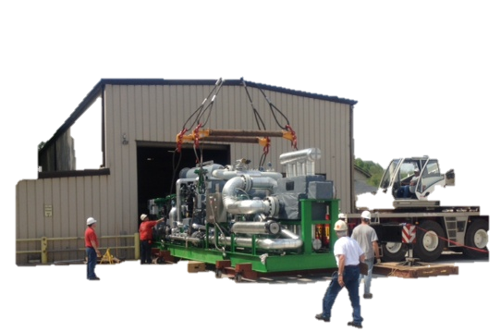
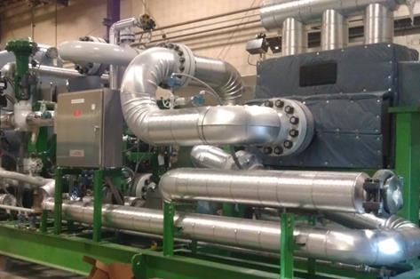

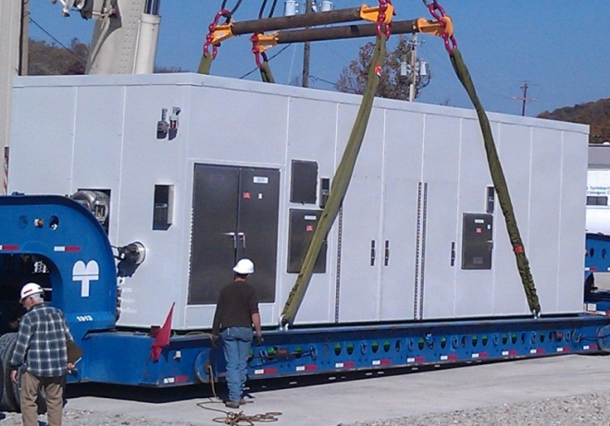
Echogen EPS100
EPS100 process skid
EPS100 power skid
Project derived from EPS100, first commercial sCO₂ system in the world

Slide 6
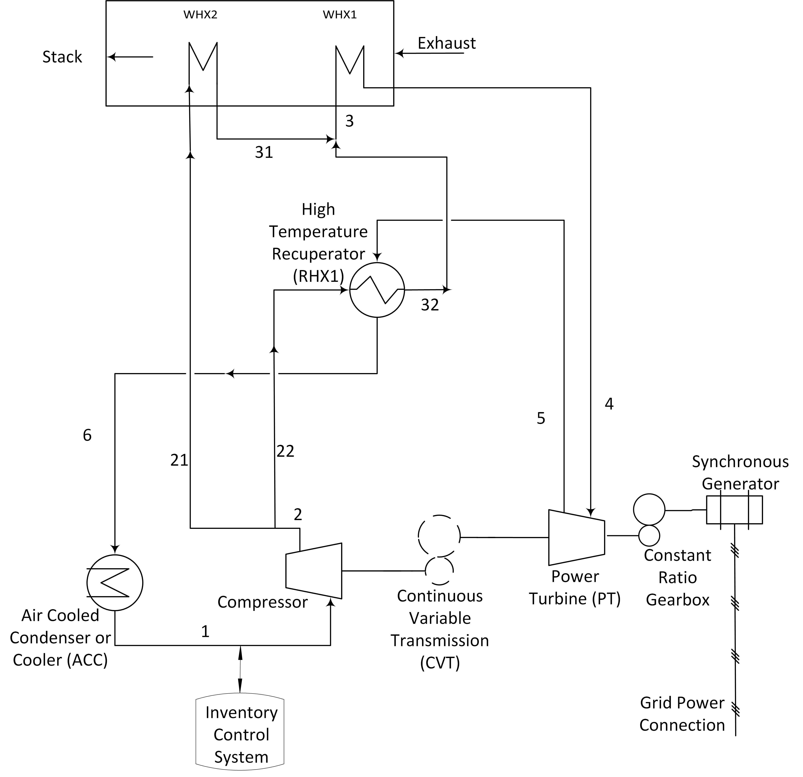
Heat recovery cycle – current project
Cycle designed for waste heat recovery
Reduces exhaust temperature to ~100°C
Flexible, allows for integration of multiple heat sources at different temperatures
Variable-speed compressor driven off power turbine

Slide 7
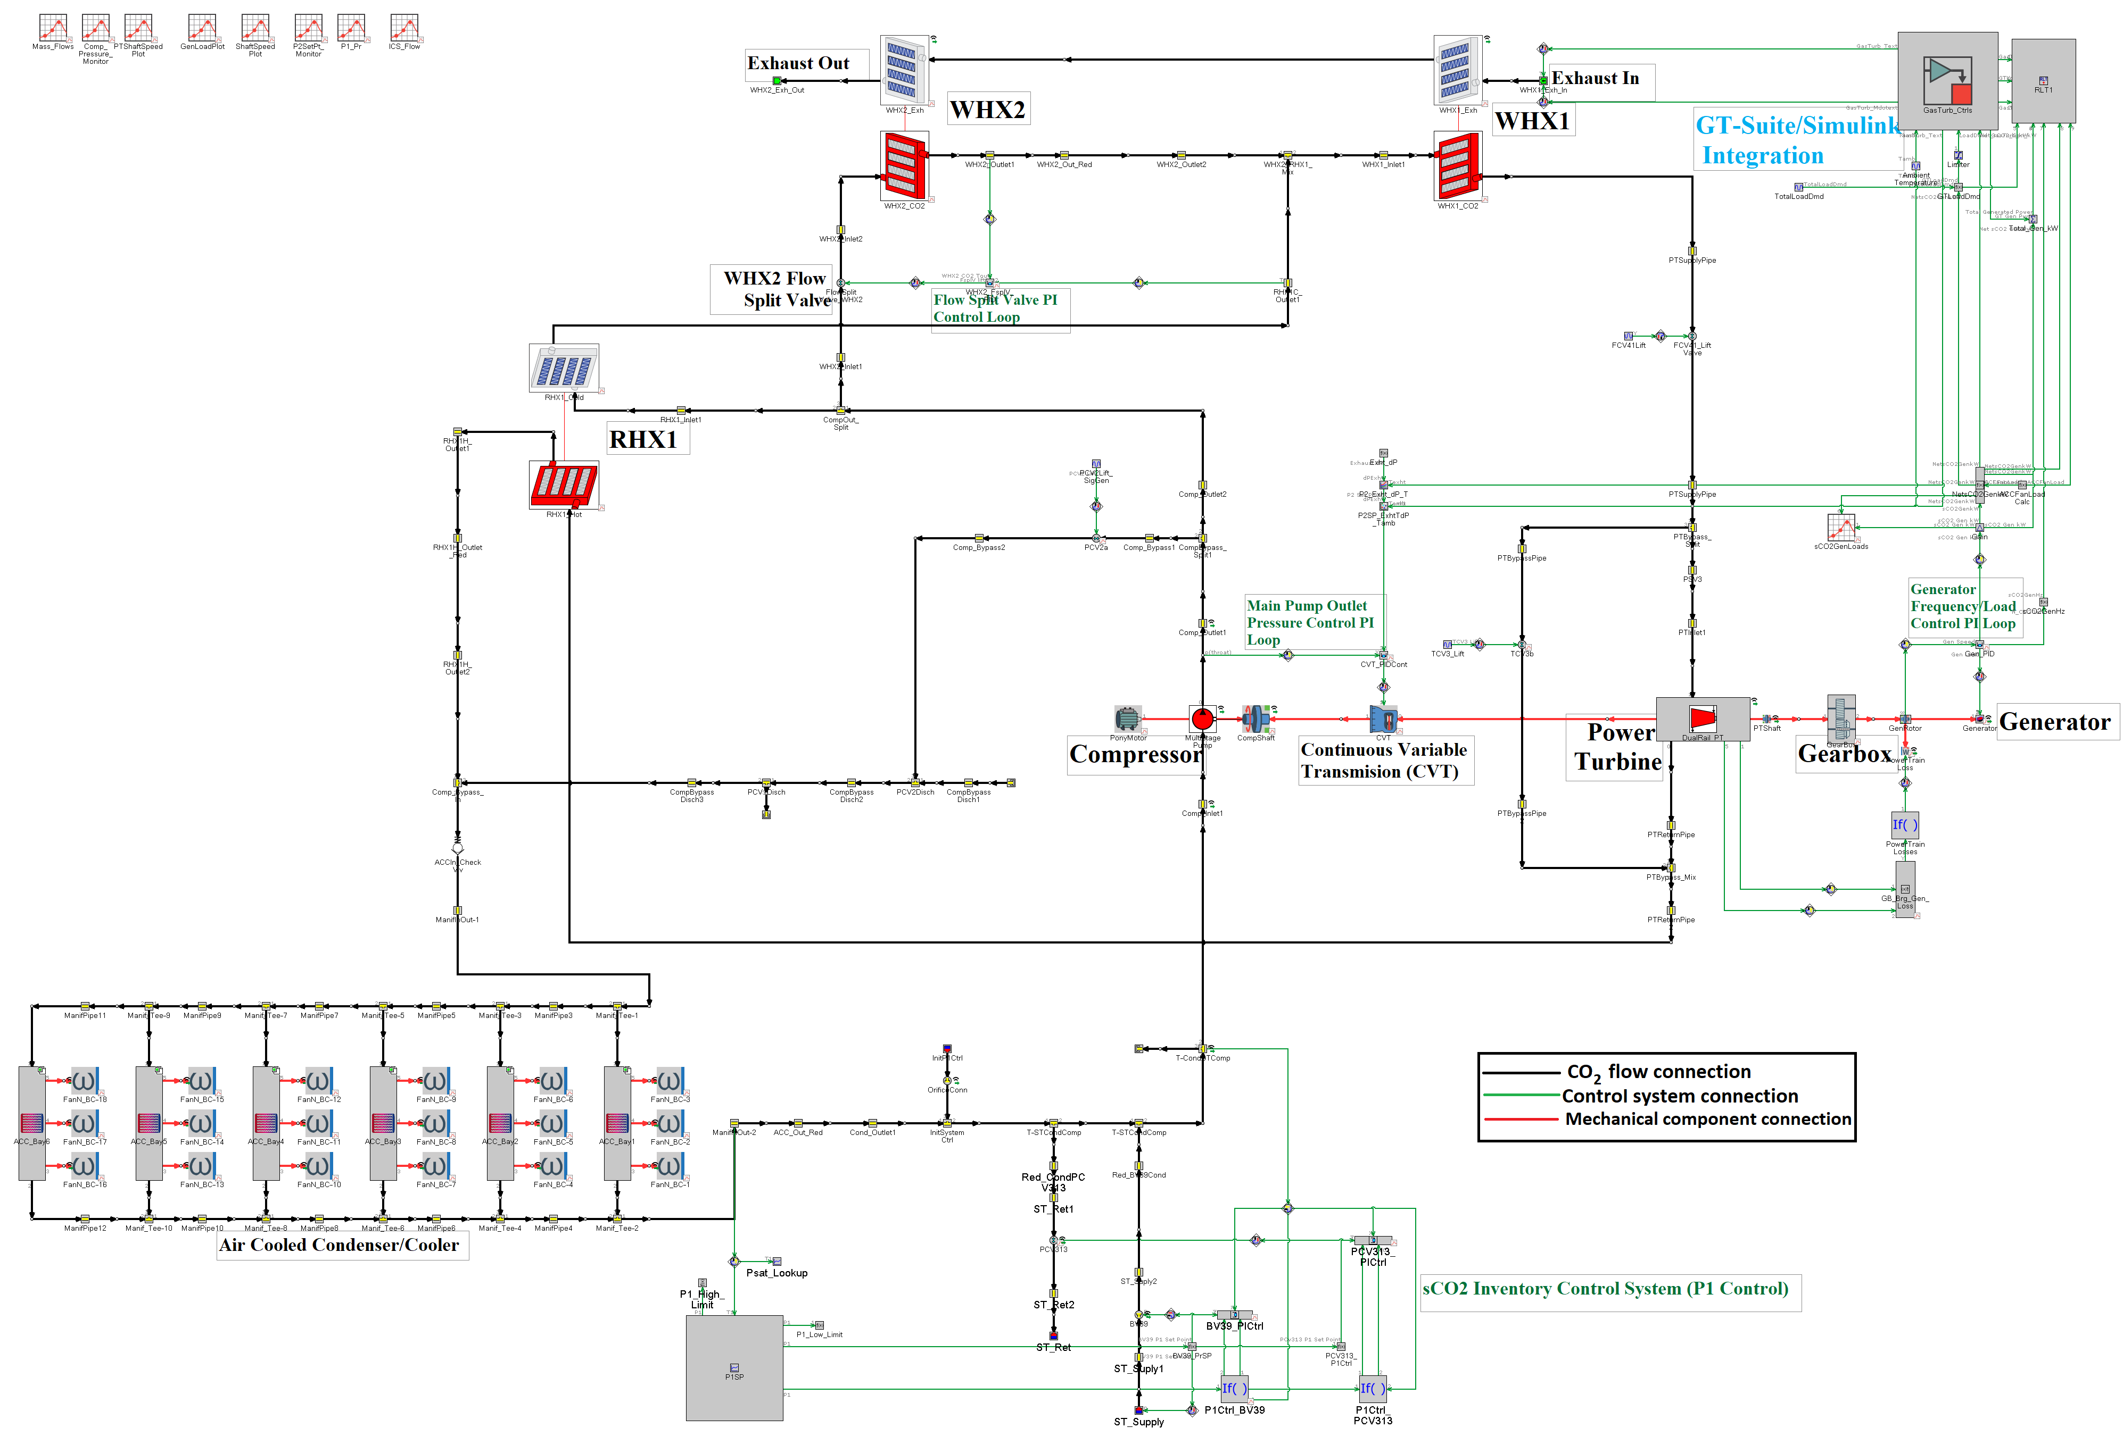
sCO₂ model in GT-SUITE
Similar architecture to EPS100
Exception is compressor speed control with variable-ratio gearbox on common power turbine shaft
Includes air cooling, active inventory control
Control system in Simulink block

Slide 8
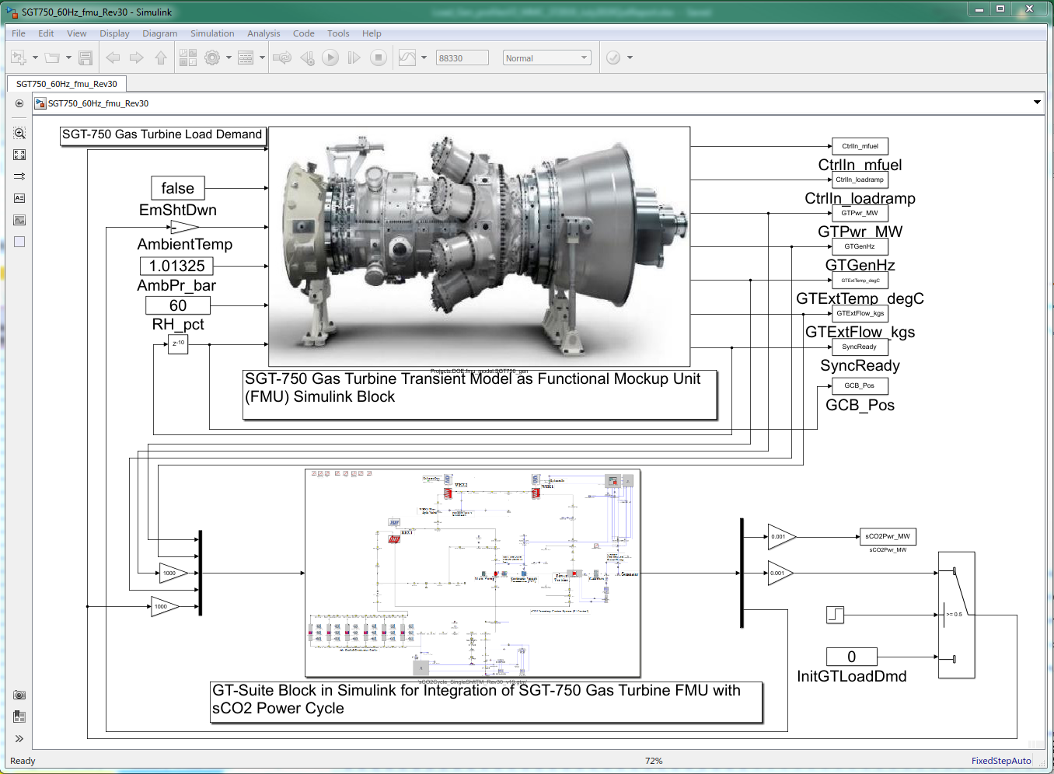
Functional Mockup Interface for co-simulation
SGT-750 model in Dymola
sCO₂ system model in GT-SUITE
Control system in Simulink
Grid modeling separately using PSS (does not support FMI)

Slide 9
Control system design
Multiple-layer control system
Regulatory layer adjusts manipulated variables (MV) to drive controlled variables (CV) to setpoints
Supervisory layer determines CV setpoints to meet grid demand signal and system constraints, preferably at optimal state

Slide 10
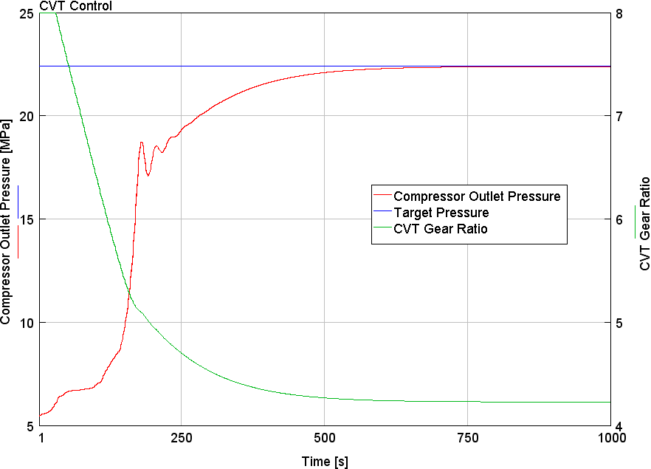
Regulatory control layer – sCO₂ power cycle
Compressor discharge pressure(P2) control
PID loop on compressor speed
For direct-drive system (EPS100), cascade control on compressor speed to set P2

Slide 11
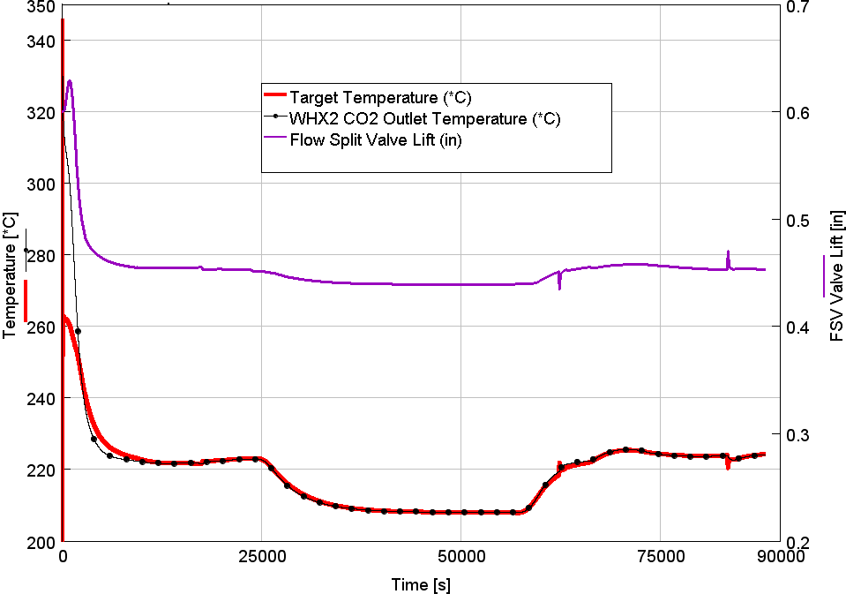
Regulatory control layer – sCO₂ power cycle
Intermediate PHX temperature control (T31)
Flow split valve modulated to balance temperature of PHX2 outlet with RHX outlet
Supervisory layer defines T31 setpoint

Slide 12
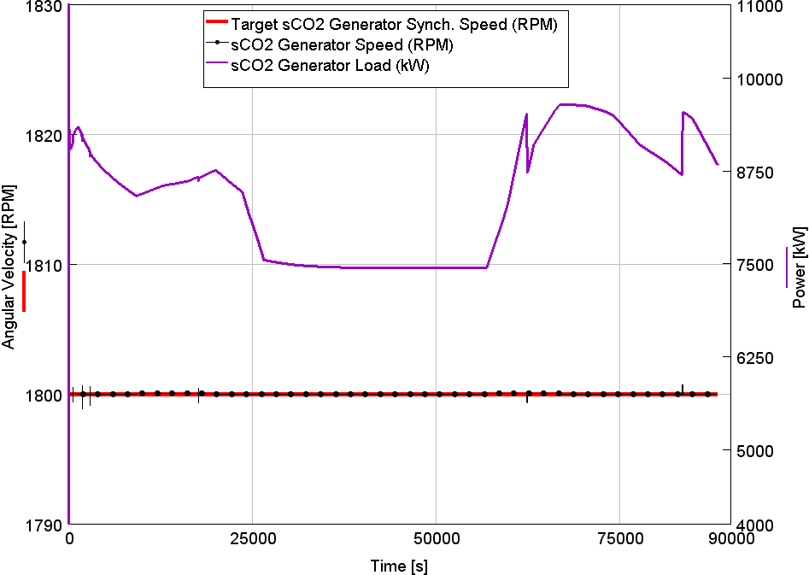
Regulatory control layer – sCO₂ power cycle
Generator speed
Steady-state control based on grid stabilization
Fault tolerance evaluation as part of grid modeling

Slide 13
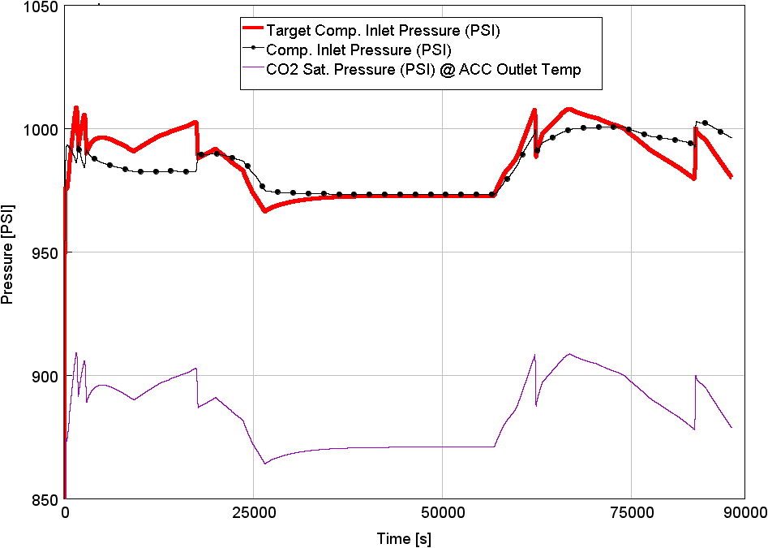
Regulatory control layer – sCO₂ power cycle
Compressor inlet pressure
Inventory modulated to control compressor inlet pressure

Slide 14
Microgrid description
Microgrid model with peak demand of 60 MW (winter) and min demand of 28 MW (summer)
Typical seasonal and diurnal demand curves created based on Siemens PTI experience
Generation assets:
SGT-750: 33 MW (summer) - 45 MW (winter). Minimum output = 20 MW (emissions limit)
sCO₂ system: 8.5 – 13 MW
PV generation: 24 MW max
Battery system: 9.6 MW

Slide 15
Example load curve – no issues managing power / demand balancing
Demand
GT+sCO₂
PV
BESS charging
BESS generating

Slide 16
Short time-scale behavior – fault case
Scenario: 3-phase short-circuit cleared after 6 cycles, results in loss of 50% of grid demand
Overspeed > 62 Hz for 10 seconds trips protective relay
Supervisory control intentionally trips sCO₂ breaker to keep GT operating

Slide 17
Fault recovery and tolerance
Preferentially trip sCO₂ system to keep GT within limits
Subgrid breaker manipulation to keep both units online
Optionally, global supervisory control layer can open & close sub-grid breakers to manage load sequencing and keep both generators operating

Slide 18
Summary & next steps
sCO₂ control system simulation successfully reproduces behavior of EPS100 in test cell
Co-simulation allows for independent simultaneous simulation in different codes
Grid model shows limitations in responsiveness of sCO₂ system limit fault tolerance of microgrid
Exploring use of model predictive control (MPC) for regulatory control later responsiveness improvements

Slide 19
The Fine Print
This material is based upon work supported by the Department of Energy under Award Number(s) DE-FE0031621.
This report was prepared as an account of work sponsored by an agency of the United States Government. Neither the United States Government nor any agency thereof, nor any of their employees, makes any warranty, express or implied, or assumes any legal liability or responsibility for the accuracy, completeness, or usefulness of any information, apparatus, product, or process disclosed, or represents that its use would not infringe privately owned rights. Reference herein to any specific commercial product, process, or service by trade name, trademark, manufacturer, or otherwise does not necessarily constitute or imply its endorsement, recommendation, or favoring by the United States Government or any agency thereof. The views and opinions of authors expressed herein do not necessarily state or reflect those of the United States Government or any agency thereof.

