Slide 1
Advanced Modular Sub-Atmospheric Hybrid Heat Engine for Fossil Fuels Contract # DE-FE0031614
2019 UTSR Project Review Meeting (11-6-2019)
Project Lead: Yaroslav Chudnovsky, PhD, MBA
847-768-0536 ychudnovsky@gti.energy
Principal Investigator: Aleksandr Kozlov, PhD, ScD
847-768-0736 akozlov@gti.energy

Slide 2
Outline
Objective and Goals
Project Team
Initial Concept and Sub-atmospheric Turbine Cycle Fundamentals
Market Drivers and Market Penetration
Refined Concept
Thermodynamic Analysis of the Sub-Atmospheric Turbine Cycle
Status of Major Components Availability
Technology Gaps
Components Test Setup and Test Plan
Conclusions

Slide 3
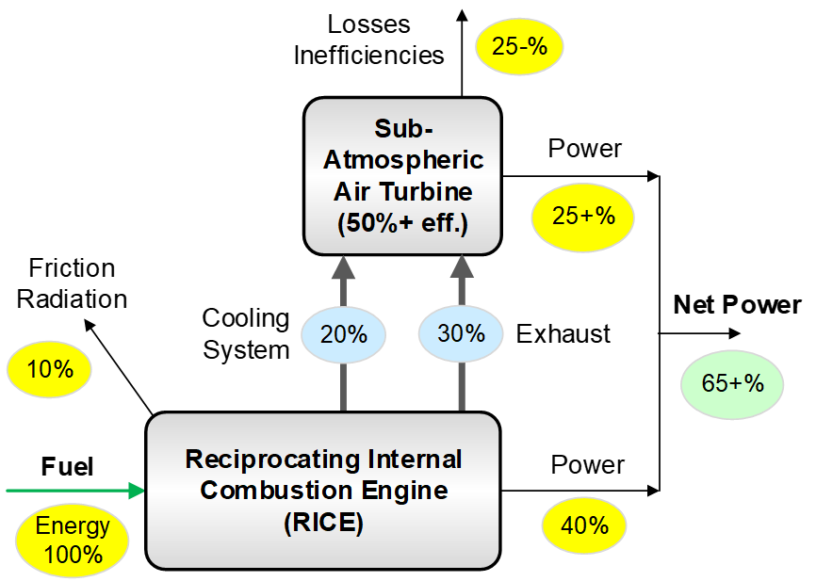
Objective and Goals
Objective: Develop and characterize a conceptual design of the novel advanced Modular sub-atmospheric Hybrid Heat Engine (MHHE) for fossil energy applications to produce electric or mechanical power from various fuels such as coal-derived syngas, hydrogen, or natural gas
Goals:
Develop a MHHE conceptual design
Characterize MHHE at a marketable size
Identify technology gaps
Develop a technology maturation plan for the follow-on pilot-scale design, engineering, fabrication and testing

Slide 4
Project Team
Gas Technology Institute (Des Plaines, IL)
Independent, not-for-profit established by Gas Industry in 1941
Contract research, technology development and deployment
Over 1,200 patents, over 500 technologies commercialized
SoftInWay Inc., Turbomachinery Engineering (Burlington, MA)
Development of efficient turbomachinery and power plants
Software, engineering services, and training
OEMs, consultants and suppliers
Identified and committed for Phase 2 work
Strong expertise and capabilities in material, manufacturing, controls

Slide 5
MHHE Initial Concept
Unique combination of a sub-atmospheric air turbine and RICE into hybrid heat engine enhanced by a humidifying regenerator, that allows achieving >65% (LHV) net efficiency
Prior to the turbine, the working flow (air at atmospheric pressure) is humidified and heated to below 300°C
Prior to the compressor, the air is dehumidified and cooled to near 0°C by the VC cooling system with COP>1
Increased volume of the air flow at the turbine inlet and reduced volume of this flow at the compressor inlet boosts the turbine cycle efficiency to an ultra-high level
Sub-Atmospheric MHHE Concept
(U.S. Patent pending)

Slide 6
Sub-atmospheric Air Turbine Fundamentals
Modified Closed Brayton Cycle
Psychrometric Chart
Humidification/Dehumidification
Heat and Mass Regeneration

Slide 7
Project Scope (Phase 1)
Analyze the potential market and primary fuels
Refine and characterize the MHHE conceptual design
Select the modular size and functionality
Complete thermodynamic cycle analysis for the selected module size
Identify the technology gaps and develop a resolution plan
Outreach the potential stakeholders and OEMs

Slide 8
Market Drivers
A fossil gas-fueled RICE is a main heat source for the air turbine operated by modified Brayton cycle
The sub-atmospheric MHHE leverages additional attributes of a RICE (short start up, high ramp rate, and suitability for modular size)
The sub-atmospheric air turbine almost doubles the efficiency compared to RICE (from 30-50% to above 65%)
RICE units are available from major OEMs in sizes up to 10/20MW, so the MHHE maximum power rating may be limited to ~30 MW per module
The MHHE will result in extremely low NOx emissions per unit of fuel input

Slide 9
Market Penetration Basis
The market power segments include power ranges:
0.5-1MW, 1-2MW, 2-5MW, 5-10MW and 10-20MW
The global gas engine market is segmented into four major regions that includes North America, Europe, Asia-Pacific and the rest of the world
With the proper incentives for OEM partner(s) to MHHE commercial deployment, we can utilize their extensive marketing networks
The forecasted growth in the gas engines market based upon variety of gaseous fuel (natural gas, coal-derived syngas, hydrogen) offers a significant market potential for the MHHE
A target installed cost of $1,800/kW for selected 2.5MW MHHE is competitive

Slide 10
Refined MHHE Concept
Sub-atmospheric air turbine
MHHE
MHHE components:
1.0 MW sub-atmospheric air turbine
1.5 MW gas engine
2.5 MW MHHE at 67.1% efficiency
Utilizes low/medium grade waste heat

Slide 11
P&ID: Sub-Atmospheric MHHE

Slide 12
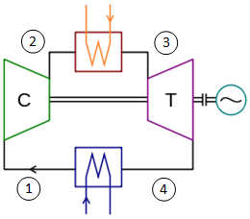
Thermodynamic Analysis of the Turbine Cycle
The core of MHHE is a modified turbine Brayton cycle
The turbine Brayton cycle thermal efficiency
η = W_{net} /Q_{H} = 1 – Q_{L} /Q_{H} = 1 – [m_{L} c_{pL} (T₄ - T₁)]/[m_{H} c_{pH} (T₃ – T₂)]
Isentropic equations with the ideal gas law
η_{ideal} = 1 – T₁/T₂ = 1 – T₄/T₃
η_{ideal} = 1 – (r_{p})^{(1 – k)/k}, r_{p} = P₃/P₄ = P₂/P₁
The Carnot cycle efficiency
η_{Carnot} = 1 – T_{min}/T_{max} = 1 – T₁/T₃
The ideal cycles including Carnot cycle assume no mass change of the working fluid

Slide 13
Turbine Cycle Enhanced with Humidity Regeneration
The mass ratio m_{L} /m_{H} may essentially affect the turbine cycle efficiency even at low air temperature at the turbine inlet
η = W_{net} /Q_{H} = 1 – Q_{L} /Q_{H} = 1 – [m_{L} c_{pL} (T₄ - T₁)]/[m_{H} c_{pH} (T₃ – T₂)]
For instance, as m_{L} /m_{H} → 0, the turbine cycle efficiency η→100%, thus breaking the Carnot efficiency limit while not violating the 2nd Law of Thermodynamics
Example: r_{p} =1.6, T₃=165°C, T₁=62.3°C
While the η_{ideal} depends on T₃ , the η_{sub} highly depends on m_{L} /m_{H}

Slide 14
Real Sub-Atmospheric Turbine Cycle
Turbine power: 1000 kW
Turbine isentropic efficiency: 86.9%
Compressor isentropic efficiency: 82.1%
Turbine inlet temperature: 147°C
Compressor pressure ratio: r_{p} = 1.48
Turbine unit net efficiency: 54.2%
Carnot cycle efficiency: 34.7%

Slide 15
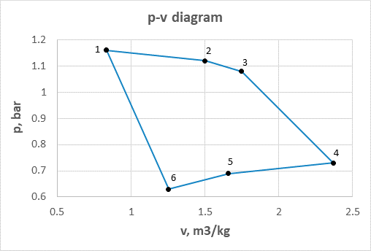
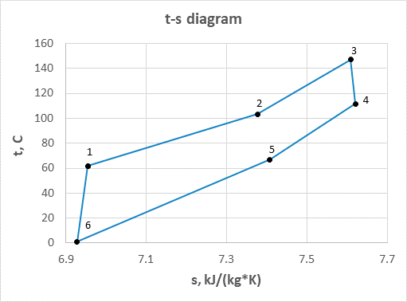
Sub-Atmospheric Turbine Cycle in P-V and T-S
Low levels of temperature and pressure ensure the low capital cost

Slide 16
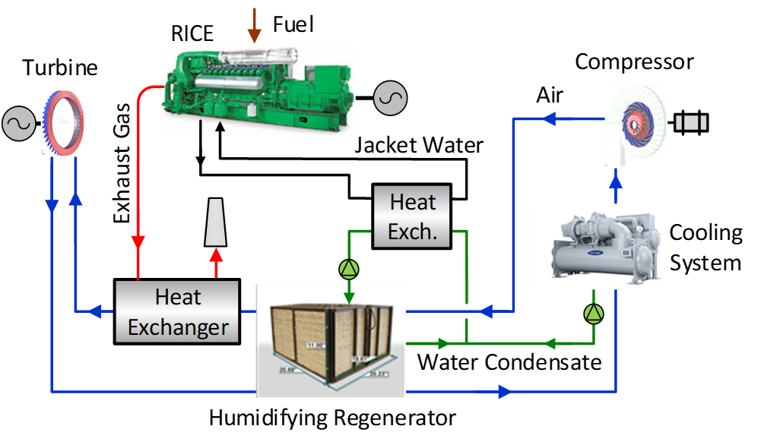
MHHE Major Components - Availability For Integration
Off-shelf or straight-forward modifications of existing designs

Slide 17
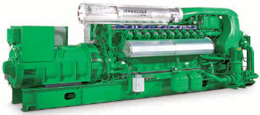
MHHE: Status of Major Components [RICE]
Jenbacher J420 gas engine (INNIO Jenbacher-Clarke Energy)
Fuel input | kW | 3669
Electrical efficiency | % | 40.8
Electrical output | kWe | 1497
Fuel gas LHV | MJ/m³ | 36.6
Jacket water | kW | 394
Intercooler and lube oil | kW | 566
Exhaust gas temperature | °C | 422
Exhaust gas cooled to 110°C | kW | 810
Length | m | 7.1
Width | m | 1.8
Height | m | 2.2
Weight empty | ton | 13.27

Slide 18
MHHE: Status of Major Components [Turbine and Compressor]
Straightforward modifications of existing designs, optimization and OEM review with low temperature and low cost materials (SoftInWay, Inc.)
Parameter | Unit | Comp. | Turb.
Power | kW | 63 | 1414
Total-to-total isentropic efficiency | % | 83.5 | 93.3
Total-to-static isentropic efficiency | % | 82.1 | 86.9
Mass flow rate | kg/s | 1.02 | 21.5
Rotational speed | krpm | 23 | 3.6
Impeller diameter | mm | 256 | -
Mean diameter | mm | - | 1167
Stator blade height | mm | 17.3 | 132.1
Number of rotor blades | - | 12 | 87
Number of stator blades | - | 15 | 40

Slide 19
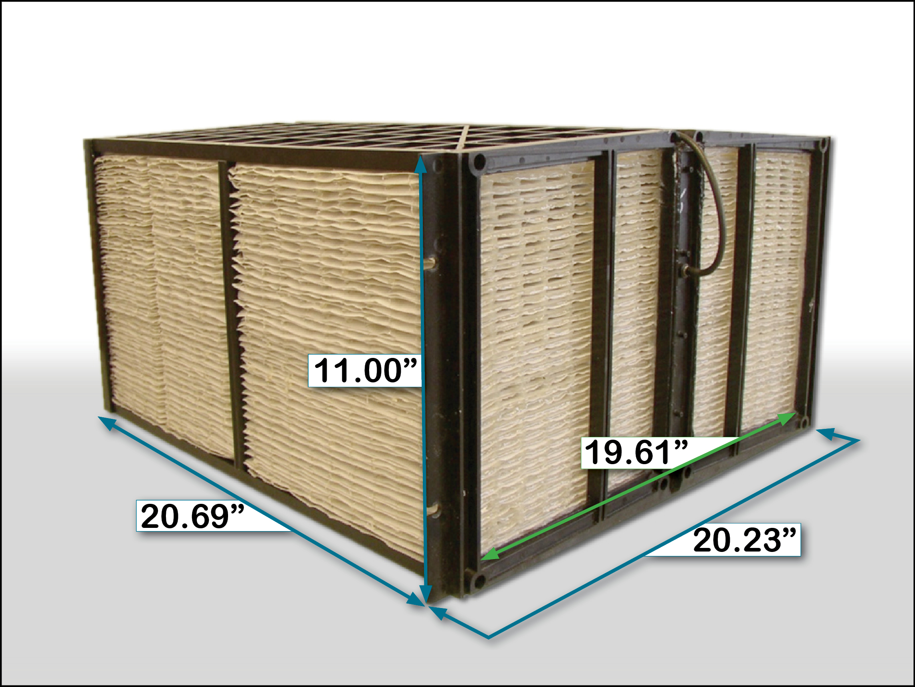
MHHE: Status of Major Components [Humidifying Air Regenerator]
Multilayer-plate (Coolerado by Seeley Int’l) or spiral-thermosyphon (Smart Heat Co) heat and mass exchanger design – modification, optimization and performance characterization are required

Slide 20
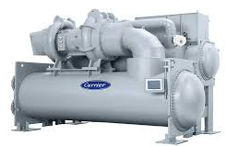
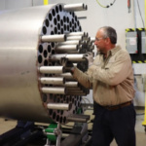
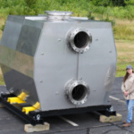
MHHE: Status of Major Components [Heat Exchangers and Chiller]
Available or straightforward modifications of existing designs (Heat Exchangers by Flex Energy, Inc., HRI; Chiller by Danfoss, Johnson Controls, Carrier)

Slide 21
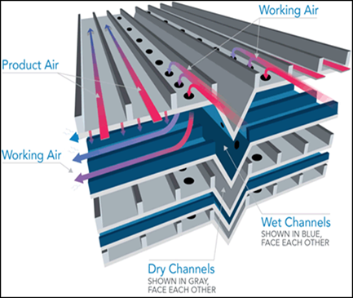
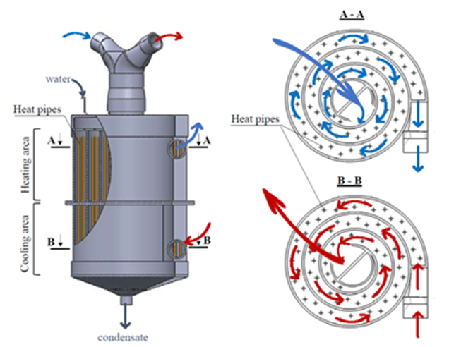
Technology Gaps Identified
The humidifying air regenerator (HAR) has been identified as a key technology gap for the MHHE (material, design, footprint)
The HAR should condense and evaporate a large amount of water vapor from and to air to allow the low temperature turbine to produce high power at ultra-high efficiency due to moisture cycling
While the HAR operating feasibility has been proven, the design optimization (size and cost) is a subject for follow-on effort (Phase 2)

Slide 22
Humidifying Regenerator Test Bed and Test Plan
1:10 pilot scale HAR
1MW net power turbine case
OEM/GTI test facility
Pressure range 0.2 to 1.2 bara
Temperature range 0 to 200C
Scale-up design OEM review
Parameter | Unit | 1 | 2 | 3 | 4 | 5 | 6 | 7 | 8 | 9 | 10
Pressure P | bara | 1.0 | 1.2 | 1.16 | 1.12 | 1.08 | 0.73 | 0.69 | ~1.0 | 0.71 | 1.14
Temperature T | °C | 20 | >T₂ | 62 | 103.4 | 147 | 111.5 | 66.9 | >T₇ | 89 | 83
Humid air flow rate M | kg/s | - | 0.1 | 0.1 | 2.15 | 2.15 | 2.15 | 0.14 | 0.14 | - | -
Relative humidity RH | % | 60 | - | - | 100 | <100 | <100 | 100 | <100 | - | -
T measurement (Y/N) | °C | Y | Y | Y | Y | Y | Y | Y | N | Y | Y
P measurement (Y/N) | Bara | Y | Y | Y | Y | Y | Y | Y | N | Y | Y
M measurement (Y/N) | kg/s | N | Y | N | N | Y | N | N | Y | Y | Y
RH measurement (Y/N) | % | Y | N | N | N | Y | Y | N | Y | N | N

Slide 23
Conclusions
The MHHE conceptual design has been developed for 2.5MW power generation unit to be used across a wide application spectrum ranging from modular coal gasifiers and power plants to gas compression stations
The main components of the MHHE are a RICE and a low temperature, high efficiency sub-atmospheric air turbine. Low/medium grade waste heat from the RICE operation is recovered at high turbine efficiency (>54%) thus yielding a MHHE net output at >65% efficiency
The MHHE technology gaps were identified and a plan to address these gaps has been developed and submitted to U.S.DOE along with the Phase 2 renewal application
The MHHE may drastically change the present fossil fuel power generation market by being more efficient and less expensive over state-of-the-art

Slide 24

Questions

