Slide 1
DE-FE0031615: Modular Heat Engine for the Direct Conversion of Natural Gas to Hydrogen and Power Using Hydrogen Turbines (Phase I)
Presented at University Turbine Systems Research (UTSR)
November 6th, 2019
Orlando, FL
Contact:
Jeff Mays
Program Manager, GTI
jmays@gti.energy
(818) 813-2740 (Cell)

Slide 2
DOE Program on Modular Heat Engines (Area of Interest 3)
Vision: Design, build and operate a modular heat engine system for efficient co-production of clean power, CO₂ and H₂

Slide 3
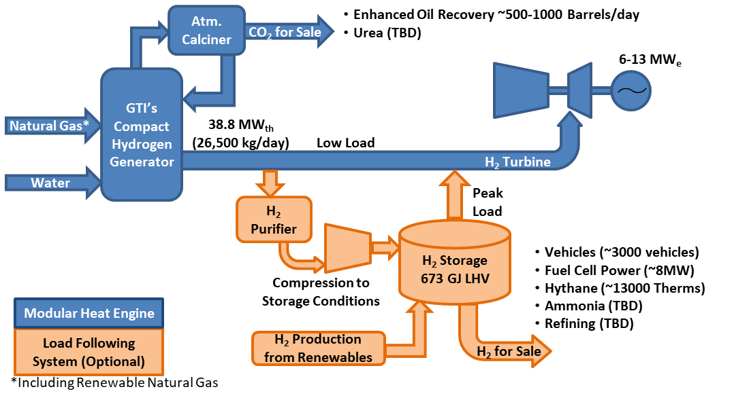
H2-Power MHE System Concept

Slide 4
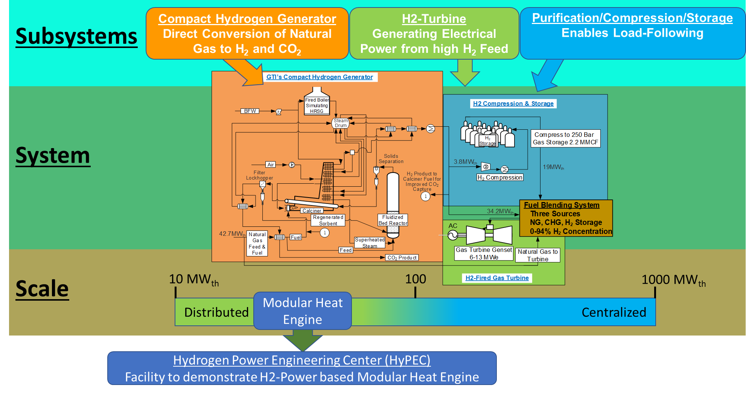
H2-Power System and Demonstration

Slide 5
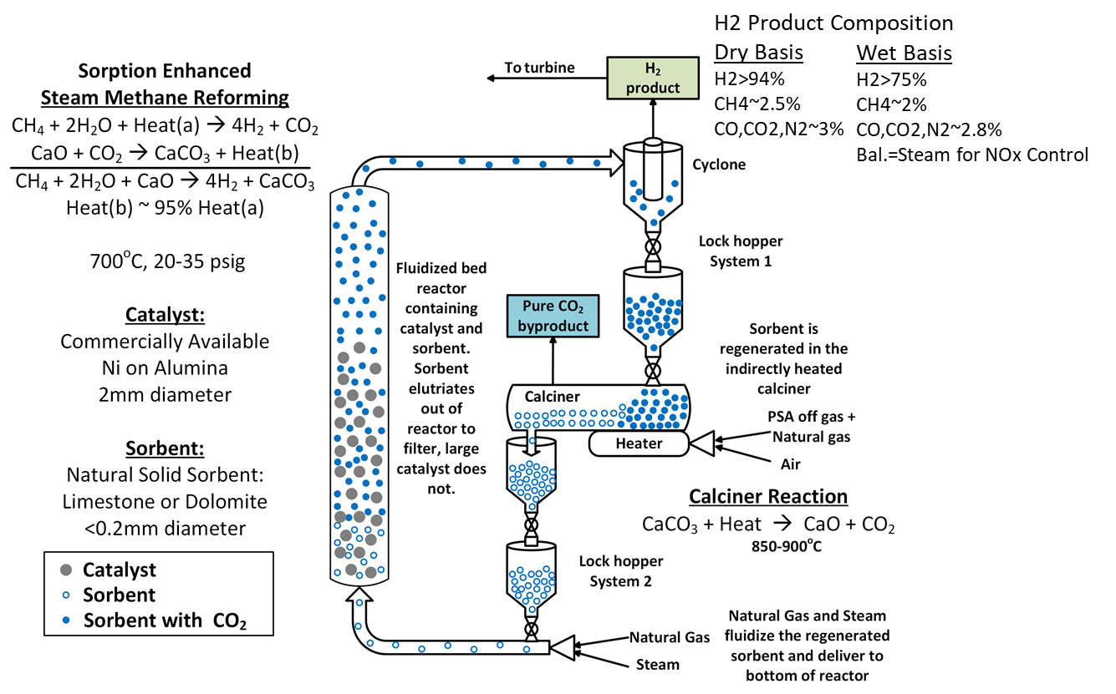
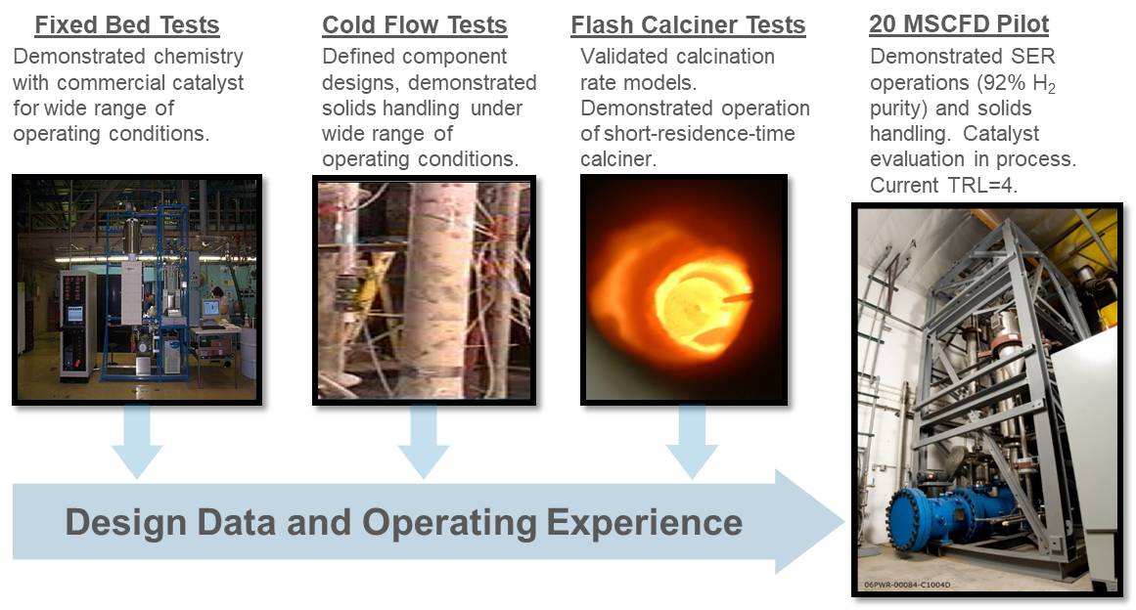
CHG Process Schematic & Technology Development
3

Slide 6
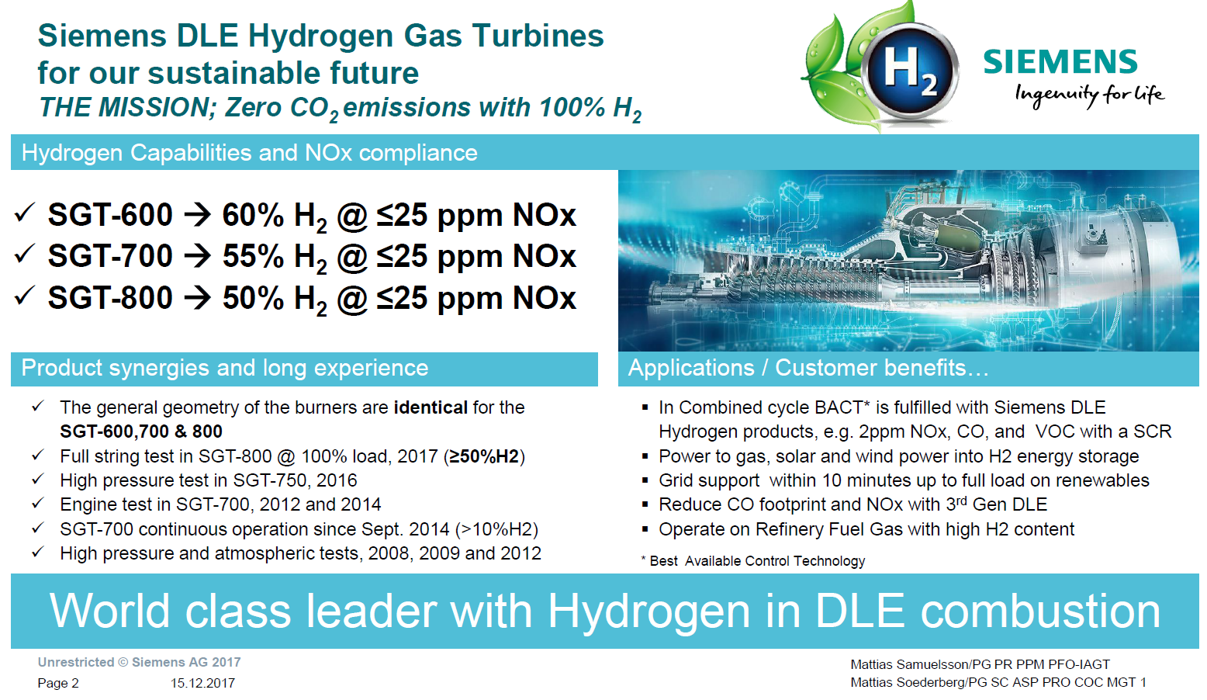
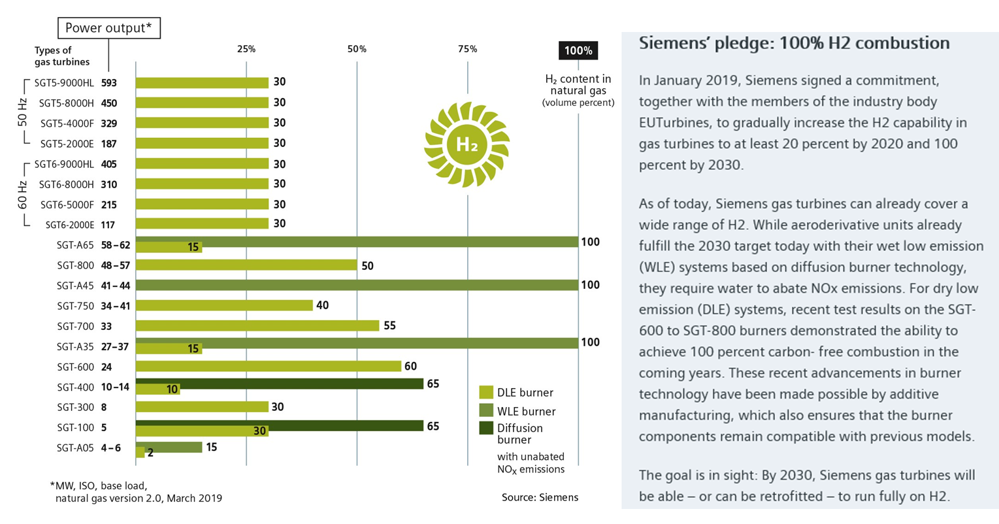
DOE/Industry H₂ Turbine Development
Significant H₂-fired turbine development was performed in the last 15 years. Commercial H₂-fired turbines are currently in operation

Slide 7
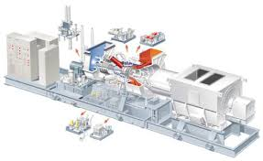
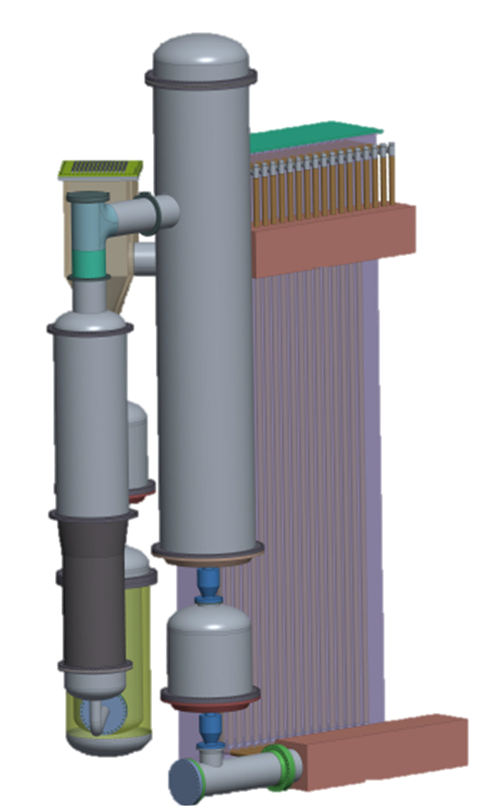
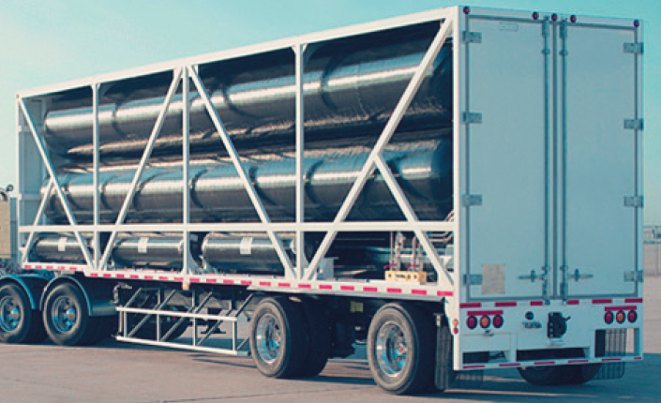
H2-Power MHE Demonstrator System
Siemens SGT-400
For high H₂ fuel
GTI’s CHG H₂ Generator
(38.8 MWth)
Titan 40XL H2 Storage
Courtesy: Hexagon Lincoln
Notes:
7

Slide 8
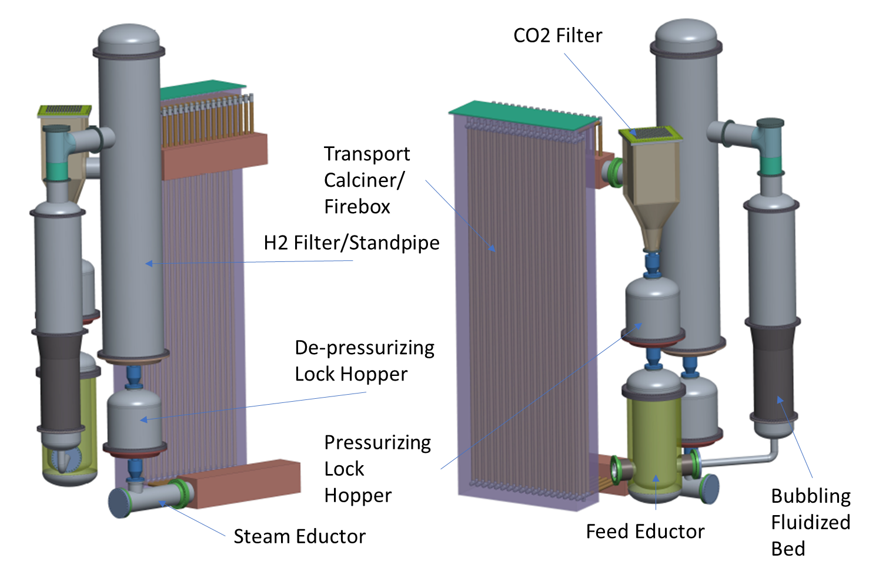
H2-Power CHG Subsystem Conceptual Design
Notes:
8

Slide 9
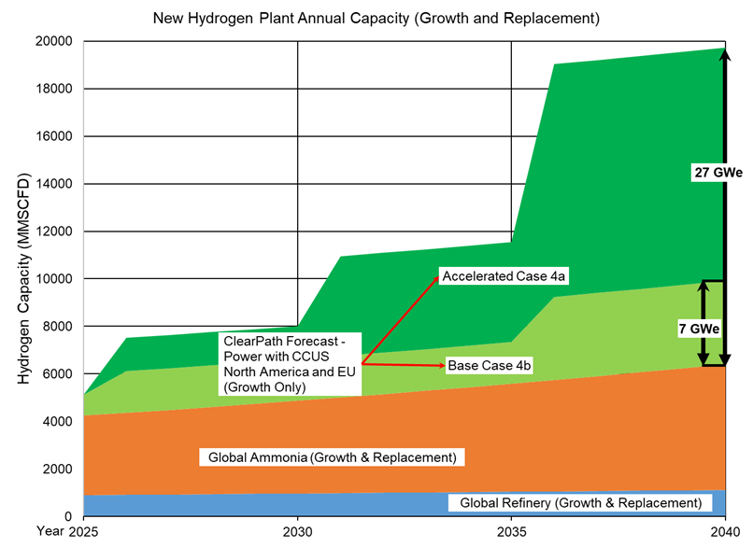
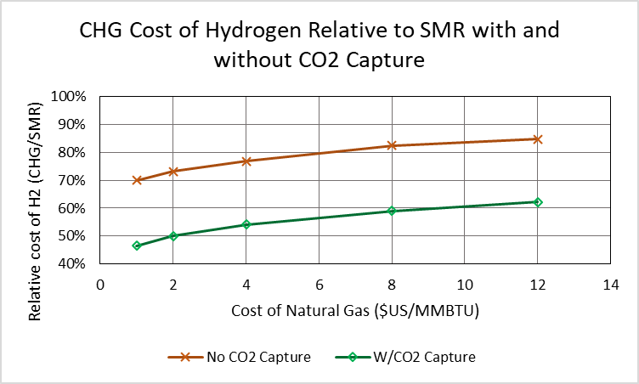
Hydrogen Market and CHG Value Proposition
GTI utilized a recent assessment for CO₂-EOR needs and determined corresponding H₂ demand for power generation using the CHG technology
GTI Compared cost of hydrogen from its CHG technology and conventional SMR-based systems with and without CO₂ capture. Shows the relative cost of hydrogen advantage as a function of natural gas cost (excludes valuation of CO2)
72-226 GWe NGCC with CCS capacity by 2040
Reference: https://clearpath.org/wp-content/uploads/2018/07/Making-Carbon-a-Commodity-.pdf, Scenario 4a, 4b
Power market assumes U.S. and Europe only following Clearpath scenarios based on respective annual power generation

Slide 10
H₂-Power Large-Scale Economic Comparison (Preliminary)
$6.13/MMBTU-HHV
(NETL Reference)
$3.00/MMBTU-HHV
(est. current price)
With Sequestration credits, COE less than NGCC without capture at current fuel prices

Slide 11
Scale-up and Centralized Modular System Approach
Pilot
Current Pilot (0.071 MWth) demonstrates:
CO2 capture
Solids Handling
BEIS H1 Project (if awarded) demonstrates:
Full Pressure
Transport Calciner
~50 MWth System
100 MWth System
To be demonstrated on DOE H2-Power Project
Uses 2x 50MWth Solids Handling/Calcining Loops
Reactor grows ~1.414
150 MWth System
Uses 3x 50MWth Solids Handling/Calcining Loops
Reactor grows ~1.732
300 MWth System will have 2x 150 MWth Units

Slide 12
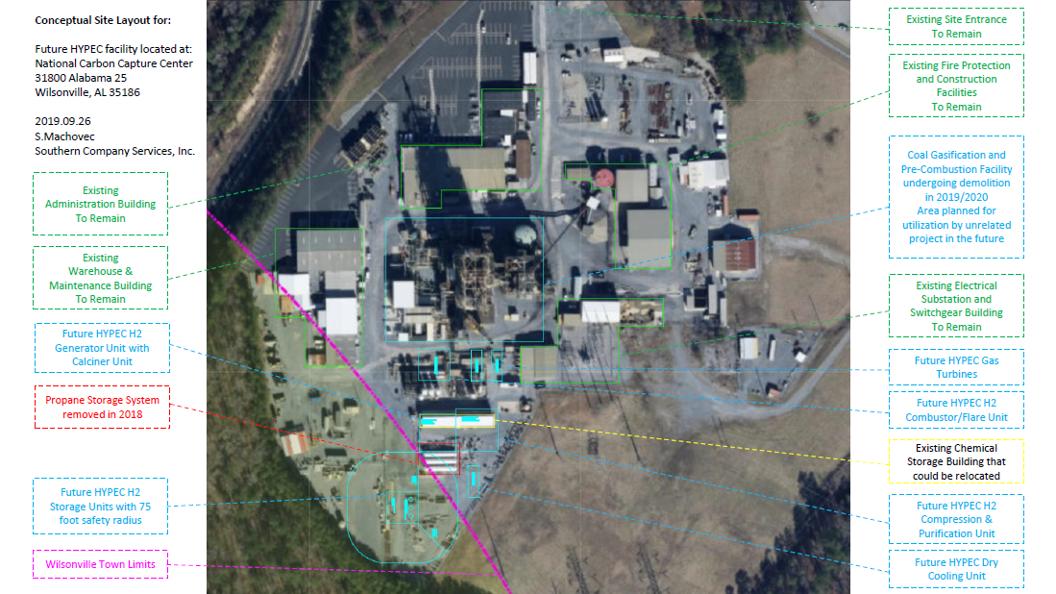
NCCC Site Layout (Conceptual)
Notes:
12

Slide 13
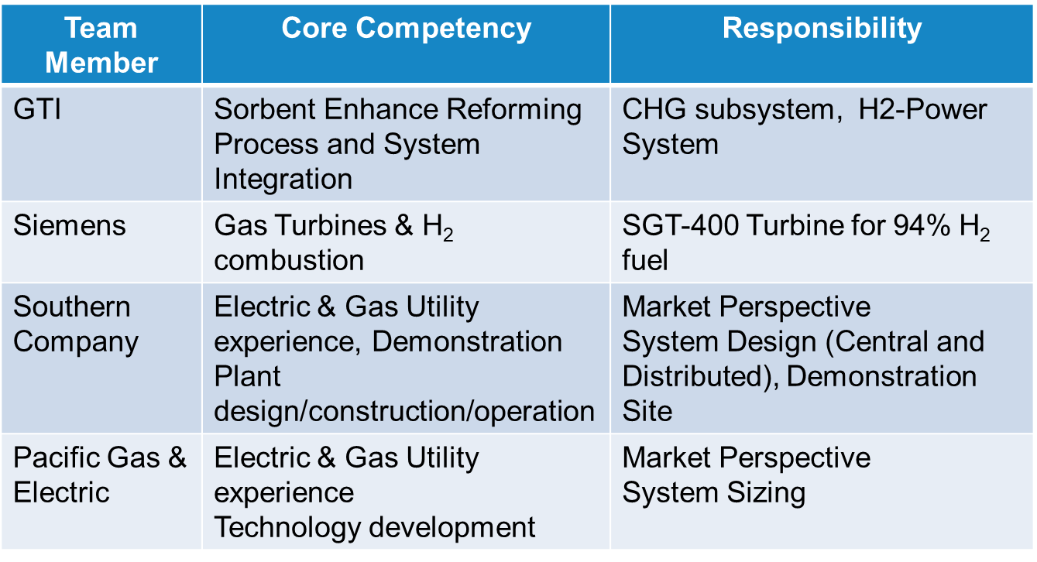
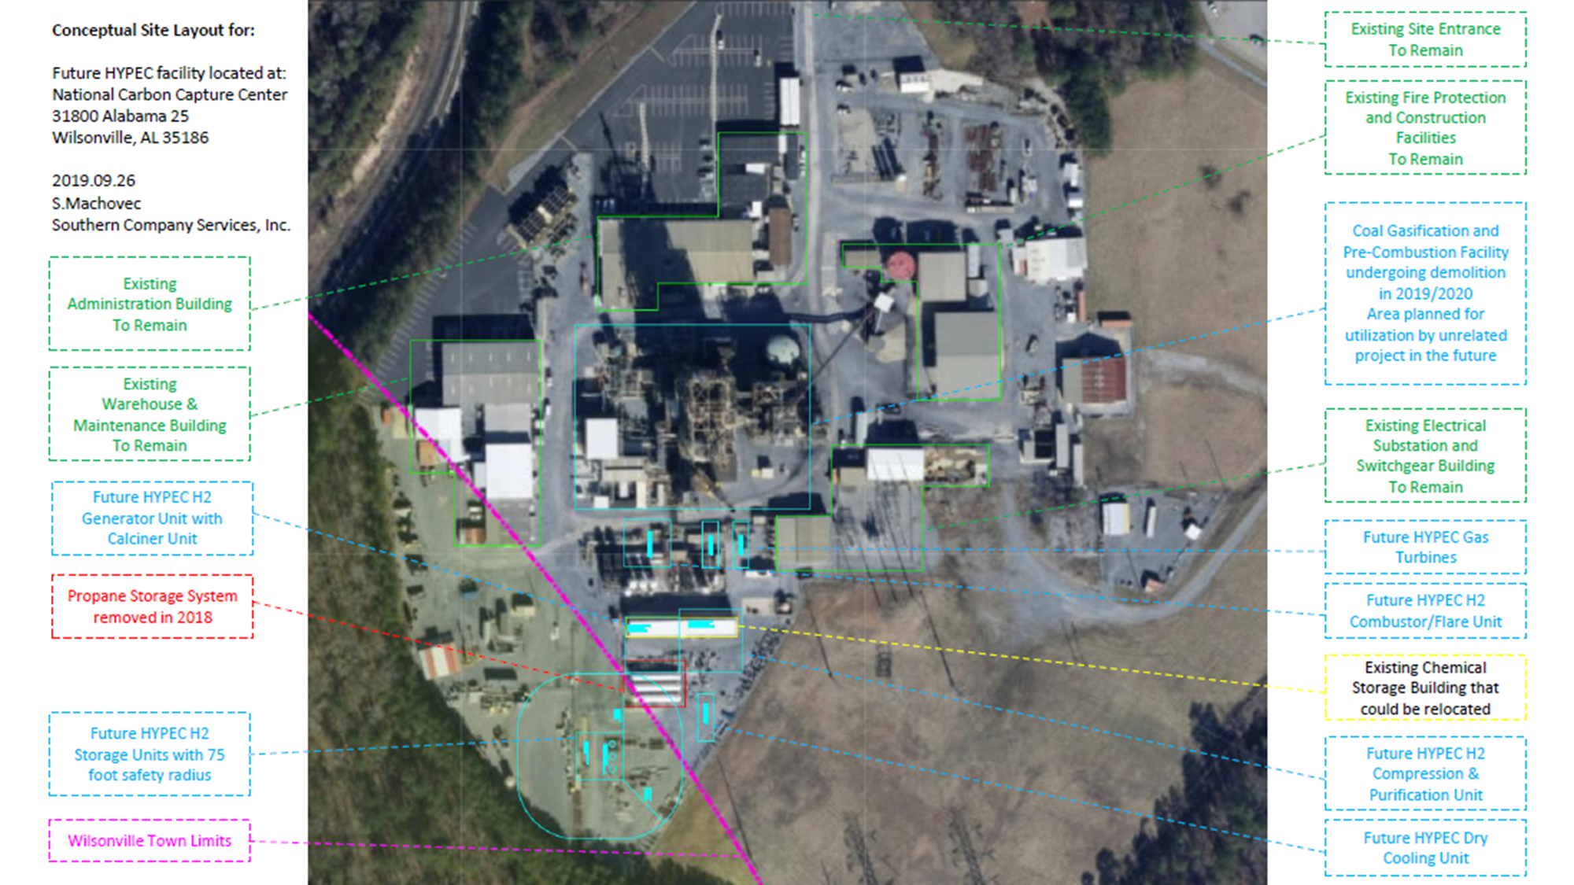

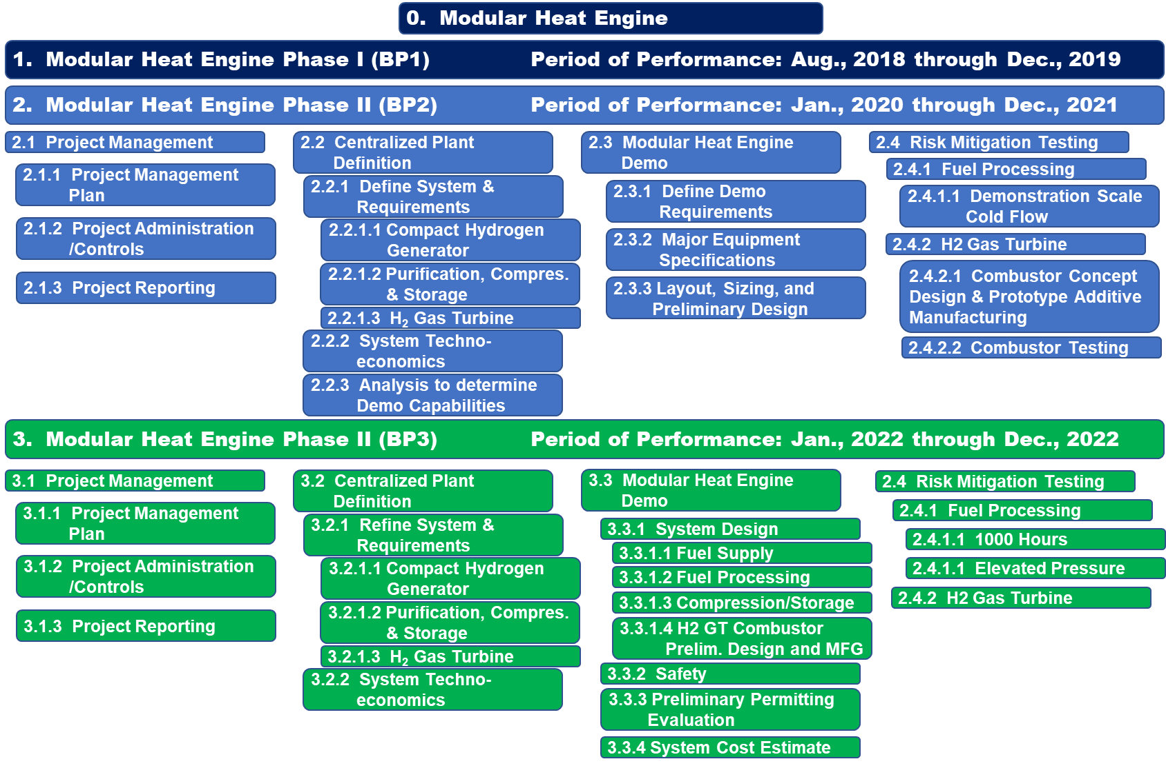
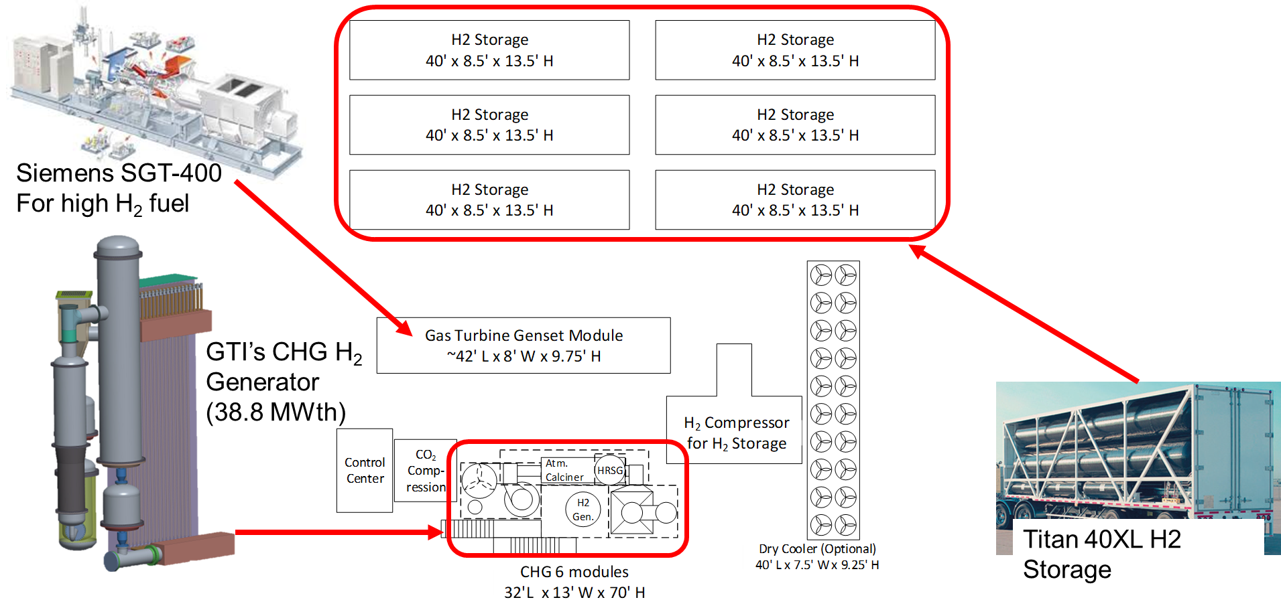
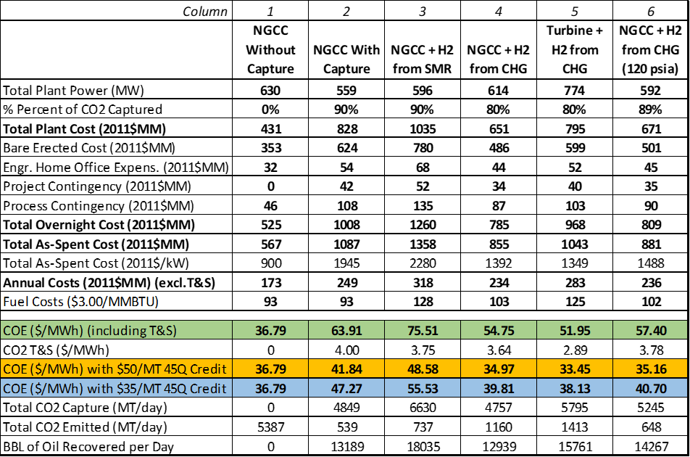

Phase I Objectives and Accomplishments
Phase I – System Definition
Create Team: End-Users
OEM’s
NG Distributors
Industrial Gas Co’s
Define System: Requirements
Architecture
Modularity
Assess: Technology Readiness
Technology Gaps
Techno-Economics (Lvl 5)
Phase II Test Planning
$$1/2$$
18 Months

Slide 14
Summary
Pre-Combustion carbon capture solution for natural gas fired power plant
Lowest cost of electricity, 11% better that post-combustion capture
Assembled a strong team which brings together expertise in: subsystems, site, and diverse end-user market perspective
Have a identified a highly capable site with engineers and technicians with development expertise
Completed conceptual design of the system and approach for modularized scale-up
GTI is evaluating candidate applications
Power and H2 infrastructure, 100% electrical power, and marine applications

Slide 15

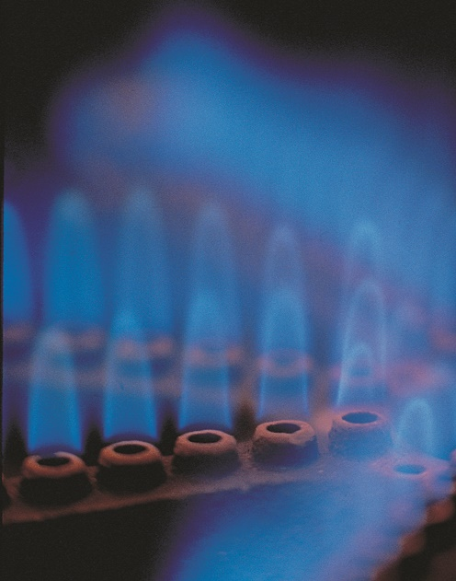

Turning Raw Technology into Practical Solutions
Thank You!
www.gti.energy ⎟ jmays@gti.energy

