Slide 1
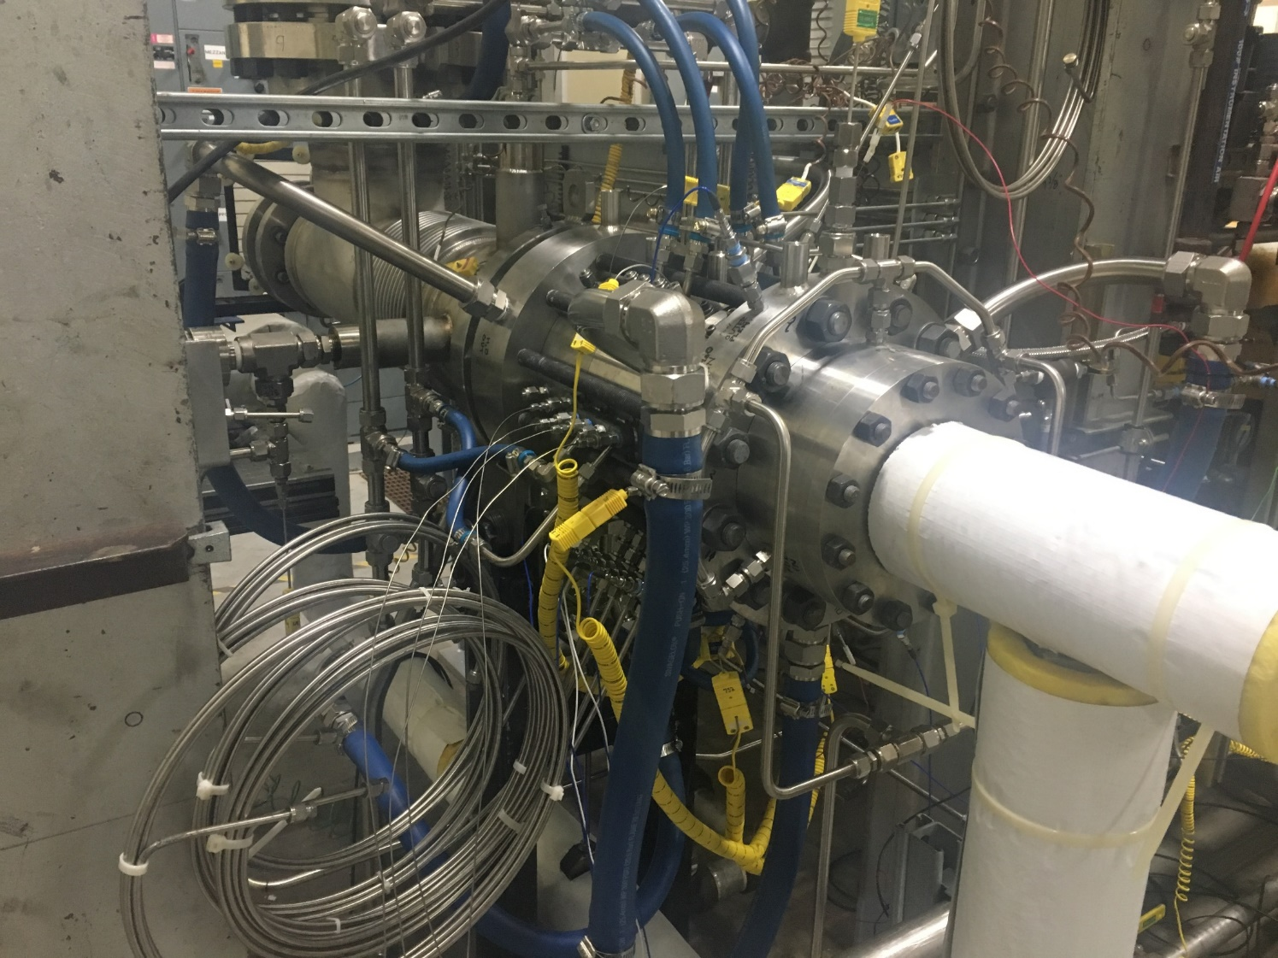
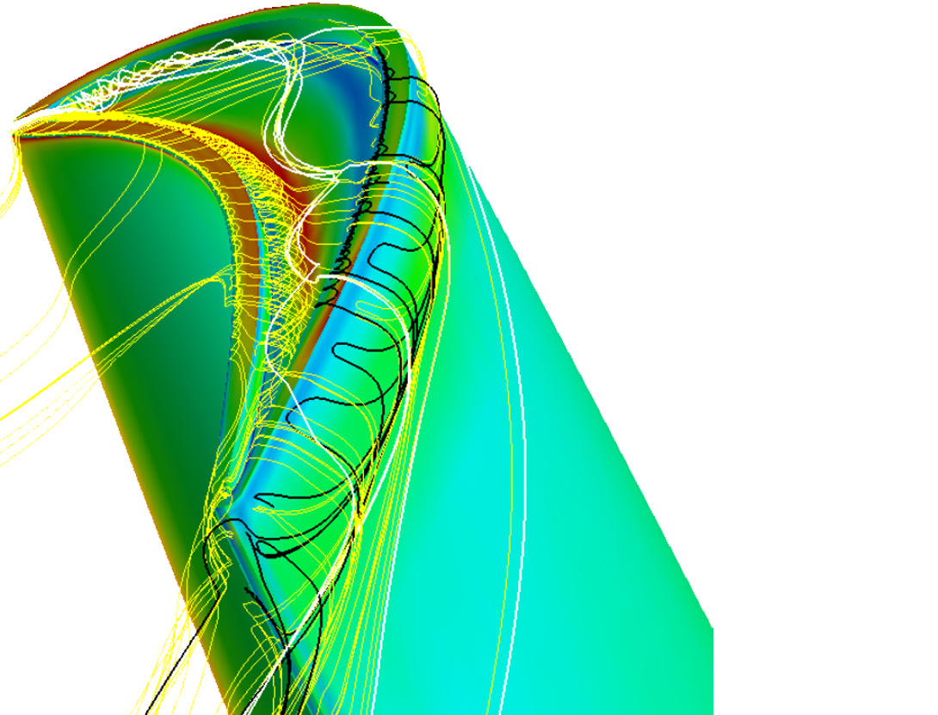

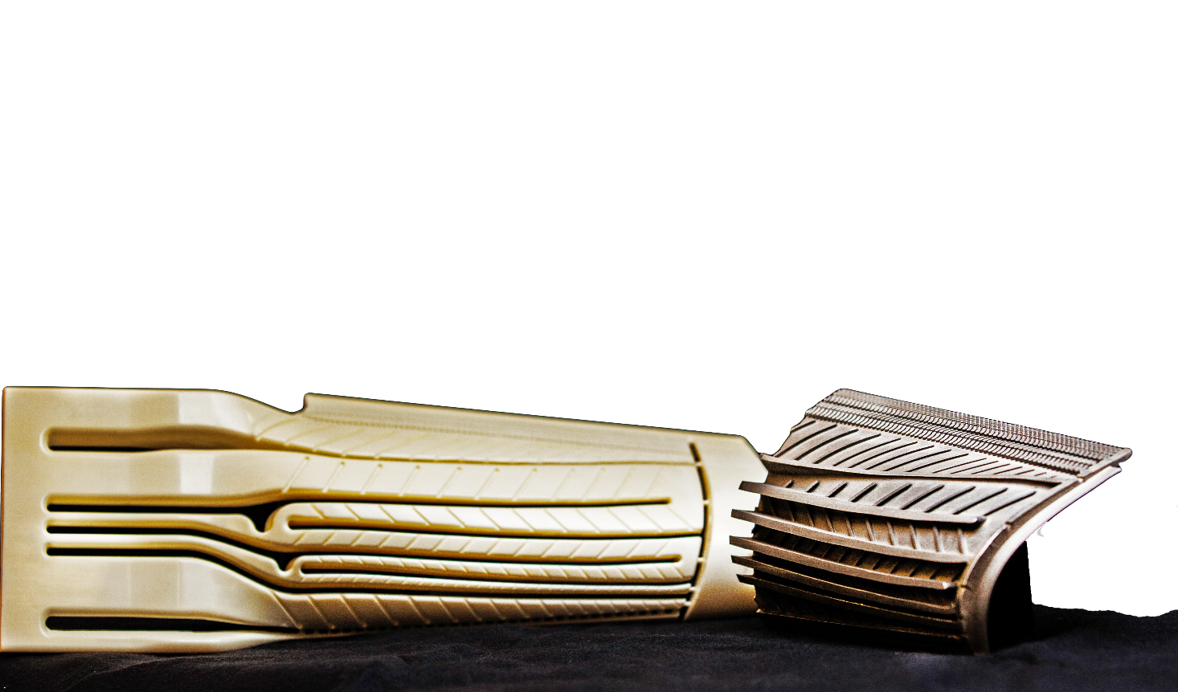

DOE Sponsored Program on Pressure Gain Combustion
Solutions for Today | Options for Tomorrow
University Turbine Systems Research
Project review Meeting
Orlando, FL– Nov 5-7, 2019
Don Ferguson
T. Sidwell, P. Strakey, C. Bedick,
A. Roy, S. Can Uysal,
K. Johnson, A. Tulgestke

Slide 2
Outline
Background/Motivation
DOE Roadmap
DOE Funded PGC
NETL in-house research in PGC
  Water-cooled RDE start-up
Notes:
1910
Coal research begins in Pittsburgh, PA
1918
Petroleum research begins in Bartlesville, OK
1943
Materials research begins in Albany, OR
1946
Synthesis gas research begins in Morgantown, WV
1977
All four sites join new U.S. Department of Energy
1996
PA & WV sites form new Federal Energy Technology Center (FETC)
1999
FETC becomes National Energy Technology Laboratory (NETL)
2000
National Petroleum Technology Office in OK joins NETL
2001
NETL opens Arctic Energy Office in Fairbanks, AK
2005
Albany Research Center joins NETL
2009
OK office moves to Sugar Land, TX

Slide 3
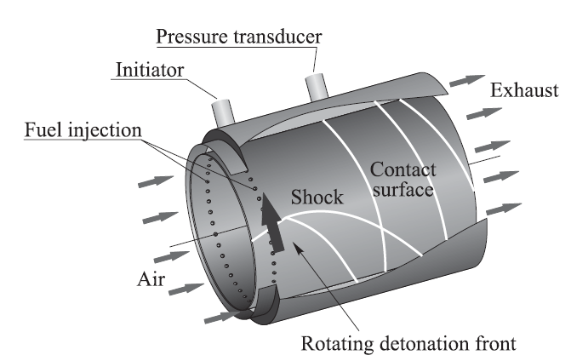
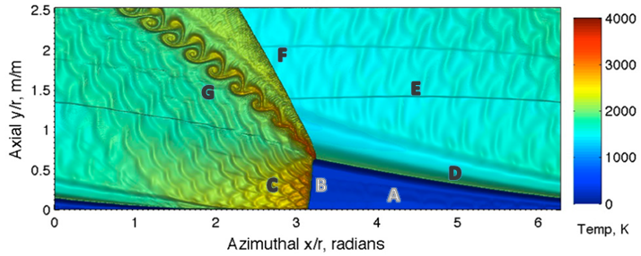
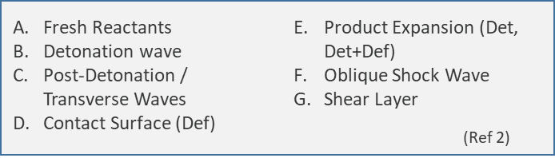
Rotating Detonation Combustion
(Ref 1)
Bulk axial flow with circumferential detonation wave
Detonation wave, once initiated, is self-sustained.
No moving parts – No complex valving required at the inlet compared to PDE’s
Unsteady flow at high frequency may have minimal impact on turbine performance.
Estimated 49% increase in pressure [3]
Potential for low NOx
Wolanski, P., Proc. Comb. Institute, 2013
Nordeen et al, 49th AIAA Aerospace Sciences Meeting, Orlando, FL:, 2011.
Kaemming, T.A. and Paxson, D., 2018 AIAAJoint Propulsion Conf., Concinnati, OH.

Slide 4
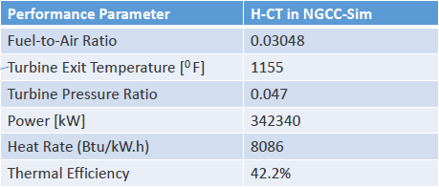
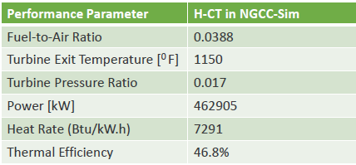
RDC Integration Cycle Analysis
H-Class GT
with
Conventional
Combustor
H-Class GT
with RDE

Slide 5
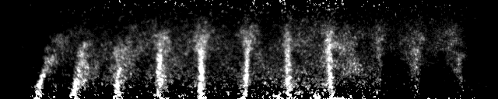
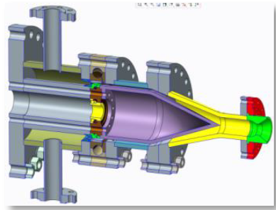
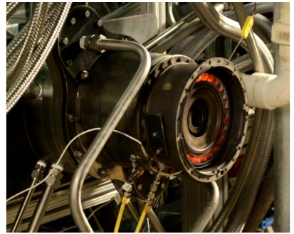
DOE PGC Roadmap
Improve fundamental understanding stable continuous wave detonation
  Wave directionality, bifurcation, translation speed (~CJ)
  Det wave influence on operational parameters (i.e fuel injection/mixing)
Develop scale laws to better understand the parametric impacts
  Flow, pressure temperature, fuel composition (det cell size)
  Gap width, combustor length, diameter (number of waves)
Maximize pressure gain / turbine work availability and reduce emissions
  Inlet / exhaust transition configuration (including valves for PDE’s)
  Deflagration, shear layer and downstream shocks
  CO, NOx emissions
Improve modeling capabilities
  Simultaneous detonation and deflagration
  Grid dependences, chemical kinectics
  Reduced order thermo and chemical models
NETL Characterization of Injector Response using Acetone PLIF
Aerojet Rocketdyne conceptual design of RDE with diffuser
RDE coupled to T63 Turbine at AFRL
Andrew Naples, John Hoke, Ryan T. Battelle, Matthew Wagner, and Frederick R. Schauer. "RDE Implementation into an Open-Loop T63 Gas Turbine Engine", 55th AIAA Aerospace Sciences Meeting, AIAA SciTech Forum, (AIAA 2017-1747)

Slide 6
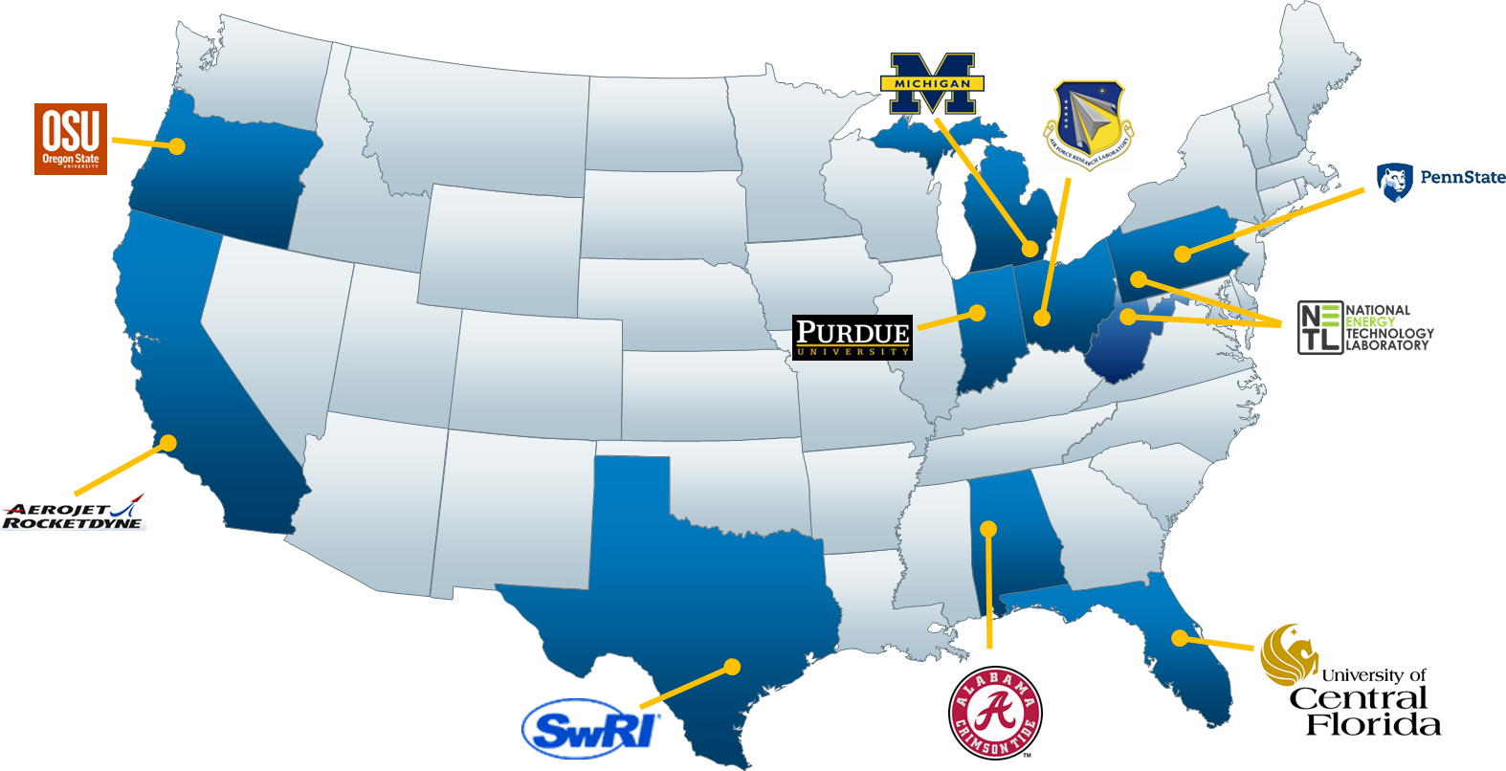
Current DOE Pressure Gain Combustion Funded Activities (2017 - 2019)

Slide 7
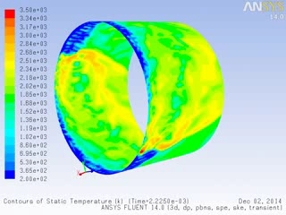
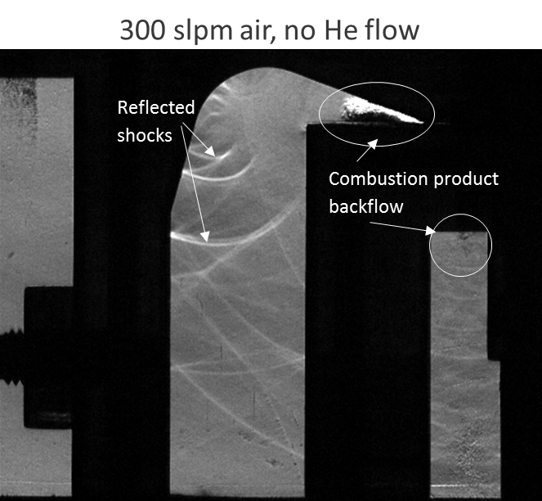

NETL In-House Research Activities
RDE Sector / Inlet Test Rig
  Rapid evaluation of inlet concepts with correlation to lab-scale combustor.
Computational Studies
  Chemical Reactor Network (CRN)
    Reduced order model with emissions
  CFD
    Fundamental aspects of detonation
    Inlet / geometry physics
    Turbine integration
Lab-Scale Experiment
  Approximate gas turbine conditions
  Increased percentage of NG (H2/Air)
  Model validation
NETL Lab-Scale RDE Inlet Sector Rig
CFD model of RDE with temperature contours (H2/Air)
NETL Water-Cooled, Pressurized RDC

Slide 8
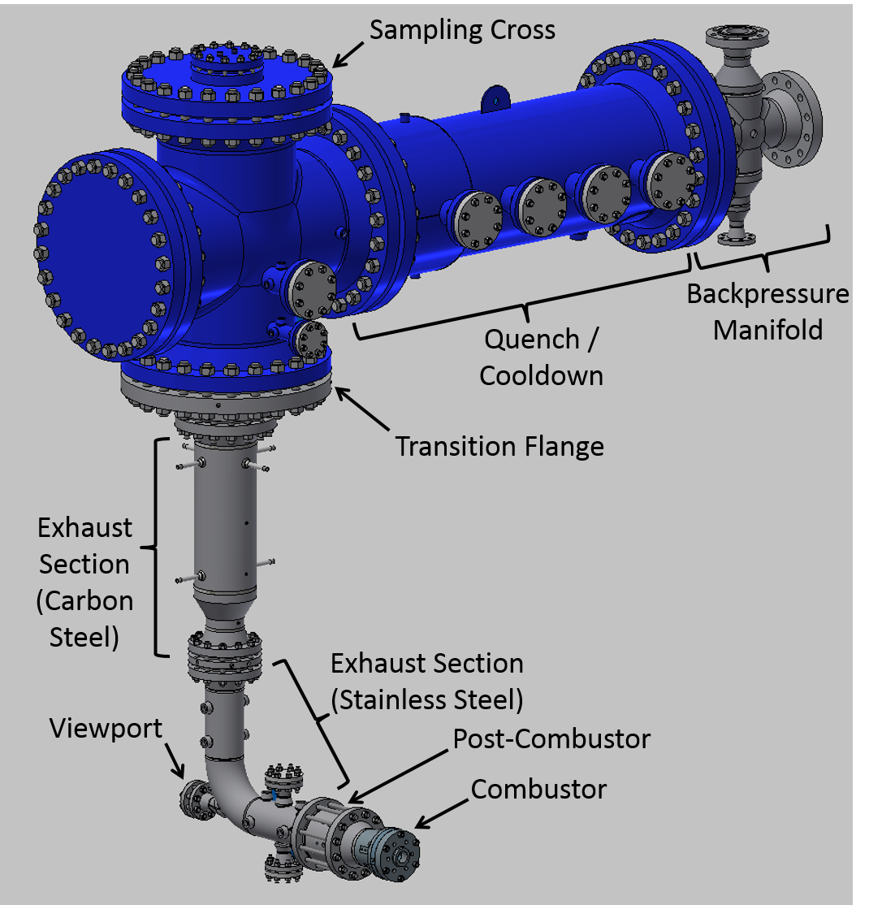
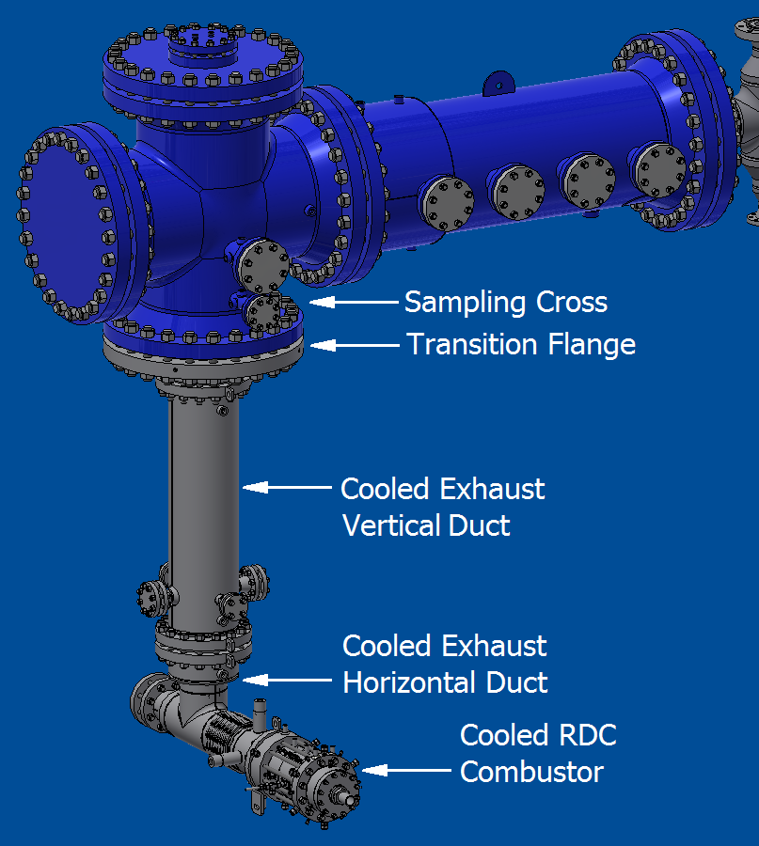
Cooled RDC Integration Status
Required Hardware Modifications
Replacement of uncooled combustor and exhaust sections with cooled components
Replacement of refractory in Sampling Cross
Addition of refractory to Transition Flange
LECTR in Uncooled RDC Configuration
LECTR in Cooled RDC Configuration

Slide 9
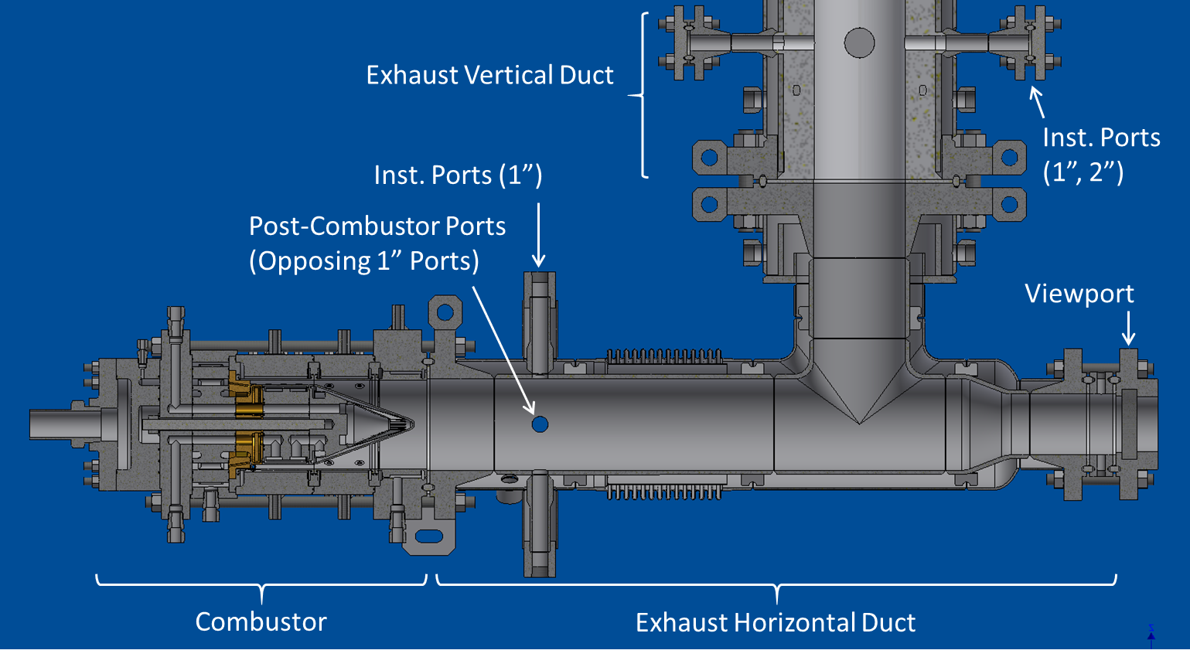
Cooled RDC Design
Design Basis
Designed to Provisions of ASME Section VIII Division 2
  Provides criteria to evaluate plastic collapse, fatigue life, ratcheting of components
  “Design by Analysis” provisions with elastic-plastic material behavior
    Model stress and deformation more accurately than standard elastic analysis; required to model thermally-induced stress and deformation
Design Conditions
  Max. process T = 4000°F (2477K)
  Cooling: process water @ 40 gpm, 150 psig
  Max. shell T ≈ 600°F (477K)
  Max. shell P ≈ 225 psig
  1 kg/s air flow rate @ 600°F (477K) max. preheat
Modular Geometry
  Outer body Dia: 149 mm
  Center body Dia: 133.6 mm (Δ = 7.7 mm)
  Air: Ainj/Aann = 0.2 (Radial Injection)
  Fuel: 80 x 0.89mm (dia)
  Accommodate changes to fuel/air routing, injector, centerbody, outerbody, exhaust, instrumentation ports

Slide 10

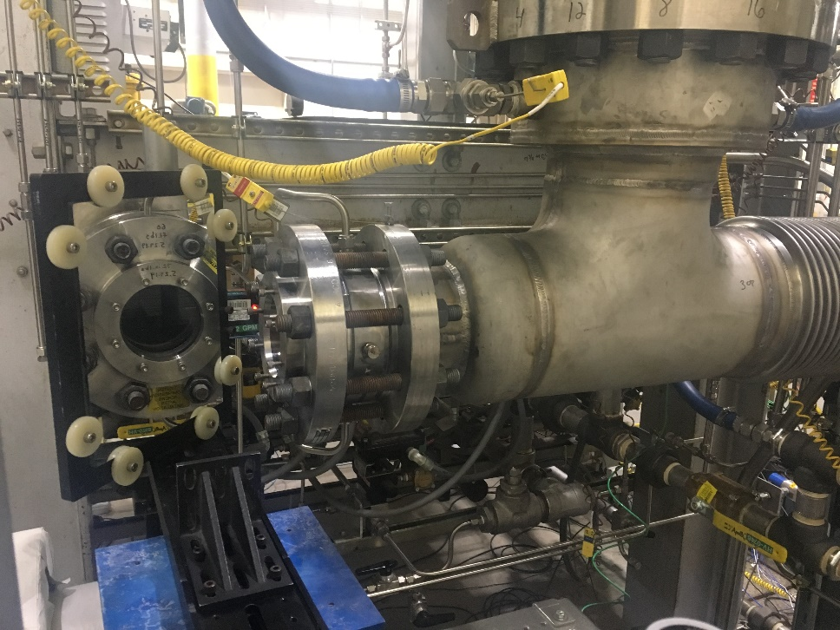
Cooled RDC Design
Aft axial viewport with mirror to protect high speed video camera.
NETL water-cooled RDC with instrumentation package.

Slide 11
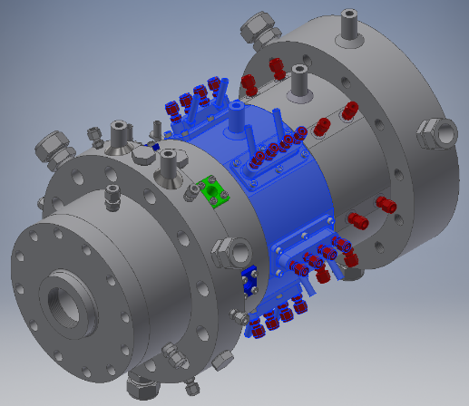
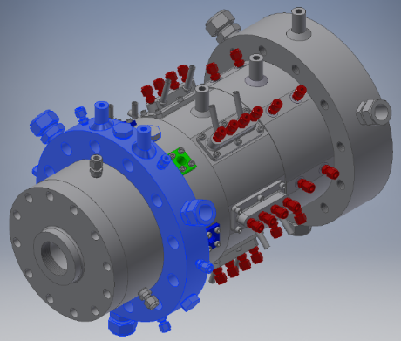
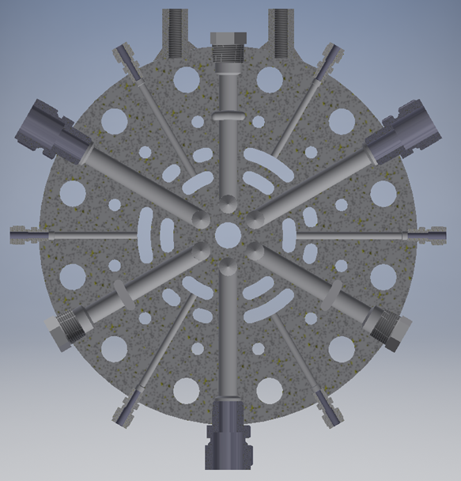
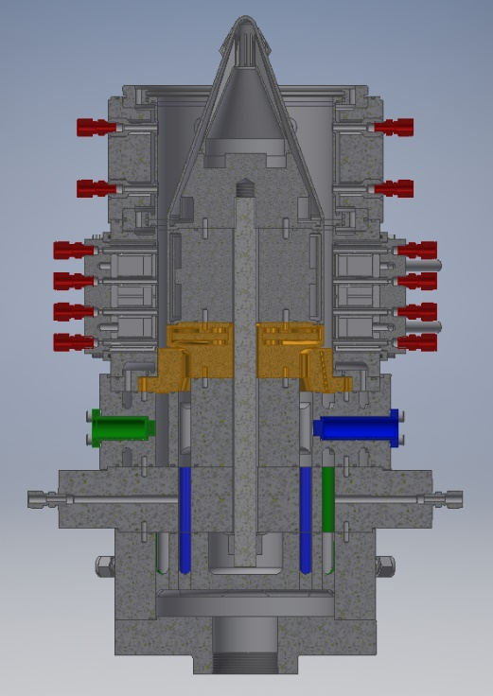
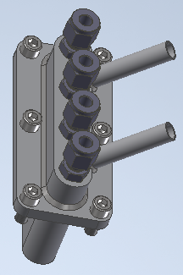
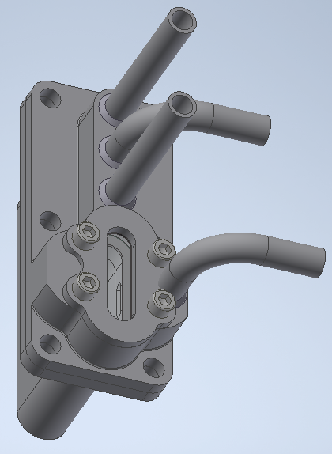
Cooled RDC Instrumentation
Port | Azimuthal Location (θ)
A, B, C | 30, 90, 150
D, E, F | 210, 270, 330
PF3
PA1
Plenums
z = -77 mm
PA3
PF1
Ex2
Port | Axial Location (z – mm)
1 | 4.9
2 | 30.3
3 | 55.7
4 | 81.1
Ex1 | 129.2
Ex2 | 180.0
Ex1
PF2
PA2
4
3
Port | Azimuthal Location (θ)
PA1, PA2, PA3 | 30, 150, 270
PF1, PF2, PF3 | 90, 210, 330
2
1
Replaceable instrumentation modules including module with sight glass

Slide 12
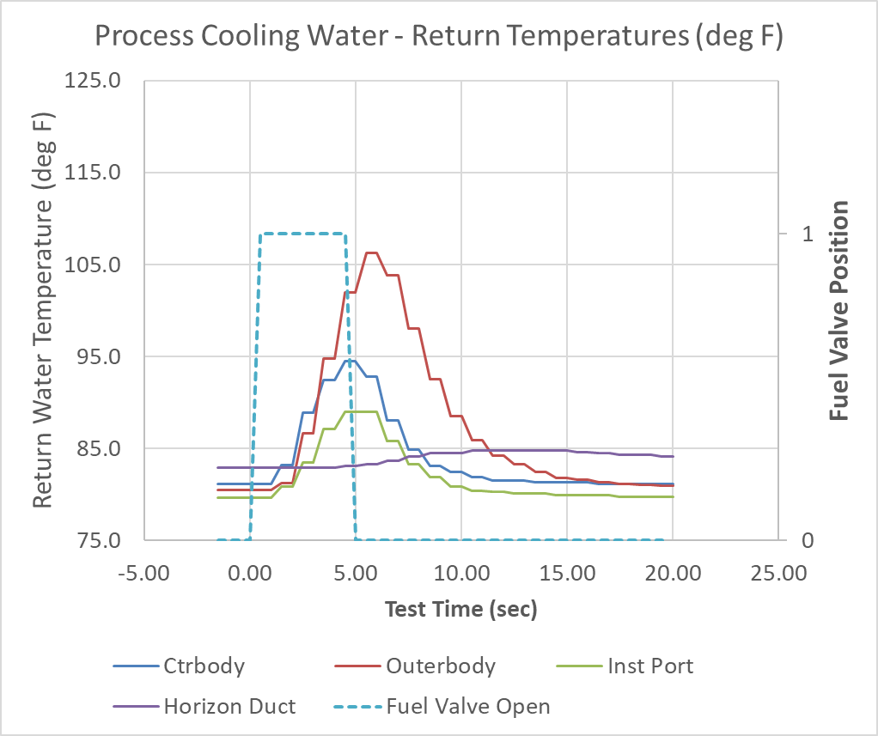

Preliminary Results (5 sec test)
Air Flow = 45,000 scfh (0.343 kg/sec), H2 fuel, phi = 0.6, 1 atm, Tair = 150 F, 40 gpm

Slide 13
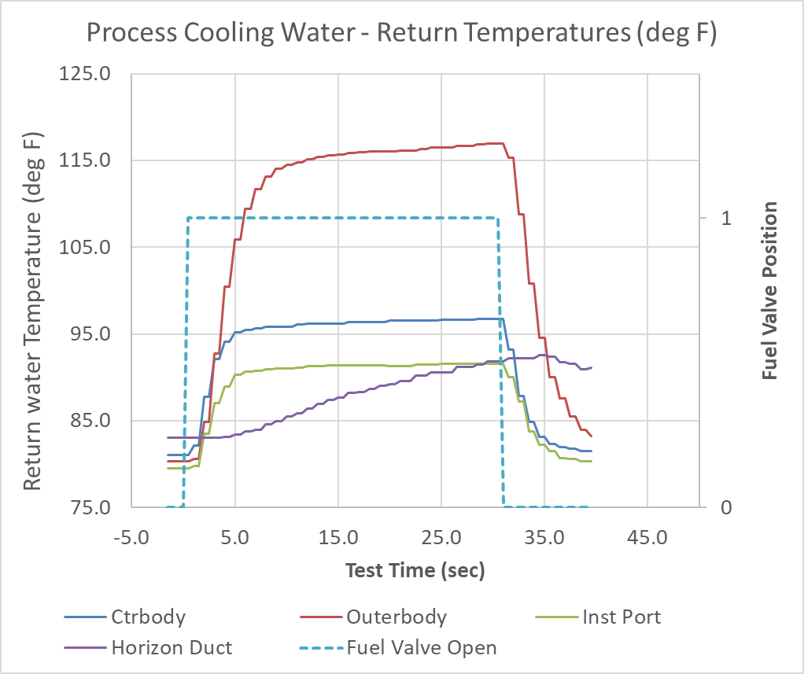
Preliminary Results (30 sec test)
Air Flow = 45,000 scfh (0.343 kg/sec), H2 fuel, phi = 0.6, 1 atm, Tair = 150 F, 40 gpm

Slide 14
CTAP Pressure (φ=0.84, air = 55,000 scfh, Tair = 150 F, 20 psi)
Variation with time
E3
E2
E1
Main fuel valve opens @ 1.5 sec

Slide 15
CTAP Pressure (φ=0.84, air = 55,000 scfh, Tair = 150 F, 20 psi)
Variation with time
~25 - 30 sec
E3
E2
E1
~3-5 sec
Main fuel valve opens @ 2 sec

Slide 16
ITP Pressure (φ=0.84, air = 55,000 scfh, Tair = 150 F, 20 psi)

Slide 17
ITP Pressure (φ=0.84, air = 55,000 scfh, Tair = 150 F, 20 psi)
Time: 0-5 sec

Slide 18
ITP Pressure (φ=0.84, air = 55,000 scfh, Tair = 150 F, 20 psi)
Time: 3-5 sec

Slide 19
ITP Pressure (φ=0.84, air = 55,000 scfh, Tair = 150 F, 20 psi)
Time: 25-30 sec

Slide 20
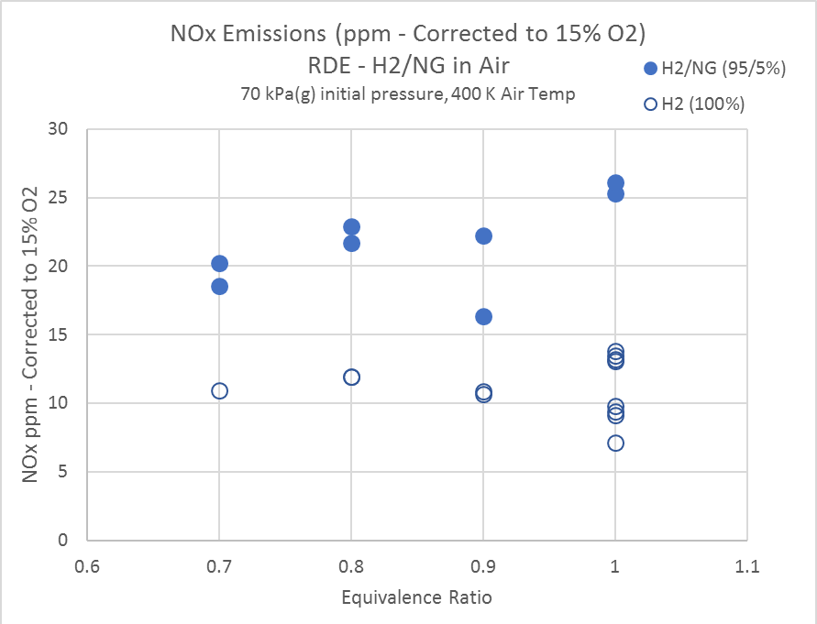
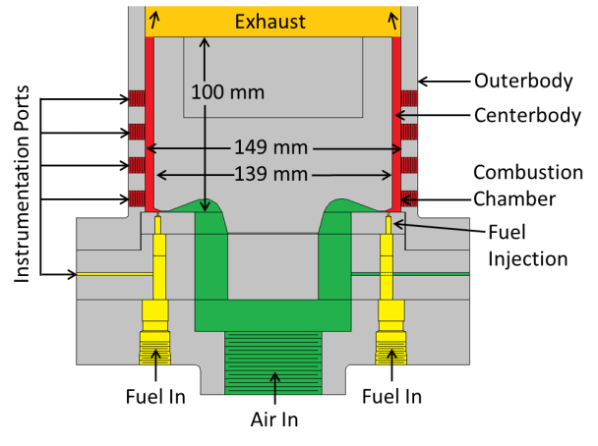
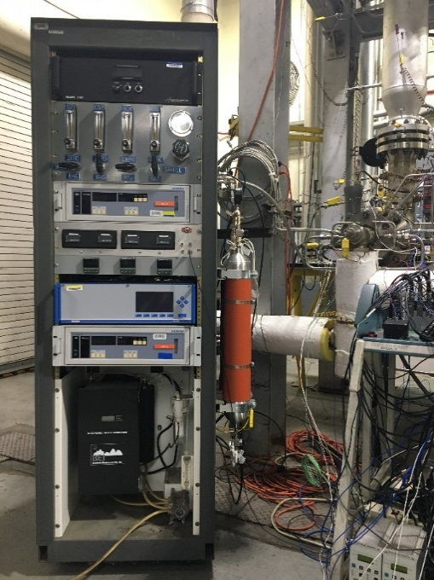
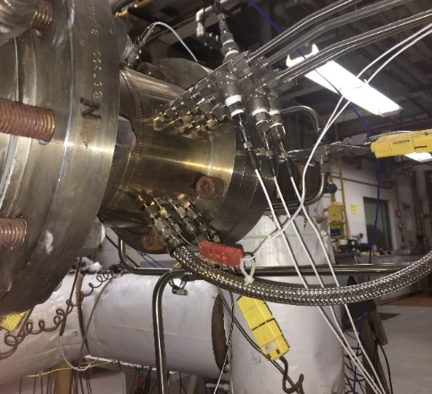
NOx Emissions
Results from previous tests in uncooled RDE
2
6
Experimental RDE is unmodified AFRL RDE
- Not optimized for mixing
4
5
1
3
5
6
4
NOx Analyzer (1 sec response)
O2 Analyzer
Gas Sample Storage Tanks (x3)
Gas sample line
RDE
Gas sample port
Challenges
Unheated sample line permitted condensation (H2/Air) likely resulting in NO2 loss.
Some tests experiences periods of unstable and stable detonation.
Incomplete combustion (determined from O2 Emissions)

Slide 21
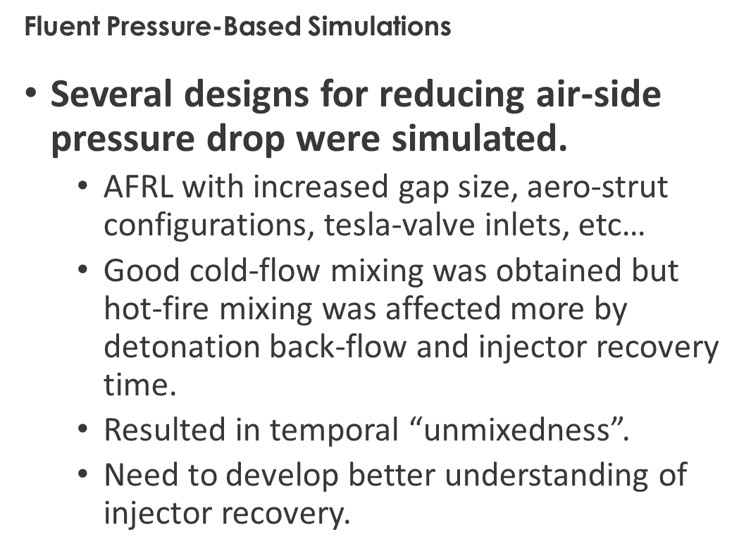
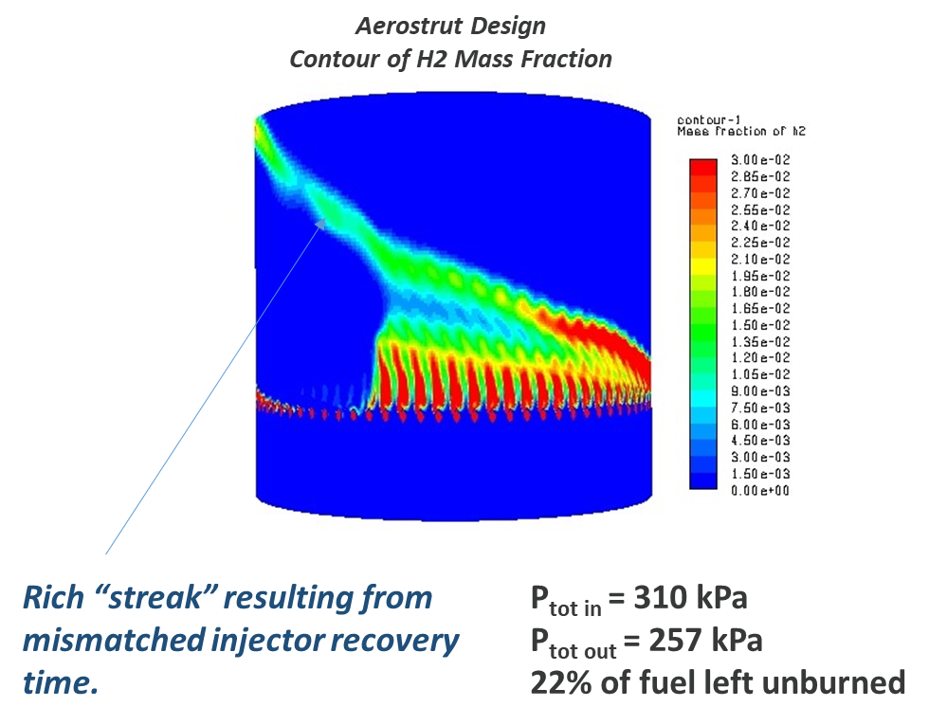
Computational Study of Low Loss Injectors

Slide 22
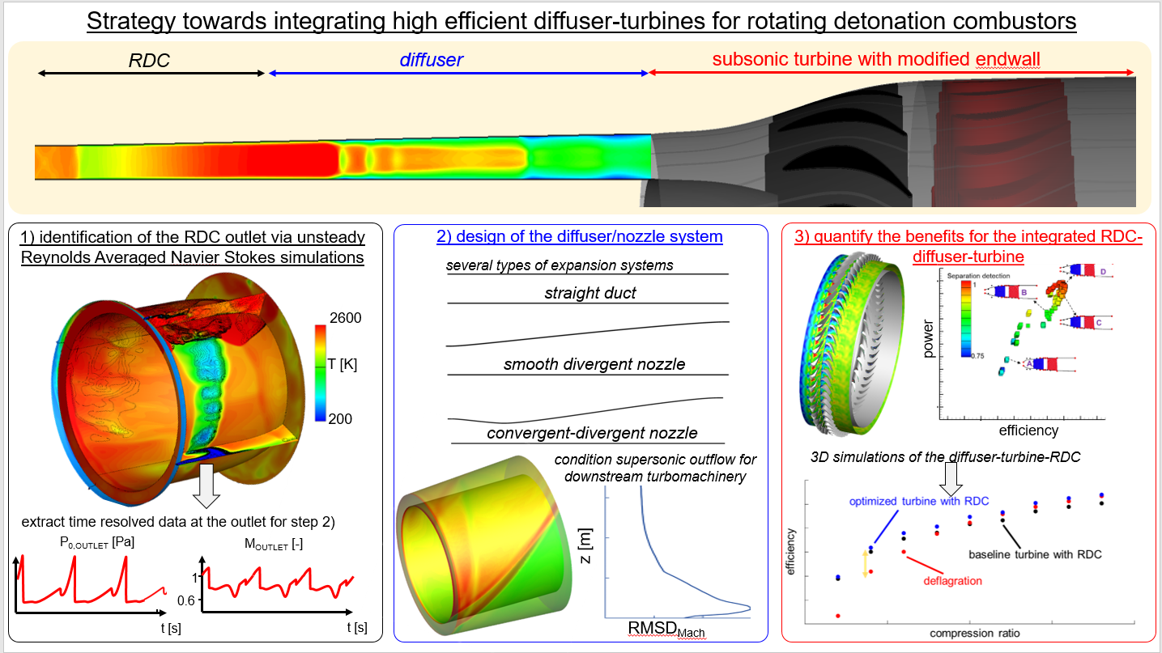
Turbine Integration – High efficiency Diffuser
Guillermo Paniagua and James Braun (Purdue University)

Slide 23
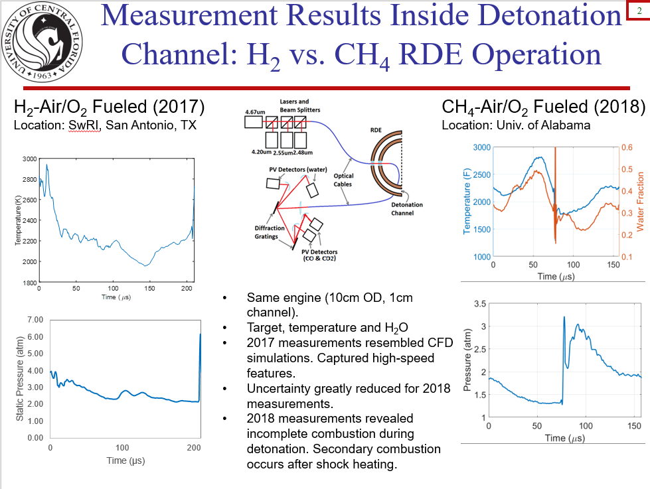
Improved Sensors: TDLAS (T and species)
Subith Vasu (UCF)

Slide 24
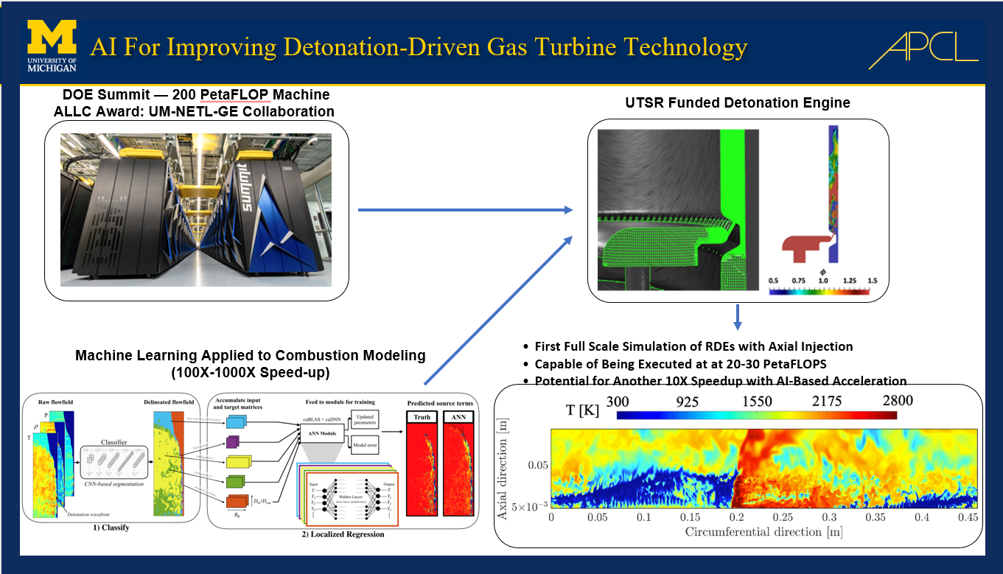
CFD for PGC
Venkat Raman (University of Michigan)

Slide 25
Summary
DOE continues to fund research in PGC
NETL in-house research is designed to be complementary to externally funded programs
New water-cooled RDC will permit operation of a thermally stable RDC

Slide 26


Thank You.
Questions??
Don Ferguson, PhD
donald.ferguson@netl.doe.gov
(304) 285-4192

