Slide 1
2019 University Turbine Systems Research Project Review Meeting
5-8 November 2019
Computational Analysis of Advanced Cooling Strategies
for High-Efficiency and Long-Service Life Gas Turbines
Tom I-P. Shih
School of Aeronautics and Astronautics, Purdue University
Mark Bryden
Ames National Laboratory, U.S. Dept. of Energy
Robin Ames and Rich Dennis
National Energy Technology Laboratory, U.S. Dept. of Energy

Slide 2
Needs in the ELECTRIC POWER Sector
driven by economic, regulations, reduced cost of NG, and emerging technologies
Many Challenges and Opportunities:
Want more efficient and cleaner GT
Want more efficient cycles: sCO₂
Storage of over supply of energy from renewable sources via batteries & hydrogen
Develop GTs that use hydrogen and/or works with batteries.
New capabilities enable by additive manufacturing, AI, machine learning, Big Data
Gas Turbine Hot Section:
Increasing efficiency implies the need to push all technologies to the limit: combustion, turbine aerothermal, materials, control, …
On turbine aero/thermal, it means
reducing aerodynamics losses
Increase TIT with same or reduced cooling flow
providing the thermal management to always allow operation near the maximum allowable material T and $∇T$.
Thus, must understand details and fundamentals well!

Slide 3
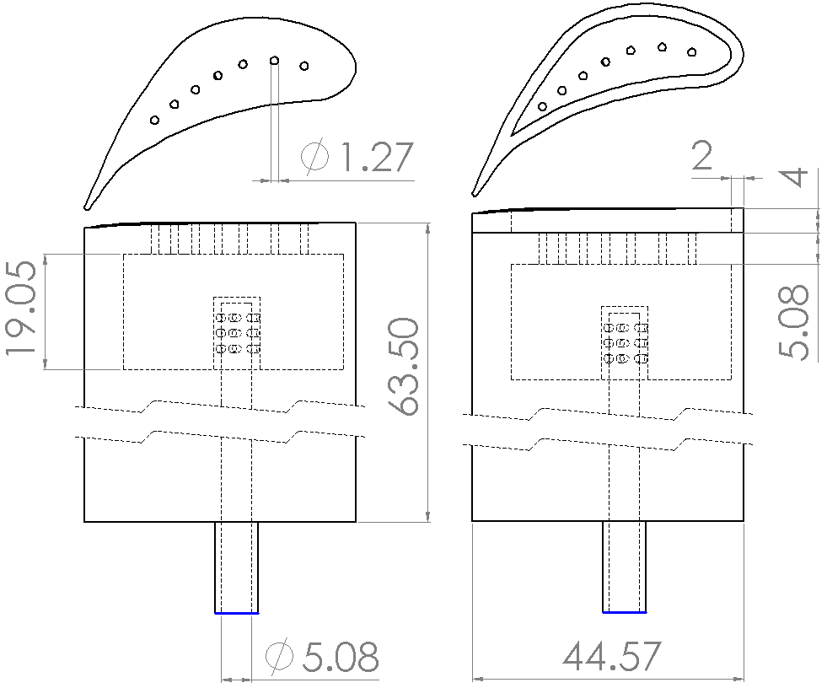
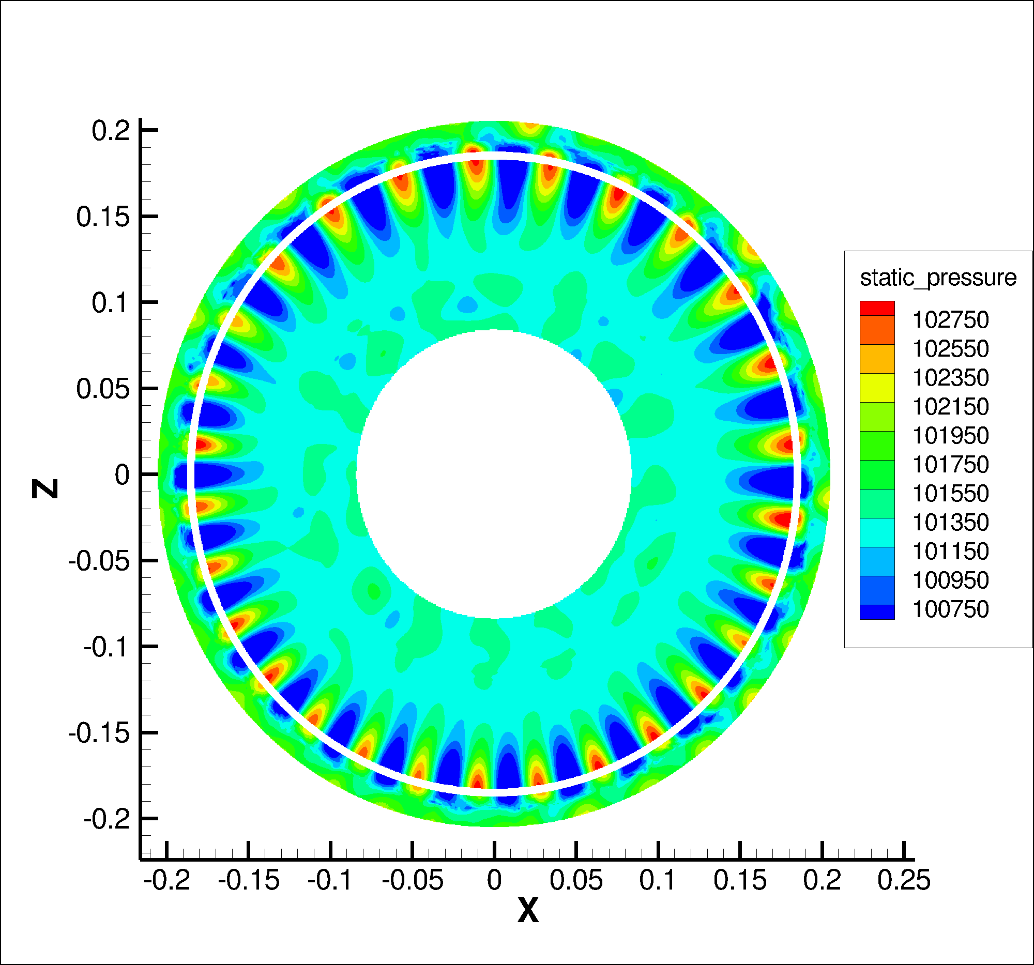
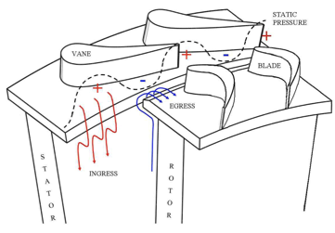
Current efforts:
Reduce cooling flow:
RANS and LES of rim seals (induced by rotation disk w/o blade, rotating blade, stator blade.
LES of blade-tip leakage in a 1.5 stage turbine with different blade tip treatment under lab and engine-relevant conditions, high- and low-load conditions.
New film-cooling designs.
Fundamentals:
Simulate Jap Kapat experiments on sCO₂ at UCF on HX under extreme conditions (high P & T and huge Re)
RANS, LES, hybrid on effects of heating rate on HTC.
Using machine learning to interrogate LES/DNS on RANS models.
Revisit T_{bulk} and T_{adiabatic} – physical meaning & how to measure.
BLADE TIP in 1.5 stage:
Flat, squealer, … w/ and w/o film cooling
RIM SEALS:
Bath test rig:
1.0 stage 360 degrees

Slide 4
Adiabatic-Wall Temperature - Revisited
James Peck, Jason Liu, and Tom I-P. Shih
School of Aeronautics and Astronautics, Purdue University
K. Mark Bryden
Ames Laboratory, Department of Energy
Robin Ames and Richard Dennis
National Energy Technology Laboratory, Department of Energy

Slide 5
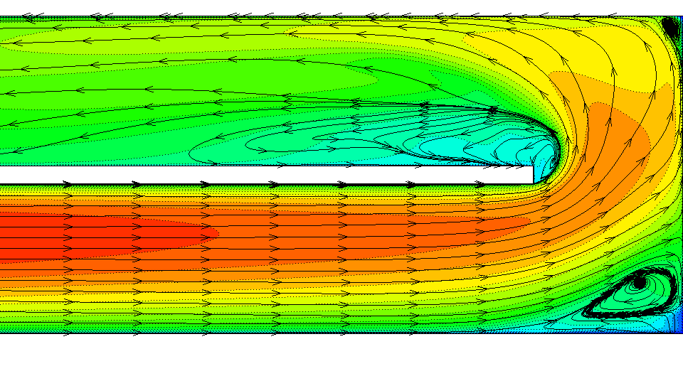
Convective heat transfer from a solid surface is typically characterized by the heat-transfer coefficient, defined by Newton’s law of cooling:
$$q_{s}^{′′}=h\left(T_{s}−T_{ref}\right). T_{ref} = ?$$
External Flow
$T_{ref}$ = freestream temperature =
Internal Flow
$T_{ref}$ = bulk temperature =
$$T_{∞}$$
$$T_{b}$$
$$T_{b}=\frac{\int_{A_{c}}{ρuC_{p}TdA}}{\int_{A_{c}}{ρuC_{p}dA}}$$
So, what’s the problem?
External flows: multiple temperature (e.g., film cooling)
Internal flows: separation, U-bends, pin fins, vortex generators, …

Slide 6
One solution: adiabatic wall temperature, $T_{ad}$
$$q_{s}^{′′}=h_{ad}\left(T_{s}−T_{ad}\right)$$
Note:
$T_{ad}$ is defined so that $T_{s}=T_{ad}$ where and when $q_{s}^{′′}=0$
$T_{ad}$ is often assumed to depend only on the flow, the property of the fluid, geometry, and independent of $T_{s}$ and $q_{s}^{′′}$.
For flow of an “ideal” gas with freestream M past an object with adiabatic walls:
$$T_{ad}=\frac{T_{o}\left(1+r\frac{γ−1}{2}M^{2}\right)}{1+\frac{γ−1}{2}M^{2}}$$
$$r=\frac{T_{ad}−T}{T_{o}−T}≈\sqrt[3]{Pr}$$
$=0.885±0.01,$if $Pr=0.7$

Slide 7
Previous Work
Moffit (1998)
provided an excellent history on $T_{ad}$, starting with the work by Eckert and his co-workers at the U. of Minnesota in the 1950s.
Sellar et al (1956), Moffat & co-workers (1982, 1989, 1992, 1994, 1998), Hacker & Eaton (1997),
Used “discrete” Green’s function and/or inverse Green’s function along with measurements of $q_{s}^{′′}$ to get $T_{ad}$ and $h_{ad}.$
Paniagua & co-workers (2012, 2013, 2018):
Applied get $T_{ad}$ and $h_{ad}$ to steady and unsteady flow and heat transfer in GT and HX.

Slide 8
What are the challenges?
How to obtain $T_{ad}$?
$T_{ad}$ is defined by $q_{s}^{′′}=h_{ad}\left(T_{s}−T_{ad}\right)$ so that $T_{s}=T_{ad}$ where and when $q_{s}^{′′}=0$.
If $T_{s}=T_{ad}$ but $q_{s}^{′′}≠0$ because of mistakes in measuring or computing $T_{ad}$, then $h_{ad}=\frac{q_{s}^{′′}}{\left(T_{s}−T_{ad}\right)}=∞$.
In film cooling, $q_{s}^{′′}$ switches sign so that $T_{s}=T_{ad}$ definitely takes place. Thus, mistakes in measuring/computing $T_{ad}$ must be avoided or quantified.
$$T_{s} −T_{ad}=0$$
Notes:
/computing

Slide 9
How is $T_{ad}$ measured? Two Ways!
Create adiabatic wall via low thermal conductivity material plus guard heater and measure surface temperature. This approach assumes $T_{ad}≠f\left(T_{s},q_{s}^{′′}\right)$ anywhere on the surface.
Assume $T_{ad}≠f\left(T_{s} \right)$ and $h_{ad}=\frac{q_{s,1}^{′′}}{\left(T_{s,1}−T_{ad}\right)}=$ $\frac{q_{s,2}^{′′}}{\left(T_{s,2}−T_{ad}\right)}$
Questions:
Do the 2 methods yield the same results?
If not, which is right?
Could both be wrong? For example, could the assumptions invoked by these methods be wrong?
Is there a method that will yield a unique and correct $T_{ad}$?
= constant at any point on the surface.
THUS, $T_{ad}$ and $h_{ad}$can be measured by 2 sets of measurements:
$$q_{s}^{′′}$$
$$\left(T_{s,2},q_{s,2}^{′′}\right)$$
$$\left(T_{s1},q_{s1}^{′′}\right)$$
$h_{ad}=$ $h_{ad,1}=h_{ad,2}$
$$h_{ad}$$
$$h_{ad,1}=q_{s,1}^{′′}/\left(T_{s,1}−T_{ad}\right)$$
$$h_{ad,2} =q_{s,2}^{′′}/\left(T_{s,2}−T_{ad}\right)$$
$$T_{s}$$
$$T_{ad}$$

Slide 10
Objectives
Compare $T_{ad,c}$ obtained by setting $q_{s}^{′′}=0$ on the surface and $T_{ad,e}$ obtained by measuring ($q_{s}^{′′}$, $T_{s}$) at two $T_{s}$ and then extrapolating.
Present a method that yields a unique and correct $T_{ad}$, such that $T_{s}=T_{ad}$ where and when $q_{s}^{′′}=0$. Note: For a given $T_{s}$ and $q_{s}^{′′}$, $T_{ad}$ is known only at locations where $q_{s}^{′′}=0$ on the surface.
Compare $T_{ad,c}$ and $T_{ad,e}$ with $T_{ad}$ and $h_{ad}$ obtained by $T_{ad,c}$, $T_{ad,e}$, and $T_{ad}$.
Approach
Use CFD based on steady RANS to simulate the experiments.

Slide 11
Outline of Talk
Introduction
Problem Description
Formulation, Numerical Method, and Code
Grid-Sensitivity Study
Results
Summary

Slide 12
Problem Description
Geometry
D | 1 mm
L₁ | 48D
L₂ | 15.73D
S | 3D
W | S/2
H | 7D
Y | 25D
$$φ$$ | 35⁰
L₁
L₂
y
w
x
S
Operating Conditions
$$G_{c}$$ | 19.96 ${Kg}/{m^{2}s}$
M | 0.5
$$T_{c}$$ | 400 ºC
$$T_{h}$$ | 1500 ºC
$$T_{s}$$ | Adiabatic + 15 $T_{s}$ from “around “ 400 to 1500 ºC
$$P_{b}$$ | 25 atm
Tu | 20% (Turbulence Intensity)
P_{b}
$$G_{h}, T_{h}$$
Y
z
$$φ$$
x
D
Inviscid, Adiabatic wall
Inviscid, Adiabatic or Isothermal with Temp $T_{s}$
Subscripts:
c: coolant
h: hot gas
$$G_{c}, T_{h}$$
H
Symmetry
$$M=\frac{{\left(ρV\right)}_{c}}{{\left(ρV\right)}_{h}}=\frac{G_{c}}{G_{h}}$$
Inlet/Outlet
Notes:
Velocity Ratio, VR = $\frac{V_{c}}{V_{h}}=$ 0.190
Density Ratio, DR = $\frac{ρ_{c}}{ρ_{h}}=$2.63

Slide 13
Formulation, Numerical Method, and Code
Steady RANS
Formulation
Compressible
ensemble averaged continuity, momentum & energy
thermally perfect gas with temperature-dependent properties
Incompressible
Ensemble averaged continuity, momentum, and Energy
constant transport properties
realizable k-ε turbulence model integrated to wall (i.e., no wall functions)
Code: ANSYS Fluent Version 17.1 (double precision)
Algorithm: SIMPLE with 2nd-order upwind for all advection terms & 2nd-order central for all diffusion terms
Convergence Criteria: Iterate solution until all residuals plateau and largest magnitude < 10⁻⁶

Slide 14
Transport Properties of Air
Temperature dependent transport properties: $μ, k, \& C_{p}$were used to model air in all cases.
Viscosity
$$μ \left[Pa∗s\right]$$
Assuming: effects of pressure are negligible.
$$μ=1.53{∗10}^{−5}+2.69{∗10}^{−8}T$$
$$R_{μ}^{2}=0.9992$$
Wiley Heat & Mass Transfer
Least Squares Regression
Thermal Conductivity
Sutherland, 2 Coefficient
$$k \left[\frac{W}{m∗K}\right]$$
Sutherland, 3 Coefficient
Sutherland, 2 Coefficient:
$$k=3.34∗{10}^{−2}+1.37∗{10}^{−5}T+1.95∗{10}^{−8}T^{2}$$
$$C_{1}=1.458{∗10}^{−6} [\frac{Pa∗s}{\sqrt{K}}]$$
$$R_{k}^{2}=0.998$$
$$μ=\frac{C_{1}T^{3/2}}{T+C_{2}}$$
$$C_{2}=110.4 [K]$$
Specific Heat Capacity (Constant Pressure)
Sutherland, 3 Coefficient:
$$C_{p} \left[\frac{J}{Kg∗K}\right]$$
$$μ=μ_{0}{\left(\frac{T}{T_{0}}\right)}^{3/2}\frac{T_{0}+S}{T+S}$$
$$C_{p}=9.48∗{10}^{2}+1.88∗{10}^{−1}T$$
$$S=110.56 [K]$$
$$R_{μ}^{2}=0.997$$
$$μ_{0}=1.7894∗{10}^{−5} [Pa∗s]$$
$$T_{0}=273.11 [K]$$
$$T \left[K\right]$$
Notes:
Assuming effects of pressure on the transport properties is negligible, data for each at 1 atm was taken from Wiley Heat & Mass Transfer (). A least-squares polynomial regression of order at most 2 was fit to the data which was used in the simulations.
The linear regression for viscosity turned out to have less error over the entire data range than Sutherland’s Law (both 2 and 3 coeff. versions)

Slide 15
Grid
All Grids:
Structured
1st grid points away from wall y+ < 1
Constant grid spacing off of wall for first 3 cells
No. of Cells: 0.94 to 15.6 million

Slide 16
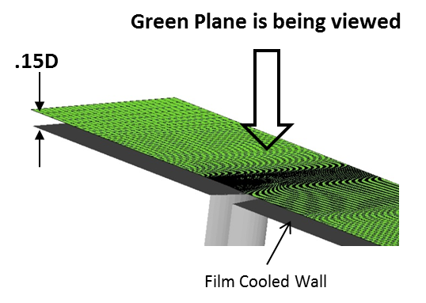
Grid Sensitivity
All grids:
Structured
1st grid points away from wall y+ < 1
Constant grid spacing for first 3 cells
Grid at z/D = 0.15D
Coarsest:
Coarse:
Mesh | Cells Across $\frac{1}{2}$ Hole | Total Cell Count (Million)
Coarsest | 32 | 0.94
Coarse | 40 | 4.3
Baseline | 56 | 6.0
Finer | 56 | 10.6
Finest | 76 | 15.6
Baseline/Finer:
Finest:
Notes:
Fluid sensitivity study conducted with adiabatic walls

Slide 17
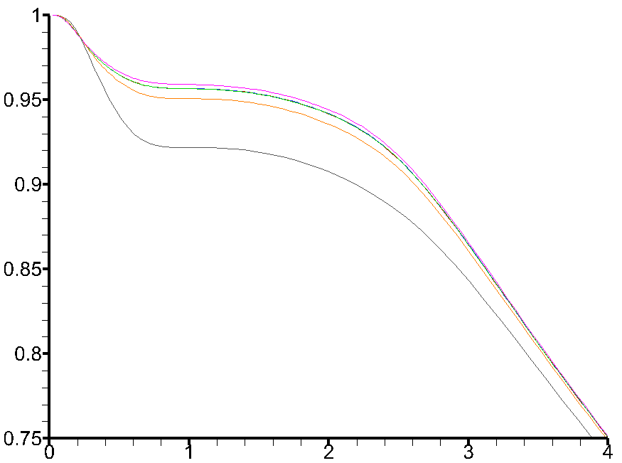
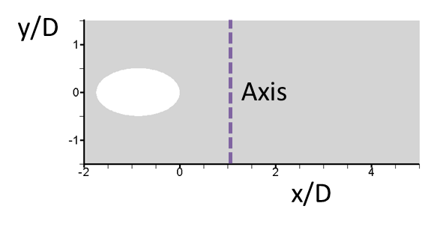
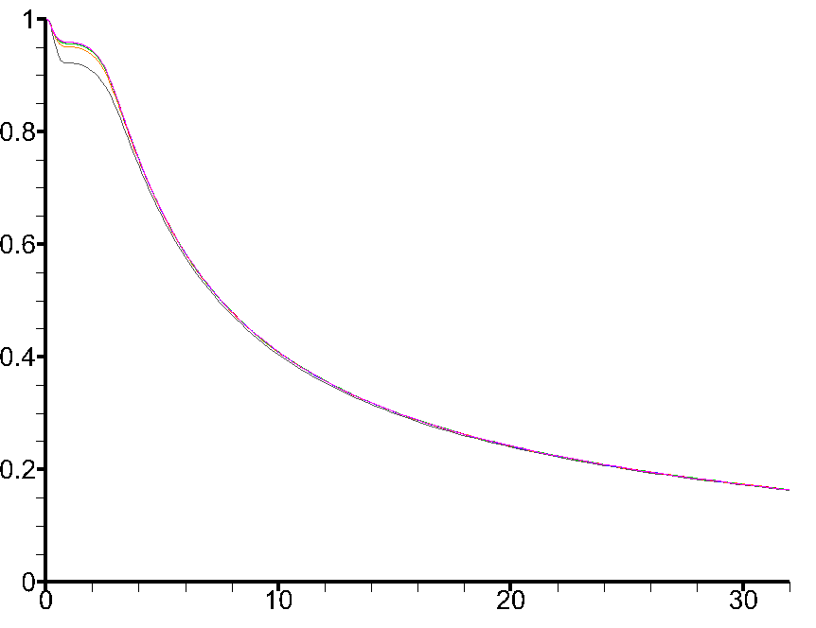
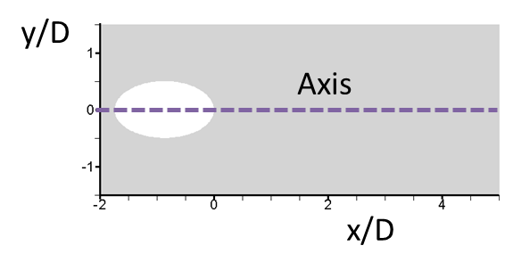
Grid Independence Study
Mesh | Cells Across $1/2$ Hole | Cell Count (Million)
Coarsest | 32 | 0.94
Coarse | 40 | 4.3
Baseline | 56 | 6.0
Finer 1 | 56 | 11.0
Finer 2 | 56 | 15.6
Finer 3 | 76 | 10.6
$$η$$
$$η$$
$$\left|τ_{w,y}\right|[Pa]$$
x/D
$$η=\frac{(T_{h} −T_{w, adiabatic}) }{(T_{h}− T_{c})}$$
x/D
y/D

Slide 18
Grid Independence Study
Y/D
$$T_{s} −T_{ad}=0$$
Baseline
Finer 1
(refinement in the region $3≤\frac{x}{D}≤10$ over baseline)
Finer 3
(refinement surrounding the hole over Baseline)
x/D
Notes:
Even with a Refined Grid, a singularity exists in the HTC. In fact, the contour shape remains unchanged with grid refinement but the singularity line is sharper.

Slide 19
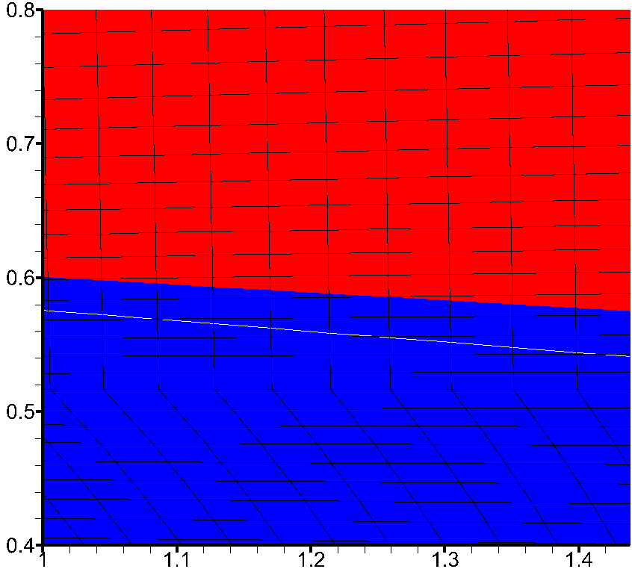
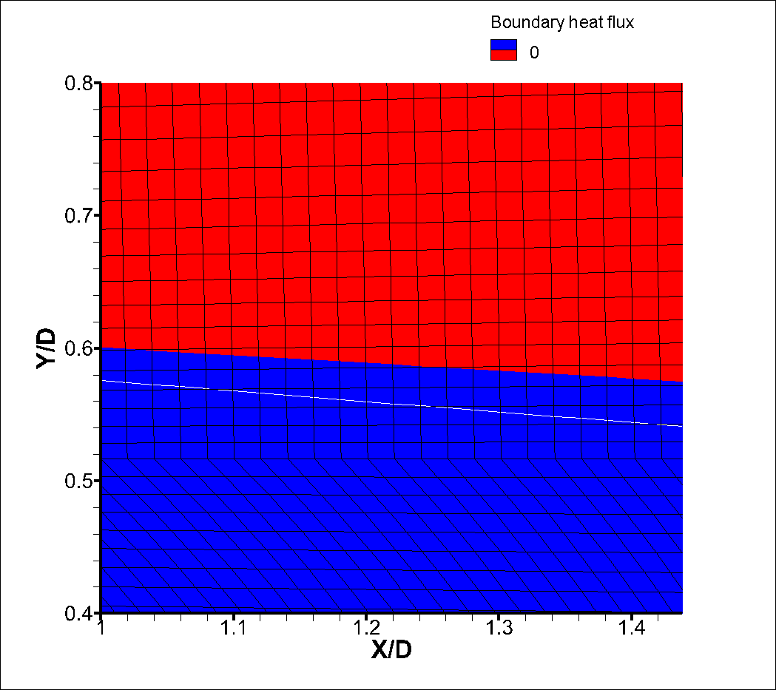
Grid Independence Study
$$T_{w,iso} −T_{w,adia.}=0$$
y/D
Baseline
Finer 1
Finer 3
x/D
Notes:
Even with a Refined Grid, a singularity exists in the HTC. In fact, the contour shape remains unchanged with grid refinement but the singularity line is sharper.

Slide 20
Grid Independence Study
$h$ $\left[\frac{W}{m^{2}K}\right]$
$$h=\frac{qs"}{(T_{s}− T_{ad,c})}$$
y/D
Baseline
Finer 1
(refinement in the region $3≤\frac{x}{D}≤10$ over baseline)
Finer 3
(refinement surrounding the hole over Baseline)
x/D
Notes:
Even with a Refined Grid, a singularity exists in the HTC. In fact, the contour shape remains unchanged with grid refinement but the singularity line is sharper.

Slide 21
Outline of Talk
Introduction
Problem Description
Formulation, Numerical Method, and Code
Grid-Sensitivity Study
Results
Summary

Slide 22
Observations on $T_{ad,c}$
q” (W/m²)
q”> 0
q”< 0
Is unique for any given problem (just set $q_{s}^{′′}=0)$.
But, where $T_{s}=T_{ad,c}$, $q_{s}^{′′}≠0.$
Thus, the assumption that $T_{ad}≠f\left(T_{s},q_{s}^{′′}\right)$ anywhere on the surface is incorrect.
$q_{s}^{′′}=0$is easy for CF, but hard for experiments.
Y/D
$$T_{s}=690 ℃$$
$$T_{s} −T_{ad,c}=0$$
$$T_{s}=950 ℃$$
$$T_{s}=1210 ℃$$
X/D
It is interesting/great to note that lines where $q_{s}^{′′}=0$ matches closely to where $T_{s}=T_{ad,c}$ for a wide range of T_{s} conditions, including conjugate. Thus, the concept of $T_{ad}$ is quite general and useful.

Slide 23
Observations on $T_{ad,c}$
Why is the assumption $T_{ad}≠f\left(T_{s},q_{s}^{′′}\right)$ anywhere on the surface incorrect?
$$T_{s}=690 ℃$$
$$T_{s} −T_{ad,c}=0$$
The heat transfer on the surface affects the
nature of the fluid (e.g., ρ, Pr)
the fluid flow (shear stress)
next to the surface and hence $T_{ad}$!
$$T_{s}=950 ℃$$
$$T_{s}=1210 ℃$$

Slide 24
Observation on $T_{ad,e}$
T_{c} = 400 ºC
T_{h} = 1500 ºC
X
q”> 0
q”< 0
Which two temperatures to use?
Since T_{s} could be anywhere between T_{c} and > T_{h} (because conversation of dynamic P to T), need to use a wide range of ($q_{s}^{′′}$, $T_{s}$).
Each pair of ($q_{s}^{′′}$, $T_{s}$) yields a different $T_{ad,e}$.
Thus, $T_{ad,e}$ is not unique!

Slide 25
Compare $T_{ad,c}$ and $T_{ad,e}$ at a Point
X
q”< 0
q”> 0

Slide 26
Compare $T_{ad,c}$ and $T_{ad,e}$ at a Point
X
q”> 0
q”< 0

Slide 27
Compare $T_{ad,c}$ and $T_{ad,e}$ along a Line
q”> 0
q”< 0

Slide 28
Compare $T_{ad,c}$ and $T_{ad,e}$ in HTC for 4 $T_{s}$
HTC differs considerably as $T_{s}$ changes!
Thus, how useful are measurements made under lab conditions?
Even with the same $T_{s}$ in regions far from $q_{s}^{′′}=0$, $T_{ad,c}$ and $T_{ad,e}$ can differ considerably from each other.

Slide 29
Summary and Observations on $T_{ad,c}$ and $T_{ad,e}$
$T_{ad,c}$
Is unique for any given problem (just set $q_{s}^{′′}=0)$.
But, where $T_{s}=T_{ad,c}$, $q_{s}^{′′}≠0.$
Thus, the assumption that $T_{ad}≠f\left(T_{s},q_{s}^{′′}\right)$ anywhere on the surface is incorrect.
How good or bad still needs to be assessed.
$T_{ad,e}$
Not unique.
Strongly dependent upon the two sets of $\left(T_{s},q_{s}^{′′}\right)$ used.
Thus, $h=\frac{q_{s}^{′′}}{T_{s}−T_{ad,e}}=\frac{dq_{s}^{′′}}{dT_{s}}$ is not constant so that $\frac{q_{s,1}^{′′}}{T_{s1}−T_{ad,e}}≠\frac{q_{s,2}^{′′}}{T_{s2}−T_{ad,e}}$.
Both methods if used consistently is OK if comparing effectiveness of different film-cooling design.
However, something better is needed for design and for validation of CFD methods and models.
$h$ $\left[\frac{W}{m^{2}K}\right]$

Slide 30
Observations on $T_{ad,e}$ → New Method to Get “True” $T_{ad}$
Observation:
As more $T_{s}$ isothermal cases are measured or computed (e.g., from n = 5 to 15), the curve that passes through all pairs of $\left(T_{s},q_{s}^{′′}\right)$_{i}, i = 1, 2, …, n appear to converge to a unique value at $q_{s}^{′′}=0$ that is independent of $T_{s}$.
The converged $T_{s}$ value that corresponds to $q_{s}^{′′}=0$ , referred to as $T_{ad,P}$, matches the $T_{ad}$ from CFD along lines where $q_{s}^{′′}=0$.
Thus, $T_{ad,P}$could be the “true” $T_{ad}.$
Thus, though $h_{ad}=\frac{q_{s1}^{′′}}{\left(T_{s1}−T_{ad}\right)}=$ $\frac{q_{s2}^{′′}}{\left(T_{s2}−T_{ad}\right)}$ is not true, $T_{ad}≠f\left(T_{s} \right)$ is true at each point though distribution of $T_{ad}$ depends on $T_{s}$.

Slide 31
Observations on $T_{ad,e}$ → New Method to Get “True” $T_{ad}$
What’ next?
Develop method to get $T_{ad}$?
Polynomial interpolant based on Lagrange with Chebyshev points or splines
Root finding.
Assess how many $\left(T_{s},q_{s}^{′′}\right)$ needed? 3, 5, … and the associated errors.
Assess how true is $T_{ad}≠f\left(T_{s} \right)$ at each point? So far, only showed for isothermal cases.
Assess error in $T_{ad,c}$ and $T_{ad,e}$ and the HTCs that they generate by comparing with “true” $T_{ad}$.
Assess effects of $T_{s}$ on HTC.
On these and more, see our 2020 IGTI paper on the subject.

Slide 32
Summary
Compared $T_{ad,c}$ obtained by setting $q_{s}^{′′}=0$ on the surface and $T_{ad,e}$ obtained by measuring ($q_{s}^{′′}$, $T_{s}$) at two $T_{s}$ and then extrapolating and showed that
Assumptions invoked by both methods are incorrect.
For both methods, $q_{s}^{′′}≠0$where and when $T_{s}=T_{ad}$. Thus, even if error in $T_{ad,c}$ and $T_{ad,e}$ maybe < 20%, errors in HTC can be huge.
Both methods are OK if used to assess which design is better, but not for validation of CFD. Why? $T_{ad,c}$ is hard to reproduce experimentally. $T_{ad,e}$ is not unique.
Developed a method that yields a unique and correct $T_{ad}$ such that $q_{s}^{′′}=0$ where and when $T_{s}=T_{ad}$.
Efforts still being conducted to assess validity and generality of method; provide guidelines for experimental and CFD studies on $T_{ad}$; and the resulting HTC assess errors in $T_{ad,c}$ and $T_{ad,e}$.

Slide 33
Thank you for your attention!
Comments? Questions?

