Slide 1
Revolutionizing Turbine Cooling with Micro-Architectures Enabled by Direct Metal Laser Sintering
The Ohio State University
Aerospace Research Center
J.P. Bons, A. Ameri, J. Gregory,
M. A. Hossain, E. Asar
(6 Nov 2019 – NETL UTSR Workshop)

Slide 2








Research Team
TEAM LEAD
Dr. Jeffrey Bons
Focus: Experimental Fluid Mechanics and Heat Transfer
Contributing Students and Researcher
Co-PI
Dr. Ali Ameri
Focus: Computational Fluid Dynamics and Heat Transfer
Ryan Lundgreen
Postdoc
Robin Prenter
PhD
Arif Hossain
PhD Candidate
Co-PI
Dr. Jim Gregory
Focus: Experimental Fluid Mechanics, Fluidic Oscillator Development
Lucas Agricola
MS
Elif Asar
MS

Slide 3
Objectives
Explore innovative cooling architectures enabled by additive manufacturing techniques for improved cooling performance and reduced coolant waste.
Leverage DMLS to better distribute coolant through microchannels, as well as to integrate inherently unstable flow devices to enhance internal and external heat transfer.
Demonstrate these technologies
at large scale and low speed.
at relevant Mach numbers in a high-speed cascade.
finally, at high speed and high temperature.
Complement experiments with CFD modeling to explore a broader design space and extrapolate to more complex operating conditions.

Slide 4
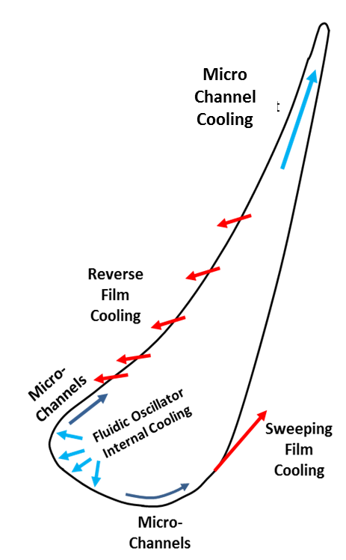
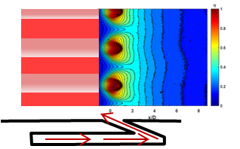
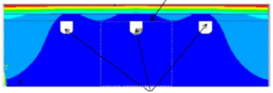
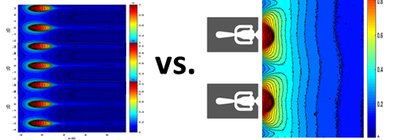
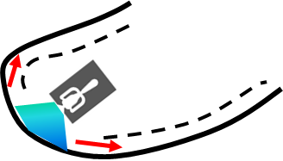
Integration of Promising Designs in NGV
1. Reverse Cooling on PS:
Fed by upstream microchannel
Better surface coverage with lower massflow?
Microchannel and Micro-architecture
pin-fin cooling
4
2. Sweeping Jet Film Cooling on SS:
Improved coverage with lower massflow required?
1
3. Sweeping Jet Impingement Cooling on LE:
Eliminate showerhead
Lower massflow required?
Microchannel exhaust
2
3
Sweeping jet film cooling
4. Microchannels in TE:
Improved coverage with lower massflow required?
Weight savings with skin cooling?

Slide 5
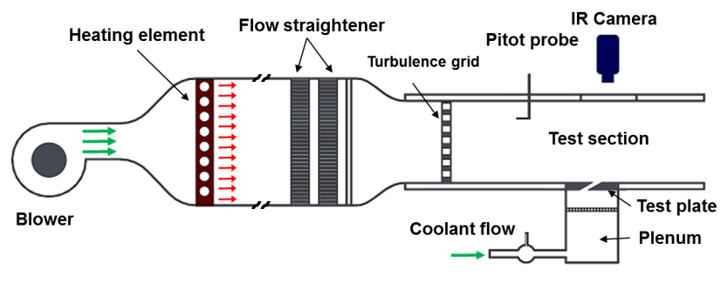
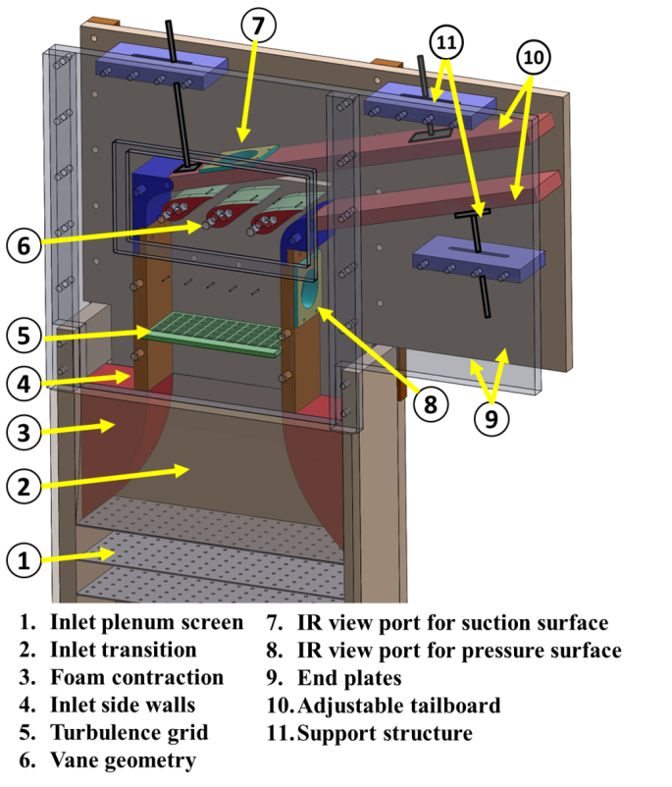
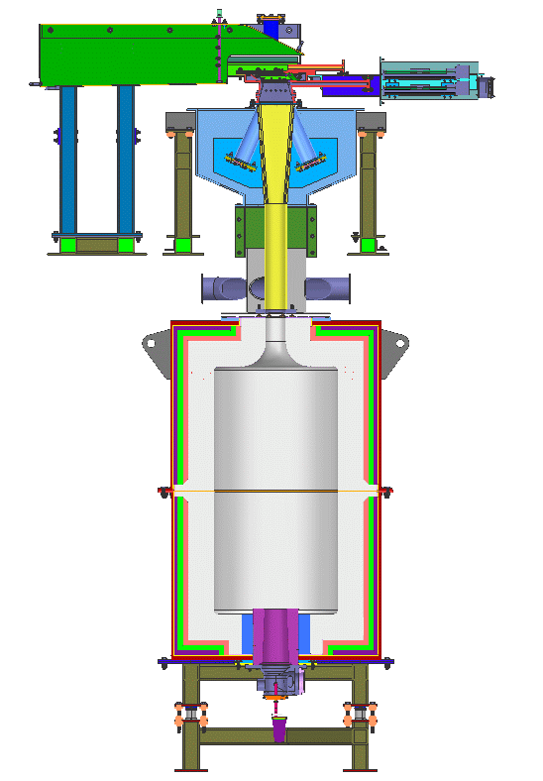
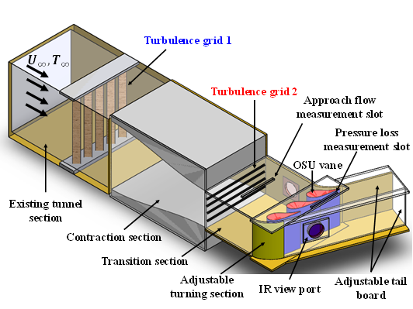
Turbine Heat Transfer Facilities
For innovative concepts to be viable, must be vetted in facilities that simulate the real operating environment
Graduated complexity -
Phase 1
Phase 2
Phase 3
Low speed
large scale
Low temperature
High speed
Smaller scale
Low temperature
High speed
Engine scale
High temp (T_{w}/T_{b})

Slide 6
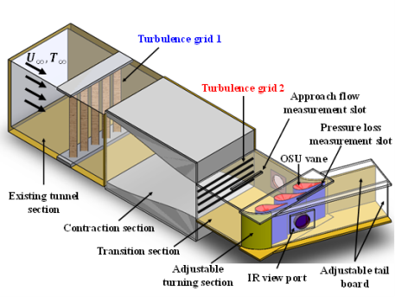
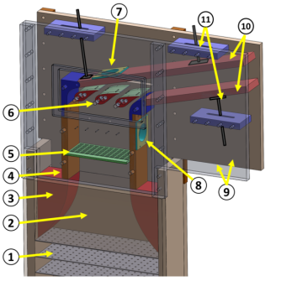


Assessment of Innovative Cooling Concept
Best cooling concepts were qualified for the next phase.
Flat plate
Large scale
Low-speed
cascade
High-speed
cascade
High temperature
cascade
Test Facility | Flat plate | Low-speed cascade | High-speed cascade | High-temperature cascade
1. Reverse cooling
2. Sweeping jet film cooling
3. Sweeping jet impingement cooling
4. Micro-channel cooling
5. Micro-architecture pin-fin cooling

Slide 7
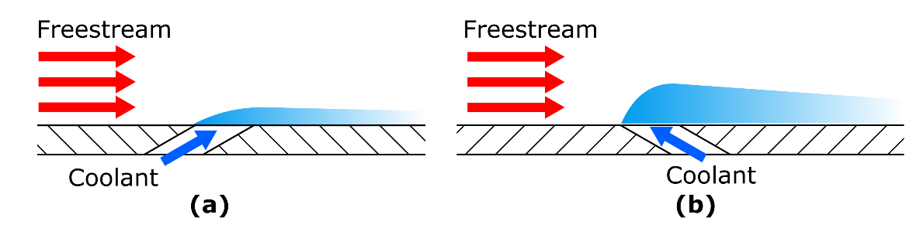
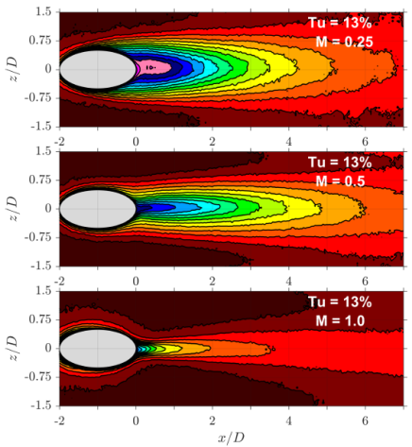
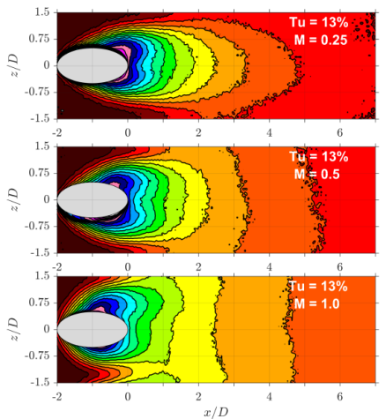
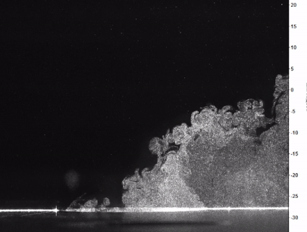

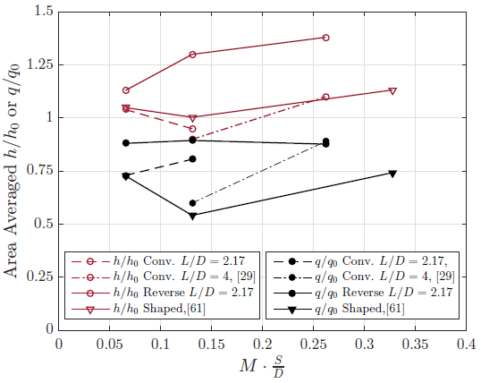
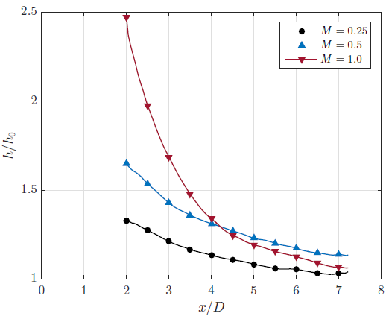
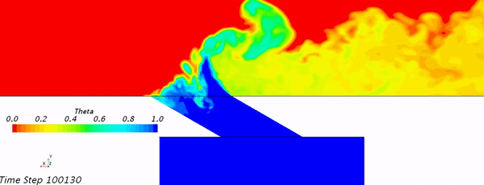
Assessment of Reverse Film Cooling
Flow field was experimentally characterized using flow visualization, PIV and thermal field measurements.
Cooling Effectiveness
Conventional
Reverse
Conventional
Reverse
Reverse cylindrical film cooling produces a high, laterally uniform adiabatic cooling effectiveness
Reverse cooling was outperformed by the conventional film cooling due to high heat transfer augmentation.
Net heat flux reduction
Heat transfer augmentation
PIV
LES
*Select applications based on geometry/design

Slide 8
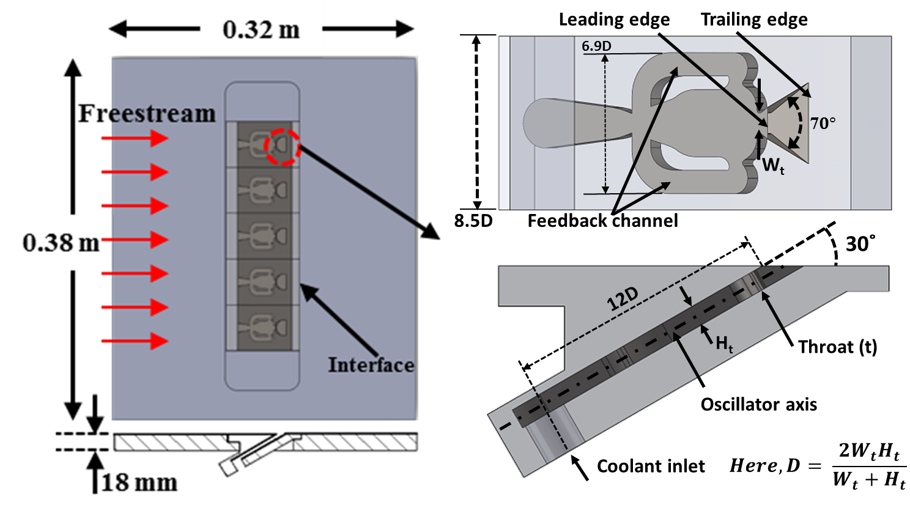
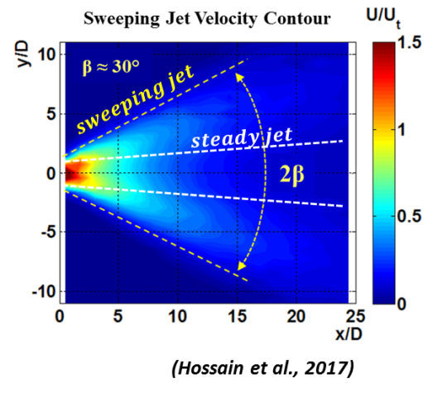
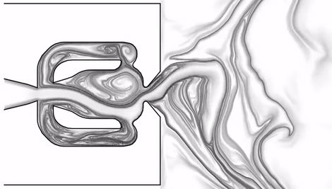
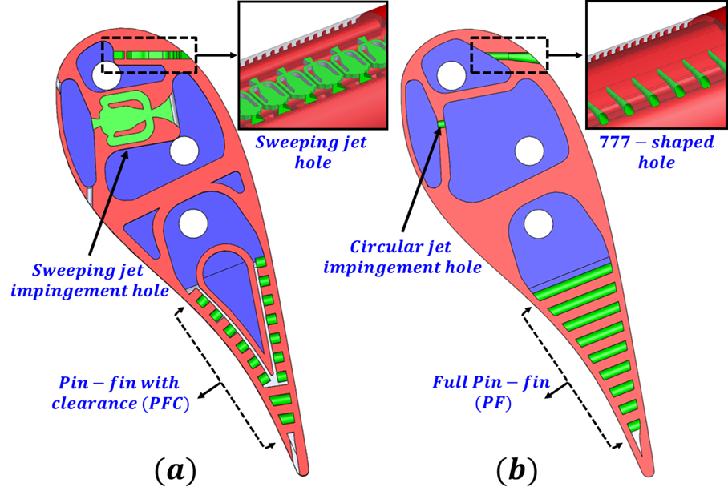
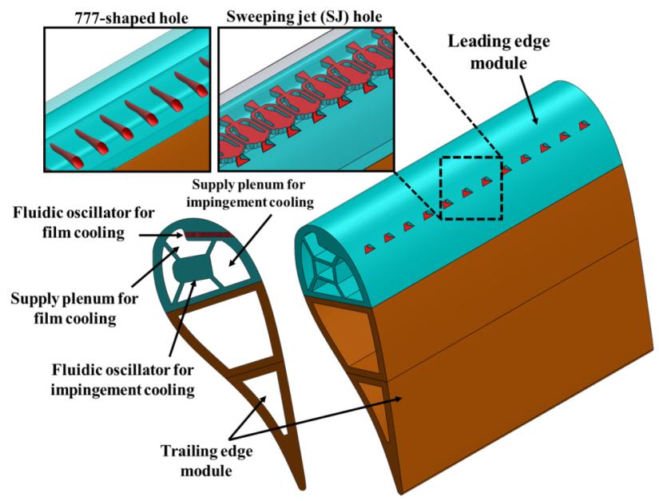


Assessment of Sweeping Jet Film Cooling
Flat plate
Fluidic Oscillator
NGV(transonic)
NGV(subsonic)

Slide 9
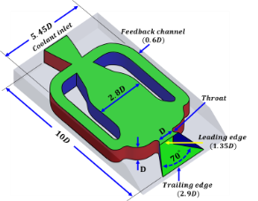
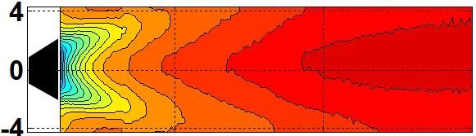
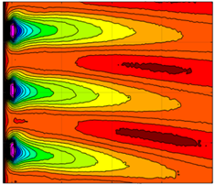
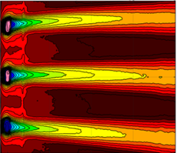
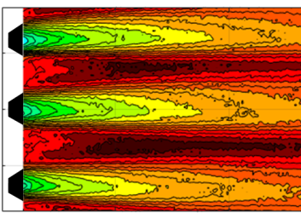
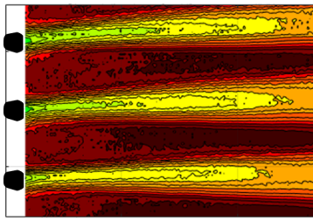
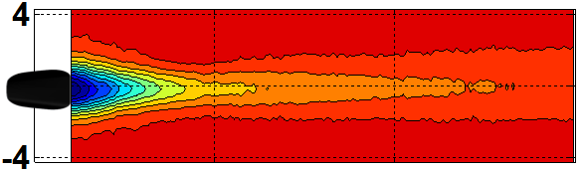
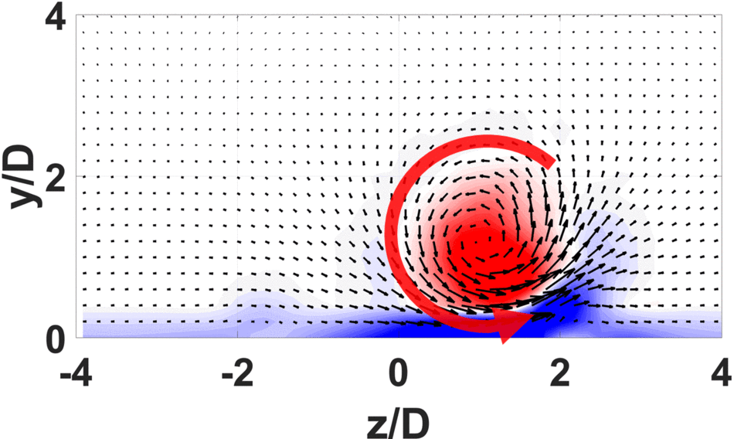
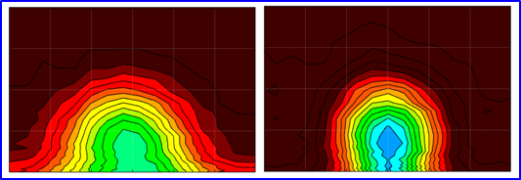
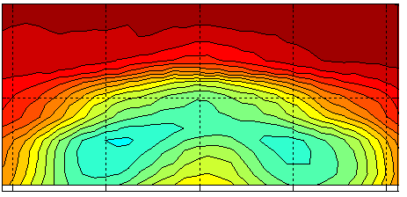
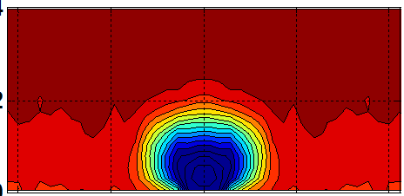
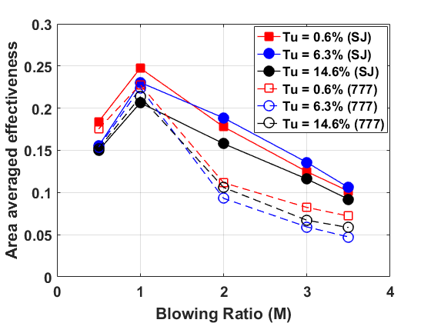
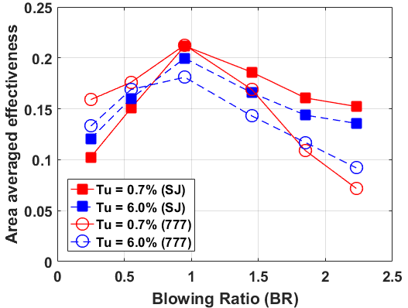


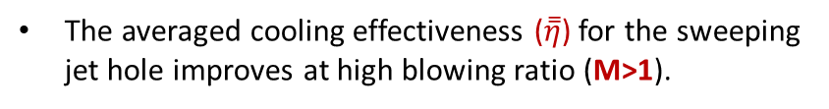
Assessment of Sweeping Jet Film Cooling
Sweeping jet hole shows higher lateral cooling effectiveness compared to shaped hole at all design conditions.
Flat plate
NGV(subsonic)
NGV(transonic)
SJ hole
777- hole
SJ hole
777- hole
SJ hole
777- hole
The sweeping motion of the jet prevents the formation of CRVP and promotes lateral spreading of coolant that improves the near hole cooling effectiveness.
Flat plate
NGV
SJ hole
777- hole
SJ hole
777- hole
The averaged cooling effectiveness ($\overset{̿}{η}$) for the sweeping jet hole improves at high blowing ratio (M>1).
The pressure loss across the sweeping jet hole and the aerodynamic loss are comparable to the standard shaped hole.

Slide 10
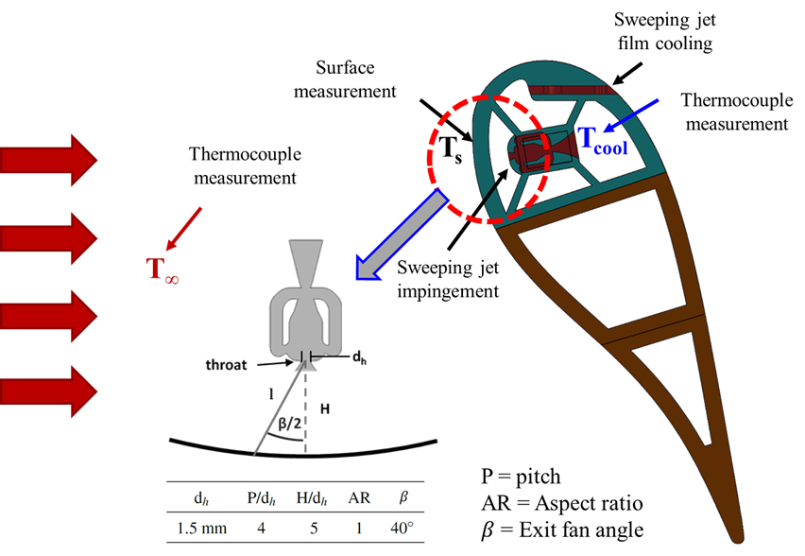
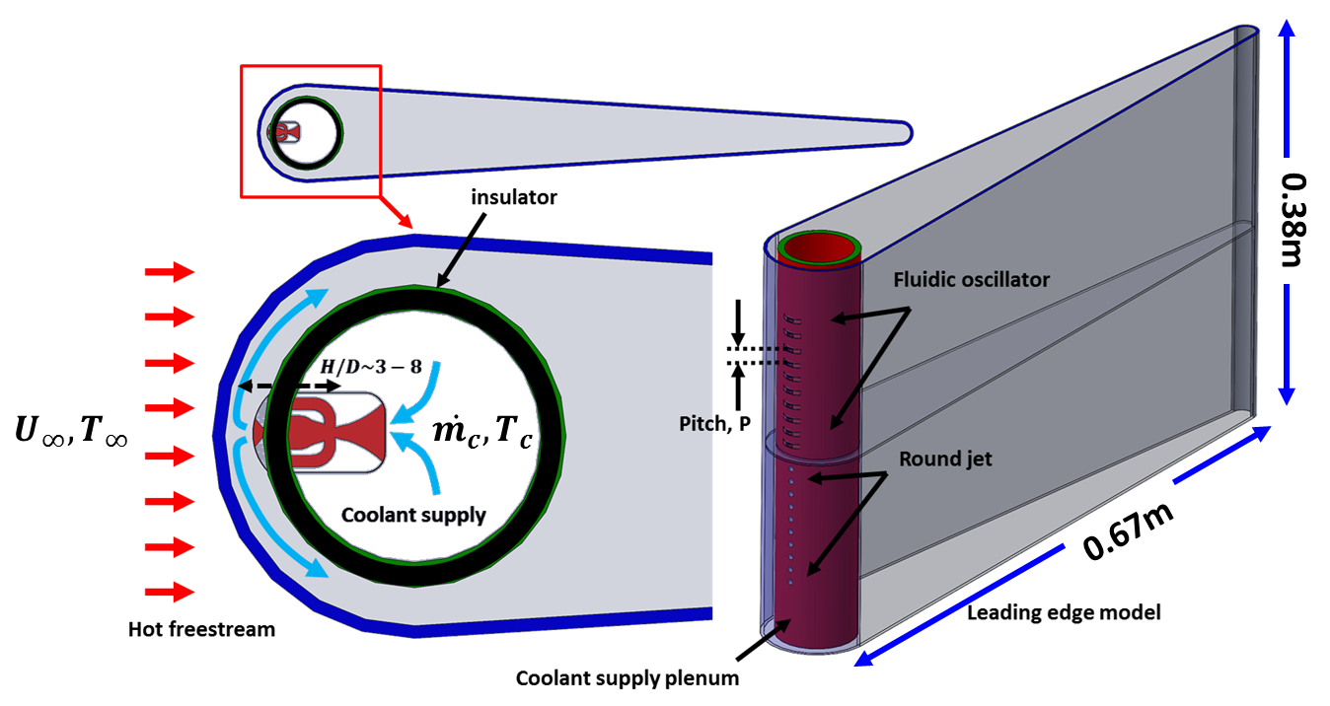
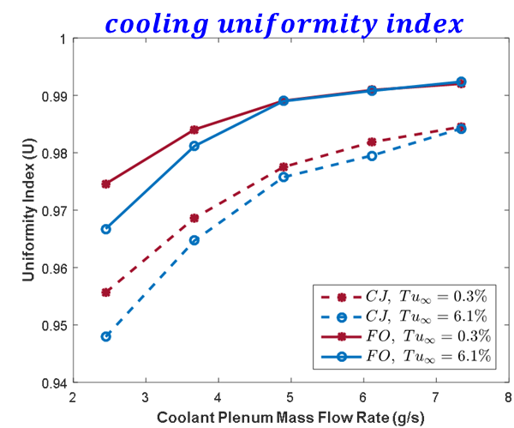
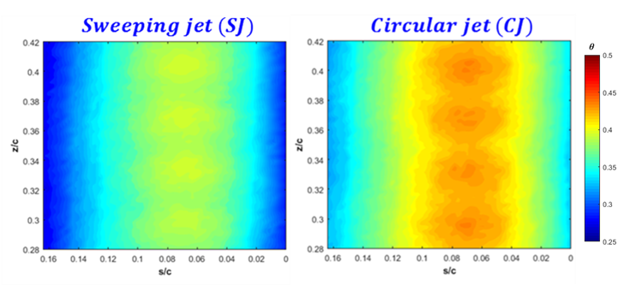
Assessment of Sweeping jet Impingement
A matched Bi-number approach was adopted to estimate the overall cooling effectiveness.
NGV(subsonic)
Large scale test piece
Although the local heat transfer for steady jet dominates, the cooling uniformity for Sweeping jet is much higher than the steady jet.
Overall cooling effectiveness

Slide 11
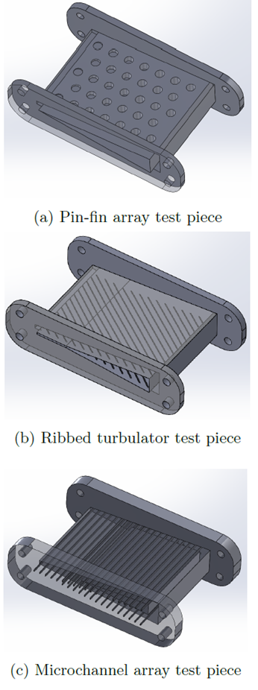
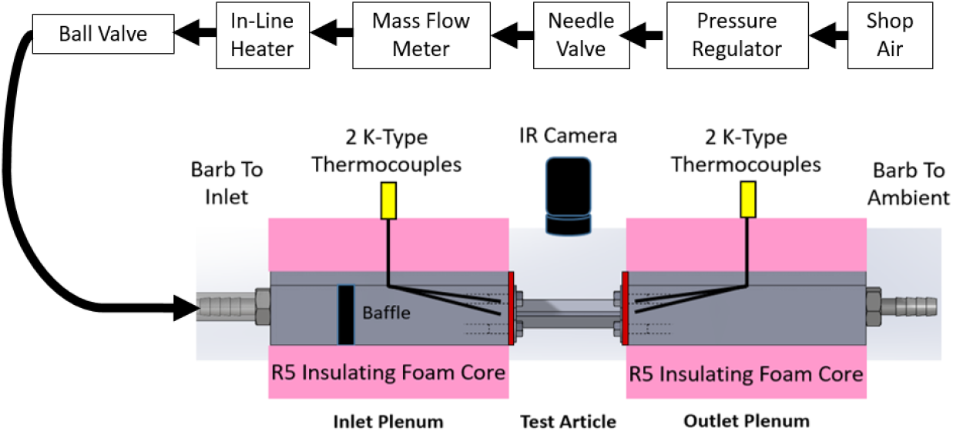
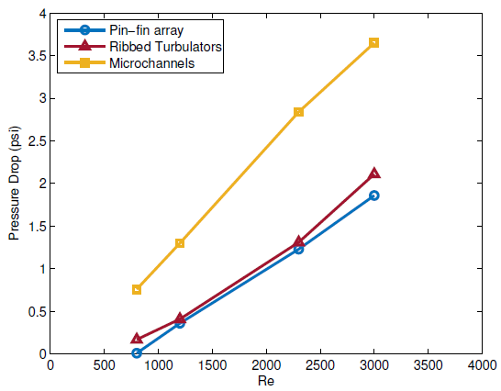
Assessment of Microchannel Cooling
Microchannels, ribbed turbulators, and pin arrays were comparatively analyzed for heat transfer and pressure drop.
Application for trailing edge cooling.
Concept is to keep the coolant near the wall to reduce coolant massflow requirement
The microchannel array drops far more pressure than the other designs.
Pressure drop

Slide 12
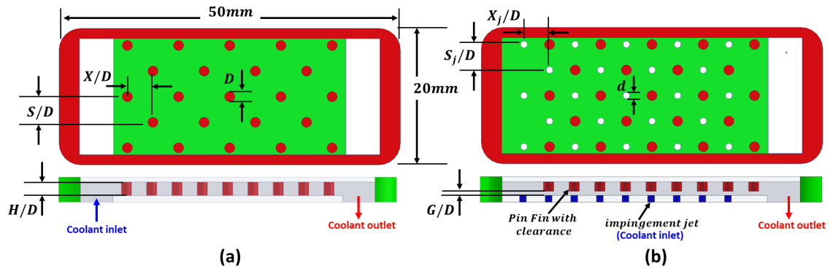
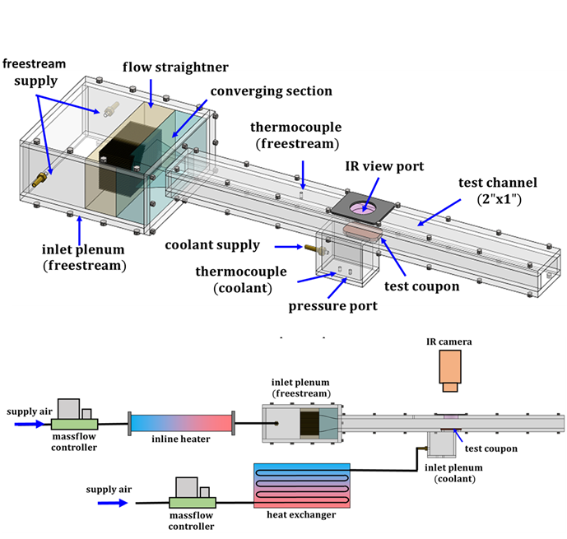
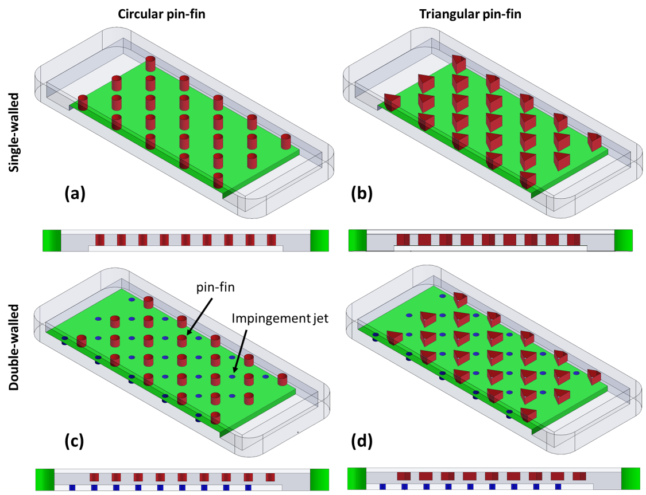
Assessment of Pin-Fin Cooling
Single-walled
Double-walled
Since microchannels did not show promise due to high pressure drop, focus was given to develop innovative pin-fin design.
Cylindrical pin-fin
Triangular pin-fin
Wall thickness = 0.75mm
Single-walled
Experimental Setup
Double-walled

Slide 13
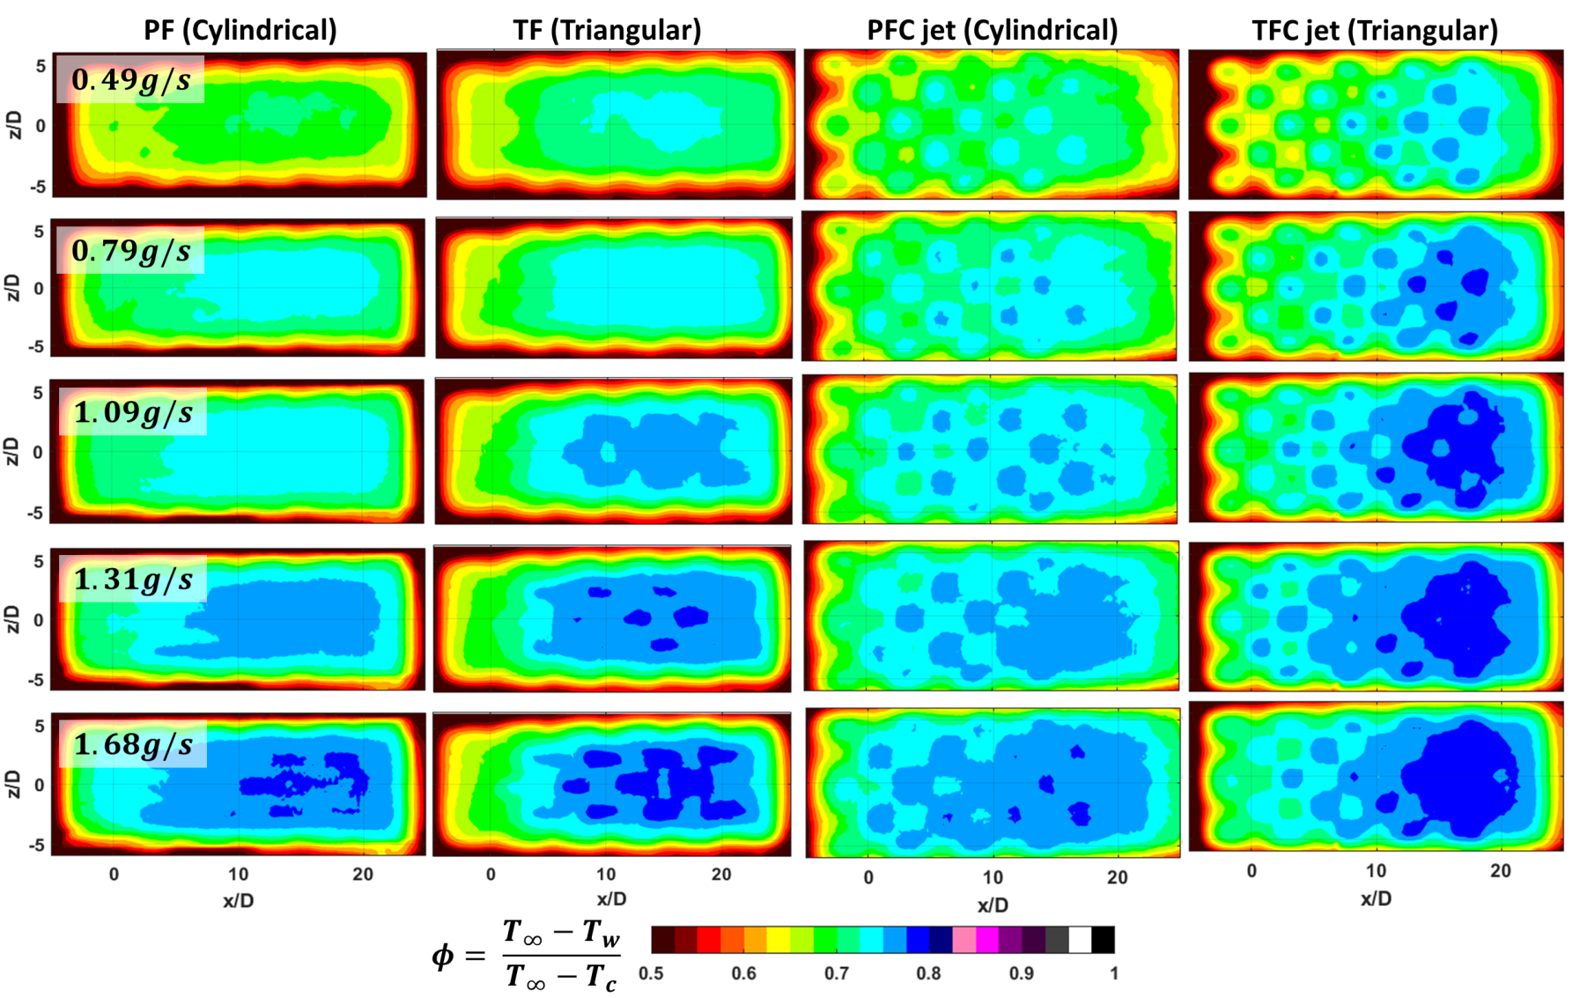
Assessment of Pin-Fin Cooling
Overall Cooling Effectiveness
The triangular pin-fin with clearance and impingement jet (double-walled) showed the highest cooling effectiveness.
Cylindrical pin-fin (PF)
Triangular pin-fin (TF)
PF with jet (PFC jet)
TF with jet (TFC jet)
Coolant Massflow

Slide 14
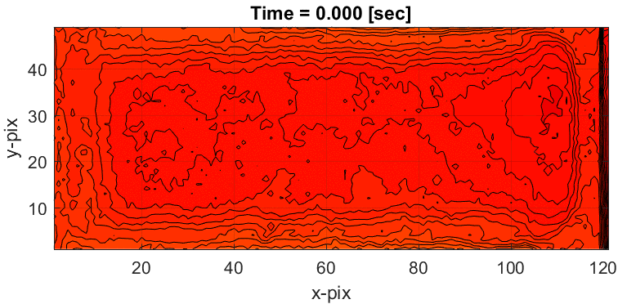
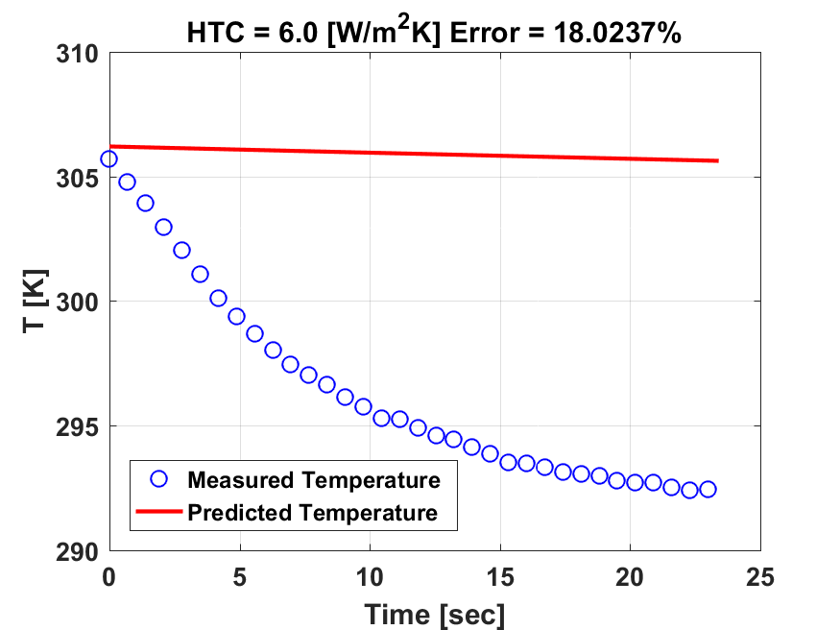



Assessment of Pin-Fin Cooling
Transient
IR data
Heat Transfer Coefficient
A 1-D transient lumped (0.75mm wall thickness) capacitance method was used for each image pixel to predict the wall temperature distribution for a guessed internal HTC.
Neglecting lateral conduction within the wall, the 1-D lumped thermal capacitance method (Nirmalan et. al., 2003) can be represented as-
Convergence
$$\frac{T_{w(i)}−T_{w(t)}}{T_{w(i)}−T_{w(end)}}=e^{−\frac{ht}{ρlC_{p}}}$$
The predicted wall temperature distribution ($T_{w}(t)$) is then compared with the measured wall temperature distribution.
An iterative method was adopted to update a new HTC to predict a new wall temperature.
Nu
Per pixel temperature prediction
The error between the predicted and measured wall temperature was kept below 0.05%.

Slide 15

Assessment of Pin-Fin Cooling
Heat Transfer Coefficient
A transient IR measurement was performed assuming a suddenly heated plate configuration to estimate the convective heat transfer coefficient.
The double-walled configuration showed higher heat transfer compared to the single walled configuration.
Cylindrical pin-fin (PF)
Triangular pin-fin (TF)
PF with jet (PFC)
TF with jet (TFC)
Coolant Massflow

Slide 16

Assessment of Pin-Fin Cooling
Pressure Drop Measurement
The full length triangular pin-fin (TF) shows the maximum pressure drop.
The partial length triangular pin-fin can still provide a better heat transfer (higher overall cooling effectiveness) with a comparable pressure drop.

Slide 17



Assessment of Pin-Fin Cooling
Internal Flowfield (CFD)
Computational Grid
The triangular pins show the formation of a pair of counter rotating streamwise vortices.
The pin-fin prevents the strong crossflow, as the coolant jet impinges and moves farther downstream.
The triangular pin wall redirects the coolant in the spanwise direction thus augmenting local heat transfer and improving cooling effectiveness
Q-criterion colored by streamwise vorticity
No pin
PF
TFC

Slide 18
PHASE 3: Fully Simulated NGV
Fabricate high-temperature alloy vane using DMLS
Characterize surface roughness and tolerances due to manufacturing method
Test full material system in the TuRFR turbine test facility
Characterize cooling performance and pressure drop at various coolant mass flow rates
Characterize cooling performance at various main flow conditions
Compare new vane design performance to conventional vane at same coolant and main flow operating conditions to determine improvement
Develop computational model of NGV
Generate and validate flow solution in context of TuRFR testing
Generate simulations at higher temperatures and pressures not possible in the facility

Slide 19


DMLS Scale Assessment
Four fluidic oscillators (DMLS – Inconel 718) have been characterized.
Two separate designs (FOFC and FOIC) with two different build directions were studied. (D_{h} = 1.1mm)
The characterization was performed by measuring the oscillation frequency and visualizing the jet spreading by water flow visualization.
Build direction Assessment
Scale Comparison

Slide 20


DMLS Scale Assessment
Only FOIC 2 showed a strong jet oscillation.
Severe blockage at the inlet (FOFC 1 and FOFC 2) section was observed which is believed to be responsible for the deteriorating performance.
The oscillators were scaled 30% larger
(D_{h} = 1.4mm) for the final design.

Slide 21









DMLS Vane Design
GEnx doublet
Adiabatic Wall Temperature (Uncooled)
A set of CFD calculation has been performed to estimate the adiabatic wall temperature $.$
Computational
domain
$Tt_{inlet}$ = 1375K (2000F)
Pressure ratio: $\frac{P_{t_{in}}}{P_{ex}}=1.55$
The wall temperature was used to determine the film hole location$.$
Pressure distribution
Temperature distribution

Slide 22




DMLS Vane Design
Conjugate Heat Transfer (CFD)
Material: Inconel 718. Wall thickness: 1.5mm
Flow condition:
Pressure ratio: $\frac{P_{t_{in}}}{P_{ex}}=1.55$,
$Tt_{inlet}$ = 1375K (2000F)
$Tt_{coolant}$ = 850K (1070F)
Steady state calculation with hybrid grid.
Overall Cooling Effectiveness
Computational
domain

Slide 23

DMLS Vane Design
Two separate vane geometries were designed using OSU vane profile$.$
Vane with
advanced cooling
Sweeping jet film cooling on SS
Sweeping jet impingement cooling at the LE
Double walled triangular pin-fin cooling at the TE
Baseline vane with
conventional cooling
777-shaped film cooling on SS
Circular jet impingement cooling at the LE
Single walled cylindrical pin-fin cooling at the TE

Slide 24



DMLS Vane Design
Advanced vane
(SJ vane)
Baseline vane
(777-vane)
Two rows of cylindrical gill shaped at the LE.
Two additional rows of holes at the SS and PS.
Geometric detail
Parameter | Value
Chord | 76mm
Span | 65mm
Solidity | 1.45
Aspect ratio | 0.85
SJ/777Film hole diameter | 1.4mm
Cylindrical hole diameter | 1.1mm
Cylindrical pin dia | 1.5mm
Pin (S/D, X/D) | 2.5mm
Pin-fin jet diameter | 1mm

Slide 25



DMLS Vane Design
Print Description
Parameter | Value
DMLS Material | Inconel-718
Minimum Layer thickness | 30$μm$
Build direction | Compound
Minimum feature size | 0.318mm
Part tolerance | 0.0760mm
Surface roughness | Ra = 5-10$μm$
SJ-vane
777-vane
Dummy vane
Singlet Assembly

Slide 26


DMLS Vane Design
Device Characterization
Oscillation frequency was measured for each hole.
Similar peak oscillation frequency was observed for each hole.
Water Flow Visualization
Water flow visualization confirmed that each hole is oscillating at a very similar jet spreading.
Peak frequency

Slide 27



Turbine Reacting Flow Rig (TuRFR)
TuRFR Capabilities
2700F Gas Path
1300F Coolant Path
Match engine Mach and Temperature
Optical access
IR for surface temperatures
NGV Housing and Exhaust
Propane Combustor

Slide 28








PHASE 3: Test Conditions
Nozzle box instrumentation
Condition | Parameter | Value
Inlet | $$T_{t_{in}}$$ | $$2000F \left(1350K\right)$$
 | $$P_{t_{in}}$$ | $$27psia$$
Exit | $$P_{s_{ex}}$$ | $$P_{atm}$$
Leading edge | $T_{t_{hub}}$ ($T_{1}$, $T_{2}$) | $$1050F \left(840K\right)$$
 | $$Pressure ratio= {P_{t_{hub }}/P}_{t_{in}}$$ | $$1.1, 1.2, 1.3, 1.4$$
Trailing edge | $T_{t_{case}}$ ($T_{3}$, $T_{4}$) | $$1050F \left(840K\right)$$
 | $$Pressure ratio= {P_{t_{case}}/P}_{t_{in}}$$ | $$1.1, 1.15, 1.2$$
Suction surface | $$T_{t_{hub}}\text{ (}T_{1}\text{, }T_{2}\text{)}$$ | $$1000F \left(810K\right)$$
 | $$Pressure ratio= {P_{t_{hub }}/P}_{t_{in}}$$ | $$1.3, 1.4$$
$$P_{t_{case}}$$
$$P_{t_{hub}}$$
Raw image
$$T_{t_{in}}$$
Suction surface
Leading edge

Slide 29



Leading Edge Cooling
The hub pressure ratios were varied from PR_{hub} = 1.1-1.4 while the case pressure ratio was kept constant (PR_{case} = 1.15).
The contours show normalized IR signal.
Qualitatively, the signal intensity seems to drop with increasing pressure ratio at the leading edge which indicates the drop in wall temperature.
Since the case side pressure was kept constant, no significant change in signal intensity was observed.
Raw IR Image (uncooled)
Coolant feed
direction
Leading edge
section

Slide 30

Trailing Edge Cooling
The case pressure ratios were varied from PR_{case} = 1.1-1.2 while the hub pressure ratio was kept constant (PR_{hub} = 1.1).
A significant change in signal intensity was observed.
The double-walled triangular pin-fin configuration showed much more uniform signal intensity comparted to the single-walled cylindrical pin-fin which is indicative of uniform cooling.
Local
hot spot
Raw IR Image (uncooled)
Coolant feed
direction
Trailing edge
section

Slide 31






Suction Surface Cooling
SJ-hole
Tests were performed at two pressure ratios (PR_{hub} = 1.3,1.4) while the case side pressure ratio was kept constant (PR_{case} = 1.15).
The current camera location did not provide much information near the SJ hole exit.
The oxidation due to coolant injection provided an indication of the coolant trace.
The coolant trace indicates that coolant distribution is much more uniform for the SJ hole.
Raw IR Image
777-shaped hole

Slide 32
Questions?
Applause ☺
Questions?

Slide 33
List of publication
Patent Application
Hossain, M.A., Ameri, A., Gregory, J., Bons, J.P., " Out-of-plane Curved Fluidic Actuator," 62/854067, May, 2019 (Submitted)
Journal Publication
Hossain, M.A., Agricola, L.M., Ameri, A., Gregory, J., Bons, J.P., "Sweeping jet film cooling on a turbine vane," ASME. J. Turbomach. 2019;141(3):031007-031007-11. doi:10.1115/1.4042070.
Hossain, M.A., Agricola, L.M., Ameri, A., Gregory, J., Bons, J.P.,"Sweeping jet impingement cooling on a simulated turbine vane leading edge,"GPPS2018-0148, Global power and propulsion journal, 2:402-414.
Hossain, M.A., Prenter, R., Lundgreen, L.M., Ameri, A., Gregory, J., Bons, J.P., 2017 " Experimental and numerical investigation of sweeping jet film cooling," ASME J Turbomach, 140(3), p.031009
Hossain, M.A., Ameri, A., Gregory, J., Bons, J.P., "Sweeping jet film cooling at high blowing ratio on a turbine vane," ASME. J. Turbomach., 2019; Paper number: GT2019-91696 (Recommended)
Hossain, M.A., Asar, M.E., Gregory, J., Bons, J.P., "Experimental Investigation of Sweeping jet film cooling in a transonic turbine cascade," ASME. J. Turbomach., 2019; Paper number: 2019-91678 (Recommended)
Conference Publication
Hossain, M.A., Ameri, A., Gregory, J., Bons, J.P., "Effects of Rotation on a Fluidic Actuator", AIAA Scitech 2019 Forum, AIAA SciTech Forum, AIAA 2019-0885
Hossain, M.A., Agricola, L.M., Ameri, A., Gregory, J., Bons, J.P., "Effects of Exit Fan Angle on the Heat Transfer Performance of Sweeping Jet Impingement," AIAA Propulsion and Energy Forum 2018, Ohio. (AIAA 2018-4886)
Hossain, M.A., Agricola, L.M., Ameri, A., Gregory, J., Bons, J.P., "Effects of Curvature on the Performance of Sweeping Jet Impingement Heat Transfer," 55th AIAA Aerospace Sciences Meeting, 2018, Florida
Hossain, M.A., Prenter, R., Lundgreen, R.K., Agricola, L.M., Ameri, A., Gregory, J., Bons, J.P., "Effect of roughness on the performance of Fluidic oscillator," 55th AIAA Aerospace Sciences Meeting, 2017, Texas. Paper number: AIAA 2017-0770.

Slide 34
List of publication
Conference Publication (Cont..)
Hossain, M.A., Prenter, R., Lundgreen, R.K., Agricola, L.M., Ameri, A., Gregory, J., Bons, J.P., "Investigation of crossflow interaction of an oscillating jet," AIAA Aerospace Sciences Meeting,2017, Texas. Paper: AIAA 2017-1690
Agricola, L.M., Hossain, M.A., Ameri, A., Gregory, J., Bons, J.P., "Impinging Sweeping Jet Heat Transfer," 53th AIAA/ASME/SAE/ASEE Joint Propulsion Conference 2017. Paper number: AIAA 2017-4974
Agricola, L.M., Hossain, M.A., Ameri, A., Gregory, J., Bons, J.P., " Turbine Vane Leading Edge Impingement Cooling with a Sweeping Jet.," ASME Turbo Expo 2018, GT2018-77073
Lundgreen, R.K., Hossain, M.A., Prenter, R., Bons, J.P., Gregory, J., Ameri, A., "Impingement heat transfer characteristics of sweeping jet," 55th AIAA Aerospace Sciences Meeting, 2017, Texas. Paper: AIAA 2017-1535
Prenter, R., Hossain, M.A., Agricola, L.M., Ameri, A., Bons, J.P., " Experimental Characterization of Reverse-Oriented Film Cooling," ASME Turbo Expo 2017, GT2017-64731
Asar, M.E., Agricola, L.M., Hossain, M.A., Bons, J.P., " An Innovative Pin Fin Design for Turbine Trailing Edge Cooling," AIAA Propulsion and Energy Forum, Cincinnati, Ohio. (AIAA 2018-4524)
Hossain, M.A., Ameri, A., Gregory, J., Bons, J.P., "Sweeping jet film cooling at high blowing ratio on a turbine vane," ASME Turbo Expo 2019; Paper number: GT2019-91696
Hossain, M.A., Asar, M.E., Gregory, J., Bons, J.P., "Experimental Investigation of Sweeping jet film cooling in a transonic turbine cascade," ASME Turbo Expo 2019; Paper number: 2019-91678
Hossain, M.A., Ameri, A., Gregory, J., Bons, J.P., "Effects of Rotation on a Fluidic Actuator at Multiple Axis of Rotation", AIAA Scitech 2020 Forum, Orlando, Florida (Under preparation)
Hossain, M.A., Asar, M.E., Ameri, A., Bons, J.P., "Conjugate Heat Transfer Study of Innovative Pin-Fin Cooling Configuration", AIAA Scitech 2020 Forum, Orlando, Florida (Under preparation)
Hossain, M.A., Ameri, A., Gregory, J., Bons, J.P., "Experimental Investigation of Innovative Cooling Schemes On An Additively Manufactured Engine Scale Turbine Nozzle Guide Vane", ASME Turbo Expo 2020, London, UK
(Under preparation)

