Slide 1
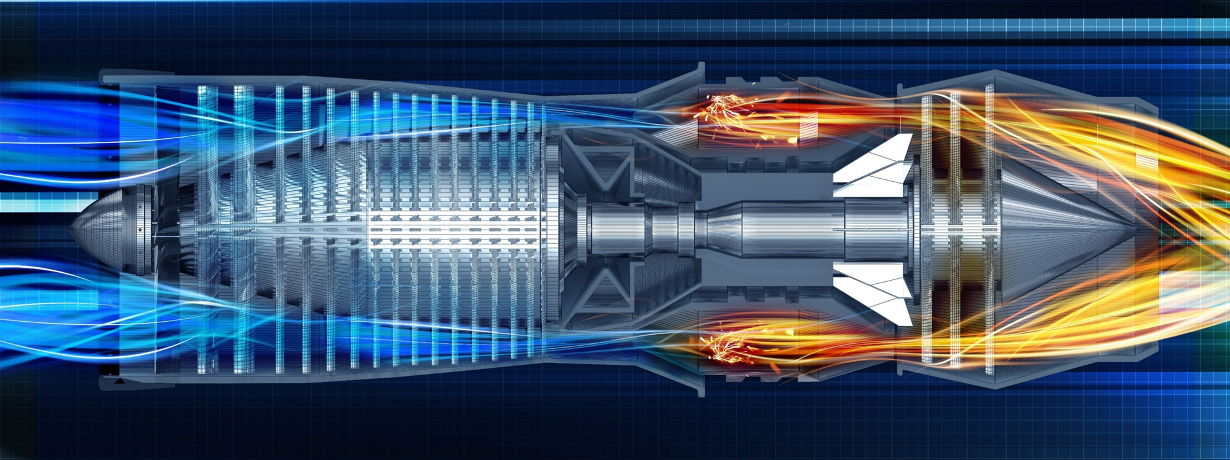
Open Discussion on the Future UTSR Program
Rich Dennis
Advanced Turbines and sCO2 Power Cycles Technology Manager
2019 UTSR Workshop and Program Review Meeting
November 5, 2019

Slide 2

Seeking Feed Back
Open Discussion on the Future UTSR Program
Topic areas for future consideration
What is working / What is not
Using the START rig
Project structure
Collaborative topic areas
UTSR Fellowship
Others

Slide 3
University Turbine Systems Research (UTSR) Program
Applied research supporting DOE goals
Support DOE FE Advanced Turbines (AT) Program goals
Addresses scientific R&D to develop advanced turbines
Goals advanced by universities, GT industry, and DOE FE
UTSR projects established through competitive FOAs
Open to all U.S. universities.
R&D topics support FE program goals and GT industry
UTSR industry fellowships funded by GT manufacturers
Annual UTSR workshop facilitates stakeholder communications
Open to the public - a review of all AT Program projects
All presentations available on the NETL public website
A forum for feed forward discussions
Notes:
Slide Source: Hydrogen Turbine Program For Chris Smith PDAS Feb 2013

Slide 4

























UTSR Program Participants
Since Program Inception at NETL
18 States
25 Universities
60 Projects

Slide 5
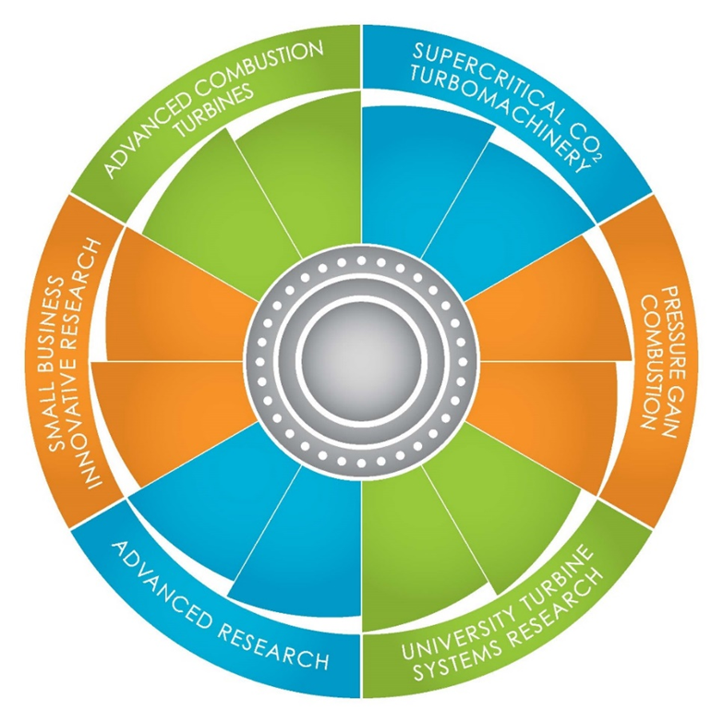
UTSR FOA Topics
2019
Pressure Gain Combustion, Advanced Materials, Additive Manufacturing, sCO2 Power Cycles, Energy Storage
2017
Low-NOx Combustion, Advanced Cooling, Advanced Materials, Big Data Analysis, Advanced Instrumentation, Pressure Gain Combustion
2015
Low NOx Combustion, Pressure Gain Combustion, Turbine Cooling, sCO2 Oxy-Combustion
2013
Combustion, Hot Gas Path R&D

Slide 6
UTSR Funding Opportunities
~$600-800k funding for each project
36 month duration
6 -10 projects as funding allows
Open Access Publishing
Historic Topic areas: combustion, materials, and heat transfer
Expanded focus includes: pressure gain combustion and SCO2 oxy-combustion

Slide 7
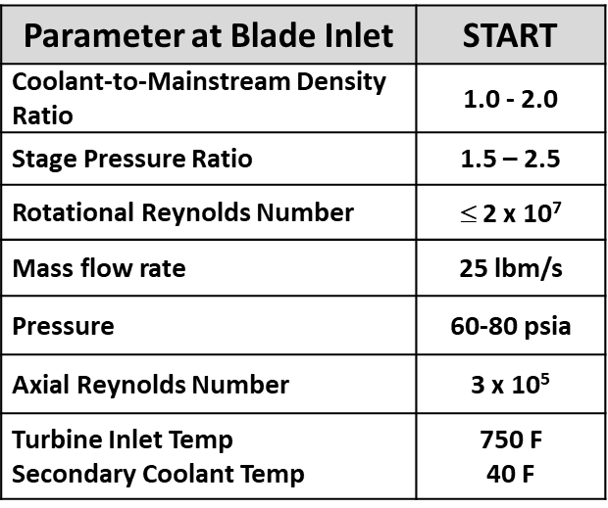
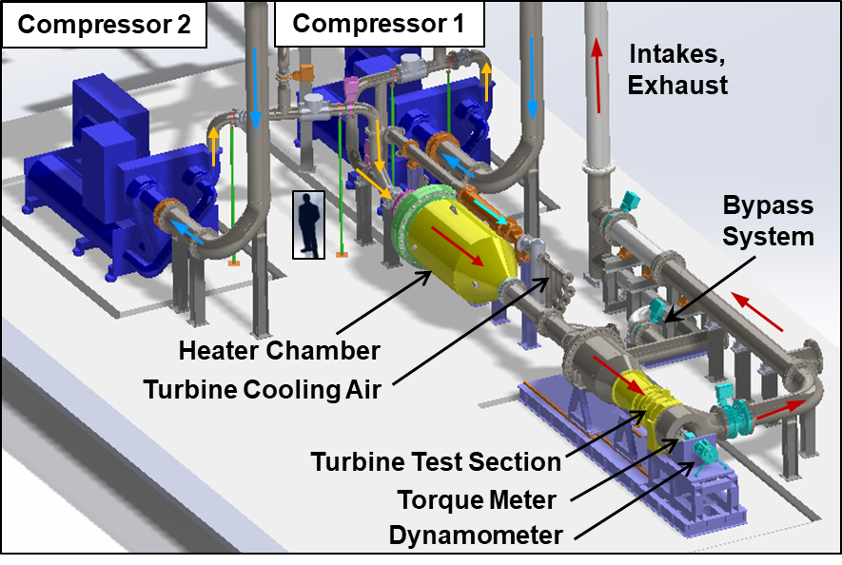
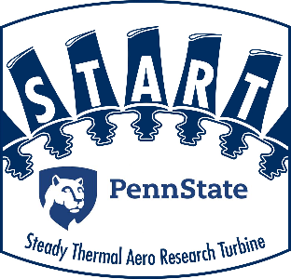


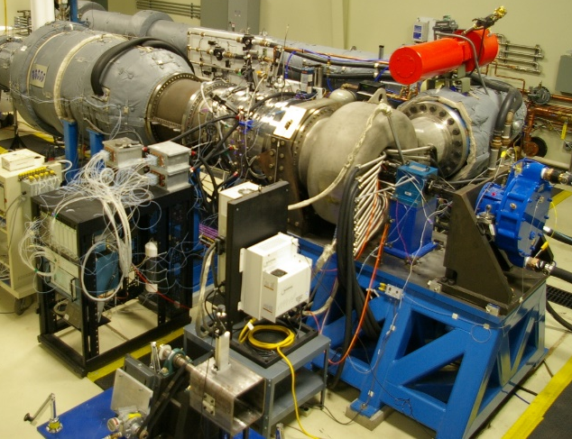
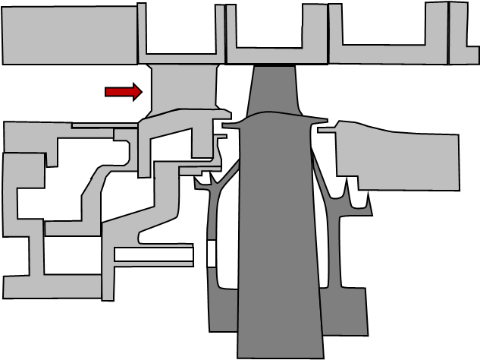
START Facility As a Platform for UTSR Research
Features
Steady operation
Transient simulations
Mag bearing for eccentricity
Add. mfg. for sensor integration
Instrumentation
Heat flux gages
Thermal imaging
Blade tip sensors
Fast-responding pressure
Species sensing for cavities
One Stage Turbine

Slide 8

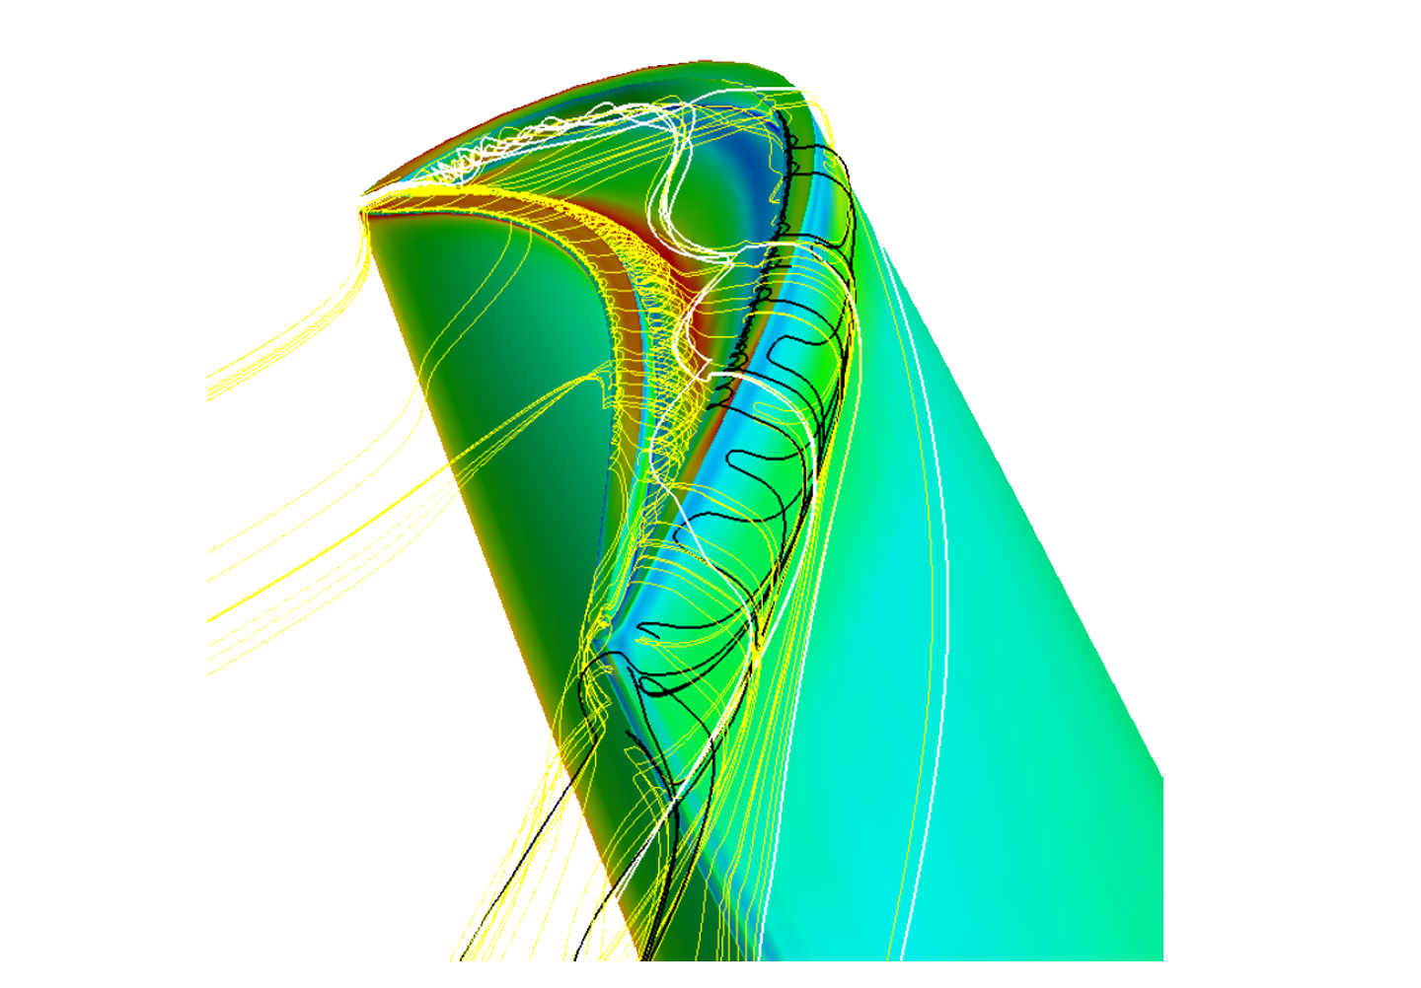
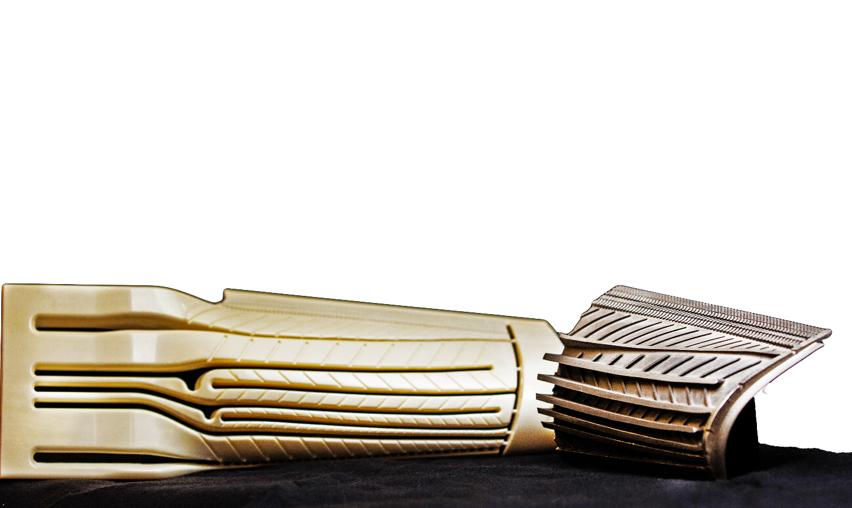
Seeking Feed Back
Open Discussion on the Future UTSR Program
Topic areas for future consideration
What is working / What is not
Using the START rig
Project structure
Collaborative topic areas
UTSR fellowship
Others

Slide 9
Future of the UTSR Program 1
Stakeholder Questions and Suggestions for the Program
Program
How can we help to keep the UTSR Program strong and recognized by those who make the decisions on funding it?
Need for pre-competitive research collaboration for long term research through consortiums at Universities where DOE has invested in rigs
Is H2 combustion an area that should be considered for future UTSR funding?
Materials
What is UTSR’s long term commitment for digital manufacturing to address big data analysis/materials/manufacturing needs?
Need for Integrated computational materials science (ICME) combined with high-throughput testing for rapid materials exploration

Slide 10
Future of the UTSR Program 2
Stakeholder Questions and Suggestions for the Program
Materials
Effects of multiaxial fatigue and robust/accurate residual useful life prediction models – need for mechanism based criteria for multiaxial/biaxial fatigue damage initiation and propagation under complex loading, effect of sudden overload, etc.
Need to link material microstructural characteristics to fatigue life prediction for accurate life prediction.
Anomaly detection in hot components operating in high-temperature and high-pressure environment –inadequate understanding of the data makes feature extraction and development of detection criterion very difficult.

Slide 11
Future of the UTSR Program 3
Stakeholder Questions and Suggestions for the Program
Storage
Need for computationally driven material design of capacitive storage materials with multiple functionality
Nanomaterials for tailoring energy storage (e.g. - improved electrochemical behavior with carbon nanotubes)
fundamental understanding of how thermodynamic properties at the nanoscale translate to bulk properties
how to control the nanoscale morphology to optimize transport behavior, packing density, etc.
Need an integrated experimental and theoretical approach for a complete understanding of these parameters for optimum design for energy storage and power

