Slide 1






National Experimental Turbine (NExT)
University Turbine Systems Research Program
November 2019
Michael Barringer, Reid Berdanier,
Scott Fishbone, and Karen A. Thole
Department of Mechanical Engineering
Pennsylvania State University
Rich Dennis and Patcharin Burke
Advanced Turbines Program
Department of Energy – NETL

Slide 2
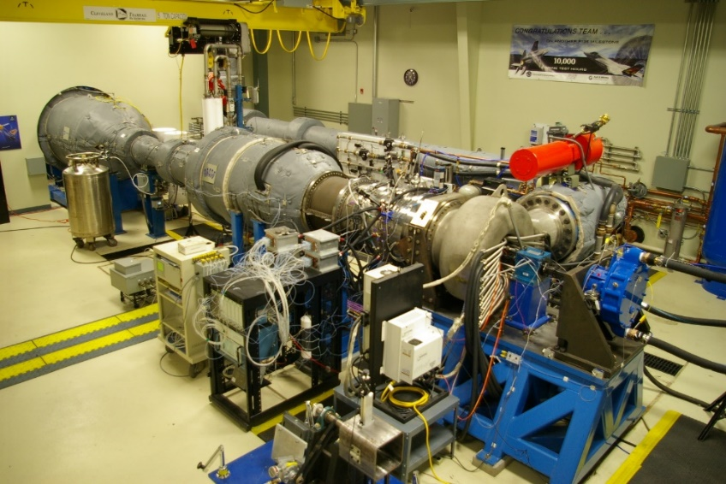
This presentation will provide a briefing on NEXT
Motivation and background
START facility and instrumentation
DOE Studies:
Part 1: Cooled blade studies
Part 2: Defining NExT
Part 3: NExT Future Studies
2

Slide 3
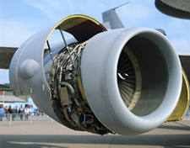
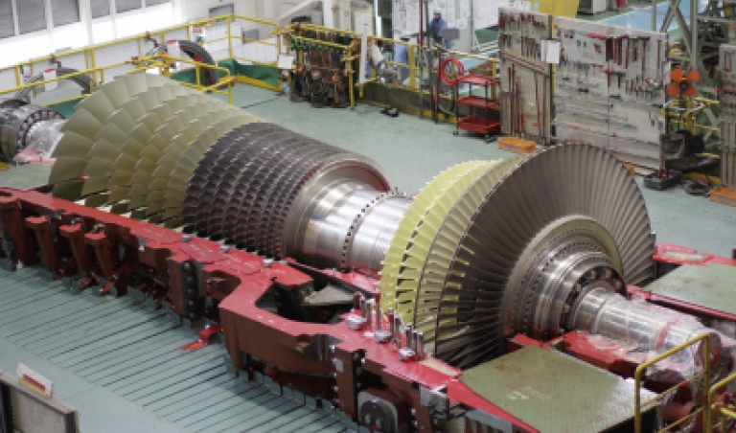
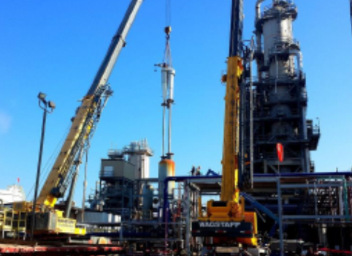
100%
Military and Commercial
Propulsion
34%
US electricity
Oil & Gas
Applications
Projections are over the next 20 years, over 40,000 new aircraft will be made.
Global demand for electricity from natural gas could grow by 50%.
US demand for pipeline growth with new compressor stations

Slide 4
Turbine “public geometries” have been sparse and are now decades old
Program Name Original date | Who led the effort | Who had access | What was available
Energy Efficient Engine (E^3) Early 1980’s | NASA / GE | GE + PW | Blade/Vane geometries and data
First Vane 1995 | DOE-UTSR Thole / Bogard | US universities/ PW | Vane geometry and data
HiT Turbine Mid-2000’s | AFRL | US OEMs | Blade / Vane geometries and data
PakB/PakH/L2F LPT Airfoils Mid-2000’s | PW / NASA / AFRL | US universities | Blade geometry and data
DOE START Project 2015 | DOE / PW | DOE | Cooling geometry and normalized data

Slide 5
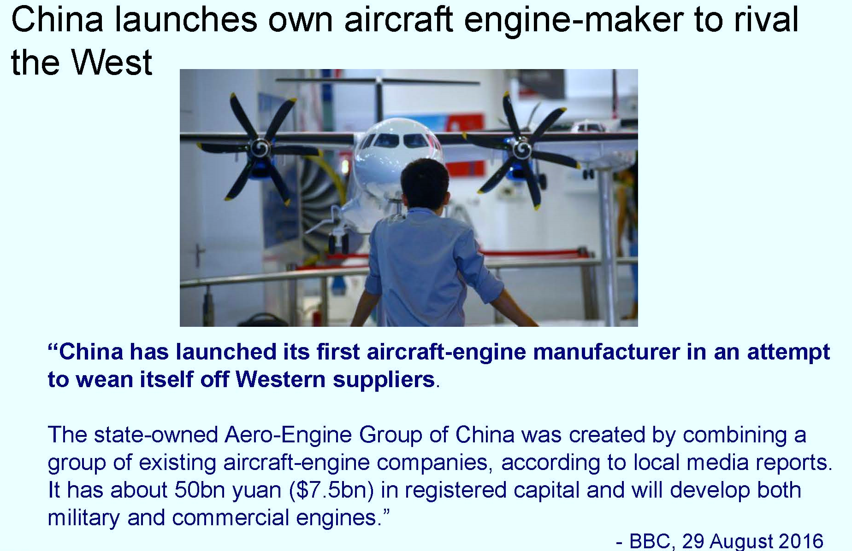
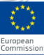
Gas turbine research is heavily supported in other nations
European Union has an established industry/university/government collaboration with common geometries.
Some Framework Series Examples:
1. Main Annulus Gas Path Interactions
RR, SNECMA, Karlsruhe Inst of Tech, MTU, Siemens, Darmstadt, etc
2. FP7 FACTOR Project:
Oxford, VKI, Safran, DLR, MTU, RR, Siemens, etc

Slide 6
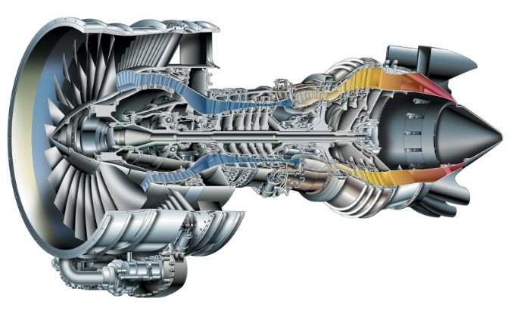
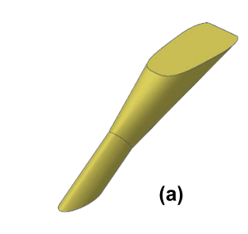
Barriers for the research community to advance turbines
Lack of facilities that can simulate turbine complexities
Lack of resources:
Universities: space and staff
Industries: costs and time
Lack of common geometries that are not proprietary
Fan
Compressor
Combustor
Turbine
Nozzle
PW6000
6

Slide 7
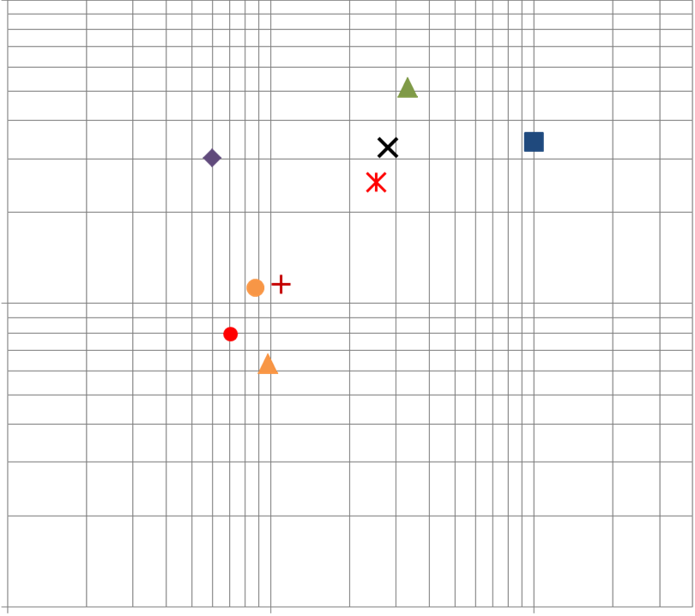


Illustration of a lack of facilities that can simulate important turbine parameters
Axial Versus Rotational Parameter Space Comparison
(Continuous Duration Facilities)
1.0E+6
Penn State START
Operating Envelope
(Same Order of Magnitude)
Engine
High Pressure Turbines*
Publically Available
Operating Points
Blade Inlet
Reynolds Number
PSU START
GE HGIR
Sussex
1.0E+5
Re =
$\frac{ρ_{∞} ∙ U_{X} ∙ C_{X}}{μ_{∞}}$
X
Aachen
ASU 1
ASU 2
Bath
Purdue
Notre Dame
NASA W6
1.0E+4
1.0E+5
1.0E+6
1.0E+7
Rotational Reynolds Number,
Re =
$\frac{ρ ∙ Ω ∙ R^{2}}{μ}$
φ
Hub, Purge
7

Slide 8
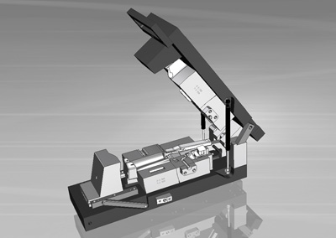
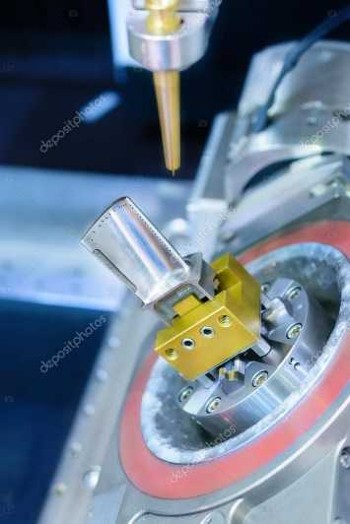
Illustration of costs and time that industry faces working with universities in developing new turbine designs
Not including infrastructure costs:
Test turbine designs require ~$1M
Cast blades cost in excess of $0.6M and require 60-90 weeks
Step 1: Tooling/Cores/Wax
Step 2: Casting
Step 3: Machining

Slide 9



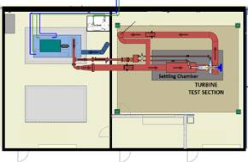
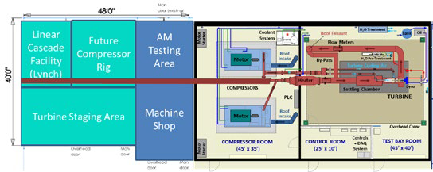
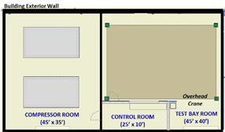
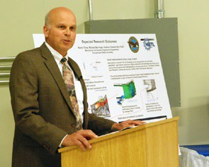
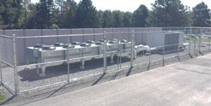
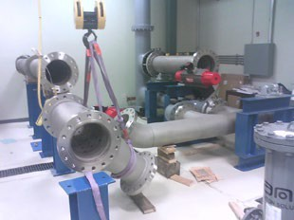
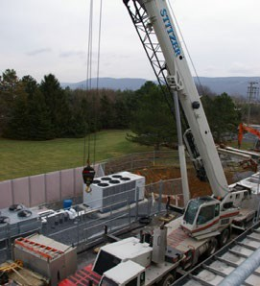
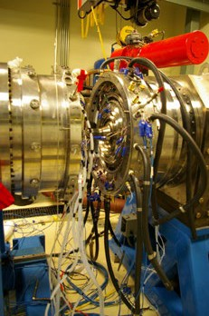
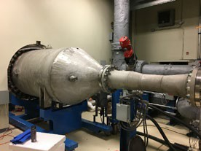
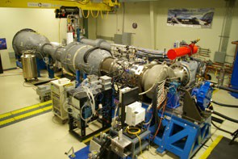

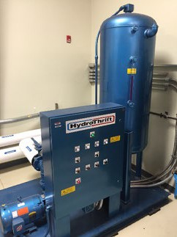
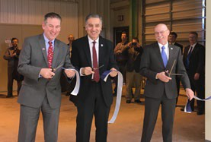
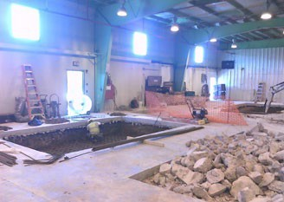
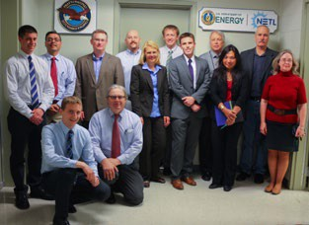
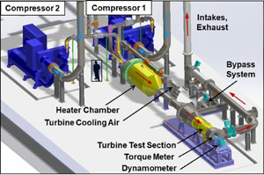
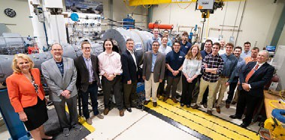
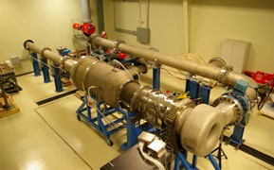
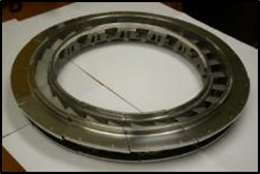
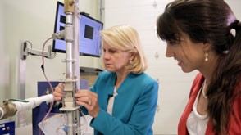
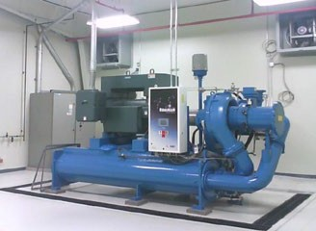
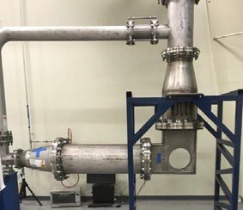
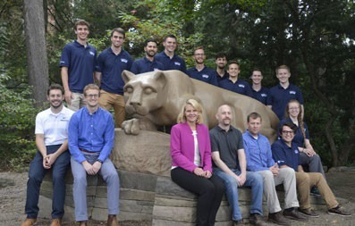
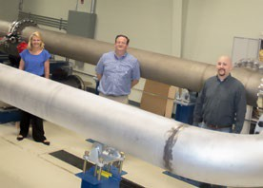
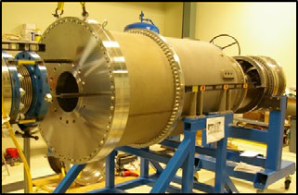
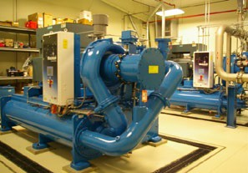
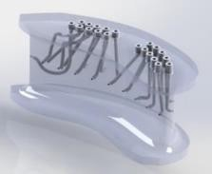
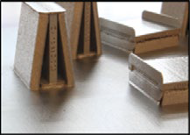
START was created in 2011 and has grown from a floor plan to a steady turbine research facility
2011
 | 2012 | 2013 | 2014 | 2015 | 2016 | 2017 | 2018 | 2019
PSU
P&W
DOE
Building, electrical
START II
Rig Design & Build
Part Span, Phase I Testing
Full Span, Phase II Testing, FAA
Facility, cooling, compressors
Facility upgrade
Cooled Blade Program

Slide 10
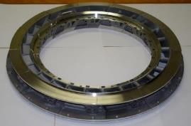

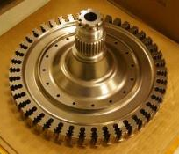
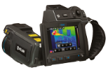
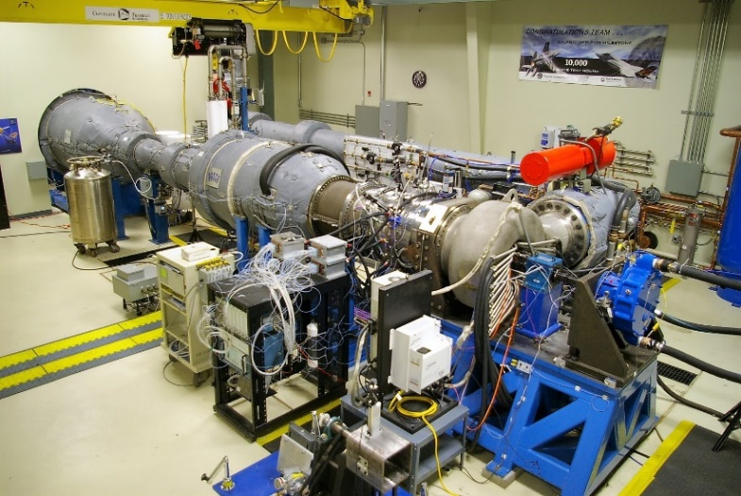
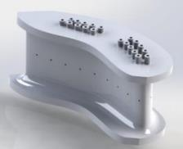
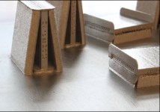
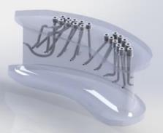
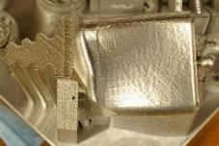
The START Lab was founded on four pillars of research emphasis to benefit the gas turbine community
Use engine hardware to generate relevant data
Provide a test bed for instrumentation development
Integrate sensors directly into turbine components
Advance additive mfg. for turbine components
Notes:
Study methods for improving turbine cooling with turbine engine hardware to give relevant data and reduce overall costs of testing
Provide a test bed for new instrumentation development
Advance the use of additive manufacturing for turbine components
Integration of instrumentation and sensors directly into turbine components

Slide 11
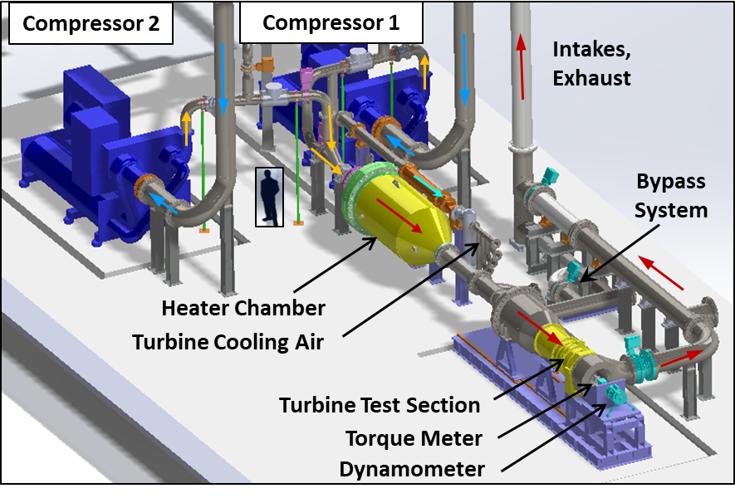
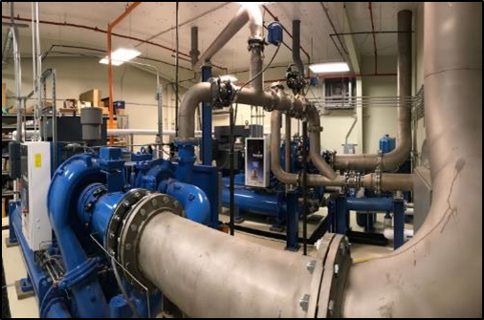
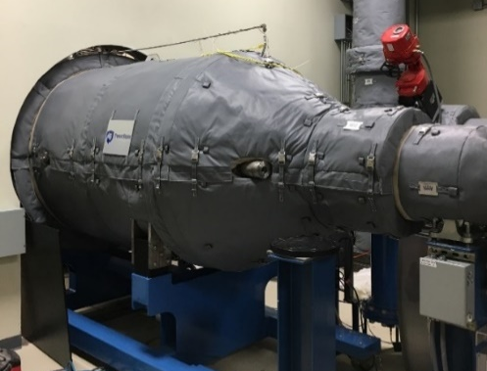
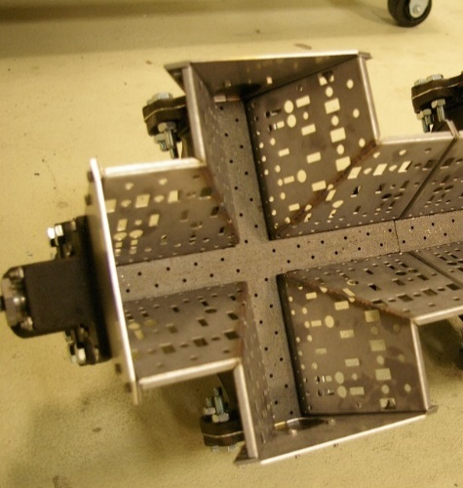

START is a continuous-duration turbine research facility capable of simulating engine-representative test parameters
Turbine Conditions | Units | Main Gas Path | Cooling Air
Pressure | psia | 30 - 80 | 30 - 80
Temperature | °F | 230 - 750 | > 30
Mass Flow Rate | lbm/s | ≤ 25 | < 3
Notes:
The meaning of "relevant" conditions from TRL definitions is dependent on the technology.
For example: aero or heat transfer technology – nondimensional parameters may be sufficient to demonstrate higher TRL, but for specific instrument capable of measuring those conditions at 2000deg would be a lower TRL when demonstrated at 400F. → Developers may separate demonstrations between facilities to fulfill contract obligations with reduced project (demonstration) cost.

Slide 12



Several flow conditions in the main gas path and secondary air system are matched to engine relevant parameters
Parameter at Blade Inlet |  | Turbine | START
Coolant-to-Mainstream Density Ratio | $$ρ_{c}/ρ_{∞}$$ | 2.0 | 1.0 - 2.0
Stage Pressure Ratio | $$P_{0,in}/P_{0,exit}$$ | 2 | 1.5 – 2.5
Rotational Reynolds Number | $${Re}_{φ}$$ | 2.0 x 10⁷ + | ≤ 2 x 10⁷
Mass flow rate | lb_{m}/s | 25+ | 25
Pressure | PSIA | 100’s | 60-80
Axial Reynolds Number | $${Re}_{x}$$ | 3 x 10⁵ | 3 x 10⁵
Turbine Inlet Temp Secondary Coolant Temp | °F | ~ 2500 ~ 1000 | 750 40

Slide 13











PSU-START utilizes a broad suite of measurement techniques to evaluate aerothermal turbine performance
Thermal Imaging
Heat Flux Gauges
Radial & Circ. Traverses
© UTC 2018
Telemetry and Slip Ring
3D Printed Vanes
Notes:
Accuracy is key for everyone – focus in START includes account for cooling, heat transfer, etc. → connect accuracy back to fundamental measurements (e.g., cooling efficiency)

Slide 14









Thin film heat flux gauges represent a key constituent of the internal instrumentation development at Penn State
Facility | Length of Test [s] | Tests Per Day | Cumulative 20 year Test Time [hrs]
OSU TTF | 0.120 | 3 | 0.730
MIT | 0.200 | 3 | 1.217
Oxford OTRF | 0.500 | 3 | 3.042
VKI | 0.500 | 3 | 3.042
AFRL | 2.500 | 3 | 15.208
Penn State | 8 [hrs]
5 µm
2b = 90 µm
2b = 90.51 µm
L = 518 µm
L = 500 µm
Anthony et al. (2011)

Slide 15



A combined effort with heat flux gauges and thermal imaging enables unprecedented validation capabilities
© UTC 2018
Mathison et al. (2012, Part II)
Schroeder and Thole (2016)

Slide 16










Introducing AM gas turbine components with integrated sensors facilitates a disruptive technological opportunity
Wereszczak et al. (2002)
Traditional Parts
"Smart" AM Parts
Risk
Siemens
Additively manufactured gas turbine components enable accelerated production timelines.
Development Time
Anthony et al. (2011)
Deng et al. (2019)
CVD Mesoscribe
Embedded sensors circumvent complex attachment techniques required for traditional instrumentation.
Mitchell et al. (2008)

Slide 17


DOE Studies
Part 1 cooled blade research kicked off in 2016
Specific goals include:
1) demonstrate increased turbine efficiency by reducing cooling flow through the systematic studies of Reynolds number, cooling flowrates, and airfoil cooling designs;
2) determine the appropriate scaling parameters for different testing environments including Virginia Tech, U Pitt, and DOE-NETL.
Ames, 2009
Ramesh, Ramirez, Ekkad, Alvin, 2016

Slide 18


Based on extensive literature reviews and review from Pratt & Whitney, Siemens, GE, and Solar, we have a baseline cooling scheme
Cooling design needed to be integrated into the Pratt & Whitney turbine airfoils
Cooled Blade Design and Manufacturing
Mid-chord Plenums
  Dedicated leading edge source
  Dedicated trailing edge source
  Dedicated three pass serpentine
    Discrete ‘V’ trip strips in passages
  Tip treatments and cooling left to the designer for balancing
Mid-chord Film Cooling Holes
  7-7-7 shaped holes
Courtesy of J. Town, DOE-NETL

Slide 19

Four different blades will be used in a ‘rainbow’ wheel to provide back to back comparisons

Slide 20



Blade cooling designs were transformed from a laboratory setting into a PW proprietary blade
1
NETL Baseline
2
NETL ‘Trailing Edge’
3
NETL ‘Antivortex’
4
‘Modified Baseline’
Double Impingement
vs.
Diamond Pedestals
Shaped
vs.
Tripod Holes
Round Holes

Slide 21







An ongoing study is evaluating internal and external blade cooling technologies under sponsorship from DOE-NETL
Modified Baseline
Baseline
Anti-Vortex
Trailing Edge

Slide 22



Significant effort and help were required to order turbine blades for the START turbine—52 weeks for over $1M
Step 1: Tooling/Cores/Wax
Step 2: Casting
Step 3: Machining

Slide 23



A subaward to Pratt and Whitney was needed for their technical support
Technical assistance with quoting cores, wax patterns, tooling, casting, and machining
Provide quality control (QA/QC) requirements for each step in the manufacturing process
Visit vendors during manufacturing to ensure they are following QA/QC requirements

Slide 24
DOE Studies
Part 2 Defining National Experimental Turbine (NExT)
started in 2019
Specific goals include:
Develop an advanced turbine geometry for US companies and institutions that provides a platform for acquiring detailed data for tool development.
Once developed, the advanced turbine can be used by the industry partners (Part 3) to develop proprietary cooling designs, secondary seals, etc that can be quickly and cheaply tested.
Detailed baseline test data will be provided to the industry partners (Honeywell, PW, Siemens, and Solar).
The majority of the funding for the turbine development is made available by DOE. A 20% cost share from industry partners is required.

Slide 25
The schedule has been updated for the official project kick off date
Complete Upcoming Tasks
2019 | Solicit input from partners on NExT geometry and requirements Perform turbine design vendor bidding and selection Agilis kick-off to begin conceptual design Conceptual Design Review November / December 2019
2020 | Preliminary Design Review March 2020 Detailed Design Review July 2020 Procurement of Long Lead Hardware August 2020 Production definition and procurement starting August 2020
2021 | Continued procurement and delivery of all NExT hardware Testing of additively manufactured blades and vanes Testing of cast blades and vanes
2022 | Continued testing if required
Notes:
Study methods for improving turbine cooling with turbine engine hardware to give relevant data and reduce overall costs of testing
Provide a test bed for new instrumentation development
Advance the use of additive manufacturing for turbine components
Integration of instrumentation and sensors directly into turbine components

Slide 26



The partners have already provided their turbine size data
Turbine Stage Sizing |  |  | NExT
Parameter |  | START | Design Target | Discussion
Inlet Inner Diameter (Hub) | Inches | 16 |  | *
Inlet Outer Diameter (Case) | Inches | 20 |  | *
Hub-to-Tip Ratio | R_{HUB} / R_{TIP} | 0.8
Total Pressure Ratio | P_{T,IN} / P_{T,OUT} | 1.0 – 2.5 |  | *
Degree of Reaction | R | - |  | *
Flow Coefficient (Blade Inlet) | C_{X} / U_{TIP} | -
Speed Parameter | rpm / (R)^{0.5} | -
Flow Parameter | lbm/s (R)^{0.5} /psia | -
Zweifel Coefficient | Z | -
Work Coefficient | Δh₀ / U_{TIP}² | - |  | *
Zweifel
$$Zw=2\frac{s}{C_{x}}\cos^{2}{β_{2}}\left(\tan{β_{1}}−\tan{β_{2}}\right)$$
Work Coefficient
$$ψ=\frac{{Δh}_{0}}{{\left(ωr\right)}^{2}}$$
Notes:
Study methods for improving turbine cooling with turbine engine hardware to give relevant data and reduce overall costs of testing
Provide a test bed for new instrumentation development
Advance the use of additive manufacturing for turbine components
Integration of instrumentation and sensors directly into turbine components

Slide 27

NExT hardware will be designed to fit within the spatial envelope of the START turbine test section
NExT
Design Envelope
Upstream
Settling Chamber
Test Section Inlet with
Strut Supported Core
For Cooling Air Delivery
Rotor Assembly and Bearing System
Downstream
Settling Chamber
Notes:
Study methods for improving turbine cooling with turbine engine hardware to give relevant data and reduce overall costs of testing
Provide a test bed for new instrumentation development
Advance the use of additive manufacturing for turbine components
Integration of instrumentation and sensors directly into turbine components

Slide 28
The roles and responsibilities of the team provide a clear guidance on how each member is to participate in NExT
Penn State
Overall project management
Oversees aggregate of RFI data to provide to designer
Defines scope of work and oversight for designer
Penn State / DOE
Manages votes for all partner anonymous/confidential feedback
Oversee resolution to potential design conflicts
DOE / Industry Partners
Provide desired NExT size, performance, and operating data
Provide desired airfoil cooling details (vanes and blades)
Provide feedback to all design reviews
Agilis Engineering Inc.
Perform conceptual, preliminary, and detailed designs
Perform product definition
Procurement of all turbine hardware
Report to partners (Kick-Off, 30%, 60%, 90% reviews)

Slide 29


The design “voting’ process will be used resolve questions
Present design issue to team and request vote via email to each partner
Reply with vote to Penn State only
by requested deadline
Penn State collects votes and will provide path forward with DOE input

Slide 30

Concept Level Rig Configuration
vane OD cooling flow
replaceable air seal
vane ID cooling flow
potential air seal cooling flow
replaceable discourager seals – both rim cavities
Rubber abradable seal lands
wire seals at all coverplate-to-disk interfaces
blade cooling flow
stepped coverplate KE seals
O-ring seals at all static leak paths
pre-swirler for blade cooling flow

Slide 31





Slide 32
Geometry and data proposed for NExT
Geometry
Vane Coordinates | X, Y, Z, Chord
Blade Coordinates | X, Y, Z, Chord
Vane and blade counts | X, Y, Z
Turbine Architecture | Ri, Ro, Underplatform, TOBI, Disk
Cooling Supply | All feature data
Internal Cooling | All feature data
External Cooling | All feature data
Upstream Approach Geom | X, Y, Z
Design-intent tip clearance | X, Y, Z
Main Gas Path
Flow | MGP Mass flow rate
Inlet Conditions | Total P and T, Velocity,Tu Profiles
Blade | Rotation Speeds
Pressure ratios | Pin; Pout
Power Output | Turbine Power
Exit Conditions | Total P and T, Velocity,Tu profiles
Efficiency | Aero and Torque-based
Secondary Flows
Blade/Vane Coolant Flows | flowrate, T, P
Vane Data | Static Pressures
(cooled) | Heat flux (steady and unsteady)
 | Spatially-resolved temps
Blade Data | Static Pressures
(cooled) | Heat flux (steady and unsteady)
 | Spatially-resolved temps

Slide 33
A Data Management Plan has been reviewed and approved
Data | Open Access Publications & Dissertations* | US Partners PW, Solar, Honeywell, SiemensUSA | US Government Agencies (DOE, NASA, AF, NAVAIR, FAA) | Universities
Turbine Conditions (Ma, P, T, Zw, etc) | No | Yes | Yes | Yes—with Technology Control Plan (TCP)
Airfoil Coordinates | No | Yes | Yes | Yes—with TCP
Cooling Technologies in Blades and Vanes | No | Yes | Yes | No
Steady aero loading (static pressures) | No | Yes | Yes | Yes—with TCP
Cooling Flows | No | Yes | Yes | No
Steady and unsteady thermal-aero data | Scaled Data with Trends | Yes | Yes | Scaled Data
External and internal heat transfer | Scaled Data | Yes | Yes | Scaled Data
* Export control classification will be completed by Agilis

Slide 34
DOE Studies
Part 3 NExT Future Studies
Goals for future research plans:
Collaborations with US universities to expand data, develop instrumentation, and provide data for computational tools.
Quick and inexpensive testing of advanced designs for the turbine manufacturing partners.

Slide 35



In conclusion, we have a three-part DOE-NETL study that will advance turbines in a timely and less expensive manner
Cooled blade using DOE-NETL cooling technologies in a proprietary vane/blade is progressing.
NExT design is underway with input from turbine partners to provide baseline data

Slide 36

Questions and Comments

Slide 37
Supplemental Slides

Slide 38


The partners provided their main gas path and cooling air flow desired conditions
Main Gas Path and Cooling Flow Conditions |  |  | NExT
Parameter |  | START | Design Target | Discussion
Mach Number at Vane Inlet | M (axial) | -
Mach Number at Blade Inlet | M (axial) | -
Reynolds Number at Vane Inlet | Re (axial) | -
Reynolds Number at Blade Inlet | Re (axial) | -
Turbulence Intensity at Vane Inlet | Tu (%) | -
Upstream Side of Disk Purge Flow | Yes/No | Yes
Downstream Side of Disk Purge Flow | Yes/No | Yes
Disk Blade and Fir Tree Cooling | Yes/No | Yes
Blade Outer Casing Cooling | Yes/No | Yes
Main
Gas
Path
Cooling
Air
Flow
Reynolds Number
$${Re}_{x}=\frac{ρu_{x}C_{x}}{μ}$$
Mach Number
$$M=\frac{u_{x,in}}{\sqrt{γRT }}$$
Notes:
Study methods for improving turbine cooling with turbine engine hardware to give relevant data and reduce overall costs of testing
Provide a test bed for new instrumentation development
Advance the use of additive manufacturing for turbine components
Integration of instrumentation and sensors directly into turbine components

Slide 39
The partners provided desired BLADE details
First Stage Blade Features |  |  | NExT
Parameter |  | START | Design Target | Discussion
Cooling Air Flow (Internal/External) | Yes/No | Yes
Total Cooling Air Flow Rate | % MGP | -
Mate Face Gaps Sealed | Yes/No | Yes
Surface Roughness (Smooth/Engine) | R | -
Tip Clearance | % Span | -
Airfoil Aspect Ratio (Span/Axial Chord) | - | -
Trailing Edge Blockage | % | -
Trailing Edge Blockage Equation =
T.E. Thickness / [Airfoil Pitch * Cos (Exit Flow Angle)]
Notes:
Study methods for improving turbine cooling with turbine engine hardware to give relevant data and reduce overall costs of testing
Provide a test bed for new instrumentation development
Advance the use of additive manufacturing for turbine components
Integration of instrumentation and sensors directly into turbine components

Slide 40
The partners provided desired VANE details
First Stage Vane Features |  |  | NExT
Parameter |  | START | Design Target | Discussion
Cooling Air Flow (Internal/External) | Yes/No | Yes
Total Cooling Air Flow Rate | % MGP | -
Mate Face Gaps Sealed | Yes/No | Yes
Surface Roughness (Smooth/Engine) | R | -
3D Printed Parts | Yes/No | Yes
Airfoil Aspect Ratio (Span/Axial Chord) | - | -
Trailing Edge Blockage | % | -
Trailing Edge Blockage Equation =
T.E. Thickness / [Airfoil Pitch * Cos (Exit Flow Angle)]
Notes:
Study methods for improving turbine cooling with turbine engine hardware to give relevant data and reduce overall costs of testing
Provide a test bed for new instrumentation development
Advance the use of additive manufacturing for turbine components
Integration of instrumentation and sensors directly into turbine components

Slide 41


Important aero and heat transfer parameters
Stage Pressure Loss
Airfoil Pressure Loading
Total-to-Total Stage Efficiency
TURBINE STAGE
PERFORMANCE
CHARACTERIZATION
$$C_{p}=\frac{P_{0,in}−P_{0,ex}}{P_{ref}}$$
$$\frac{P_{S}}{P_{0}}$$
$$η=\frac{{1−(T}_{0,ex}/T_{0,in})}{1−{{(P}_{0,ex}/P_{0,in})}^{(γ−1)/γ}}$$
Sealing Effectiveness
Cavity Flow Rates
$$=\frac{Nτ}{\dot{m}c_{p}T_{0,in}\left[1−{{(P}_{0,ex}/P_{0,in})}^{(γ−1)/γ}\right] }$$
$$ε_{c}=1−\frac{C_{w,in}}{C_{w,eg}}=\frac{χ−χ_{mgp}}{χ_{p}−χ_{mgp}}$$
$$C_{w}=\frac{\dot{m}}{μ_{c}b}$$
FLOW
CHARACTERIZATION
Reynolds Numbers
Turbulence Intensity
$${Re}_{x}=\frac{ρu_{x}C_{x}}{μ}$$
$${Re}_{ϕ}=\frac{ρωR^{2}}{μ}$$
$$Tu=\frac{{u′}_{RMS}^{}}{\overline{u}}$$
TURBINE DESIGN
VALIDATION
Zweifel
Flow
Loading
$$Zw=2\frac{s}{C_{x}}\cos^{2}{β_{2}}\left(\tan{β_{1}}−\tan{β_{2}}\right)$$
$$Φ=\frac{u_{x,in}}{ωr}$$
$$M=\frac{u_{x,in}}{\sqrt{γRT }}$$
$$ψ=\frac{{Δh}_{0}}{{\left(ωr\right)}^{2}}$$
S
41

Slide 42






Turbine Stage 1.0
Blade velocity at hub:
Ω = angular rotational speed
$$Torque on Rotor:$$
$$τ= \dot{m}∙\left(r∙C_{θ_{2}}−r∙C_{θ_{3}}\right)$$
$$\dot{m}=$$
total mass flow rate (2 to 3)
r = mean radius of rotor blade (2 to 3)
$$C_{θ}=$$
velocity in tangential direction (swirl)
C = absolute velocity
W = relative velocity
α = absolute flow angle
β = relative flow angle
C
C_{θ}
$α_{2}$ ≈ 70° typically
$α_{2}$
C_{X}

Slide 43


Slide 44


Recent facility hardware modifications allow operation of full-scale engine airfoils
Part-Span
Full-Span
Facility
Upgrades
Full-Span Operation
Part-Span Operation
2015
2016
2017
2018
Notes:
Recent changes to the facility infrastructure through 2016 and 2017 included an upgrade from the part-span to full-span blades and vanes, as shown by the highlighted regions in these cartoons.

Slide 45



Significant infrastructure allows steady and safe turbine operation
Hot
Well
Pump Chamber
Cold
Well
Compressor #2 Cooling System
800 kW
*
Turbine Cooling System
200 kW
Compressor #1 Cooling System
800 kW
Cooling
Tower
Dynamometer
Water System
100 GPM
*
*
Building Exterior Wall
Coolant Pipes
Building Back Wall
Hydraulic
Skid for
Dyno Valves
Coolant
System
Roof Exhaust
H₂O Treatment
Tank
Oil
Motor
Starter
*
Flow Meter
Roof
Intake
Venturi
1500 HP
Motor
H₂O Pre-Treatment
By-Pass
Turbine Cooling Air
*
Dynamometer
1200 HP
11000 RPM
Heater
COMPRESSORS
Settling Chamber
PLC
TURBINE
1500 HP
Motor
Roof
Intake
Flow Control Valve
Fast-Acting E-Valve
COMPRESSOR ROOM
(45’ x 35’)
CONTROL ROOM
(25’ x 10’)
TEST BAY ROOM
(45’ x 40’)
Motor
Starter

Slide 46




An optional path was identified to AM the blades with Aerojet Rocketdyne—less than 26 weeks for less than $100K
Aerojet Rocketdyne has experience AM printing liquid rocket engines and recently purchased 3D Material Technologies to enter into the aerospace sector
Tripod holes additively manufactured
3D Material Technologies Printing Machines
777 hole additively manufactured

