Slide 1
US DOE Advanced Turbines Program Overview
Rich Dennis
Advanced Turbines and sCO2 Power Cycles Technology Manager
2019 UTSR Workshop and Program Review Meeting
November 5, 2019

Slide 2
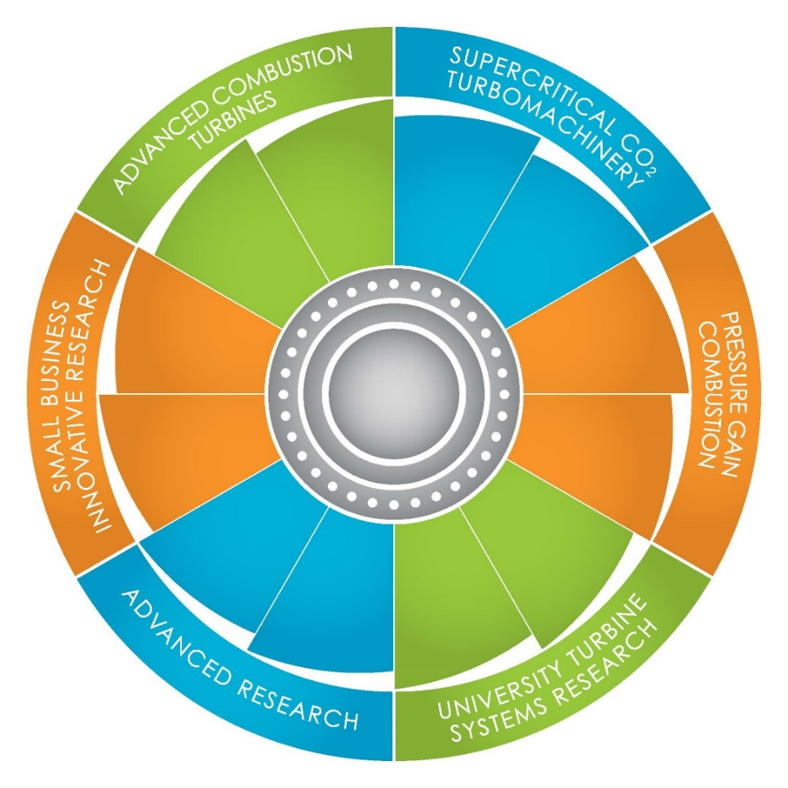
Presentation Outline
US DOE Advanced Turbines Program Overview
DOE FE & NETL Overview
Energy Snap Shot
Program Status
Opportunities
Summary / Q&A

Slide 3
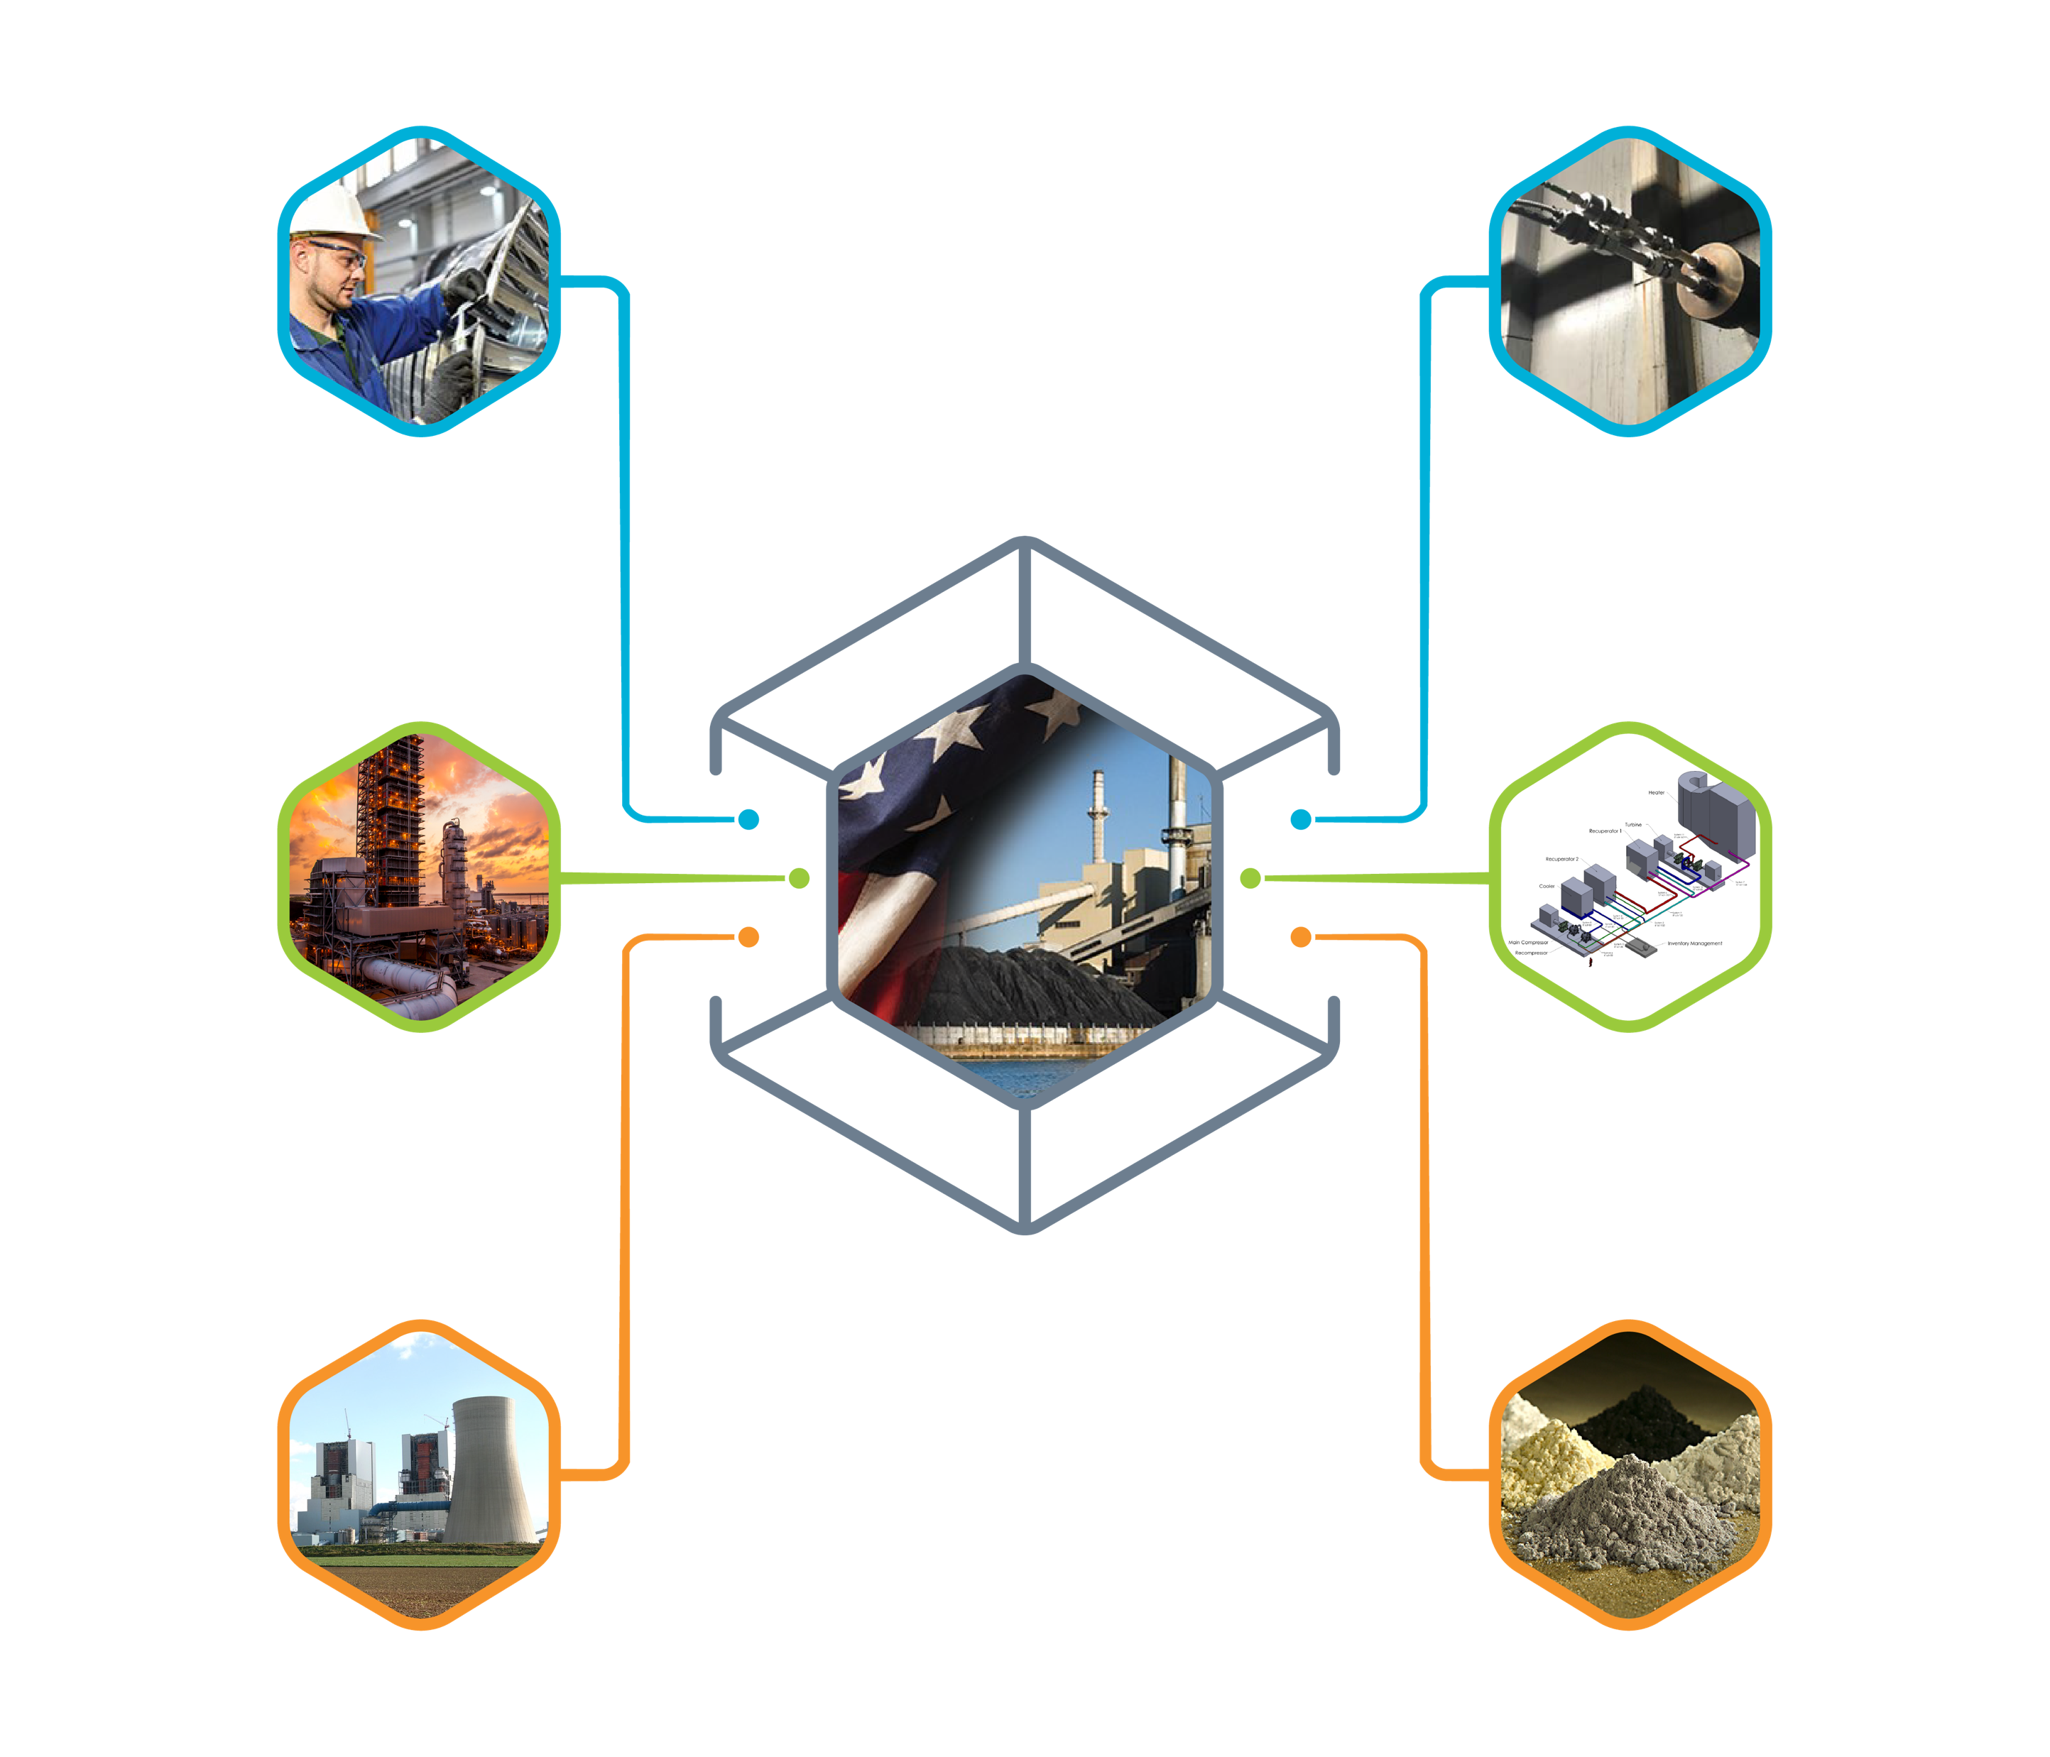
Coal Technology Thrusts
Advanced Turbines Program an element of AES
Advanced Energy Systems
Crosscutting Research
Developing & deploying advanced, more efficient, & robust coal-based power technologies to optimize the use of our abundant domestic fossil energy resources & leverage existing infrastructure.
Accelerating science & engineering-based solutions across multiple operational platforms to optimize plant performance, reduce O&M costs & water consumption, & develop the next-generation of structural & functional materials.
Carbon Capture, Utilization,
& Storage
STEP (Supercritical CO₂)
Developing & modeling sCO₂ power cycles with the potential to achieve efficiencies greater than 50%, with broad applicability to fossil, nuclear, waste-heat, & concentrated solar energy power systems
Advancing technologies & techniques to effectively capture, safely store, & economically utilize CO₂ derived from power generation & other industrial processes.
Transformational Coal Pilots
Rare Earth Elements
Developing pilot-scale transformational coal technologies aimed at enabling step-change improvements in coal-powered systems accelerating their readiness for the marketplace.
Developing novel extraction, processing, & manufacturing technologies to produce a cost-competitive domestic supply of rare earth elements from U.S. coal & coal by-products to sustain our Nation’s robust economy.

Slide 4
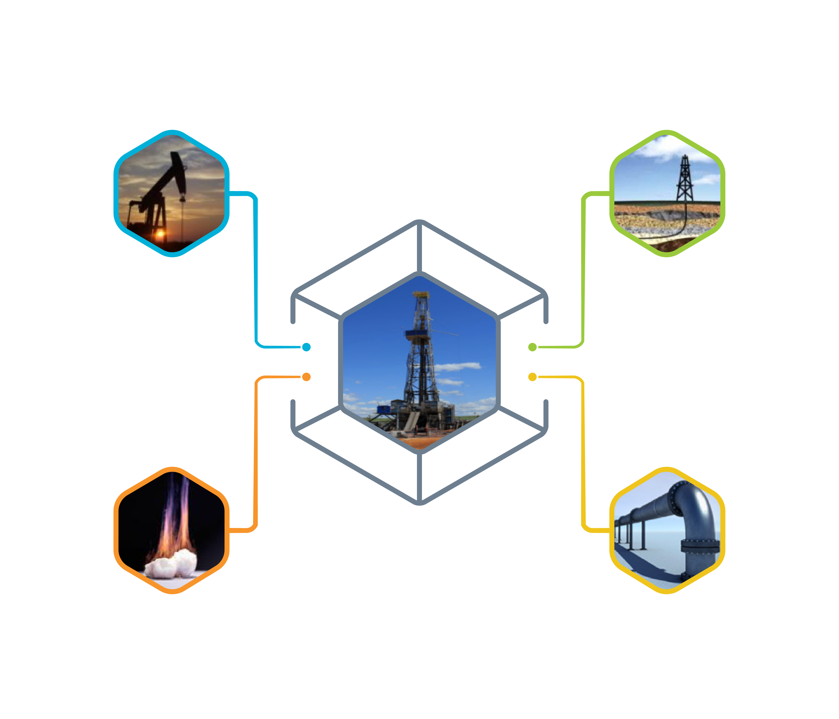
Oil & Gas Technology Thrusts
Onshore Unconventional
Offshore
Developing technologies to maximize resource recovery and reduce operational impacts in unconventional oil & gas plays.
Minimizing the environmental impacts of deepwater and ultra-deepwater oil & gas production.
Gas Hydrates
Natural Gas Infrastructure
Characterizing gas hydrate resources and developing ways to tap their massive energy potential.
Developing technologies and practices to assess and mitigate methane emissions from natural gas transmission, distribution, and storage facilities.

Slide 5
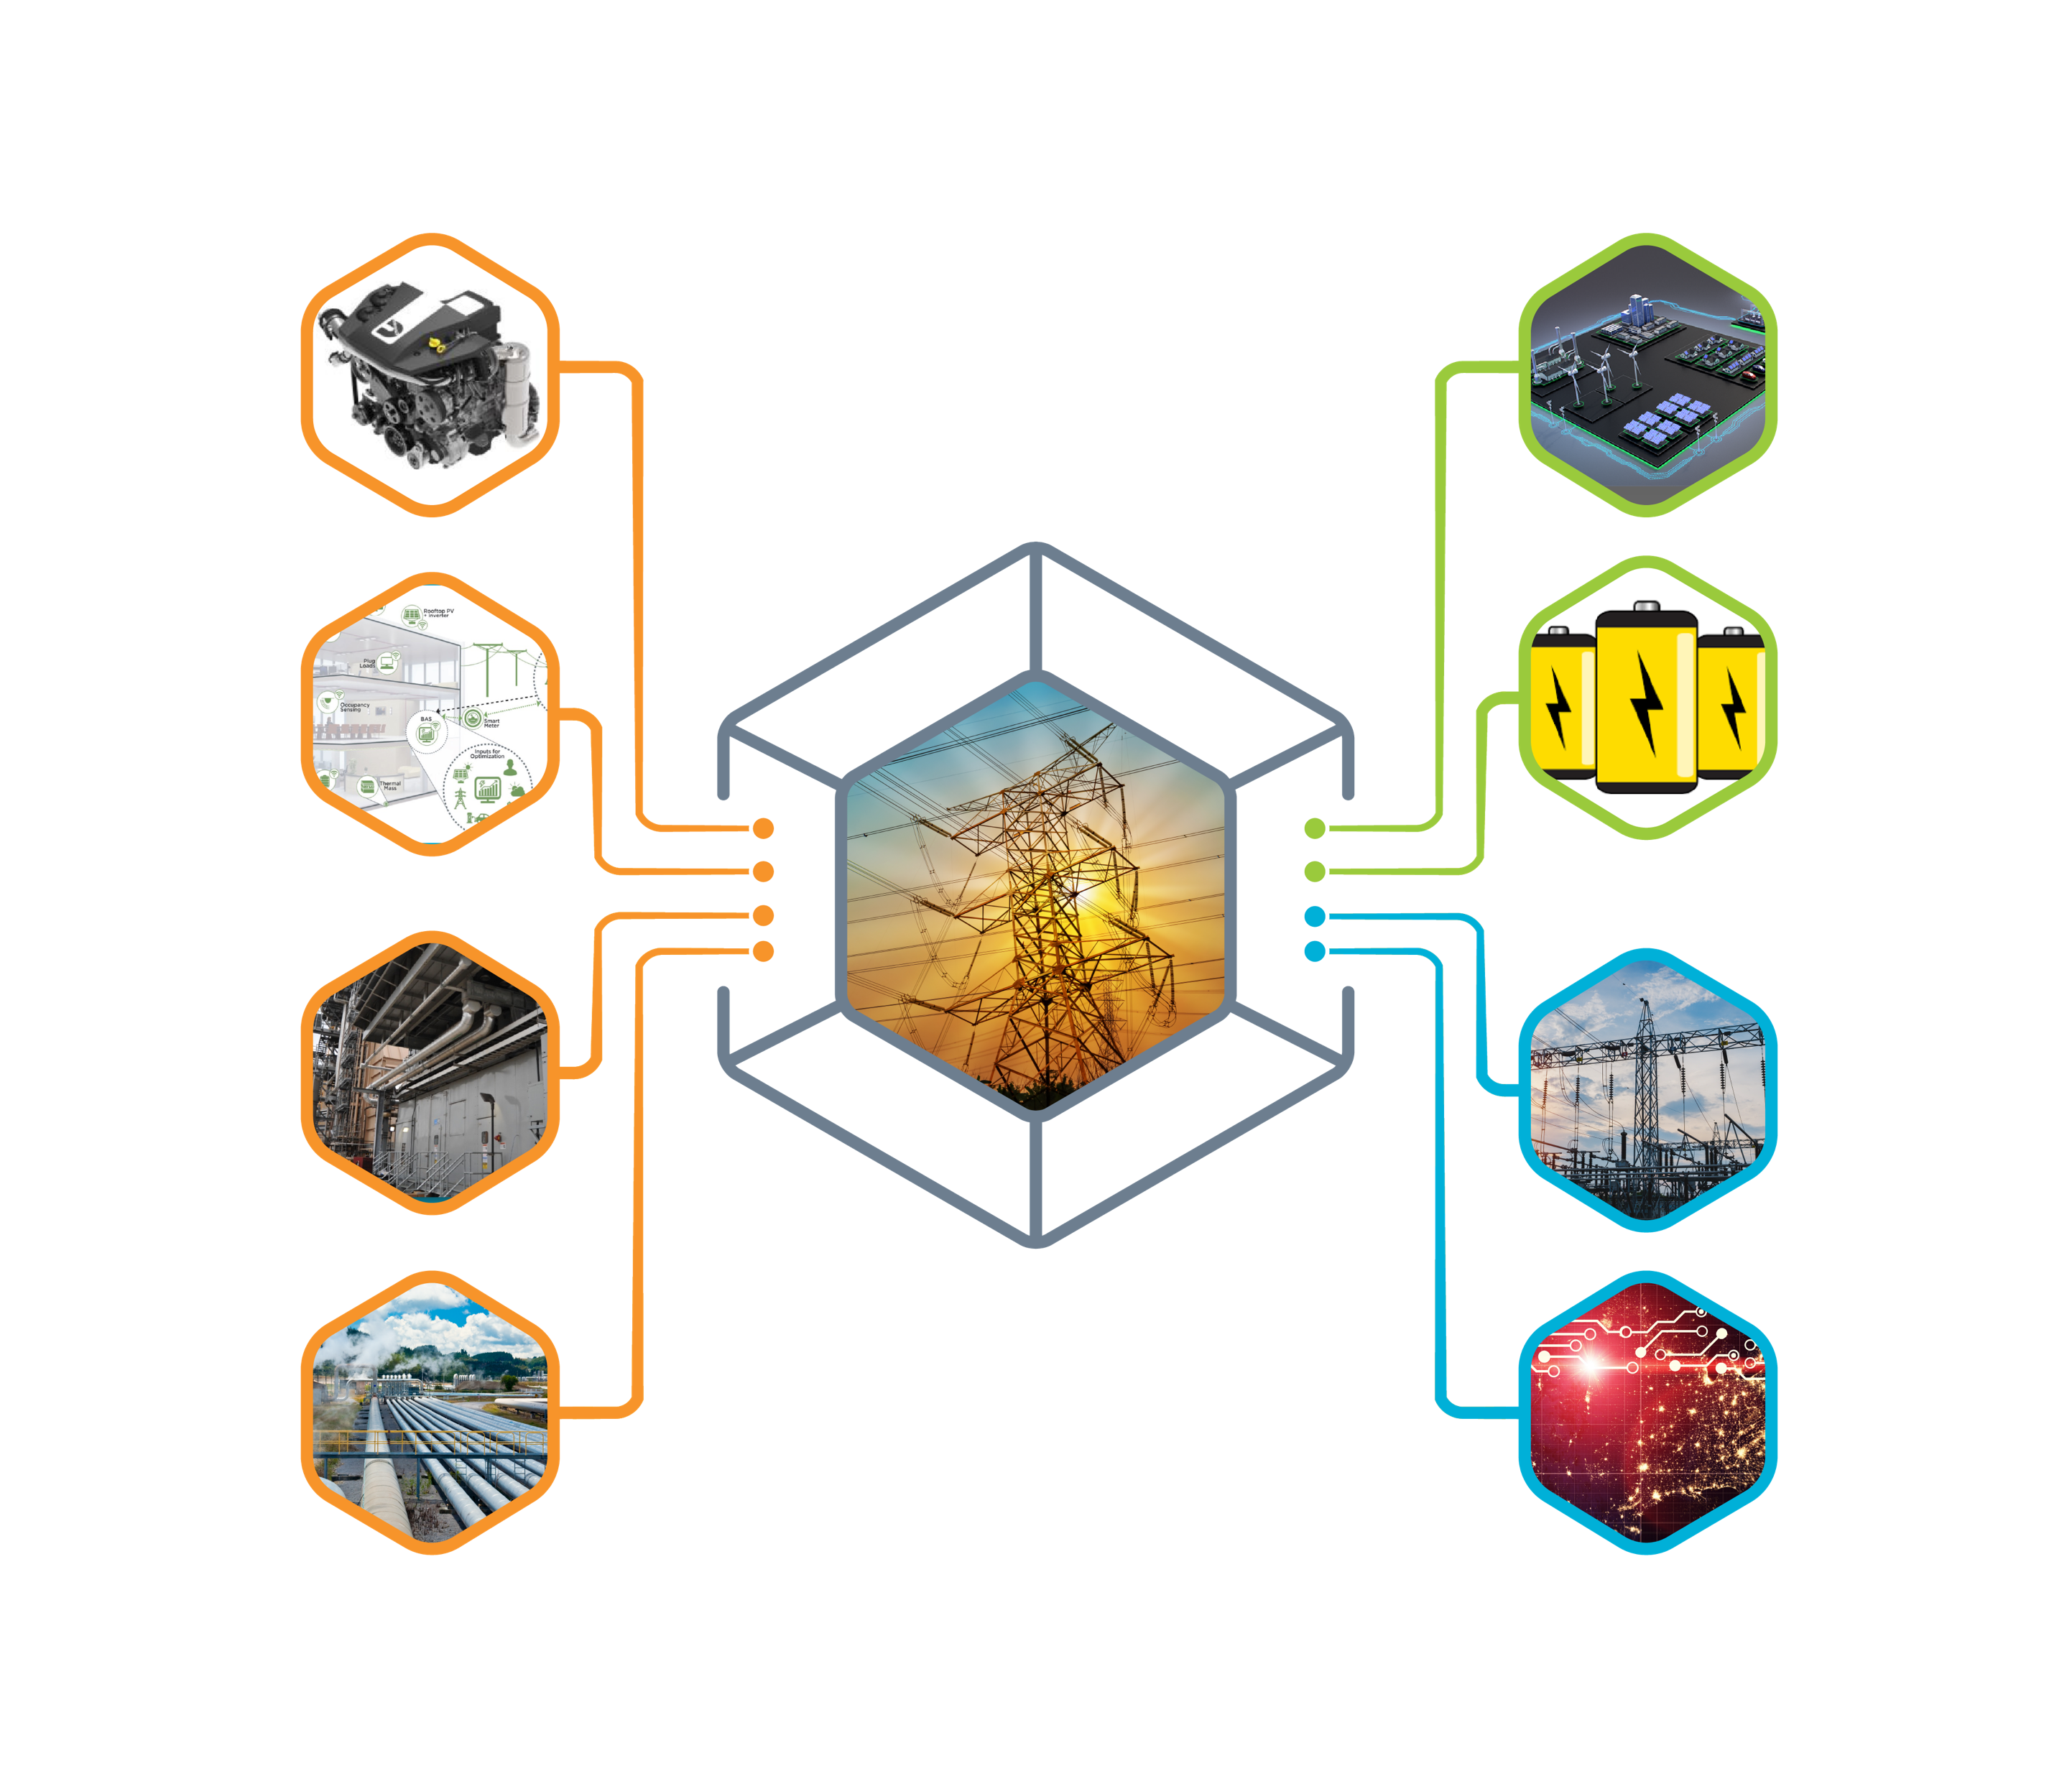
EERE, OE and CESER Technology Thrusts
ENERGY EFFICIENCY & RENEWABLE ENERGY (EERE)
OFFICE OF ELECTRICITY (OE)
Vehicle Technologies
Advanced Grid R&D
Transmission Permitting and Technical Assistance
Building Technologies
CYBERSECURITY, ENERGY SECURITY, AND EMERGENCY RESPONSE (CESER)
Advanced Manufacturing (Combined Heat & Power)
Infrastructure Security & Energy Restoration
Geothermal Technologies
Cybersecurity for Energy Delivery Systems
Helping to Implement DOE & Gov’t Programs for 25+ Years
Technical, Admin., Project Management Support
Implementation Mechanisms
Office Construction Management
Environmental Management
Legacy Management
Dept of Homeland Security
Dept of Defense
Documented Procedures and Policies
Disciplined Process w/Tracking
Acquisition (contracts)
Financial Assistance (can only be awarded by Federal personnel)

Slide 6
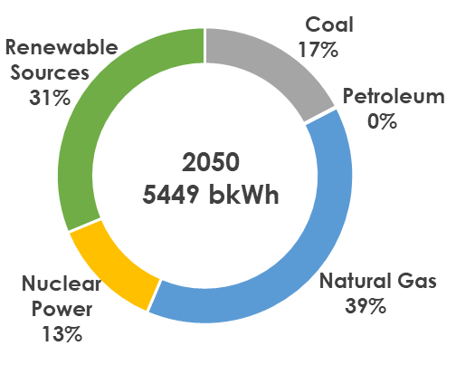
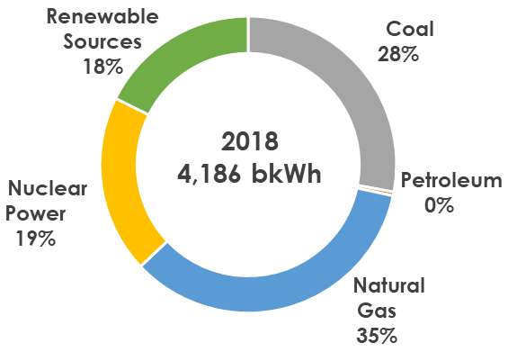
US Electricity Generation by Fuel
+ 1,264 bkWh
NG generation increases by 47% from 2018 to 2050
Renewable electricity generation experiences the largest growth of 962 bkWh followed by NG generation at 677 bkWh
EIA 2019 AEO Reference Case

Slide 7
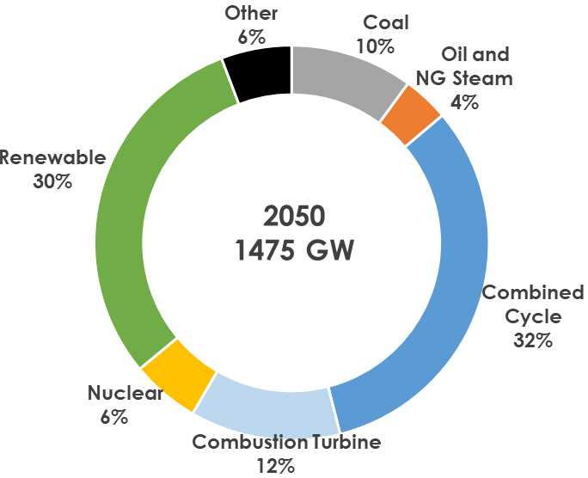
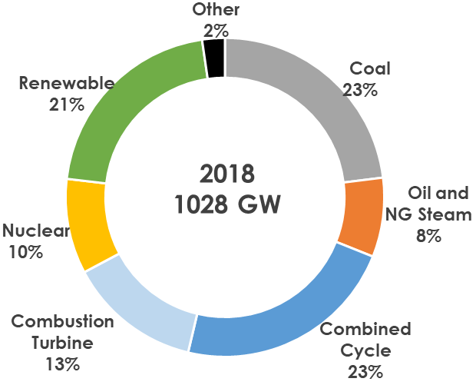
US Electricity Net Generating Capacity
+ 447 GW*
CC & CT have net capacity addition of 285 GW
NG fired plants account for 71% of capacity additions
EIA 2019 AEO Reference Case
* Net increase includes additions and retirements

Slide 8
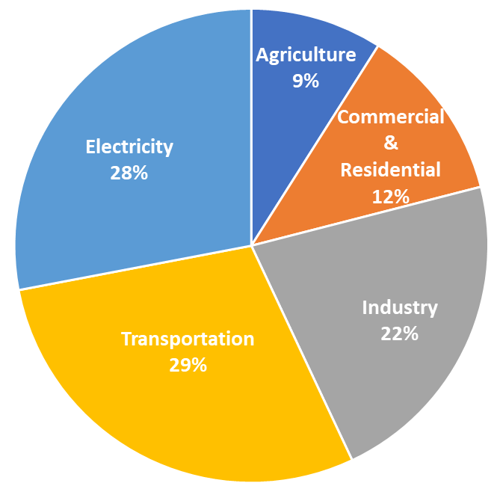
US Greenhouse Gas Emissions
By sector
2017 US Greenhouse Gas Emissions (6,456.7 MM tons CO₂ eqv.)
https://www.epa.gov/ghgemissions/inventory-us-greenhouse-gas-emissions-and-sinks
US, in 2017;
In 2017, U.S. greenhouse gas emissions totaled 6,456.7 million metric tons of carbon dioxide equivalents

Slide 9
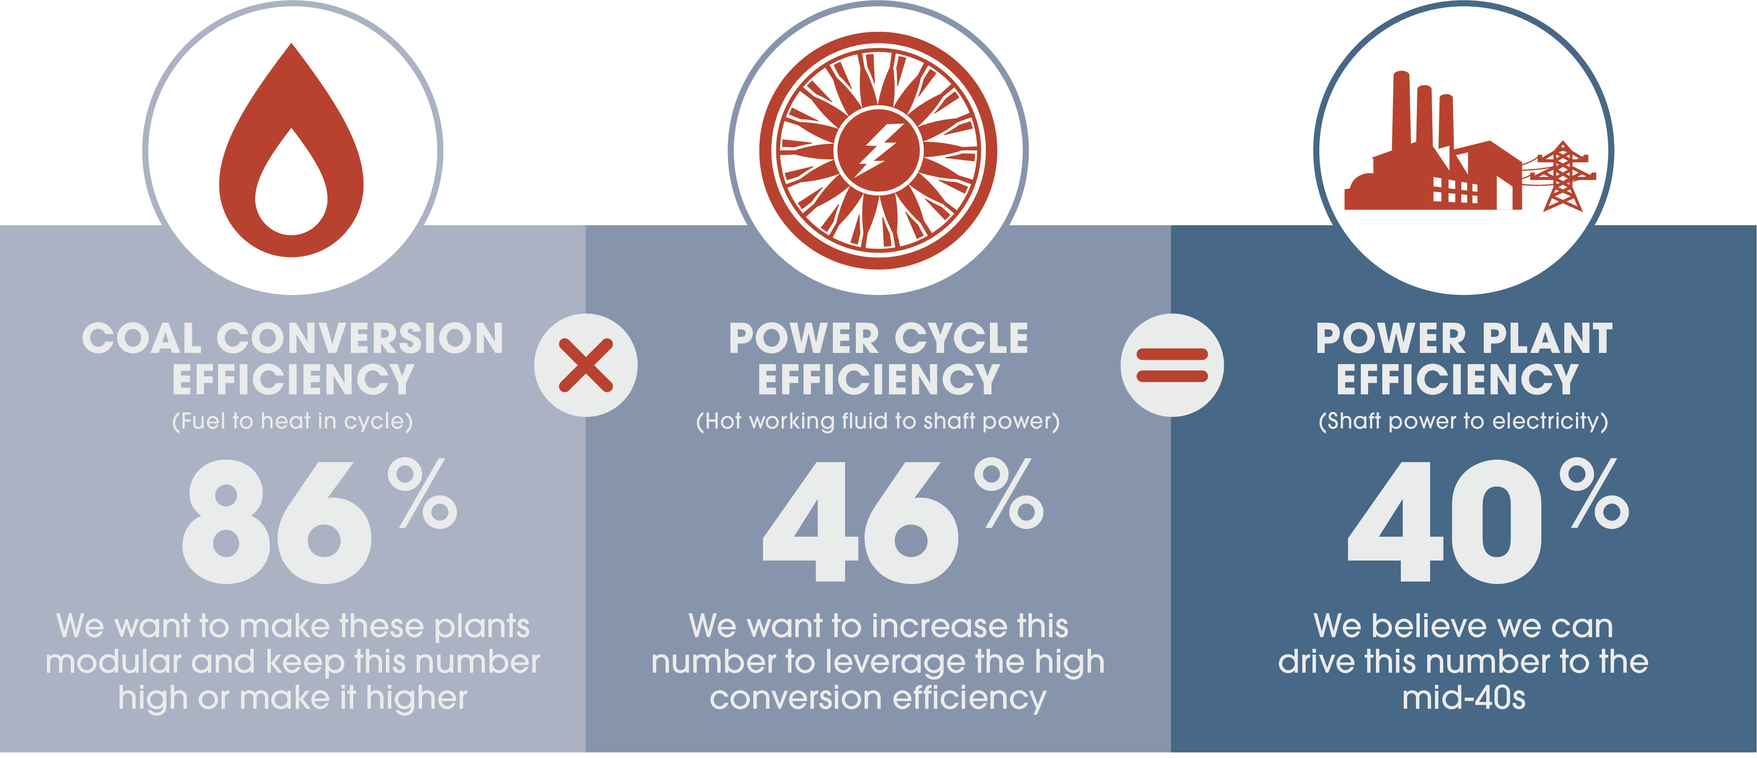
Approach to Modular Power Plant Efficiency
~
~
~
Number values are notional for discussion purposes

Slide 10
Carbon Capture and Storage Value Chain
Capture (73%)
Compression (11%)
Transportation (3%)
Storage (8%)
Monitoring (5%)
Net Power Output (MWe) | 650 | 650
TOC ($/kW) | 2,099 | 3,800
LCOE ($/MWh) | 64.4 | 114.3
Nominal CO₂ Capture (%) | 0 | 90%
CO₂ capture cost ($/ton) | 0 | 60
Nominal 650MWe Supercritical PC with Single Reheat (3,500 psig/1,100°F /1,100°F) w/o & w/ capture with Cansolv
Source: NETL, Cost and Performance Baseline for Fossil Energy Plants, Revision 3, July 2015

Slide 11
Advanced Turbines Program
Focused Research in Key Technology Areas
Advanced Combustion Turbines
CC efficiency -65% (LHV, NG benchmark, turbine inlet temperature (TIT) of 3,100°F
Syngas, NG, H2 Fuels (IGCC, NGCC)
Pressure Gain Combustion
Alternate pathway to high efficiency
TRL 2~3 (higher risk, long term, high pay back)
Supercritical CO2 Turbomachinery
sCO₂ turbines for indirect and direct applications
Oxy-combustion
Modular Turbine Based Hybrid Heat Engines
Supporting modular coal systems and stranded gas assets
Steam Turbines
Additive manufacturing technologies for maintenance, repair, and upgrading

Slide 12
FY 2019 UTSR FOA Successful Applicants
Pressure Gain Combustion
University of Michigan - Pressure Gain, Stability, and Operability of Methane/Syngas Based RDEs Under Steady and Transient Conditions
Adv. Materials Develop. for Hot Gas Path Turbine
PSU - Develop. of Additive Mfg. for Ceramic Matrix Composite Vanes
AZ State University – A Multiphysics Simulation Platform for Damage, Environmental Degradation, & Life Prediction of CMCs in Extreme Env.
Adv. Mfg. Develop. for Hot Gas Path Turbine
University of Texas at Austin - Integrated Turbine Component Cooling Designs Facilitated by Additive Manufacturing and Optimization
University of Pittsburgh - An Effective Quality Assurance Method for Additively Manufactured Gas Turbine Metallic Components via Machine Learning

Slide 13
FY 2019 UTSR (Cont.) and Steam Turbine FOAs Successful Applicants
sCO₂ Power Cycle Development
GA Tech - Advanced Model Development for LES of Oxy-Combustion and Supercritical Carbon Dioxide Power Cycles
FE Power Generation with Large-Scale Energy Storage
WVU - Techno-Economic Optimization of Advanced Energy Plants with Integrated Thermal, Mechanical, and Electro-Chemical Storage
FY 2019 Steam Turbine FOA
GE Research - Improve Performance and Cost for Steam Turbine Maintenance, Repair, and Overhaul Using Additive Manufacturing
Siemens - Ensemble Manufacturing Techniques for Steam Turbine Components Across Length Scales

Slide 14
2018 AT FOA Phase I Awards
3 Areas of Interest (AOI) - Ph II selection in FY20
Advanced Combustion Turbines
Hot section R&D
Advanced Mfg, Cooling, materials
GE, Siemens, UTRC
Oxy-fuel SCO2 Turbines
Oxy-fuel Comb. Turbines
SwRI
Modular Hybrid Heat Engines
Supporting high eff. Low Capex
Bechtel, Echogen, GTI, GE, SwRI
Closing the gap on 65 % CC
FE options for low CO₂
Modular power cycles
Supports coal FIRST

Slide 15
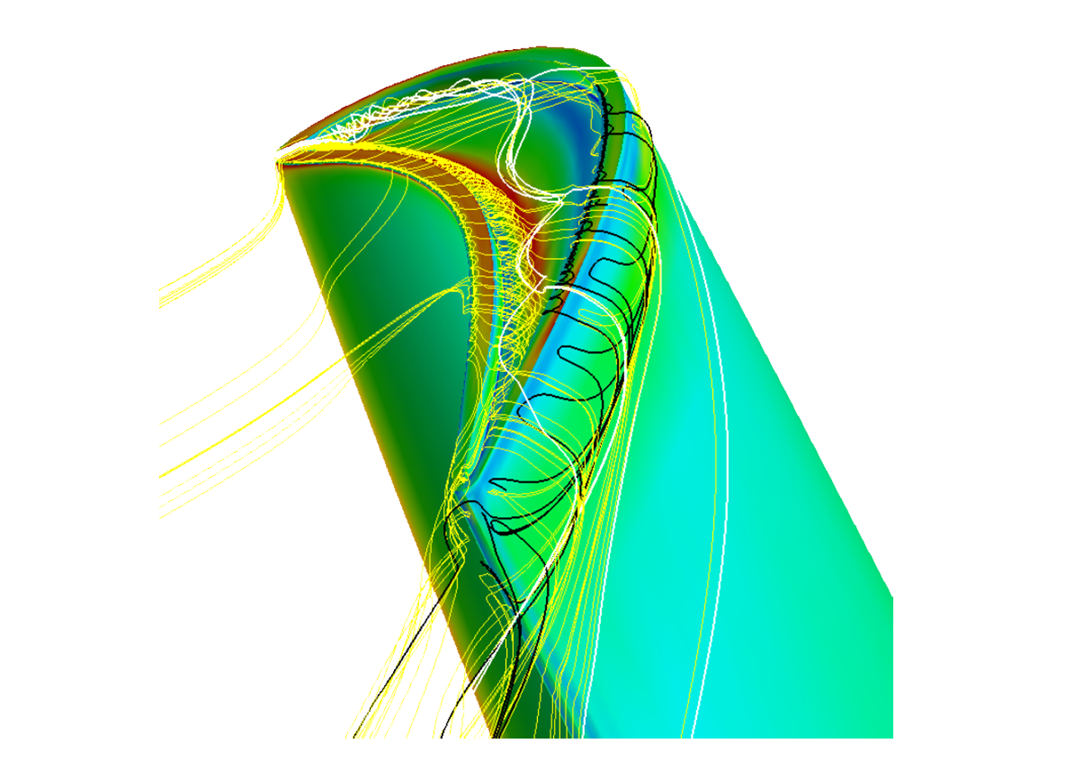
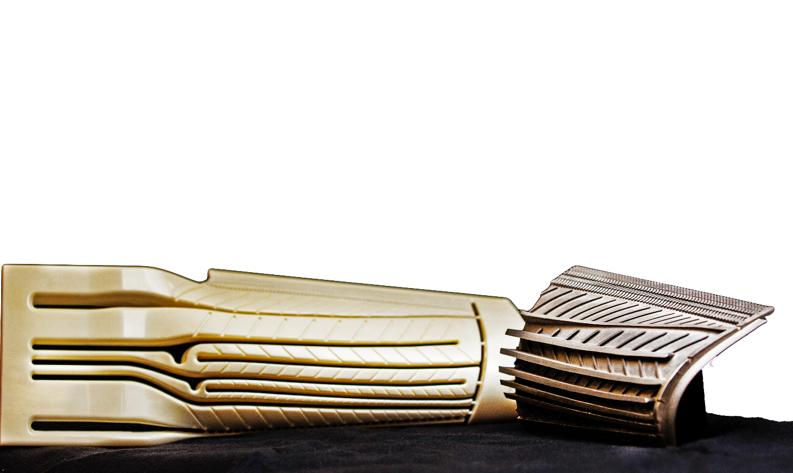
Opportunities
Gas Turbine Hot Section
Pressure Gain Combustion
Supercritical CO₂ Power Cycles
Modular Power Cycles
H₂ as a Carbon Neutral Fuel
Energy Storage
Artificial Intelligence & Machine Learning
Next Generation Materials
Advanced Manufacturing

Slide 16
Program Awareness
Export control
Open access publishing
Power cycle support to Coal FIRST
START Rig platform for UTSR R&D

Slide 17
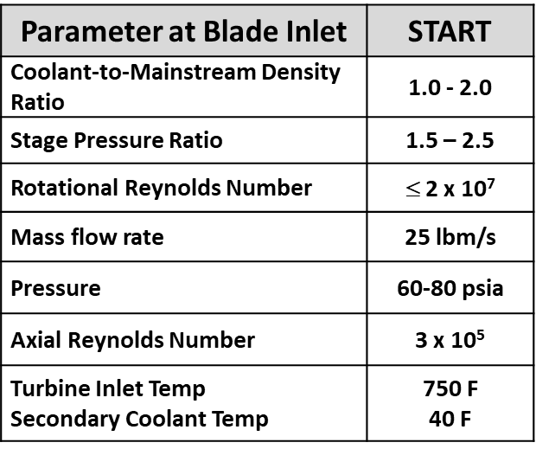
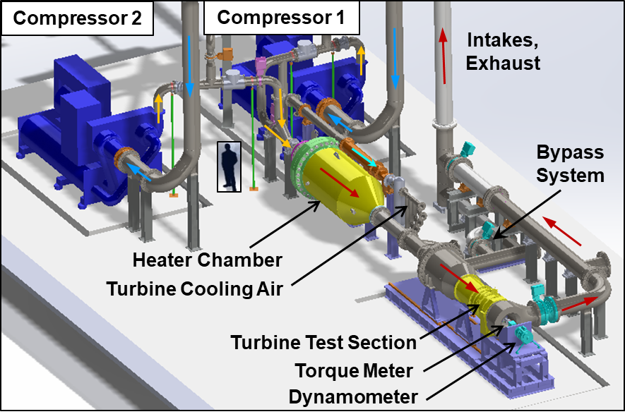
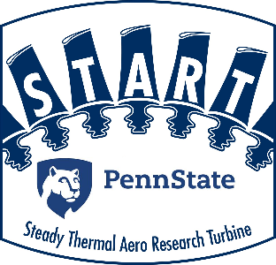
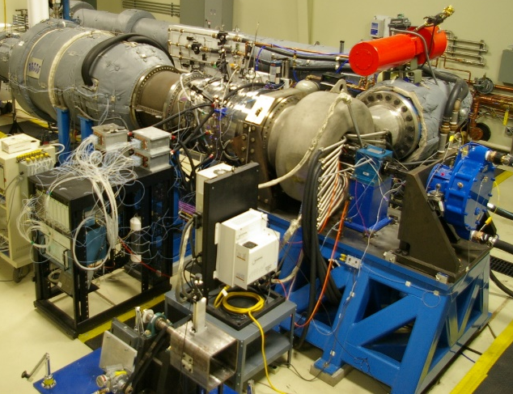
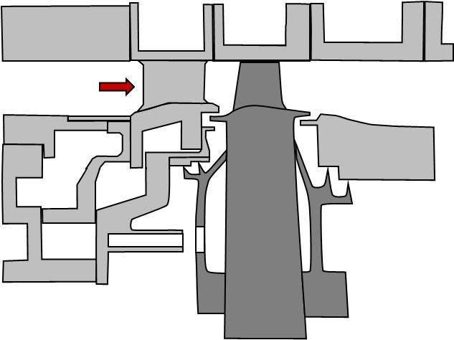
START Facility As a Platform for UTSR Research
Features
Steady operation
Transient simulations
Mag bearing for eccentricity
Add. mfg. for sensor integration
Instrumentation
Heat flux gages
Thermal imaging
Blade tip sensors
Fast-responding pressure
Species sensing for cavities
One Stage Turbine

Slide 18
Upcoming Events
TURBO EXPO
Turbomachinery Technical Conference & Exposition
Presented by the ASME International Gas Turbine Institute
AMRGT
Advanced Manufacturing & Repair for Gas Turbines
Improving Gas Turbine Design and Repair Through Advanced Manufacturing
CONFERENCE June 22 - 26, 2020
CONFERENCE March 3 - 4, 2020
ExCeL London Convention Center, London, England
EPRI Conference Center in Charlotte, North Carolina
Supercritical CO₂ Power Cycles Symposium
2020 UNIVERSITY TURBINE SYSTEMS RESEARCH WORKSHOP
November 2020
State College, PA
7th International sCO₂ Power Cycles Symposium
CONFERENCE March 30 – April 2, 2020
Hilton Palacio Del Rio, San Antonio, Texas

Slide 19
Summary and Q&A
US DOE Advanced Turbines Program Overview
DOE FE & NETL Overview
Energy Snap Shot
Program Status
Opportunities

Slide 20
Thank You!
VISIT US AT: www.NETL.DOE.gov
@NETL_DOE
@NETL_DOE
@NationalEnergyTechnologyLaboratory

