Slide 1
Advanced Materials Issues for Supercritical CO₂ Cycles FEAA123 (2016 – 2018)
Bruce Pint
Corrosion Science & Technology Group
Materials Science and Technology Division
Oak Ridge National Laboratory
Oak Ridge, TN 37831-6156 USA
Presentation for 2019 Crosscutting Research Project Review Meeting
April 9, 2019

Slide 2
Acknowledgments
J. Keiser, M. Howell, M. Stephens — oxidation experiments
T. Lowe — SEM, image analysis
T. Jordan — metallography
K. Unocic — TEM
Special thanks for alloys:
Haynes International
Special Metals
ATI
Sandvik
Capstone Turbine

Slide 3
Project is studying materials issues relevant to direct-fired supercritical CO₂ cycles
Goals and Objectives
Address materials issues for scaling up direct-fired sCO₂ Brayton cycles to higher temperatures for increased efficiency and larger size for commercial power generation
Milestones
FY16
Data analysis on effect of temperature on reaction rates (6/16, complete)
1 and 25 bar testing at three different impurity levels (8/17, complete)
Complete construction of test rig capable of studying impurity effects in sCO2 (9/17, complete)
FY17
Complete analysis of reaction products as a function of temperature, pressure, etc. (12/17, complete)
Complete 500h exposures at three different impurity levels in 300 bar sCO₂ (2/18, complete)
Complete 2,500 h of cumulative exposure in sCO₂ with a high H₂O content (6/18, complete)
FY18
Compare 2,500 h sCO₂ reaction products formed with and without O₂ and H₂O (9/18, complete)
Complete 5,000h with a high H₂O content to quantify reaction rate effects (12/18, complete)
Complete a time series of 25°C tensile properties at 750°C/300 bar w/o impurities (12/18, complete)

Slide 4
Supercritical CO₂ Allam cycle: first clean fossil energy?
NetPower 25MWe demo plant (Texas)
Exelon, Toshiba, CB&I, 8Rivers Capital: $140m
Material challenges:
Combustor: 1150°C (!?!)
Turbine exit: 750°C/300 bar
Combustion impurities: O₂, H₂O, SO₂
May 2018: announced first firing
Moving forward with limited compatibility data!
As audacious as Eddystone in 1960

Slide 5
Fossil/Solar focus on >700°C for high efficiency sCO₂
sCO₂ applications
>700°C: favors precipitation-strengthened Ni-based alloys
740/282 above 700°C
Low critical point (31°C/7.4 MPa)
High, liquid-like density
Flexible, small turbomachinery
Feher, 1965
50% sCO₂ eff @ >720°C

Slide 6
Indirect- vs. direct-fired sCO₂ systems (i.e. closed vs. open)
Closed cycle:
“pure” CO₂ 100-300 bar
Open cycle:
sCO₂ + impurities (O₂,H₂O…)
DOE SunShot funding
DOE Fossil Energy funding

Slide 7
Two sCO₂ projects completing at ORNL
DOE Fossil Energy (2015-2018)
DOE SunShot (CSP) (2015-2018)
750°C/300 bar: 500-h cycles
Focus on impurity effects for direct-fire
Baseline research grade (RG) CO₂
New autoclave with controlled O₂+H₂O
Alloys
310HCbN (HR3C, Fe-base SS)
617
230
247 (Al₂O₃-forming superalloy)
282 (Heat #1)
740
750°C/300 bar: 500-h cycles
Including 750°C/1 bar, 10-h cycles
Focus on industrial grade (IG) CO₂
Indirect fired (closed loop)
Alloys
Alloy 25 (Fe-base SS Sanicro 25)
625
740
282 (Heat #2)
FE/CSP
FE
CSP
FE
 | Air | RG CO₂ | IG CO₂ | FE: CO₂+O₂/H₂O
1 bar | 5,000 h | 5,000 h | 5,000 h | –––
300 bar | ––– | 5,000 h | 5,000 h | 5,000 h
Cooperative test matrix:

Slide 8
Thermodynamics: Oxygen levels similar in steam/CO₂ Concern about high C activity at m-o interface
2CO(g) = C(s) + CO₂(g) CO₂(g) = 0.5O₂ + CO(g)
Factsage calculations
High carbon activity at P_{total} = 1 bar
What is P_{interface}?

Slide 9
Range of alloys have been evaluated
 | Ni | Cr | Fe | Co | Refractories | Ti | Al | S | Other
Grade 91 | 0.1 | 8.3 | 90 | 0.01 | 0.9Mo,0.1Nb | <0.01 | <0.01 | 10 | 0.03Cu,0.3Mn,0.1Si,0.3V
304H | 8.4 | 18 | 70 | 0.1 | 0.3Mo,0.01Nb | <0.01 | <0.01 | 29 | 0.4Cu,1.6Mn,0.3Si,0.07N
25 | 25 | 22 | 43 | 1.5 | 3.5W,.5Nb,.2Mo | 0.02 | 0.03 | 8 | 3.0Cu, 0.5Mn, 0.2Si, 0.2N
310HCbN | 20 | 25 | 51 | 0.3 | 0.1Mo,0.4Nb | 0.01 | <0.01 | <10 | 0.1Cu,1.2Mn,0.3Si,0.3N
230 | 61 | 23 | 2 | 0.1 | 1Mo, 12W | 0.01 | 0.3 | 9 | 0.02La
625 | 61 | 22 | 4 | 0.1 | 9Mo, 4Nb | 0.2 | 0.1 | <10 | 0.2Si,0.1Mn,0.02C
617 | 54 | 22 | 1 | 13 | 9Mo, 1Nb | 0.3 | 1.1 | <3
740 | 48 | 23 | 2 | 20 | 0.3Mo, 2Nb | 2.0 | 0.8 | <10 | 0.5Si,0.3Mn,0.03C
282 | 58 | 19 | 0.2 | 10 | 8Mo | 2.2 | 1.5 | <1 | 0.1Si,0.1Mn,0.06C
247 | 60 | 8 | 0.03 | 10 | 10W,3Ta,1Mo | 1.1 | 5.3 | <1 | 1.3Hf,0.14C
Compositions measured using ICP-OES and combustion analyses

Slide 10
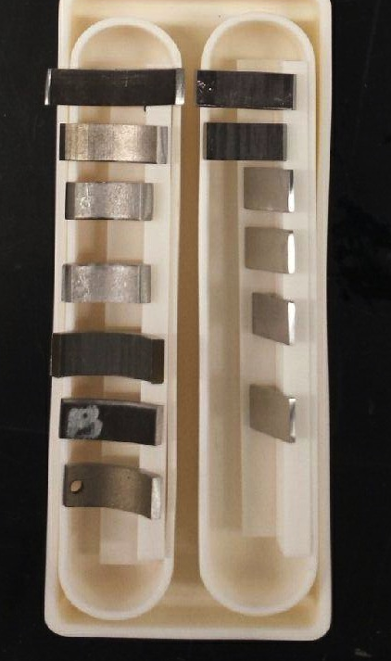
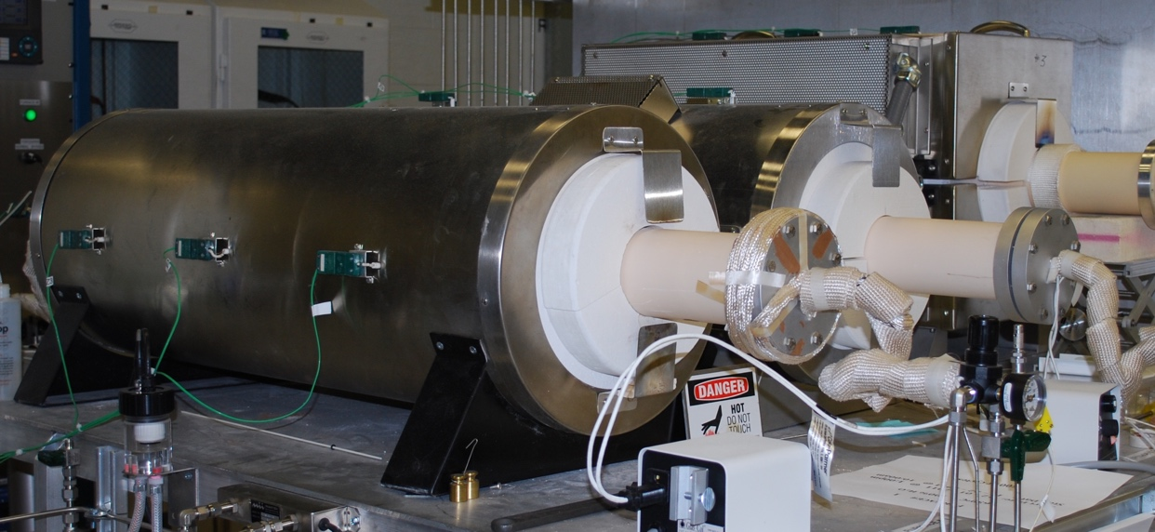
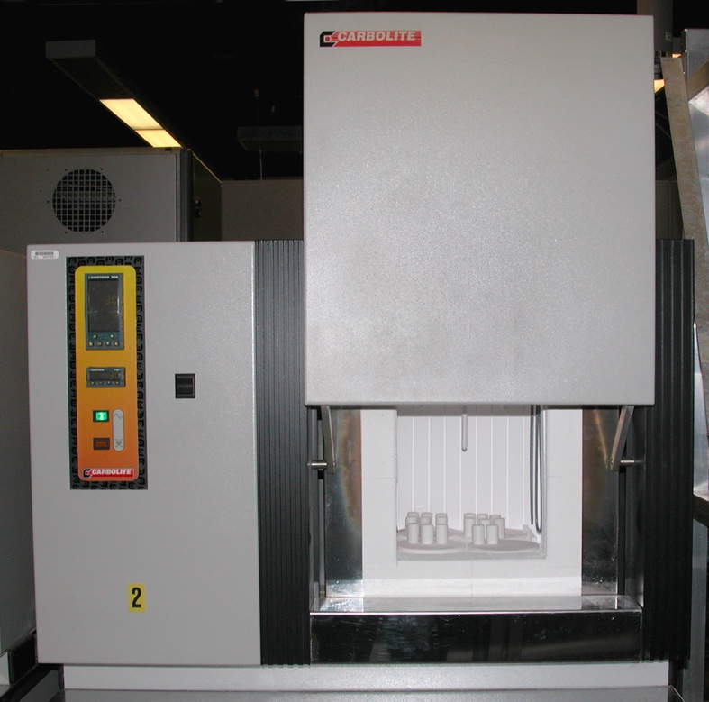
CO₂ compatibility evaluated several ways at 700°-800°C
Autoclave: 300 bar sCO₂
500-h cycles
Tube furnace: 1 bar CO₂
500-h cycles
Previously:
”Keiser” rig:
500-h cycles, 1-43 bar CO₂
Same cycle frequency as autoclave
Baseline:
Box furnace:
Lab. Air
500-h cycles
Correct temperature and pressure
Study impurities at 1-43 bar
4-5 cm² alloy coupons
Baseline of research grade (RG) CO₂: ≤ 5 ppm H₂O and ≤ 5 ppm O₂
industrial grade (IG) CO₂: 18±16 ppm H₂O and ≤ 32 ppm O₂

Slide 11
Impurities (2015): 1atm, many alloys (1 of each)
700°C
800°C

Slide 12
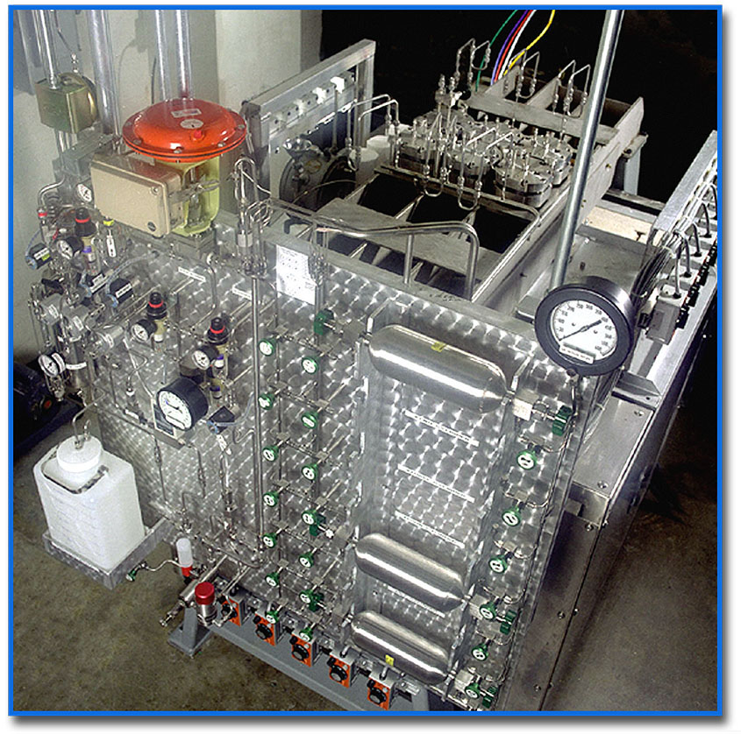
Impurities (2017): fewer alloys (3 of each), 1 and 25 bar
Two alloy 230 reaction tubes:
Pressure: 1 and 25 bar
Gas: RG CO₂
CO₂+10%H₂O
CO₂+10%H₂O+0.1%SO₂
304H
230
282
247
(Al₂O₃-fomer)
Pint, Brese, Keiser, NACE Corrosion 2018 C2018-11199

Slide 13
CSP: completed 10,000 h exposures for lifetime model
Quantification of scale thickness in three environments:
500-h cycles: three different environments
Extrapolation sCO₂ to 100,000 h
Pint, Keiser, NACE Corrosion 2019 C2019-12750

Slide 14
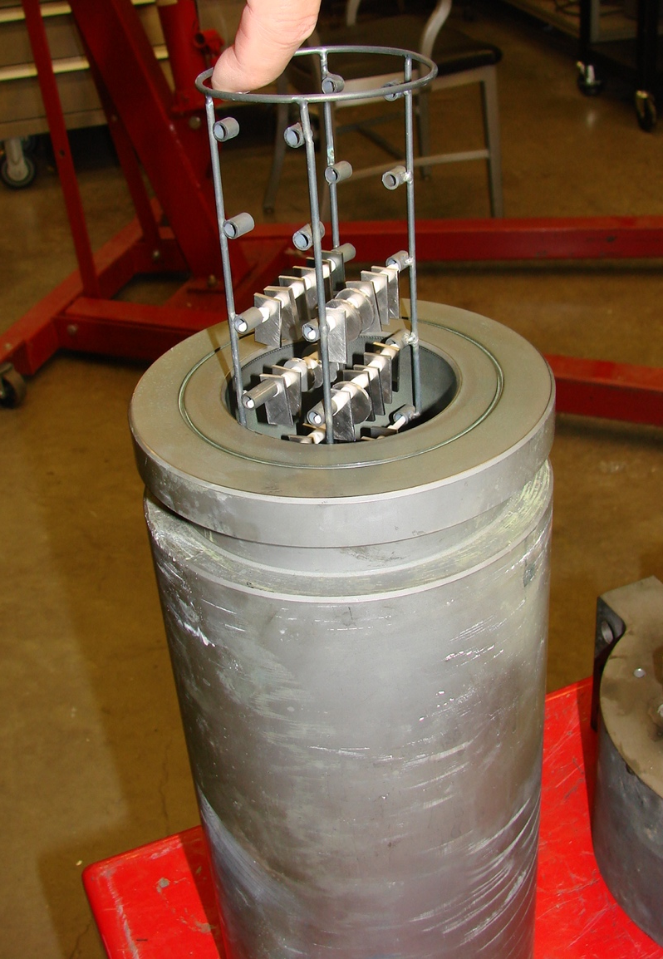
2016-2017: baseline performance in RG and IG sCO2
Sanicro 25
Fe-22Cr-25Ni
Similar mass gain in RG & IG sCO₂
Research grade (RG) CO₂: ≤ 5 ppm H₂O and ≤ 5 ppm O₂
Industrial grade (IG) CO₂: 18±16 ppm H₂O and ≤ 32 ppm O₂

Slide 15
2018: finally completed multi-pump 300 bar autoclave Clearly see an effect of impurities
Sanicro 25
Fe-22Cr-25Ni
Lower mass gain in IG sCO₂
Goal: 1%O₂+0.25%H₂O
(industry suggestion)
Not easy to control at 300 bar
Industrial grade (IG) CO₂: 18±16 ppm H₂O and ≤ 32 ppm O₂

Slide 16
Summary: impurities caused a higher mass gain
RG CO₂ + 1%O₂ + 0.25% H₂O

Slide 17
Metallography consistent with mass change

Slide 18
Fe-based alloys: strongest effect

Slide 19
SEM/EDS: Fe/Ni-rich oxide forming with impurities
1000 h at 750°C, 300 bar sCO₂+1%O₂+0.25%H₂O

Slide 20
GDOES: very different oxide forming on 25: (Fe-22Cr-25Ni)
RG sCO₂
sCO₂+1%O₂+0.25%H₂O
1000 h at 750°C, 300 bar
Glow discharge optical emission spectroscopy

Slide 21
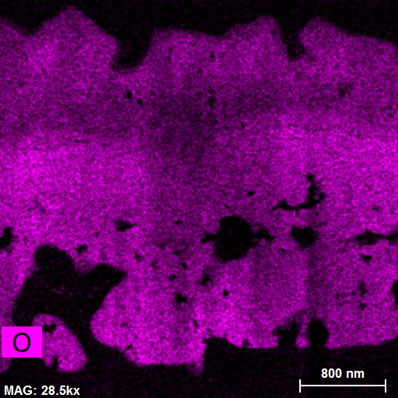
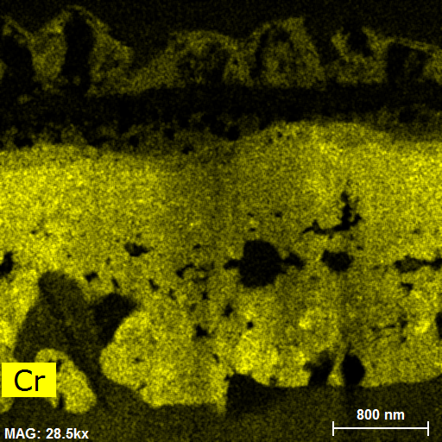
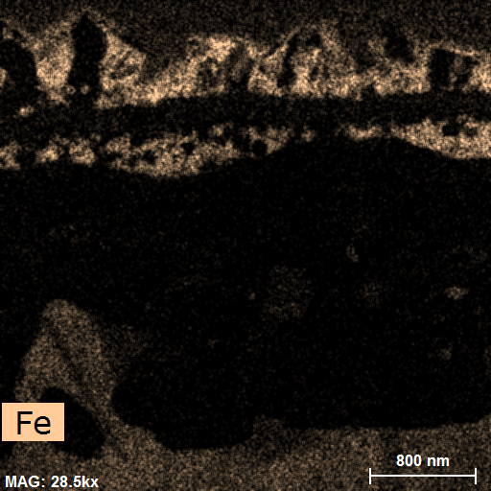
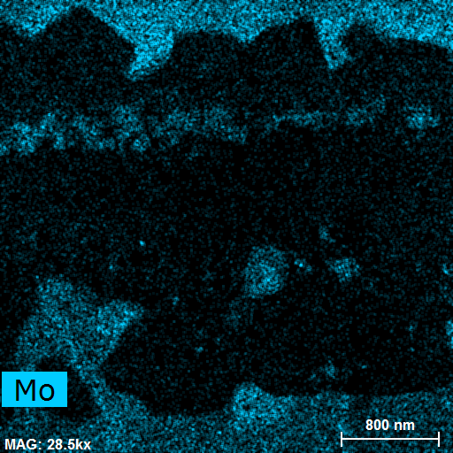
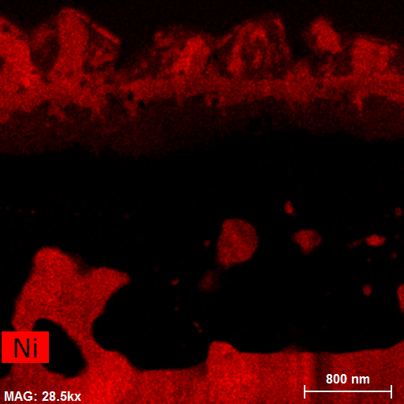
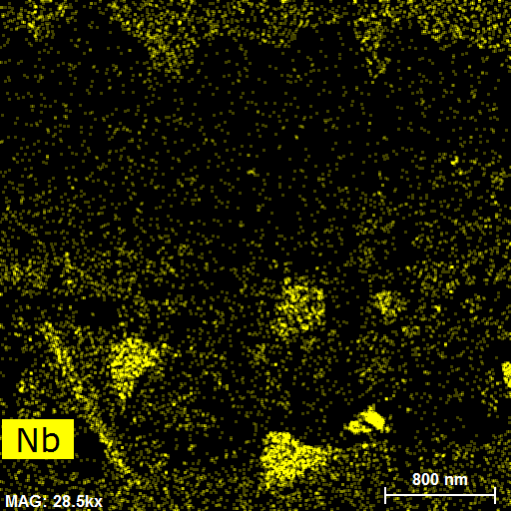
625 (NiCr) 1000h STEM: unusually thick Cr-rich oxide layer
STEM annular dark field image
Scanning transmission electron microscopy
Scale thickness 3.70±44µm
1000 h at 750°C, 300 bar sCO₂+1%O₂+0.25%H₂O

Slide 22
Measuring 25°C tensile properties suggests future strategy: Post 750°C exposure shows drop in ductility Method to quantify degradation of steels at 450°-650°C (?)
Yield strength
Elongation:
25mm
dogbone
304H: large drop in sCO₂
310: also degrading, w/o impurities
Pint, et al., Materials and Corrosion, 2019, on-line

Slide 23
Project is concluding having achieved its goals
Developed new experimental equipment for studying impurity effects on structural materials at up to 750°C/300 bar
Results indicate that there is a negative effect of impurities, more so for Fe-based alloys than Ni-based alloys
Room temperature tensile data suggests a simple route to quantify sCO₂ impact on mechanical properties of steels exposed at lower temperatures
Industrial collaborations
All major US alloy manufacturers
Conference calls conducted with HX, sCO₂ community (CSP project)
Feedback from 8 Rivers/NetPower on impurity levels of interest
Public presentations (TMS, MS&T, EFC workshop, NACE, EU sCO₂)

Slide 24
Backups

Slide 25
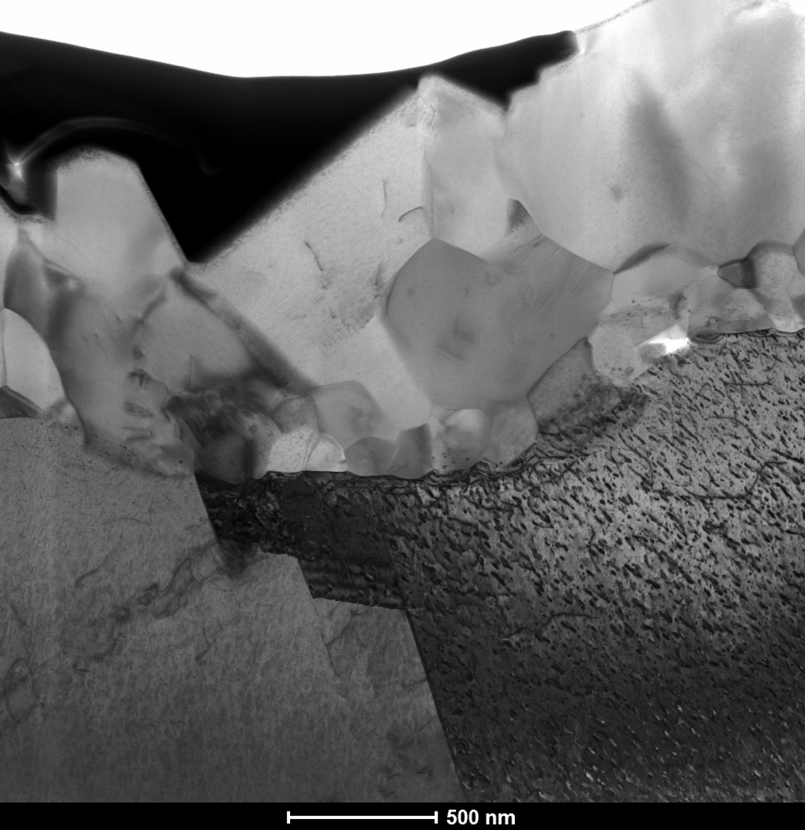
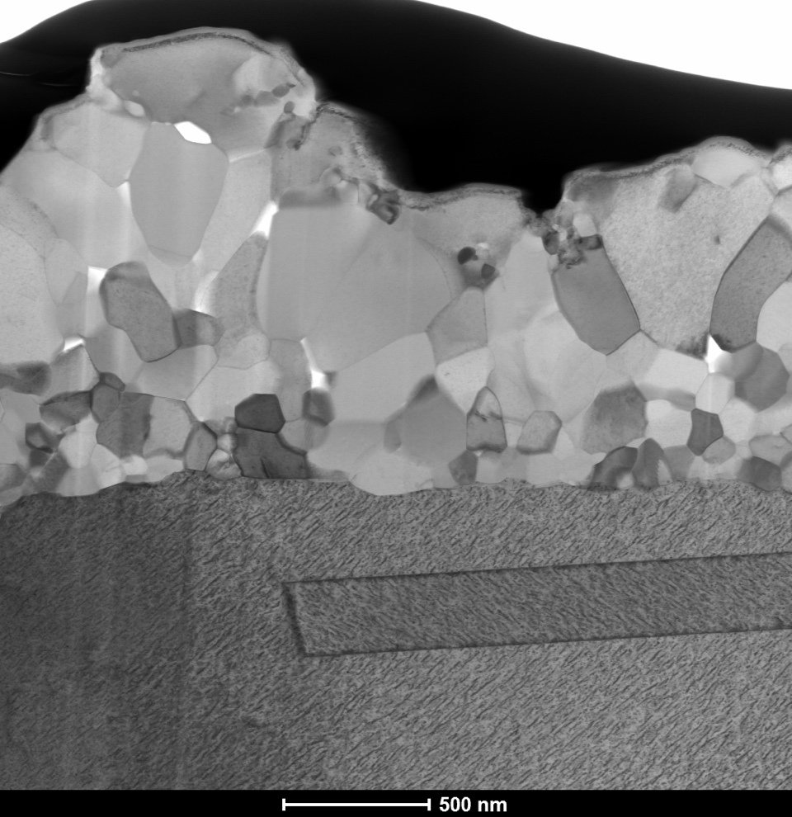
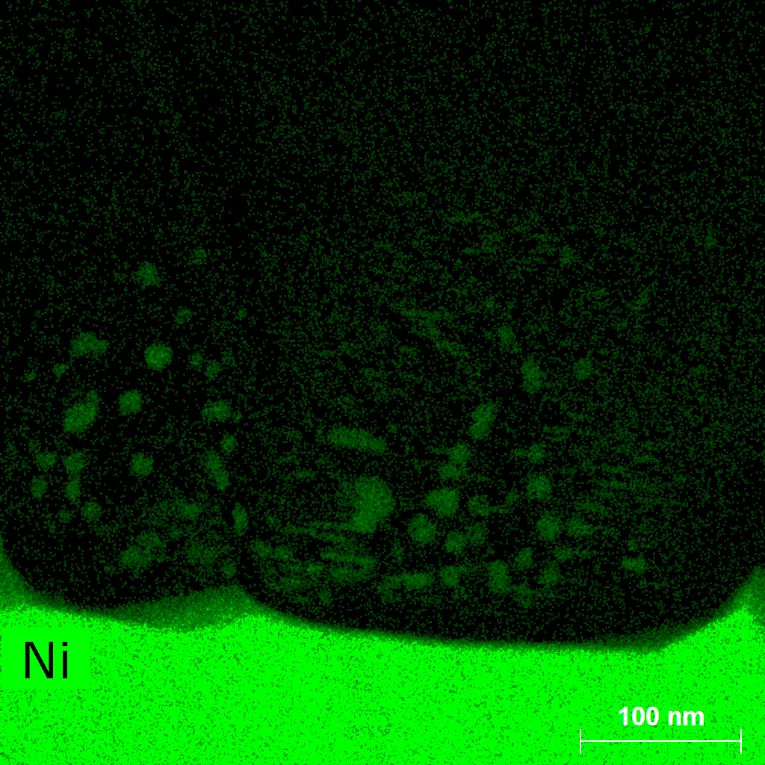
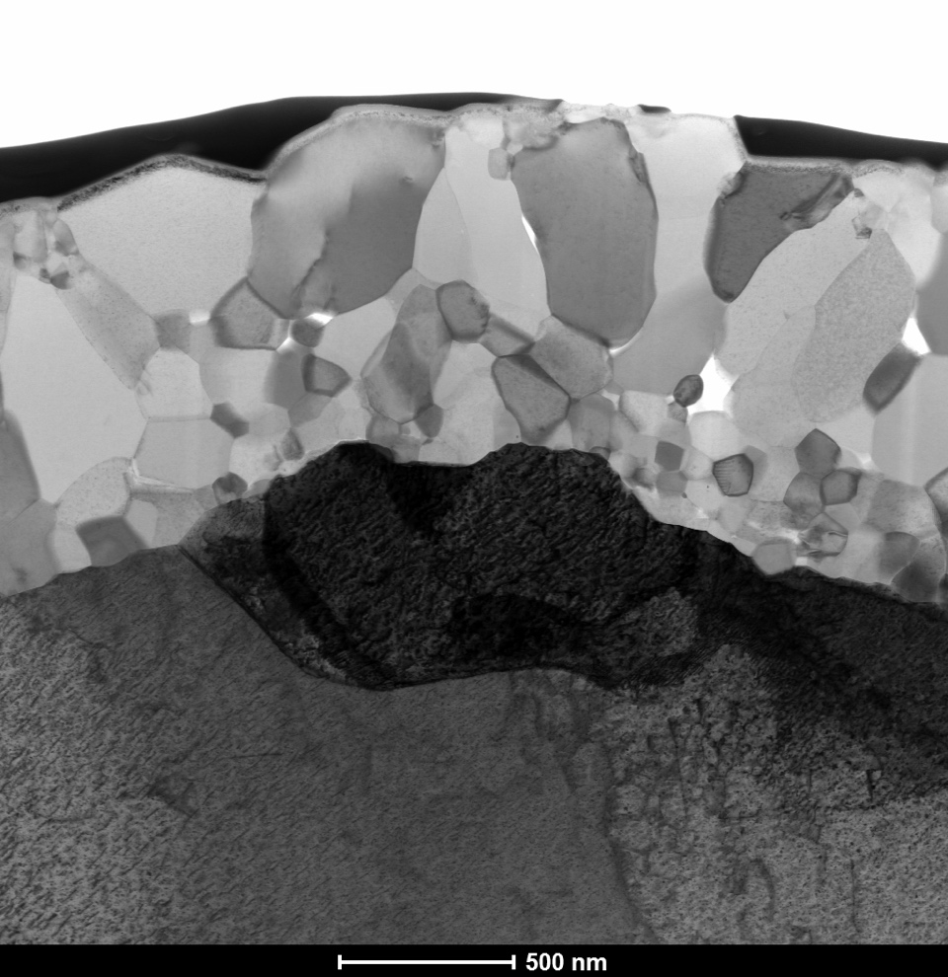
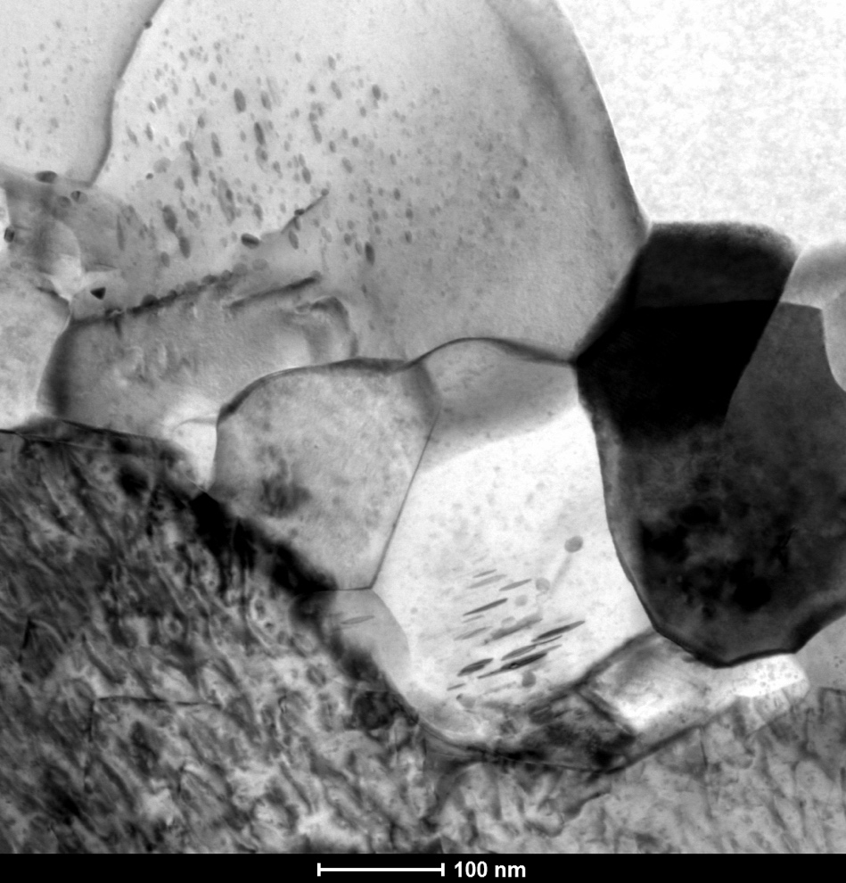
FE project studying model Ni-22Cr alloy specimens
750°C, Air, 1000h
750°C, 300 bar sCO₂, 1000h
EDS Line 2
W-protective layer
Scale
2µmz
Scale
Alloy
Line 6
BF-STEM
BF-STEM
Line 2
EDS Line 1
Line 1
Air only: Metallic Ni particles in scale near substrate interface
Line 7
C on oxide grain boundaries

Slide 26
500h at 800°C: SO₂ suppressed internal oxidation at 1 bar
Cr₂O₃-former
Al₂O₃-former
10%H₂O+1000 ppm SO₂
Similar results for SO₂ reported by Young (UNSW) and Quadakkers (Jülich)

Slide 27
500h at 800°C: at 25 bar, 0.1%SO₂ resulted in more attack
10%H₂O+1000 ppm SO₂
10%H₂O+1000 ppm SO₂
Haynes 282: Ni-20Cr-11Co-9Mo-1.6Al-2.2Ti
MarM247 superalloy: Ni-9Cr-10Co-1Mo-6Al-10W-3Ta-1.4Hf
NACE 2018 paper

Slide 28
Success warrants continued work to answer more q’s
Complete characterization and publications in early 2019
Mount 5,000 h specimens, etching, TEM, EPMA, etc.
New FWP to focus on:
Mechanistic understanding of O₂/H₂O effects with ¹⁸O/H₂¹⁸O tracers
Separate O₂ and H₂O effects
Focus on steels at lower temperatures: technology enabler
#1 question from industry is ”where can I use T91?”: cheaper and strong vs. fear
Provide input to alloy designers on effect of Cr/Ni in Fe-Cr-Ni alloys
Use 25mm tensile bars to assess sCO₂ effect on strength & ductility
Surface modifications to improve steel performance (as warranted)
Shot peening
Coatings
Creep assessment of thin-walled material at 750°C (282/740/etc.)
Model lifetime as a function of temperature/HX dimensions/heat transfer

